Slide 1
Der Web Exposure Spezialist.​
Nachhaltig und zuverlässig.​
Notes:
We’re here today to talk about something every security leader quietly asks themselves—how secure is my web environment, really?

Slide 2
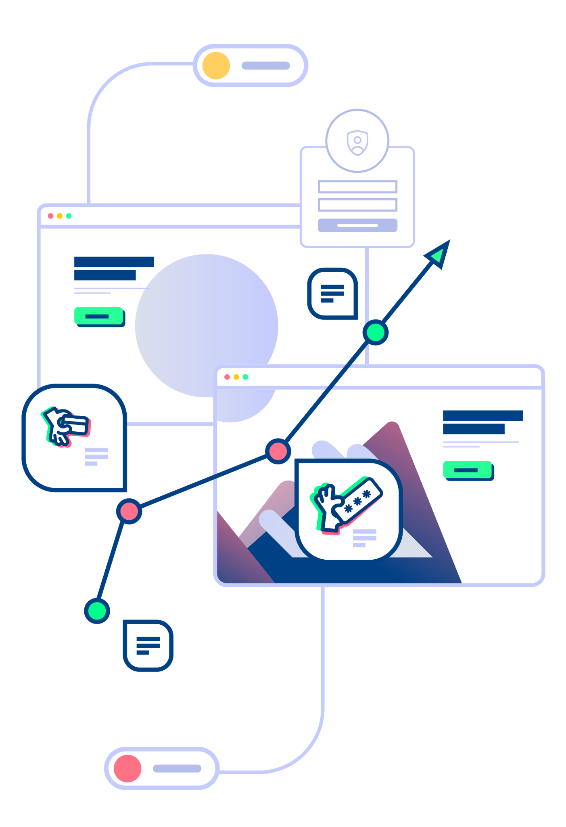
Sichtbarkeit ist der erste Schritt zur Sicherheit
“By 2026, organizations prioritizing their security investments based on a continuous exposure management program will be three times less likely to suffer from a breach.”​

Slide 3
Lüfte das Geheimnis deines digitalen Ökosystems.
Tiefenscan der Webumgebung
Discovery
Tiefgreifende Verhaltensanalyse
Automatischer Erkennungs-prozess
Smart Alerting
Behavioral Analysis
Kontinuierliches Monitoring
Agentless
Proaktiv
KI-gesteuert
AI & Analytics
Handlungsrelevante Warnmeldungen
Analyse und Datenverarbeitung

Slide 4
Sicherheitsrisiken durch interne Teams verursacht
37%
33%
18%
37%
33%
18%
9%
3%
Marketing & Digital Teams
IT Teams
Digital Team
Risk: Von öffentlichem CDN geladen und Zugriff auf sensible Eingaben
Risk: Apps, die auf der Checkout-Seite ausgeführt werden
Risk: Apps, die in einem Zahlungs-Iframe laufen.
40
35
30
25
20
15
10
5
0
IT Teams
Marketing
Digital
IT-Security
Compliance
Notes:
Here’s an example. We always suspected that internal teams contribute to web exposure, and now, the data confirms it. It proves that IT, marketing, and digital teams are responsible for the lion’s share of the risks organizations face today.
And we’re not just talking about malicious actions. It's often just poor communication and a lack of visibility between teams. Some teams move fast, adding tools and integrating services without fully understanding the security impact of what they're doing.
But this Reflectiz metric points out which departments should be talking to each other. It’s saying you could dramatically reduce your web exposure simply by improving internal communications.
Reflectiz provides a single source of truth—one unified view of web exposure that all teams can work from. Security, IT, marketing, and compliance can now align around the same data, prioritize risks based on real exposure, and move faster—together.

Slide 5
Wer nichts sieht, schützt auch nichts
Chris Kunze-Levy, 0160/975 931 53 | chris.k@reflectiz.com
Notes:
להוסיף מספר טלפון

