Slide 1



Close The Gap
Wie Exposure Management und eine Plattform-Strategie helfen können ressourceneffizient Risiken zu minimieren
Stefan Gutekunst (COO Logicalis Germany)
Nicolas Lex (XM Cyber)
14.05.2025

Slide 2

Contents
  Über Logicalis
  Ressourcen sind die wohl größte Herausforderung – Wer macht’s?
  Wie ein Plattform Ansatz helfen kann Ressourcen effizient einzusetzen
  Fix what matters. – CTEM

Slide 3


Über Logicalis
7 500 +
Mitarbeiter weltweit
10 000 +
Kunden weltweit
$
US$ 1.8B
Revenue weltweit (FY25)

Slide 4



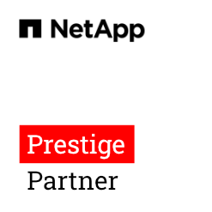

Logicalis Germany
Mitarbeiter
Jahresumsatz
Cologne
600 +
€ 350M +
Weiterstadt
Neu-Isenburg
Auswahl unserer Key Partner
Karlsruhe
Stuttgart
Munich

Slide 5
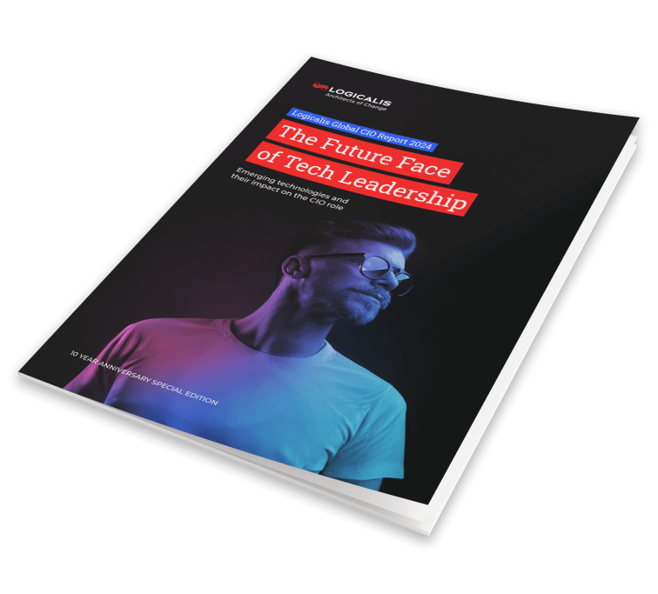
Lack of Resources
Logicalis CIO Report 2024

Slide 6
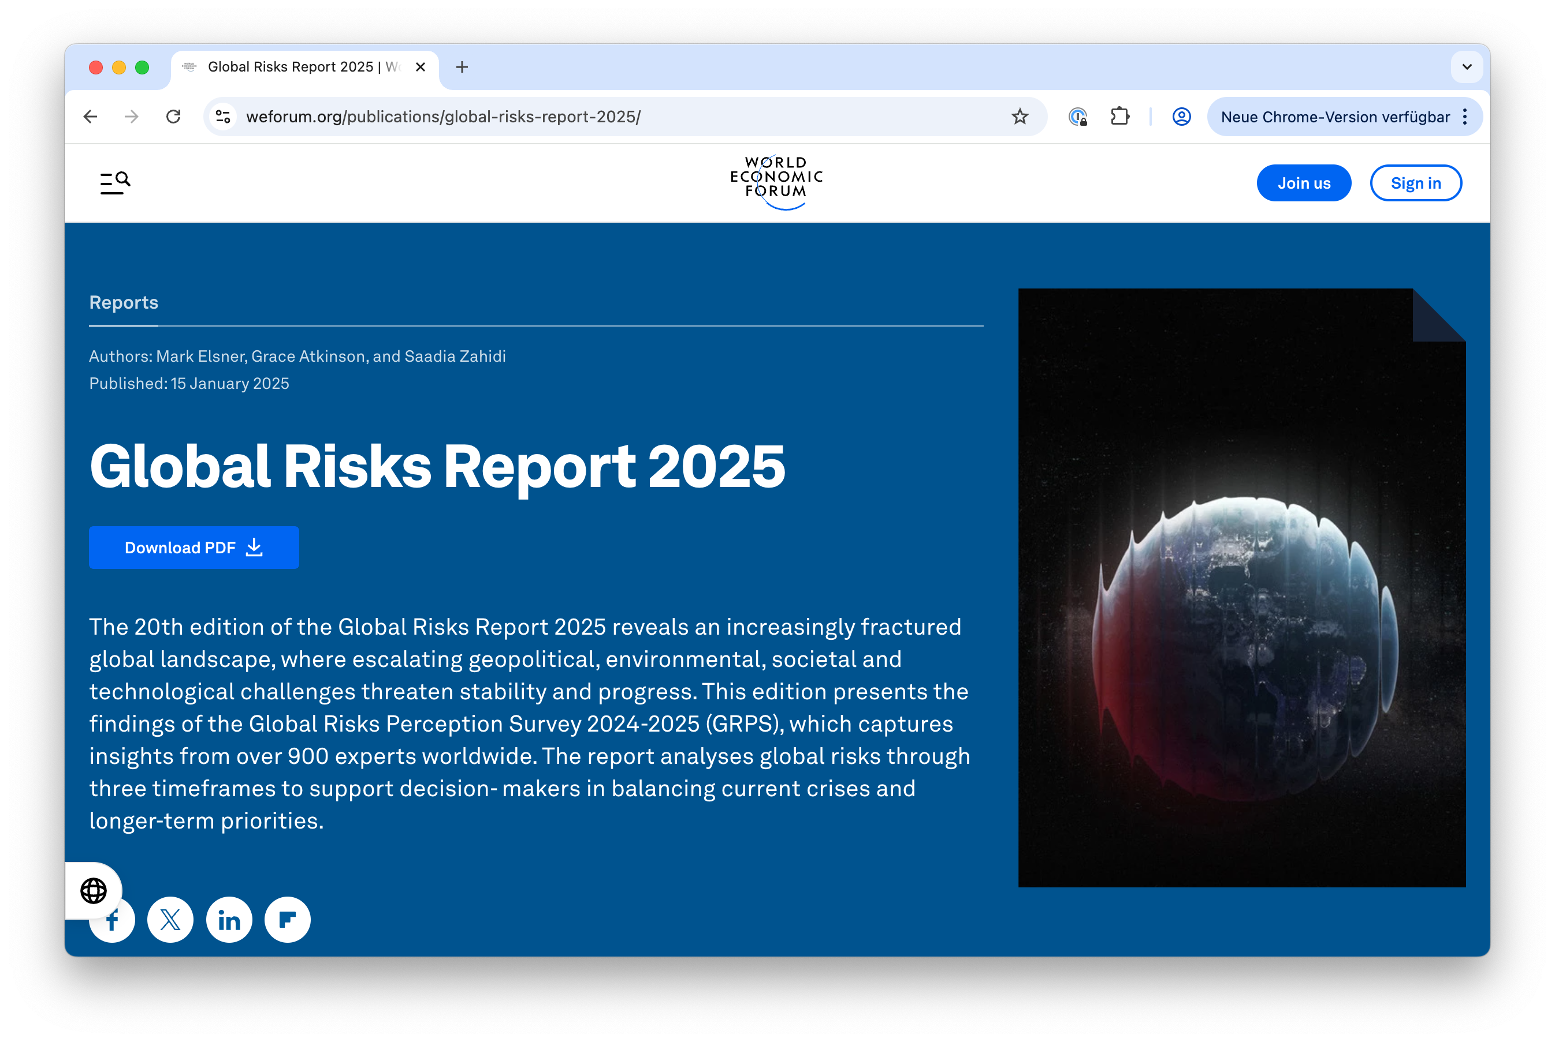
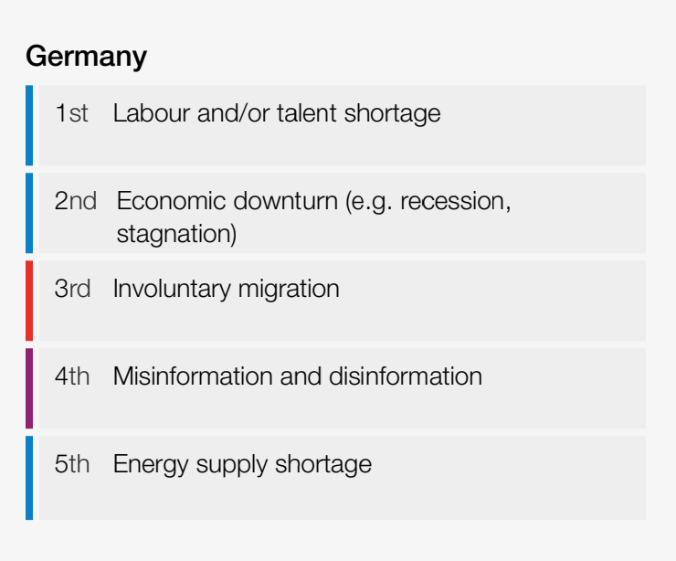
Top 5 risks identified by the Executive Opinion Survey

Slide 7
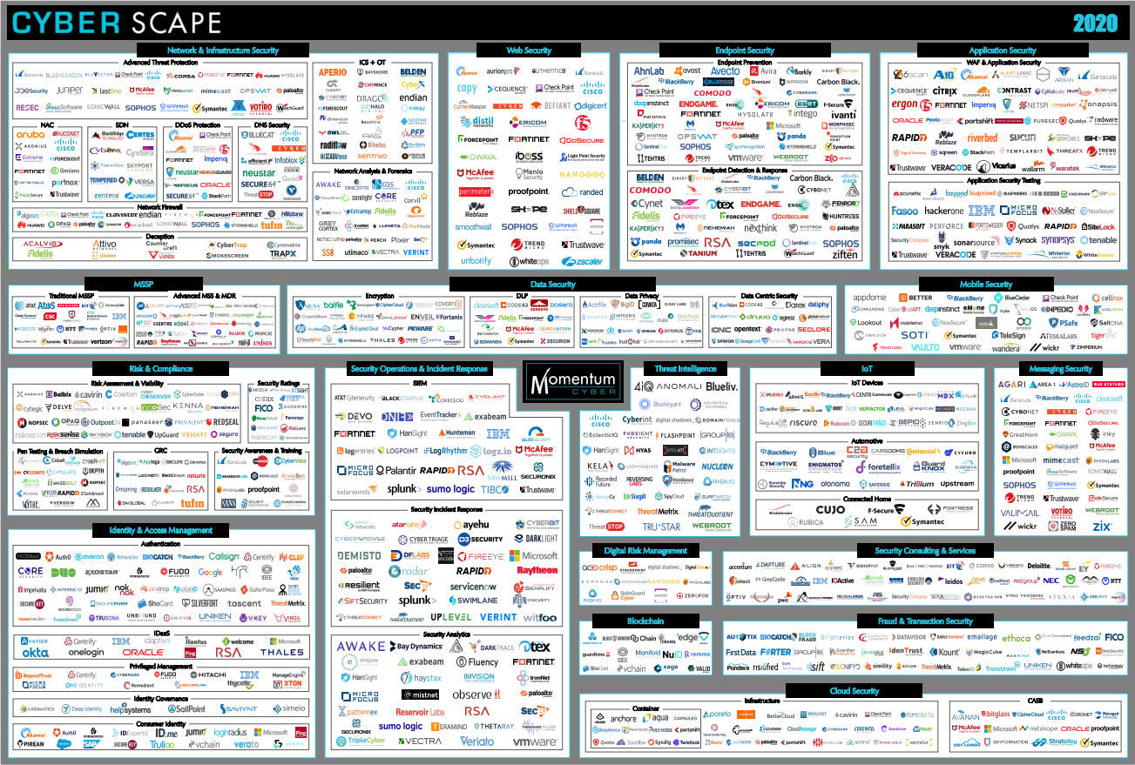
Es wird nicht weniger…

Slide 8


AI ist das „New Normal“ und nicht die Antwort auf alle Fragen …
© 2025 Logicalis Germany

Slide 9


In 2024…
84
%
der ursprünglichen Angriffsvektoren, die zu Vorfällen führten, hätten durch die Anwendung von Best Practices im Bereich Sicherheit verhindert werden können¹.
Notes:
In 2024, 84% of initial access vectors leading to incidents could have been prevented with proper security best practices, highlighting the importance of proactive and consistent measures in protecting your environment, reducing vulnerabilities, and staying ahead of potential threats…. 2024 Cisco Cybersecurity Readiness Index

Slide 10
Root Case
Die Komplexität hat das menschliche Maß überschritten.
COMPLEXITY
TODAY
APPLICATIONS
Human-scale management
POLICY RICHNESS
Notes:
Network security complexity has grown beyond human scale, with constant traffic spikes, evolving threats, and dynamic environments. Traditional methods can't keep up, leading to misconfigurations and vulnerabilities. To effectively manage and secure networks today, organizations need intelligent, automated solutions that adapt and respond faster than what human capabilities alone can allow.

Slide 11























Die Realität ist …
Personen, Standorte
und IOT Geräte
Access
Networks
Network
Services
Cloud Connectivity
Infrastruktur
Applikationen
(Data Center, Cloud)
IoT
IOT
Wireless gateway
Direct connect
Cloud providers
BYOD
BYOD
Glasgow
Wireless network
Cloud proxy
Seattle, WA
Corp devices
Regional
data centers
Corp devices
Local ISP
SWG
ISP transit providers
SaaS
onramp
Application segmentation
London
DC colocation
Paris, France
DNS
IoT
IoT
Firewall
load
balancers
VDI
Mobile networks
VPN
VDI
Cameras and sensors
400G / 800G
data center
infrastructure
Cameras and sensors
Manchester
Edge
data centers
Chicago, IL
Notes:
But in reality, those connections are almost infinitely complex, and you have to deal with challenges of not only connecting people, places and things across heterogenous access networks, but also across network services in the wide area network into their multi-cloud environment. It gets incredibly challenging (in terms of managing the unified polices, end-to-end security, ensuring services/app KPIs, etc.).
In der Realität sind diese Verbindungen jedoch fast unendlich komplex, und Sie müssen sich nicht nur mit den Herausforderungen auseinandersetzen, Menschen, Orte und Dinge über heterogene Zugangsnetze hinweg zu verbinden, sondern auch über Netzwerkdienste im Weitverkehrsnetz in ihre Multi-Cloud-Umgebung. Das ist eine unglaubliche Herausforderung (in Bezug auf die Verwaltung einheitlicher Richtlinien, die End-to-End-Sicherheit, die Gewährleistung von KPIs für Dienste und Anwendungen usw.).

Slide 12













Die Absicherung dieser Verbindungen erhöht die Komplexität.
Personen, Standorte
und IOT Geräte
Access
Networks
Network
Services
Cloud Connectivity
Infrastruktur
Applikationen
(Data Center, Cloud)
IOT
IOT
Wireless gateway
Direct connect
Cloud providers
BYOD
BYOD
Phishing
Seattle, WA
Wireless network
Cloud proxy
Ghost data
Seattle, WA
Hostile
scans
SQL
injection
Corp devices
Corp devices
Local ISP
SWG
ISP transit providers
SaaS
onramp
Brute force
DDoS
Paris, France
Paris, France
DNS
IoT
IoT
VDI
Mobile networks
VPN
VDI
Advanced
persistent
threats
Lateral
movement
Malware
Data center
infrastructure
Cameras and sensors
Cameras and sensors
Chicago, IL
Chicago, IL
Die IT braucht daher einen anderen Ansatz

Slide 13
Die Vision eines einfacheren Betriebs – Platform Approach
Personen, Standorte
und IOT Geräte
Access
Networks
Network
Services
Cloud Connectivity
Infrastruktur
Applikationen
(Data Center, Cloud)
IoT
Wireless gateway
Direct connect
Cloud providers
BYOD
Cisco Networking Cloud
Seattle, WA
Wireless network
Cloud proxy
Corp devices
Regional
data centers
Local ISP
SWG
ISP transit providers
SaaS
onramp
Application segmentation
Cisco Security Cloud
DNS
DC colocation
Paris, France
Firewall
load
balancers
IoT
Mobile networks
VPN
400G/800G
data center
infrastructure
Cameras
and sensors
Chicago, IL
Edge
data centers

Slide 14
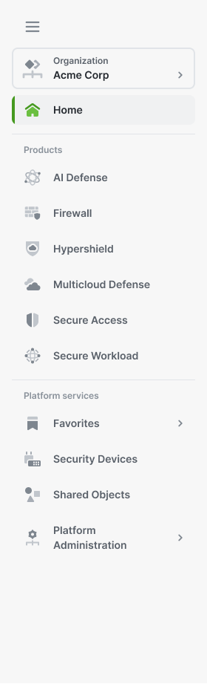
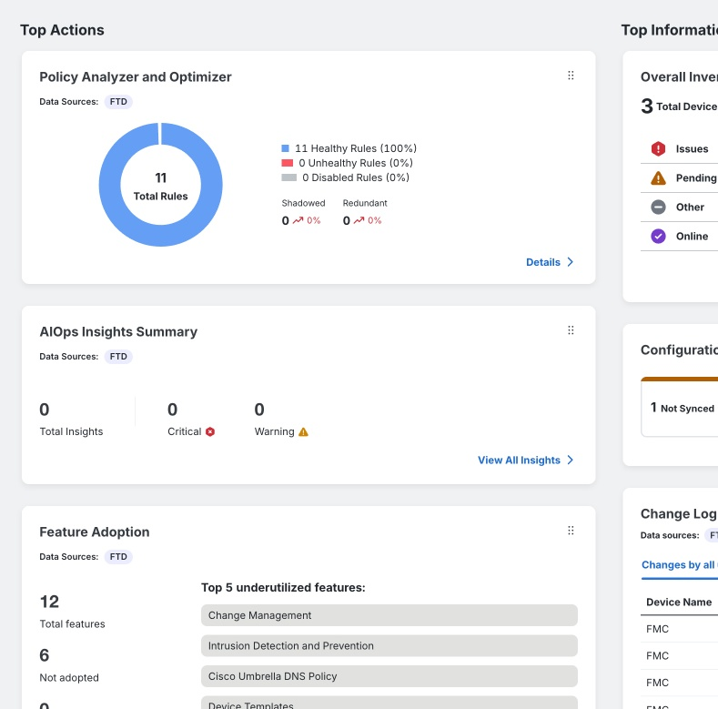

Security Cloud Control
  Bis zu 70% Vereinfachung der Verwaltung von Policies
AI Assistance für Policies
Proactives AIOps
Real world
Policy Testing
Notes:
Introducing Security Cloud Control, ensures simplified operations, enhanced, AI-embedded protection, and reduced time spent on manual tasks. Furthermore, it serves as the common management fabric for the Cloud Protection Suite, bringing together components such as Hypershield and Multicloud Defense.
With Security Cloud Control, streamline policies and control across multi-environments, including on-prem, cloud, and hybrid environments. This cloud-based solution eliminates complexity, enhancing your organization's protection against evolving threats. Boost efficiency by cutting 90% of repetitive security tasks and elevate security standards while reducing intricacies. With resilient data centers spanning regions, ensure high availability for uninterrupted security.

Slide 15
Unified Security Management
Security Cloud Control
Einheitliche UI | Zentrale Provisionierung und RBAC | Cisco AI Assistant
Secure
Firewall
ASA
Secure Firewall Threat Defense
Multicloud Defense
Hypershield
Secure Workload
Secure Access
AI Defense
Notes:
Going forward, Security Cloud Control will continue to expand its offerings by integrating new and existing security products, ensuring cutting-edge protection and comprehensive, unified security management.

Slide 16
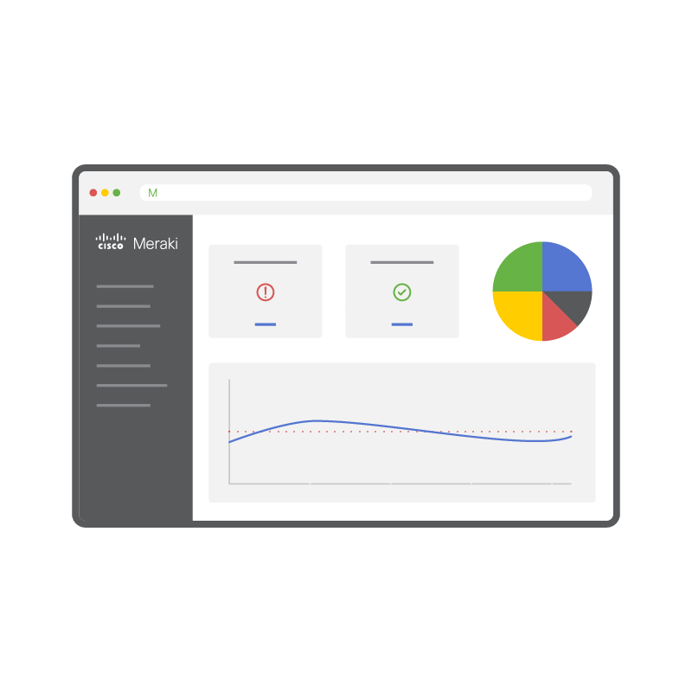
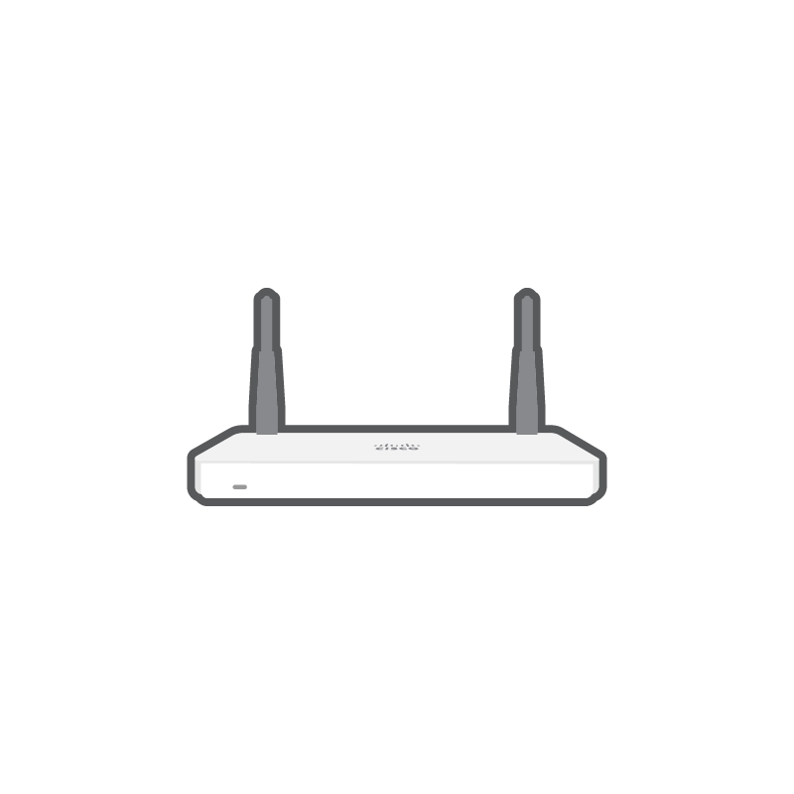

Weitere Integrationen wie Meraki MX und Cisco XDR
Meraki Organization
Cisco XDR Tenant
Meraki MX Networks
1
5
Easy configuration (bi-directional OAuth)
Contextual NetFlow: Agentless/ Direct-to-cloud
Orchestration and Automation Workflows
4
2
XDR Incidents View in Meraki Dashboard
3
Device context for XDR Asset Insights via Meraki Systems Manager
Notes:
Meraki Org(s) with ALL child networks integrate(s) seamlessly with an XDR tenant
Solution is fully agentless with single-click setup
Notes:
Here is a graphical representation of the steps and outcomes of the integration between Cisco XDR and Meraki.
Step 1: A simple OAuth flow establishes bi-direction trust between a Cisco XDR and one (pr more) Meraki dashboards.
This step enables steps 2,3, and 4”
Step 2: A view of the XDR incidents are replicated in the Meraki dashboard for a Meraki Org administrator to view. In addition, a Meraki Org admin can assign incidents or change the status of incidents in his dashboard, which will sync immediately to Cisco XDR.
Step 3: All the Meraki Systems Manager networks connect to Cisco XDR’s Asset Insights (Devices) view for MDM device context.
Step 4: The integration module allows Cisco XDR to issue L3 firewall rule to block outbound connections to an IP address on the Meraki MX.
Step 5: In addition to these outcomes, the Meraki Organization administrator can choose the MX networks that should send NetFlow traffic to XDR over TLS- encrypted direct-to-cloud channel. This step does not need any connector or sensor for data streaming.
In a future phase, MX security events (IPS/ IDS, Malware, and url) will be used to inform XDR’s incident generation and correlation process.
A few notes on the integration:
It is completely agentless, and all Meraki child networks can integrate with Cisco XDR
The list of eligible MX appliance is shown. Essentially appliances able to run MX firmware version 19.1 or higher are covered.
A Meraki MX license of SD-WAN Plus/ Advanced Security/ or Essentials/ Advantage (older licenses) is needed,
IN addition, a Cisco XDR license is also needed for the integration.
Lastly, note that both XDR and Meraki licenses are available as part of Cisco’s Enterprise Agreement 3.0 framework.

Slide 17


SKILLS
DATA SOURCES
Unified
AI Assistant
Control Hub
XDR
Networking
Secure Access
  Firewall
  Duo
Security
Observability
Meraki
SD-WAN
  ThousandEyes
Collaboration
Notes:
Now: integrating Catalyst SD-WAN and Meraki.
In private beta.
Let’s take a look at what this enables…

Slide 18
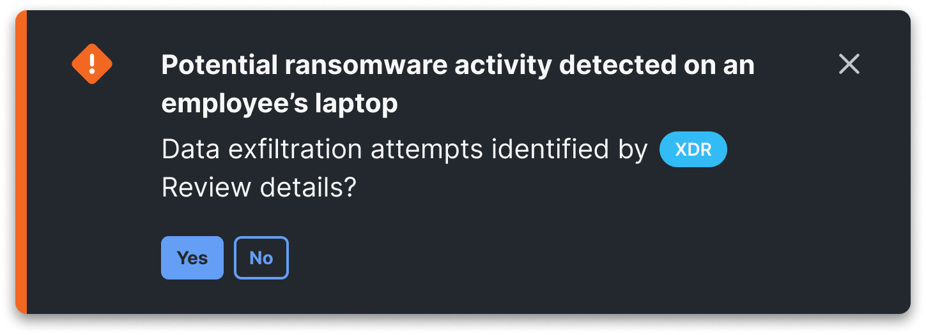
AI Assistant in action
Administrator über potenziellen Angriff informiert
XDR

Slide 19
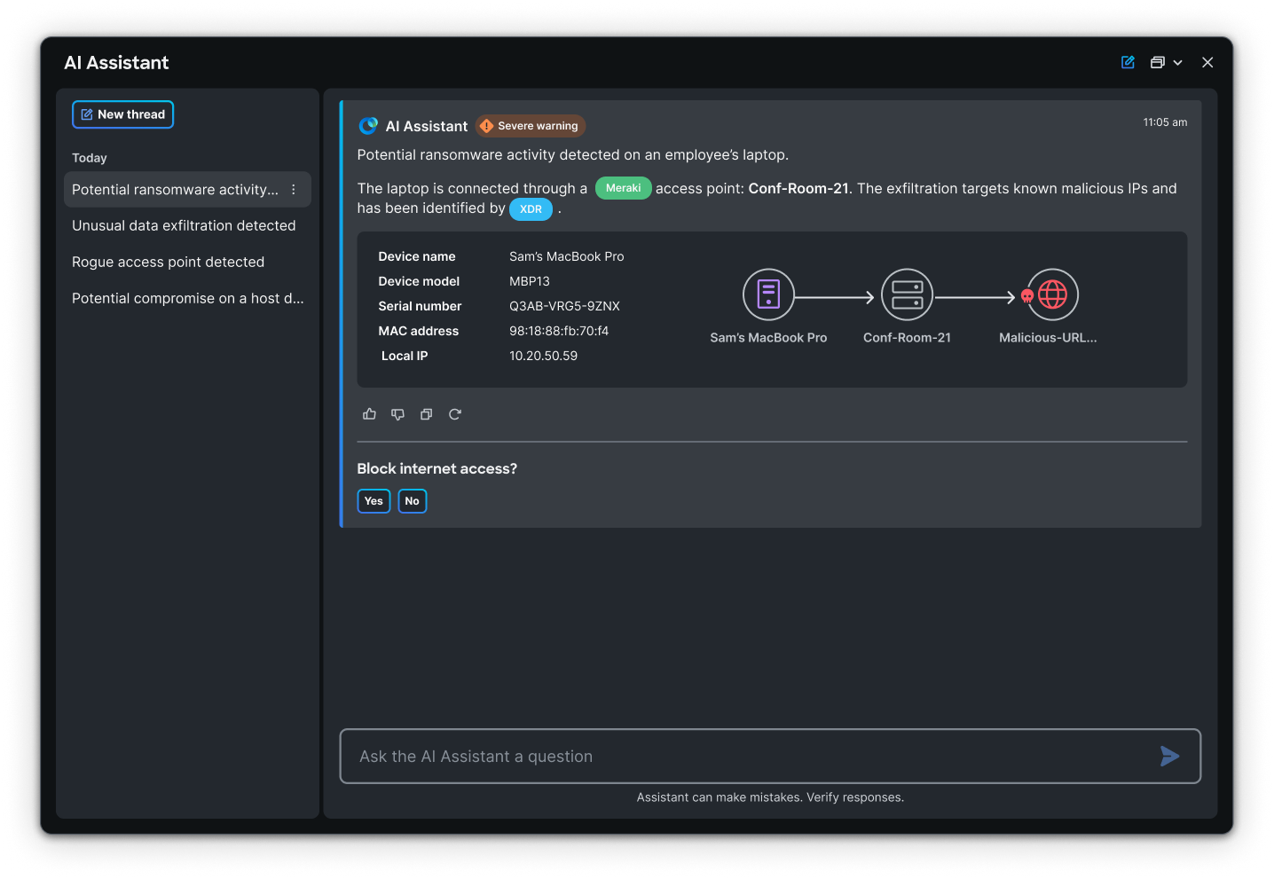
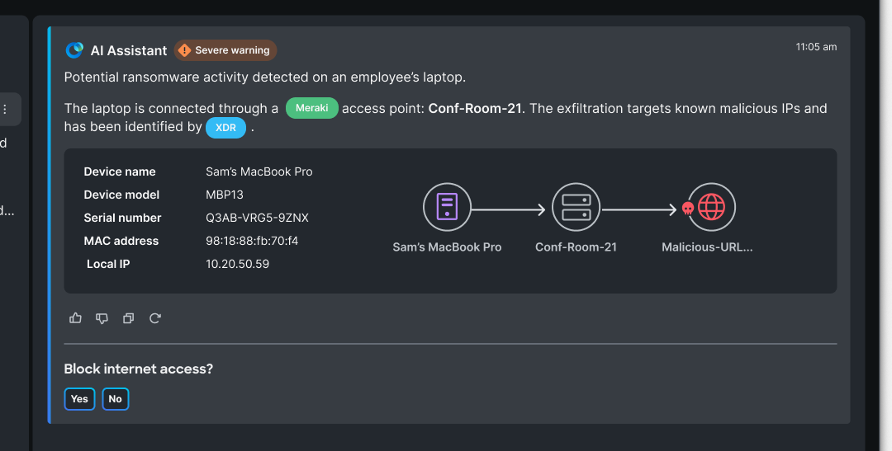
AI Assistant in action
XDR erkennt potenzielle Ransomware auf einem über Meraki verbundenen Laptop eines Mitarbeiters.
XDR
Meraki

Slide 20
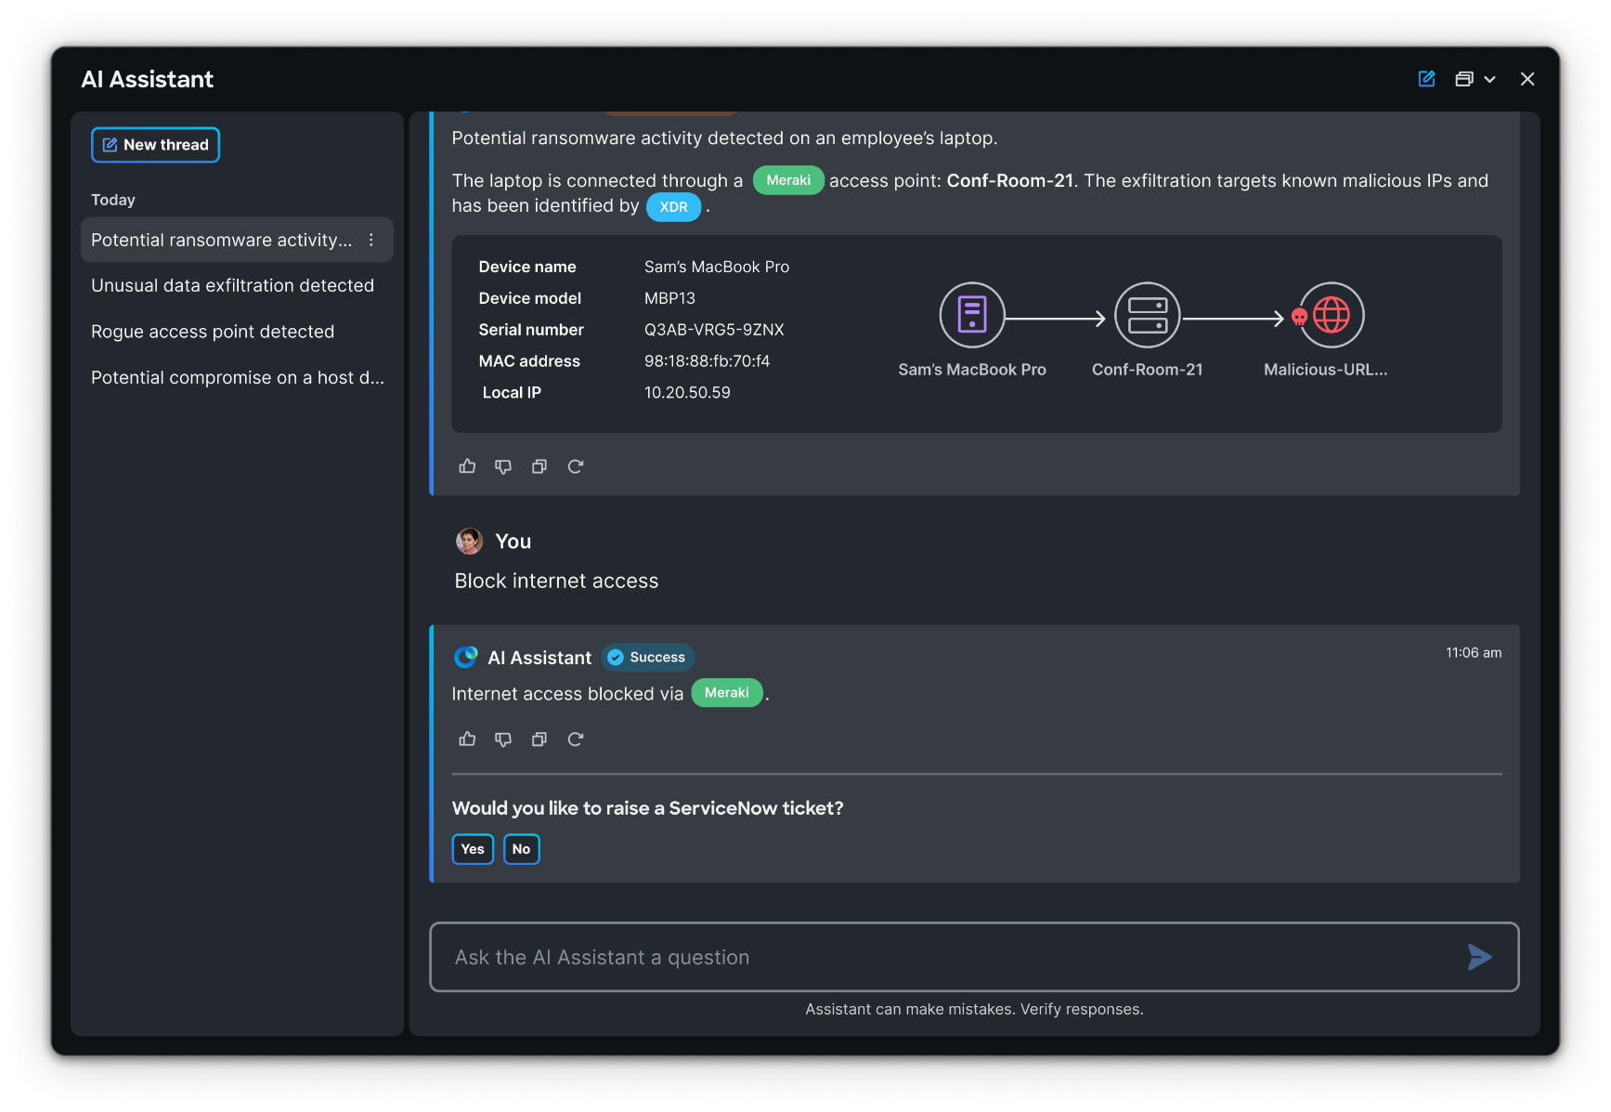
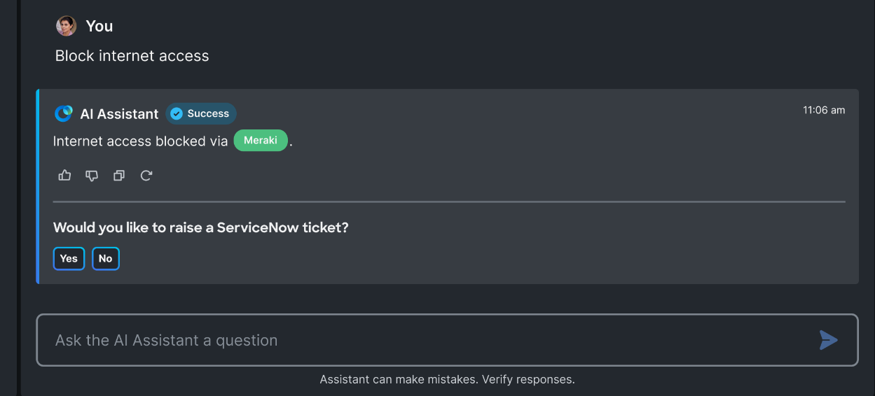
AI Assistant in action
Mit einem Klick den Internetzugang sperren
XDR
Meraki

Slide 21
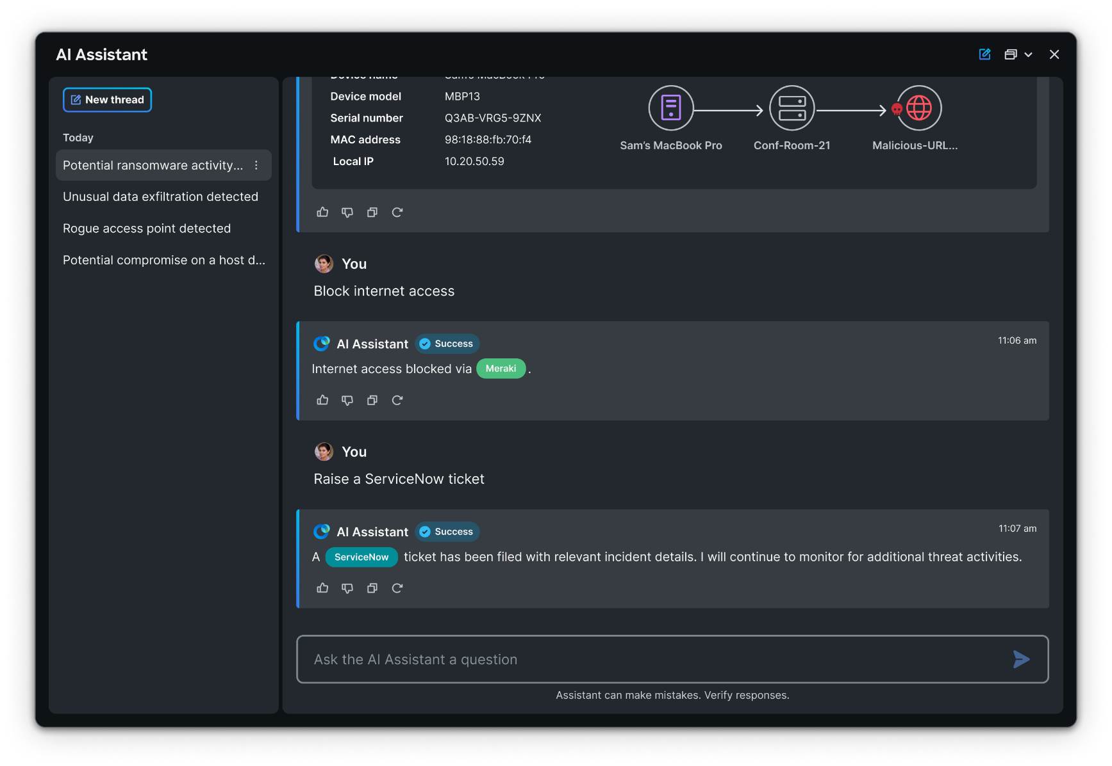
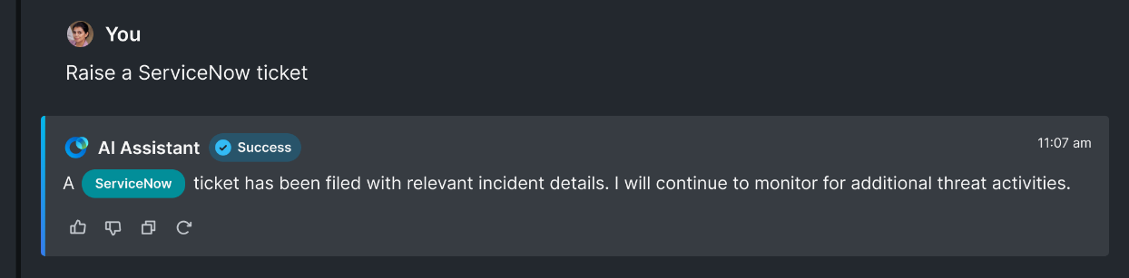
AI Assistant in action
Mit einem Klick ein Incident Ticket erstellen
XDR
Meraki
ServiceNow
Notes:
This is an example of creating a platform advantage with AI
And believe me, the best part is we are JUST GETTING STARTED!

Slide 22







Fix What Matters.
Proaktiv High-Impact Attacken verhindern mit Continuous Threat Exposure Management (CTEM)
Notes:
Hi and thank you for your time today.
I’m here to talk to you about the fact that industry analysts and enterprise organizations realized that
there is no way to fix every single threat exposure in your infrastructure.
In fact, the endless lists often hide the most critical exposures in your environment.
I wanted to talk to you today about where you focus your prioritization and remediation efforts, and how it’s working for you.
Before I start, does that align with your expectations for the next 30 minutes?

Slide 23
Aktuelle Exposure Management Practices
Vulnerability Management
Penetration Testing
Security Awareness and Training Programs
External Scanning
Und viele mehr …
Threat Intelligence
Internal Scanning
Configuration Management

Slide 24



Traditional approach leaves Defenders Blind
Overwhelming lists with incomplete data
Siloed security teams, processes, and tools are ineffective in preventing breaches
Endless lists of threat exposures without context lead to broken prioritization and wasted resources
Lack of context of risk to the business makes it impossible to measure and report on meaningful risk
Notes:
From my conversations with security leaders, the traditional approach leaves defenders blinded by overwhelming amount of incomplete data.
Working in silos increases risk because no one has central visibility of how attack techniques would be combined to form an attack on your critical assets. Patching your critical systems doesn’t solve the problem; you should assume breach and prevent lateral movement to your critical assets. This is the only way to get ahead of the attacker. We have several customers that used to only fix vulnerabilities with high severity scores through a 30-60-90 day process, until they realized their most critical exposures were around credentials and identity exposures.
The lists of CVEs drown your security teams and your IT operations so the current process is not scalable. Not having the context of how these exposures would be exploited in your environment, and what would be their blast radius means your prioritization is broken and you are investing your resources on fixes that may not impact risk. Context is also critical in cases of a system that cannot be patched, and you need to find an alternative way to mitigate that risk.
Finally, not understanding with the risk to the business is makes it impossible to measure and report on risk to executives with confidence. Even if your team reports on the remediation of 30 vulnerabilities over the past week, unless you know what attacks were prevented and which critical assets were in the blast radius, you cannot assess how it reduced your risk.
Are you satisfied with the visibility you have into your attack surface today?
How do you currently measure security effectiveness in general?
How do you measure risk reduction in your environment?

Slide 25
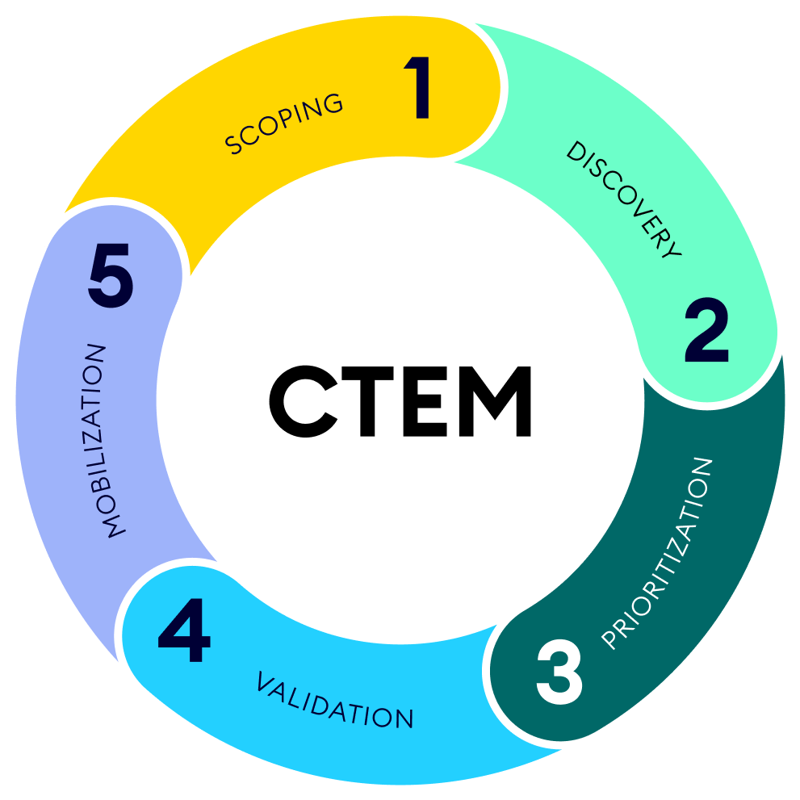
Ein clevererer Ansatz wird benötigt
By 2026, organizations prioritizing
their security investments, based
on a continuous threat exposure management program, will realize
a two-thirds reduction in breaches.
Gartner© Strategic Planning Assumption

Slide 26
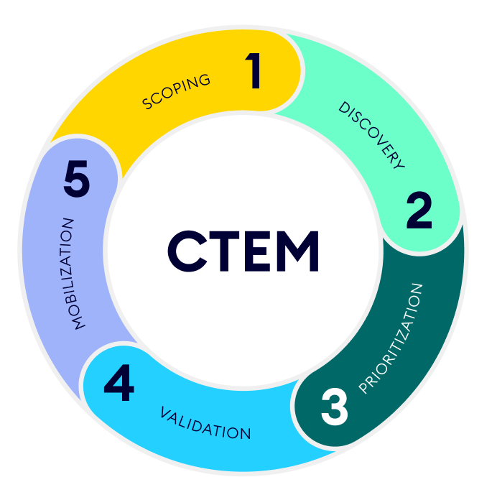

Das CTEM Framework
Identifying the assets critical to your business
Holistic, continuous discovery beyond just vulnerabilities, across the hybrid environment
Effective remediation of the most high-impact exposures, incorporated into your processes
Adaptive Prioritization based on exploitability and business impact in your environment
Validate exploitability in the context of your security controls

Slide 27

Die XM Cyber Platform - CTEM in der Praxis
Misconfigurations
Credentials
CVEs
Cloud
Active Directory
Threat intel and
external scans
Discovery
Identify vulnerabilities
1. Discover and prioritise
Discovery
In the Wild
Risk-based Vulnerability Management
In the Wild
Continually review relevance for the attacker: Exploitability, accessibility and control
Exploitable Exposures
Can the vulnerability be exploited in your environment?
Build Attack Graph
2. Validate and mobilise
75% reduction
On Path To
Critical Assets
Is the vulnerability on an attack path to a critical asset?
90% further reduction
Choke
Points
Is the vulnerability present on multiple attack paths resulting in the creation of a choke point?

Slide 28
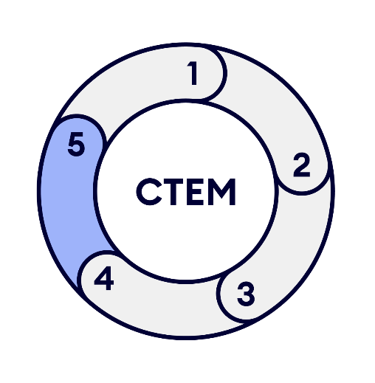
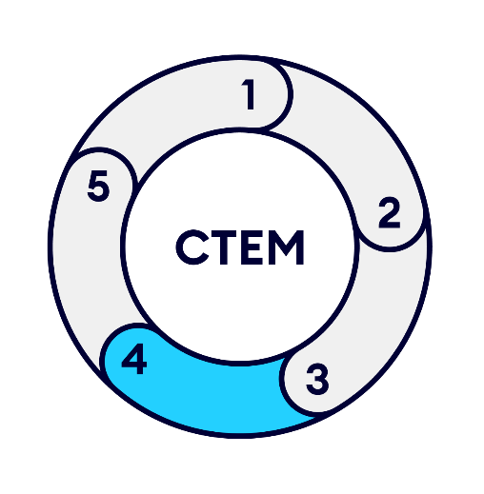
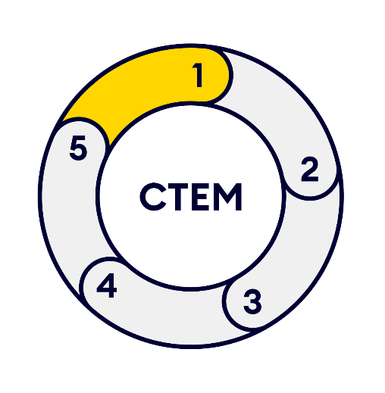
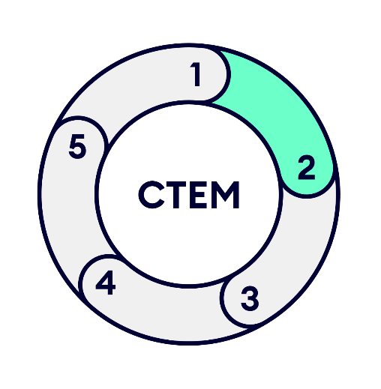
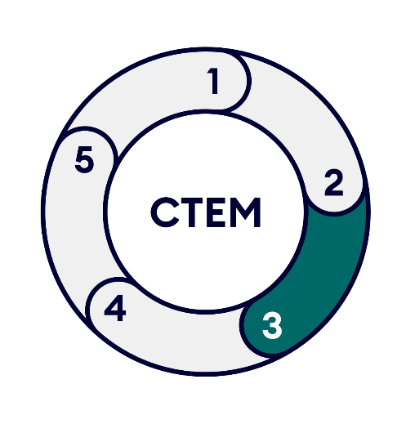
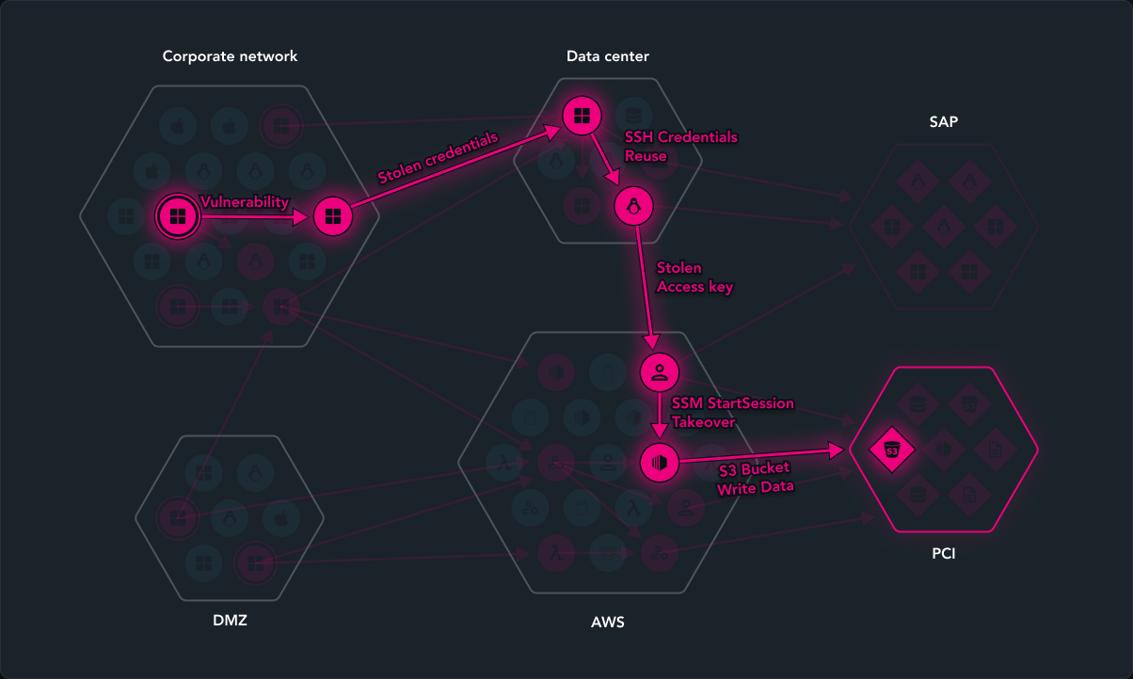
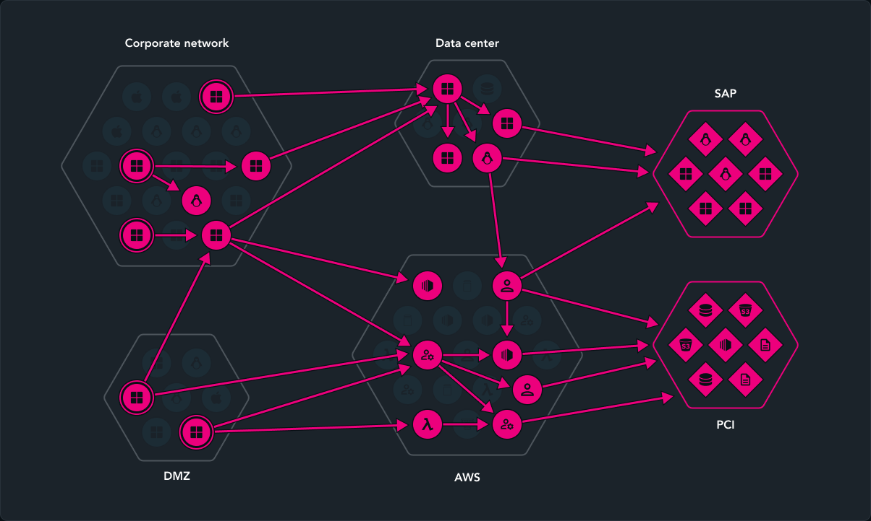
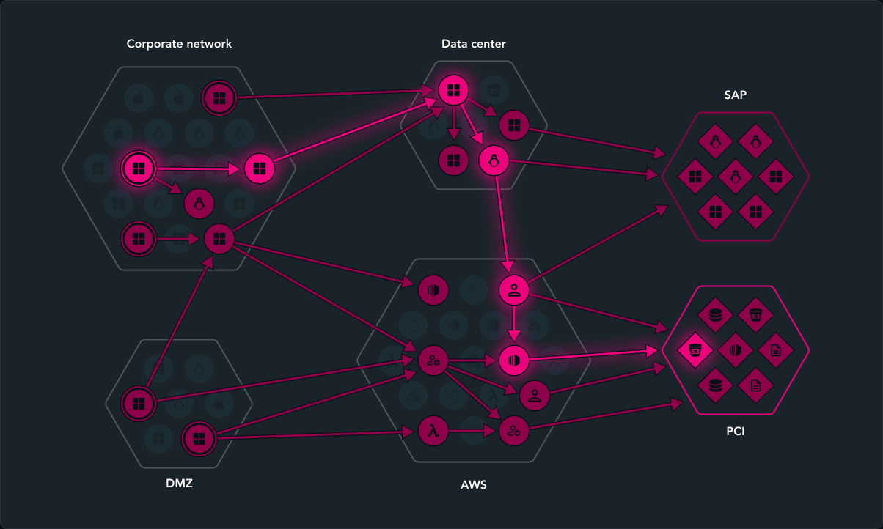
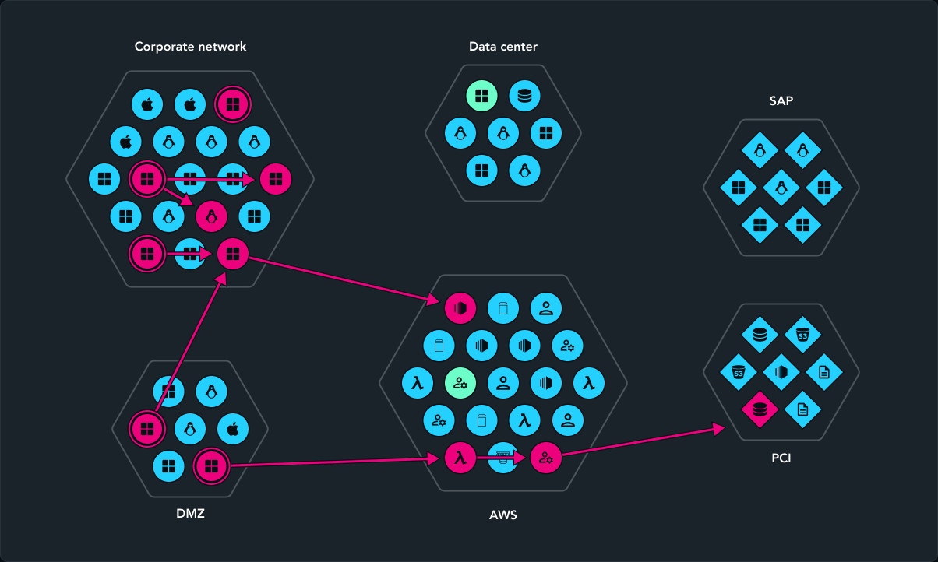
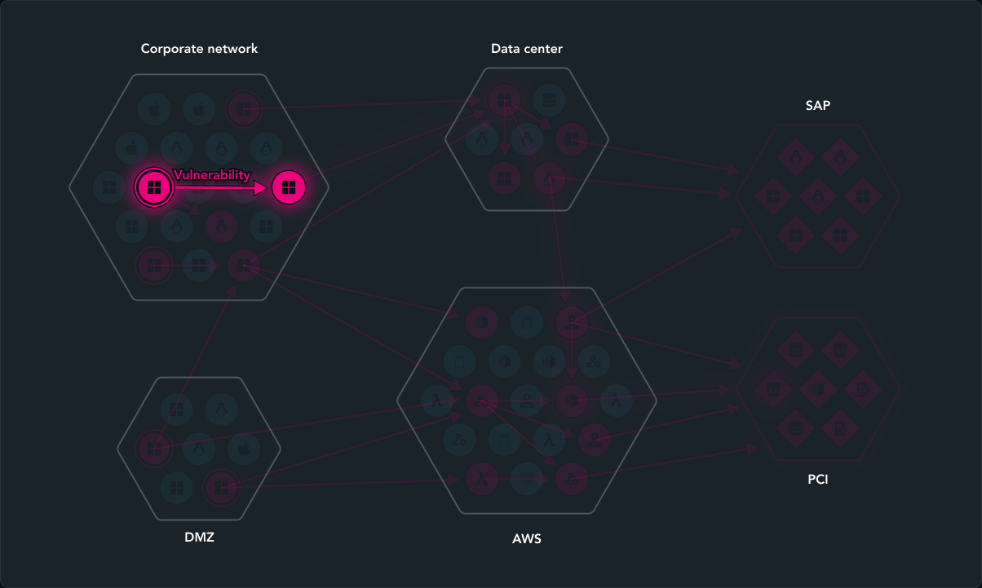
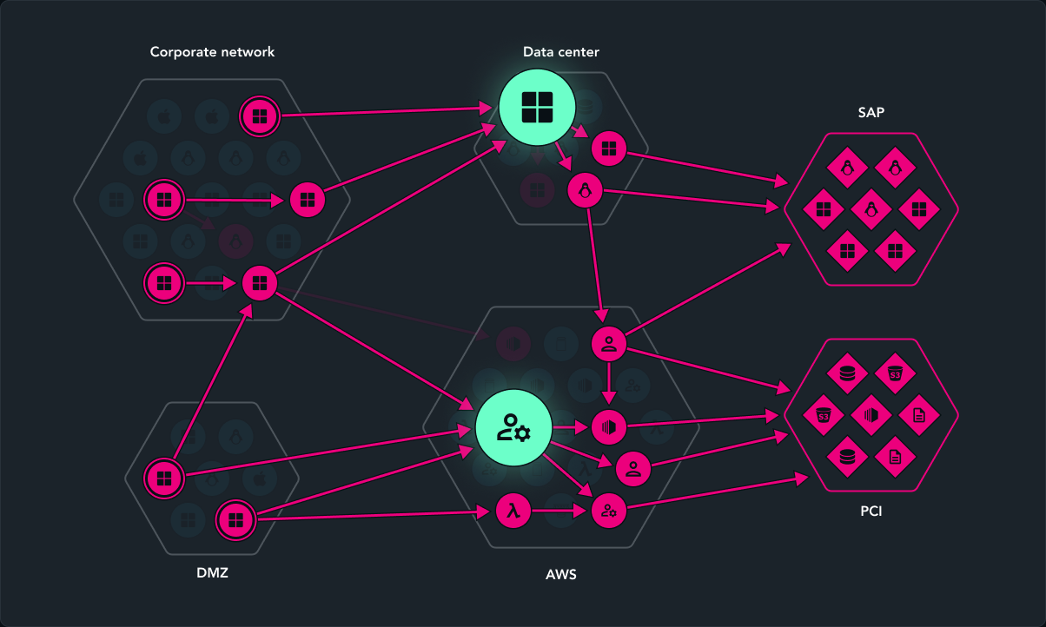
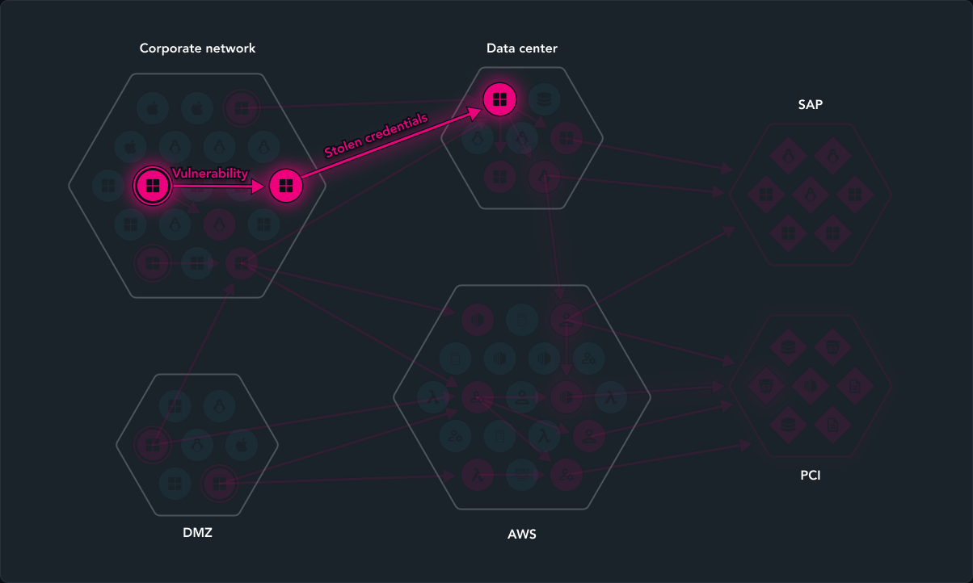
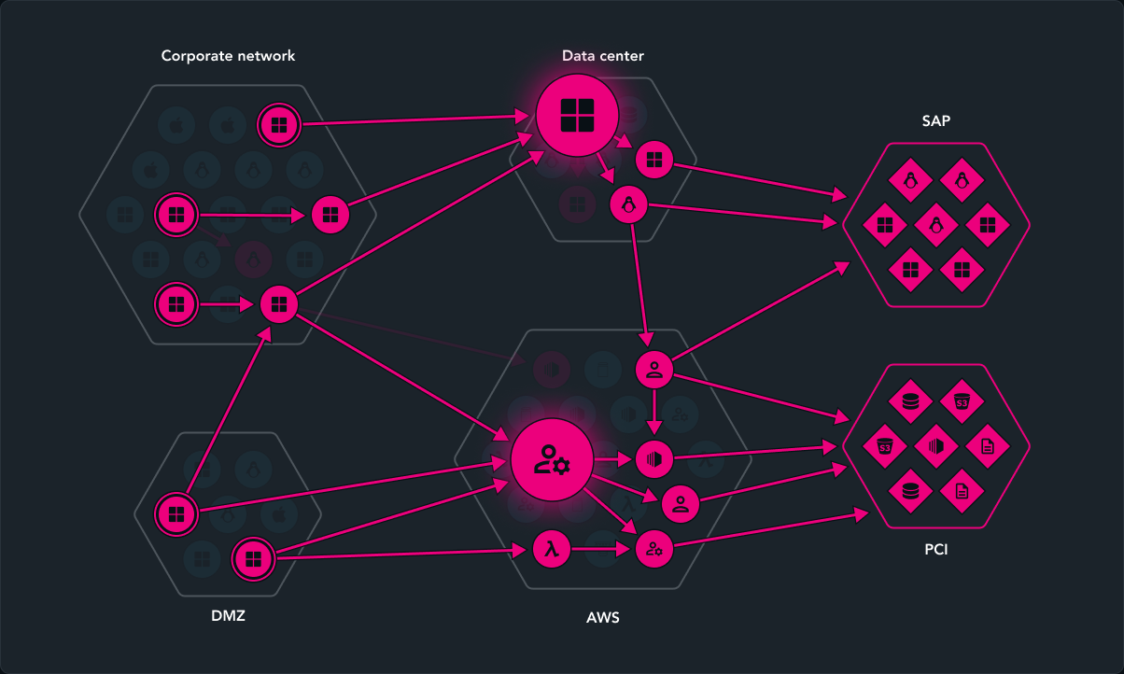
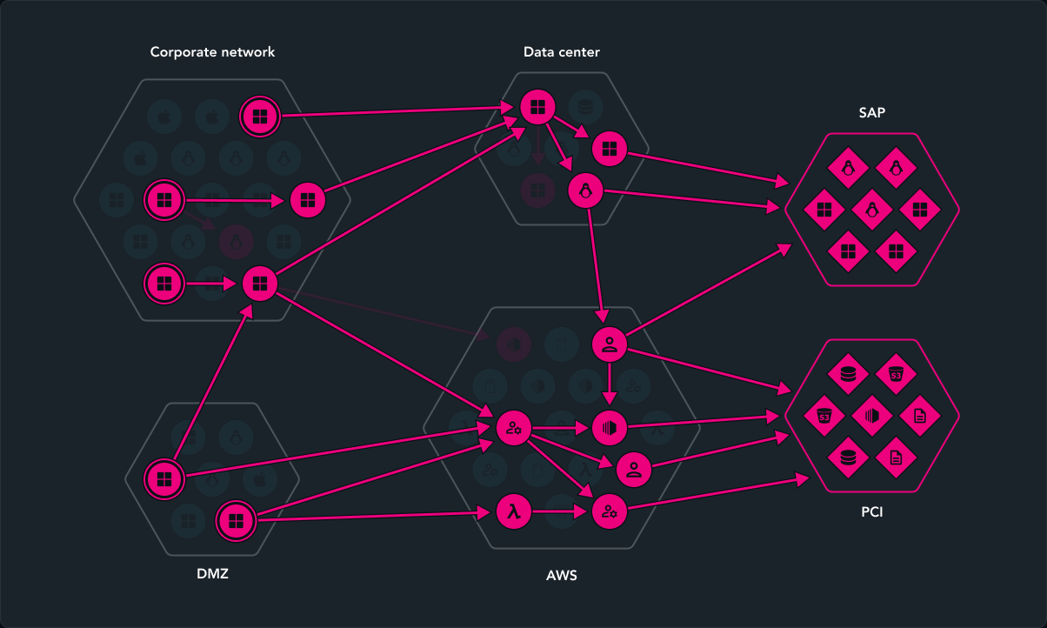
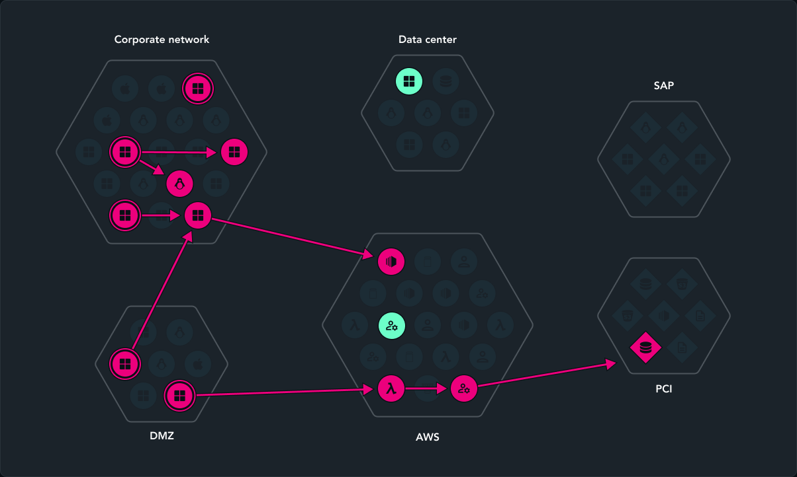
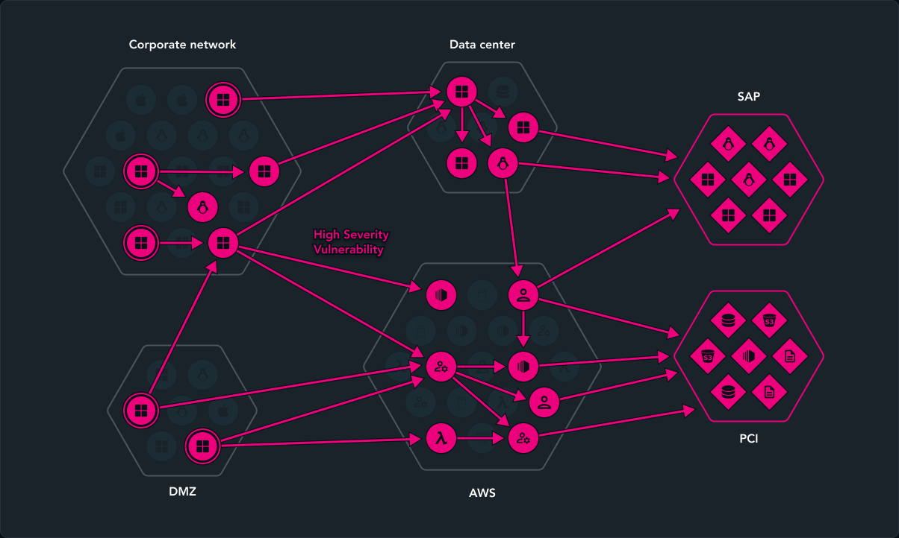
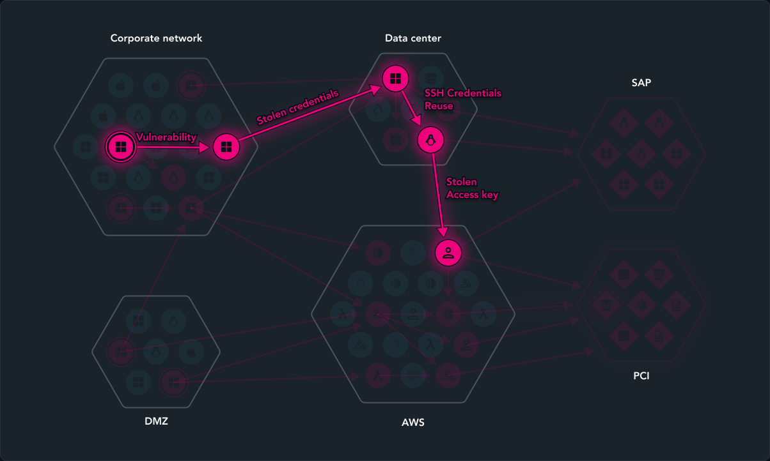
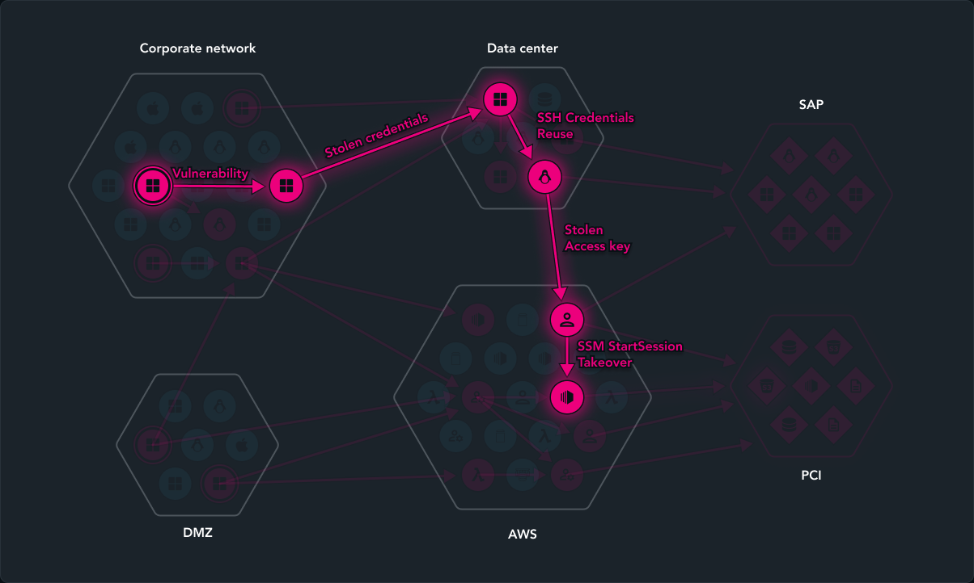
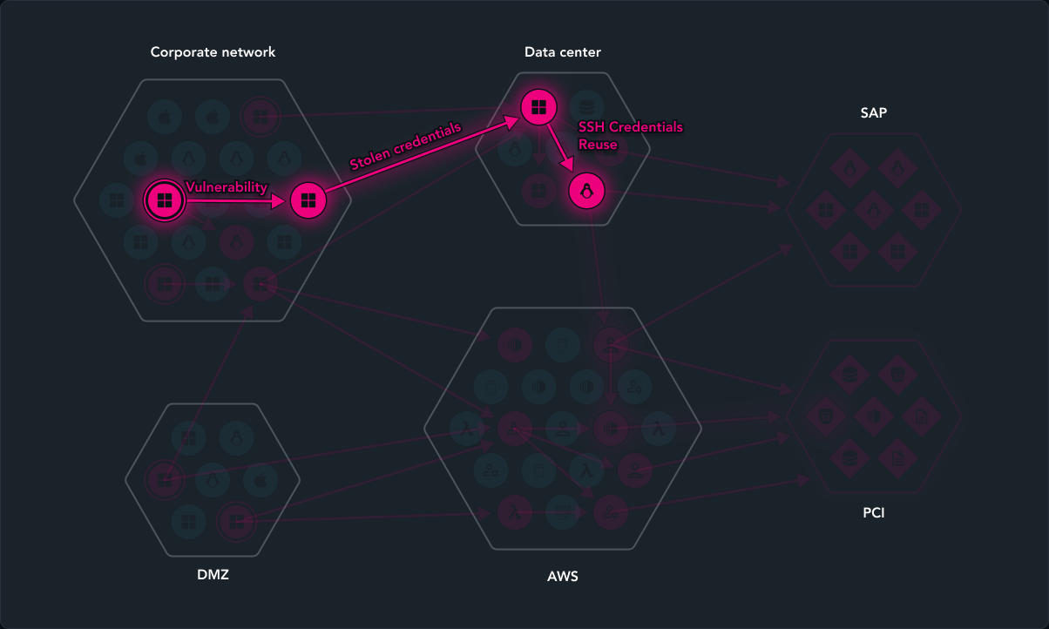
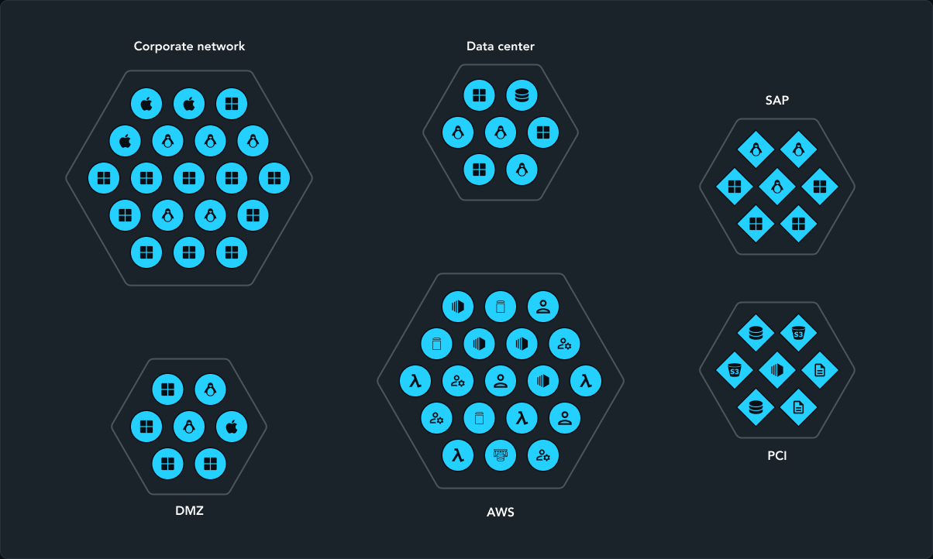
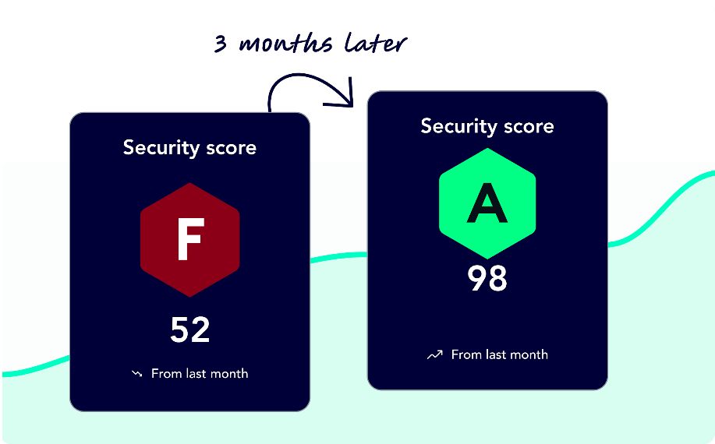
Past vs. Future - VM vs. Exposure Management
Based on Attack Graph Analysis™ on Digital Twin of your environment
Effective remediation based on rich context:
Justify Criticality (Focus)
Provide guidance AND alternatives
Integrate with ITSM
Track Progress
Holistic and continuous discovery for unified visibility
Scope IT assets and the critical business processes they map to
Prioritize by focusing on high-impact, high-ROI exposures.
Choke Points: intersections of multiple attack paths targeting critical assets.
Validation: Filter exposures on dead-ends
Measure and report on
risk-to-the-business.
Fix less. Prevent more.
Notes:
The way that XM Cyber powers CTEM for enterprise customers is with the proprietary attack graph analysis. The graph maps all the potential attack paths across your hybrid environment, unlike other vendors that can only show one attack path at a time, and do not span across on-prem and cloud.
XM Cyber pulls data from endpoints, servers, cloud instances, kubernetes clusters, and many other systems across your infrastructure to build the graph.
We are able to identify critical assets in your environment, and even offer a new methodology for mapping these critical assets to your top business processes. This scoping will then determine the blast radius of attack paths on the graph and the consequence prioritization.
What are some of your top business processes (suggest some options based on industry)?
Do you know how your IT assets map to these business processes?
CLICK
XM Cyber discovery doesn’t only discover different types of exposures, including vulnerabilities, misconfigurations, identity and access exposures, and user behavior, but also maps how they would be combined to move laterally across your hybrid environment to compromise your critical assets.
XM Cyber discovers exposed external-facing assets, as well as stolen and leaked credentials based on infostealers to map breach points and assess what the impact would be on critical assets.
CLICK
The graph is extremely powerful in effective prioritization of exposures.
I shows which exposures are exploitable in your environment, as well as which exposures compromise critical assets.
On top of that, because the graph shows multiple attack paths, it identifies “choke points”, which are intersections where multiple attack paths converge.
Focusing remediation on choke points increases efficiency and allows preventing multiple attack paths with a single fix.
How much do you think you can reduce your lists by focusing on choke point remediation?
CLICK
XM Cyber simulates the attack paths to identify dead-ends that block lateral movement and do not compromise critical assets.
Exposures that lead to dead-end, even if they are critical, will not be prioritized high for remediation because they will not have an impact on your risk level.
CLICK
Mobilization of effective remediation is based on rich context of the graph as well as strategic integrations.
Based on the graph XM Cyber provides the focus on fixing the choke points, which reduces the number of fixes significantly for IT operations. XM cyber also provides remediation guidance and alternatives in cases of not being able to patch a system.
XM cyber also integrates with automated processes to ensure that remediation can be streamlined with your existing processes.
We integrate with Jira and ServiceNow, and also have a strategic alliance with ServiceNow to integrate with their SecOps solutions.
We also integrate with leading SIEM and SOAR solutions.
We are also working on improving our feedback loop with a unique mechanism for remediation validation.
We find that this transparency leads to better alignment and cooperation betweens security and IT operations.
CLICK

Slide 29

Fix Less – Prevent More
74% of exposures are not on attack paths to an organization’s critical assets… yet organizations are still focusing on fixing these.
Organizations can practically eliminate all attack paths to critical assets by remediating just
of exposures that lie on choke points.
2%
2024 State of Exposure Management Report, XM Cyber
Notes:
Slide Goal:
Emphasize that problem of wasting time is bigger than you probably think (goal of slide is to help surfacing pain for the buyer!)
Optional Discovery:
Have you heard of CTEM? [If they say they have and respect Gartner, then optionally show Gartner CTEM quote slide]

Slide 30
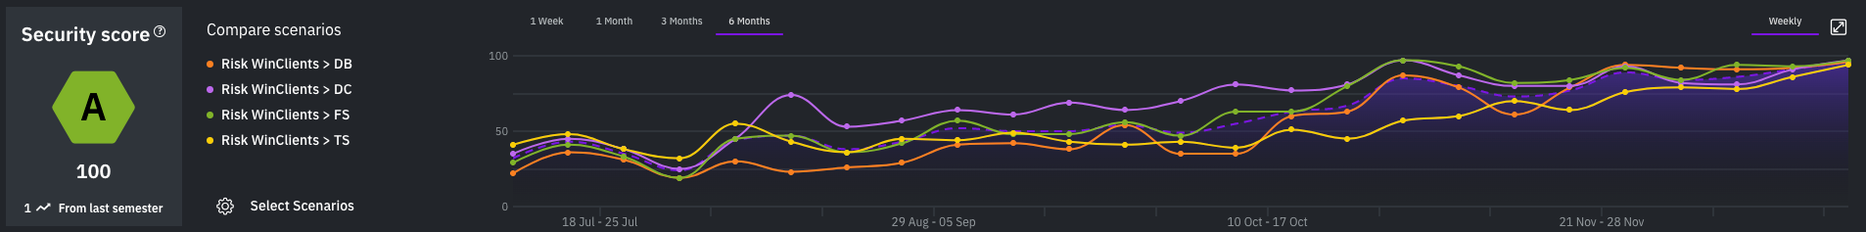
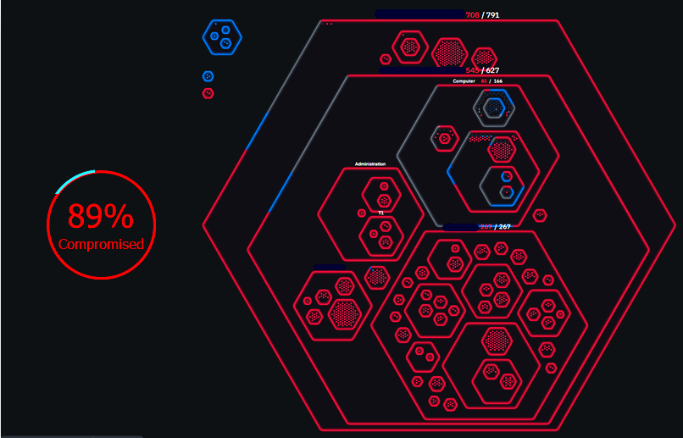
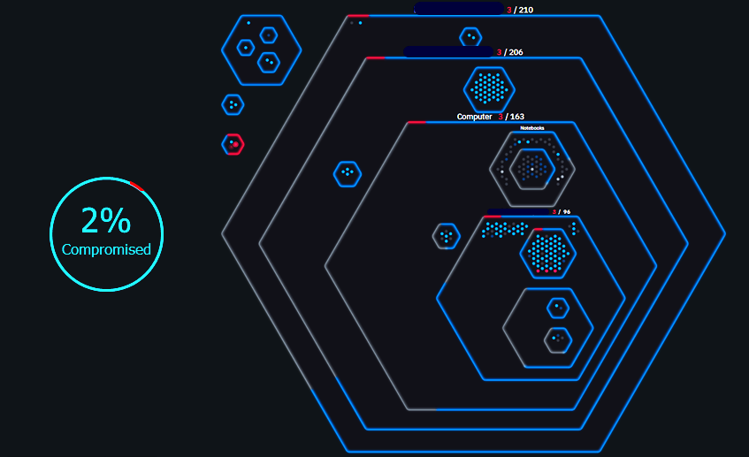
Case Study: Fast, Demonstrable Risk Reduction
30,000 employee company goes from F (34) to A (100) in 4 months
Example step in the journey: Ransomware scenario resolved in 1 day
Choke point on internet-facing
file server
2 cached
privileged credentials
EDR not running, although installed
BEFORE
AFTER
Notes:
Slide Goal:
Case Study: Real customer example. XM Cyber customers are regularly able to drastically reduce risk in their environment within months of purchasing our solution.
Main Points:
Top Graphic - One of the largest global industrial management companies. $2+Billion in Rev, 30K+ employee count
The fact that they went from an F to an A within 4 months is indicative of our success. Most new customers on average will go from a C/D to an A in less than 5 months.
Bottom Graphic - One small example of just 1 choke point remediation
Our system identified a machine that had an EDR installed, but not running (this was not known by the customer)
Asset was an internet facing file server that had 2 cached privileged credentials
Fixing the one asset took the scenario from 89% of all assets being compromised down to 2%, with Zero critical assets able to be breached.

Slide 31


Outcome = Focus on What Matters
$
Prevent High-Impact Attacks
Continuous, proactive security of Critical Assets
Gain Remediation Efficiency
Focus resources on high-impact fixes based on context
Report on Meaningful Risk
Answer executive questions with confidence and common understanding of risk to the business
Notes:
Our customers see several benefits when deploying XM Cyber.
The first one is preventing high-impact attacks by eliminating blind spots either from exposures that are not in scope, or environments that are owned by a different team, and by visualizing and identifying the exposures with highest risk to critical assets, so those can be fixed first.
Once the team starts remediating the high-impact exposures, then gain remediation efficiency because they can prevent more attack paths with a reduced subset of fixes, and can get all the required information of what to fix and how.
The final gain is around measuring and reporting on risk level with confidence, and being able to answer questions from the board or from management around the impact and effectiveness of the security program.

Slide 32

Vielen Dank
Besuchen Sie uns am Stand A30
Möchten Sie mehr darüber erfahren, wie Logicalis Ihnen helfen kann, Ihre Sicherheitslage zu verbessern?
KONTAKT
Nikolai Bakschies
nikolai.bakschies@logicalis.de

