Slide 1
Mit KI Bedrohungen voraussagen – Cybersicherheit neu gedacht
Richard Werner, Cybersecurity Platform Lead
Trend Micro

Slide 2
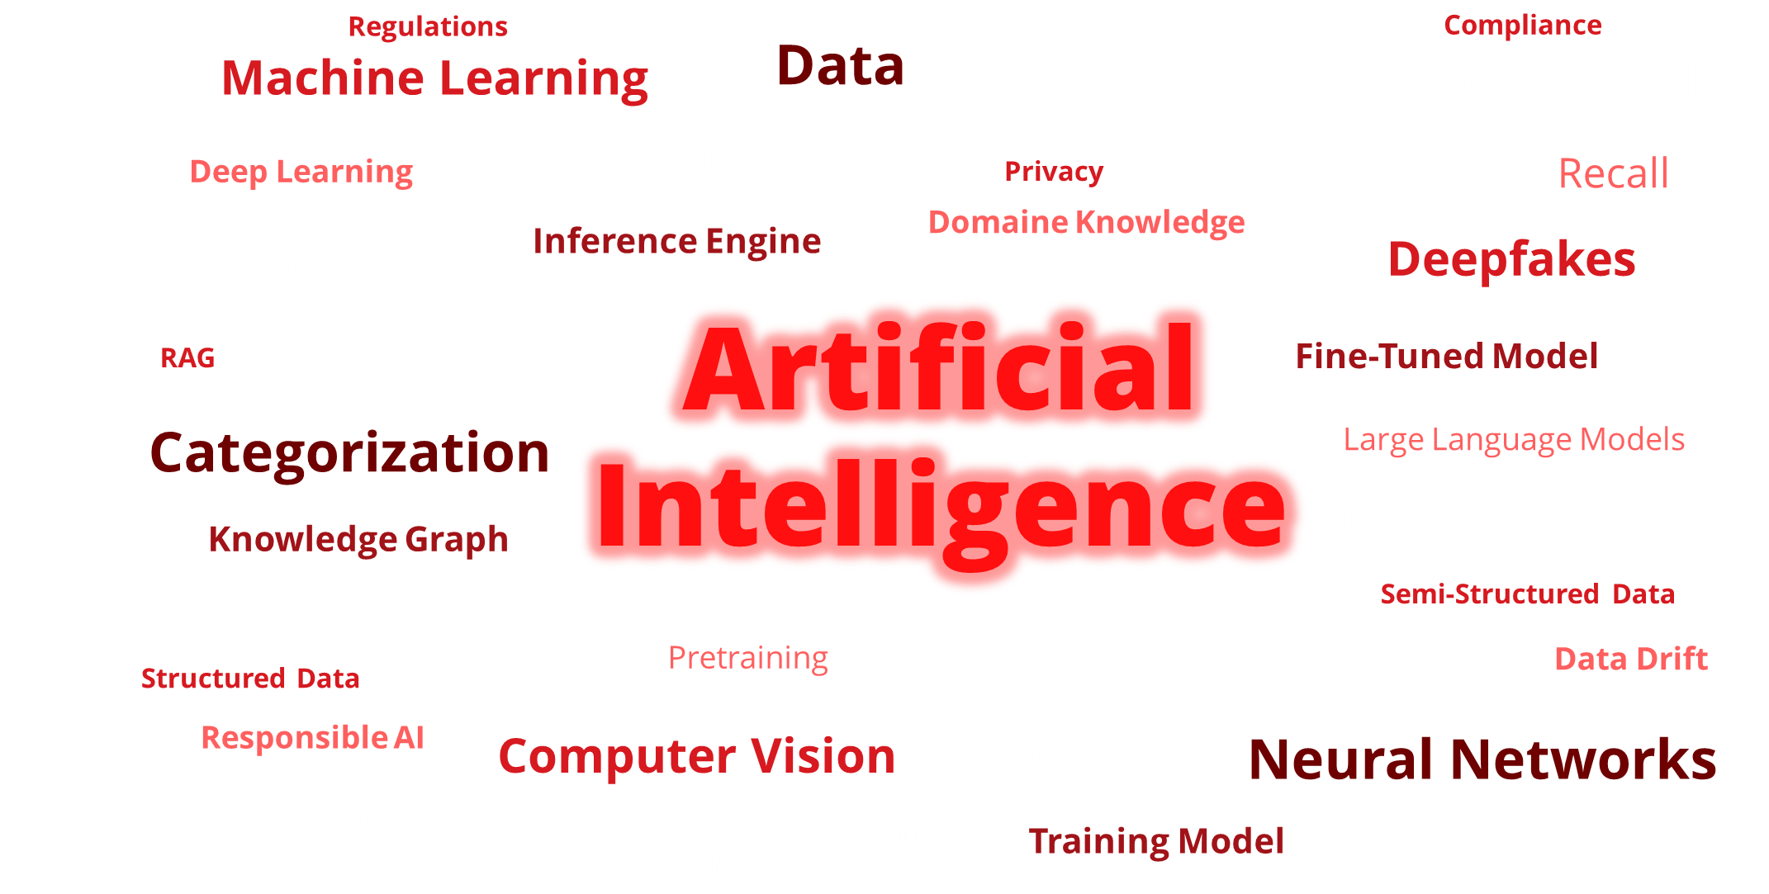
Technologien entwickeln sich

Slide 3

SCHÜTZEN
REICHT NICHT

Slide 4


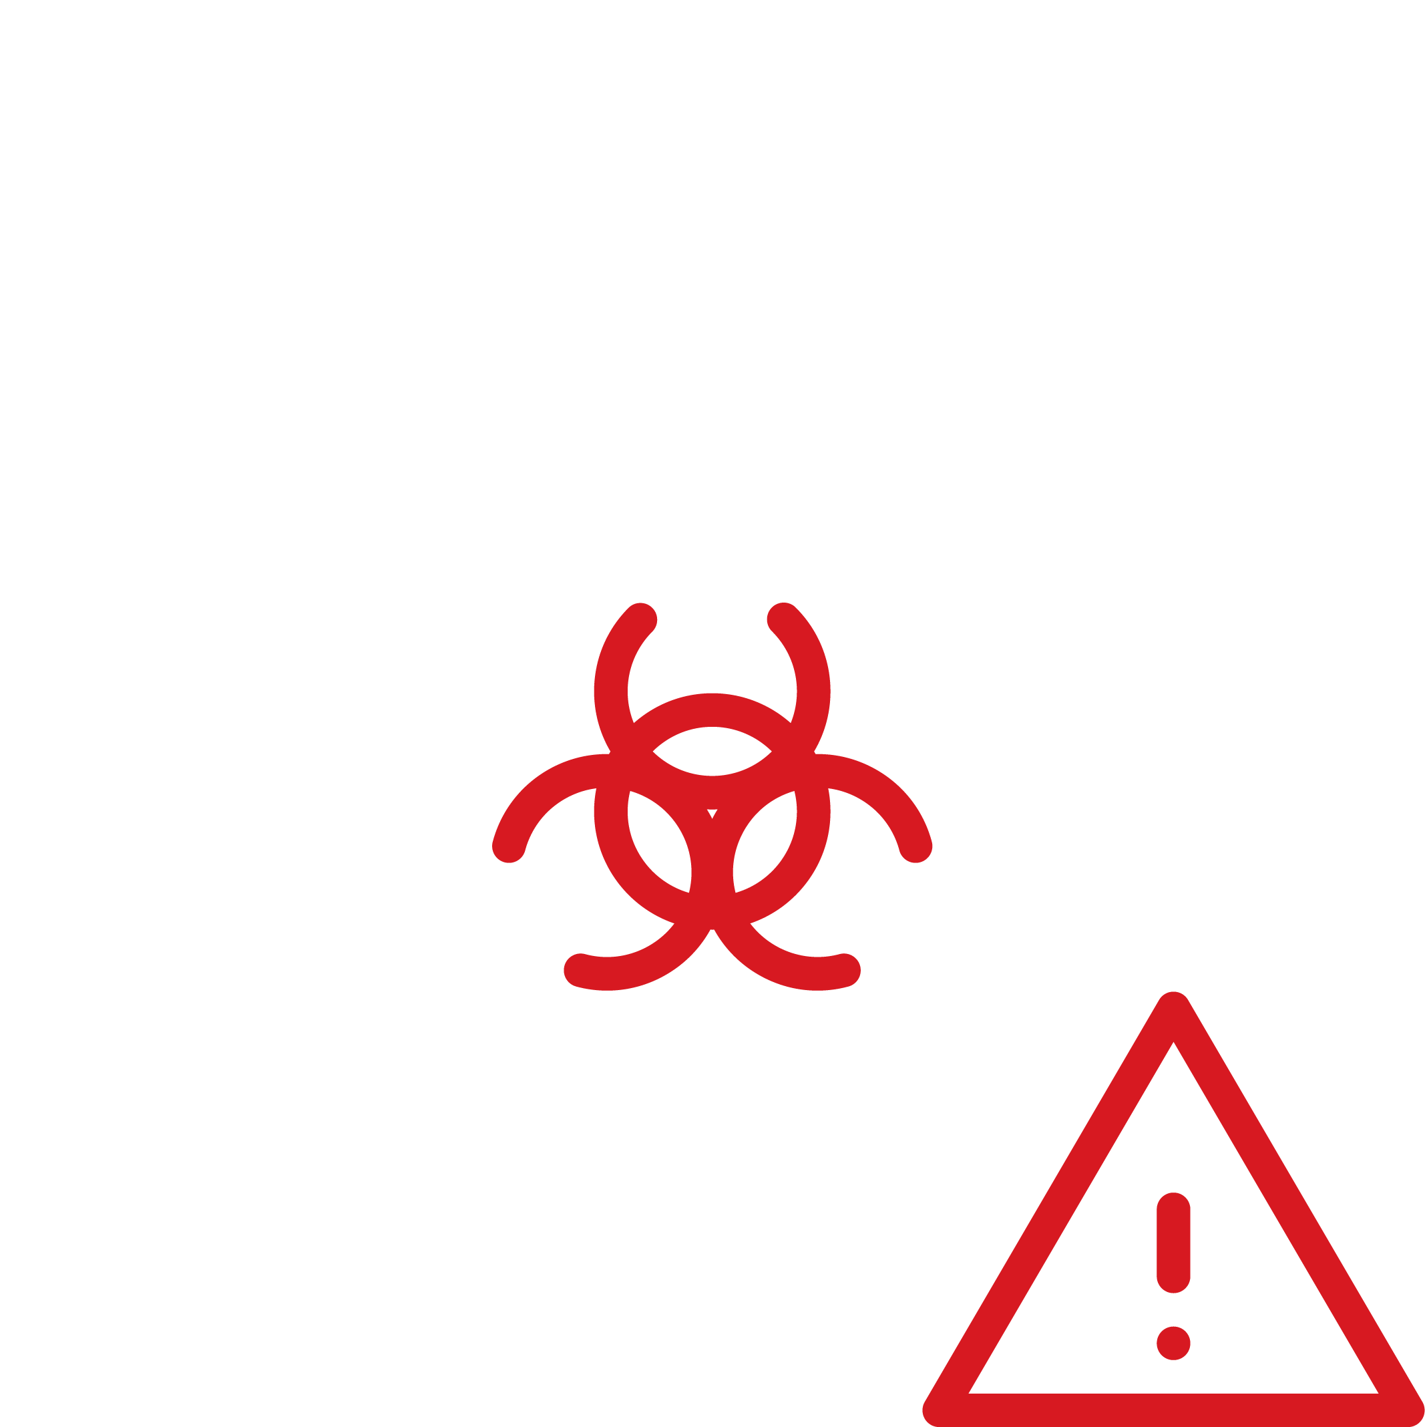
Cybersecurity kommunizieren
Cyberbedrohung

Slide 5


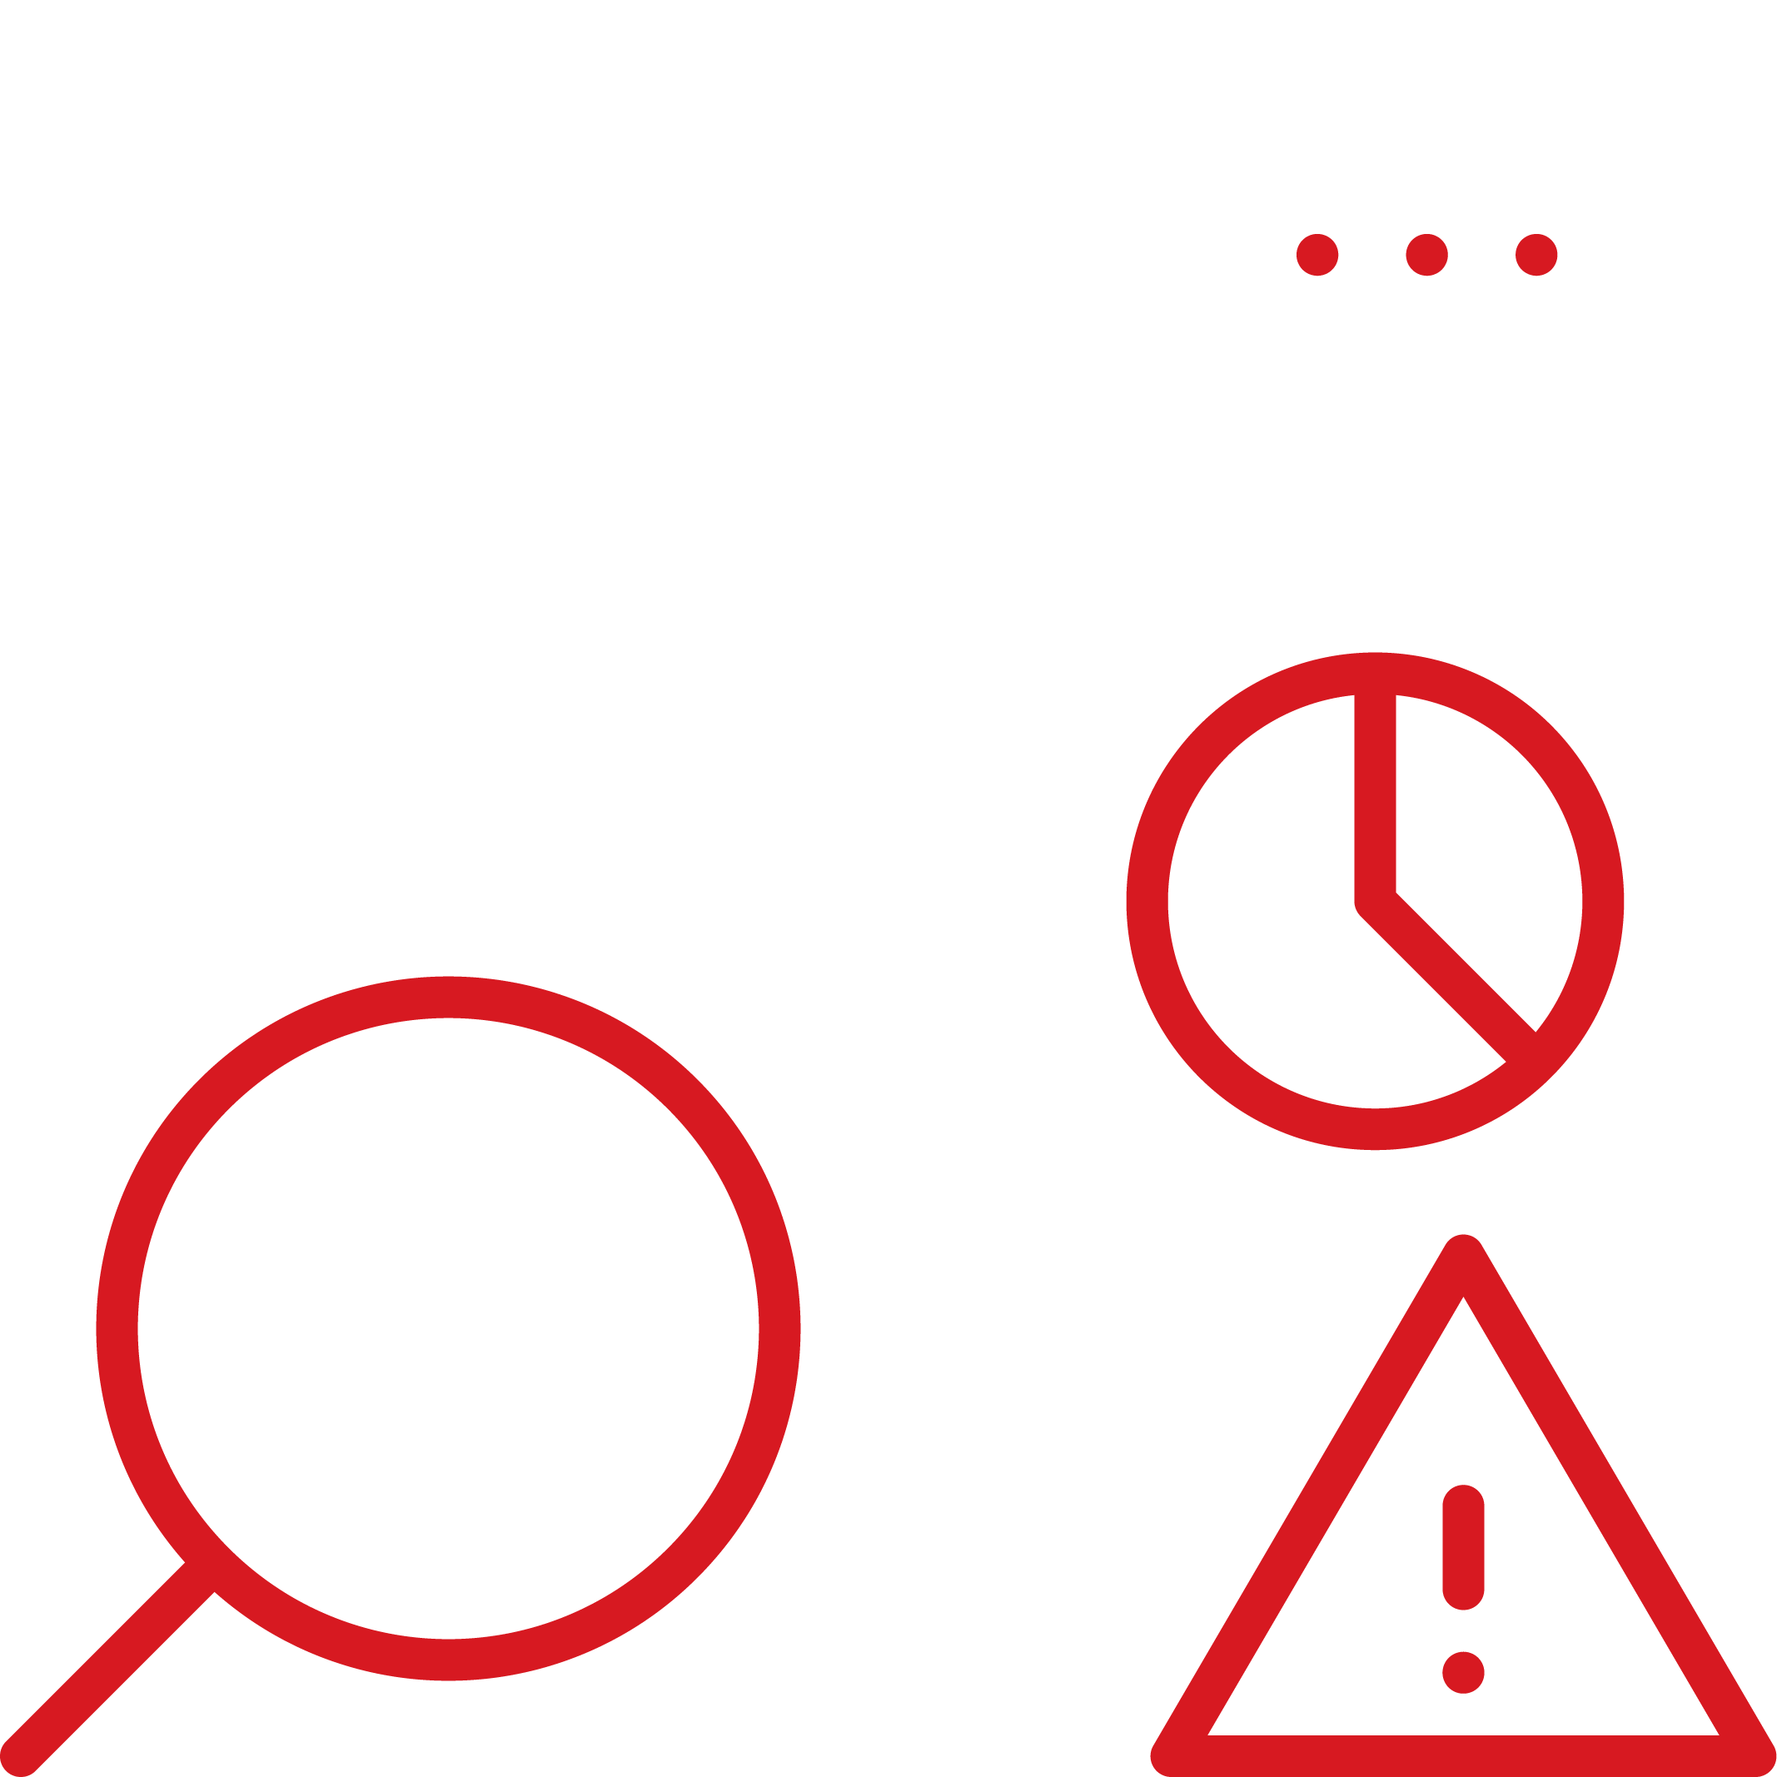
Cybersecurity kommunizieren
Cyberrisiko

Slide 6


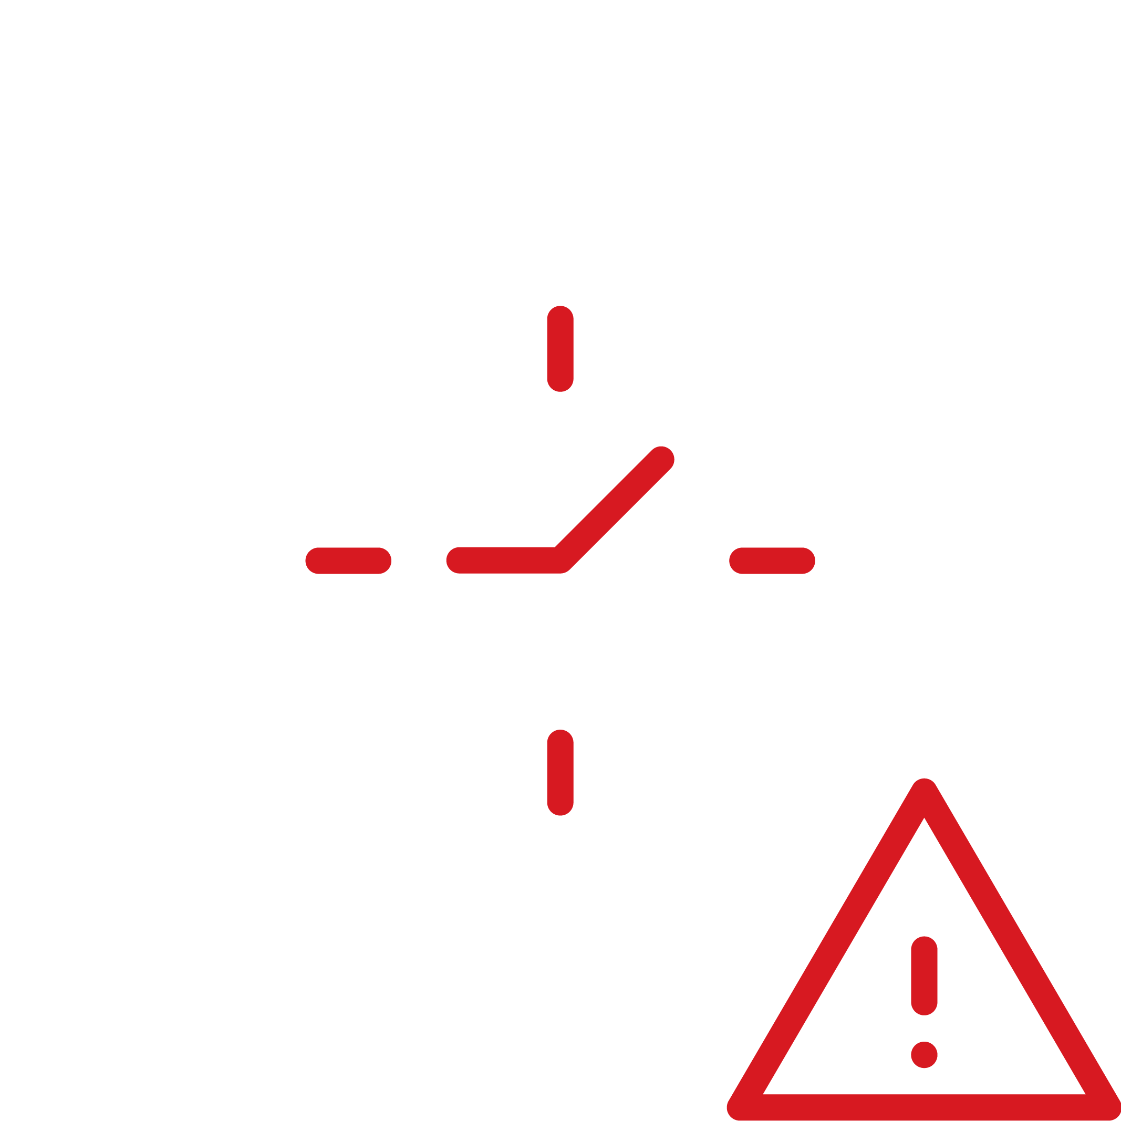
Cybersecurity kommunizieren
Cyberrisiko
=
Geschäftsrisiko

Slide 7


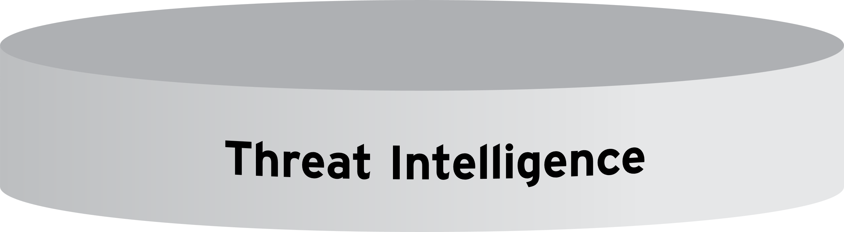

Trend Vision OneTM
Enterprise Cybersecurity Platform

Slide 8
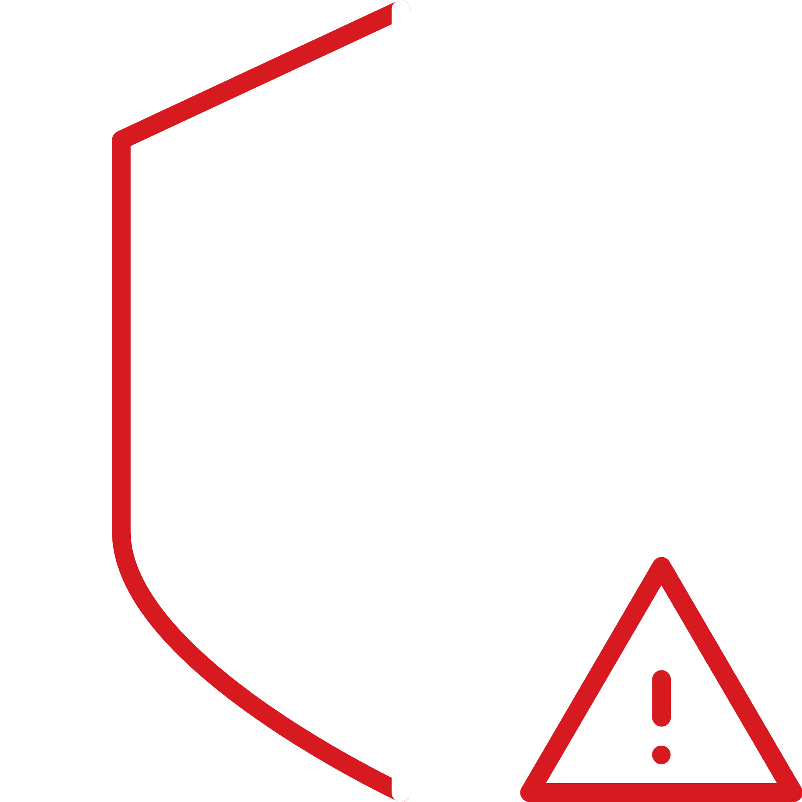


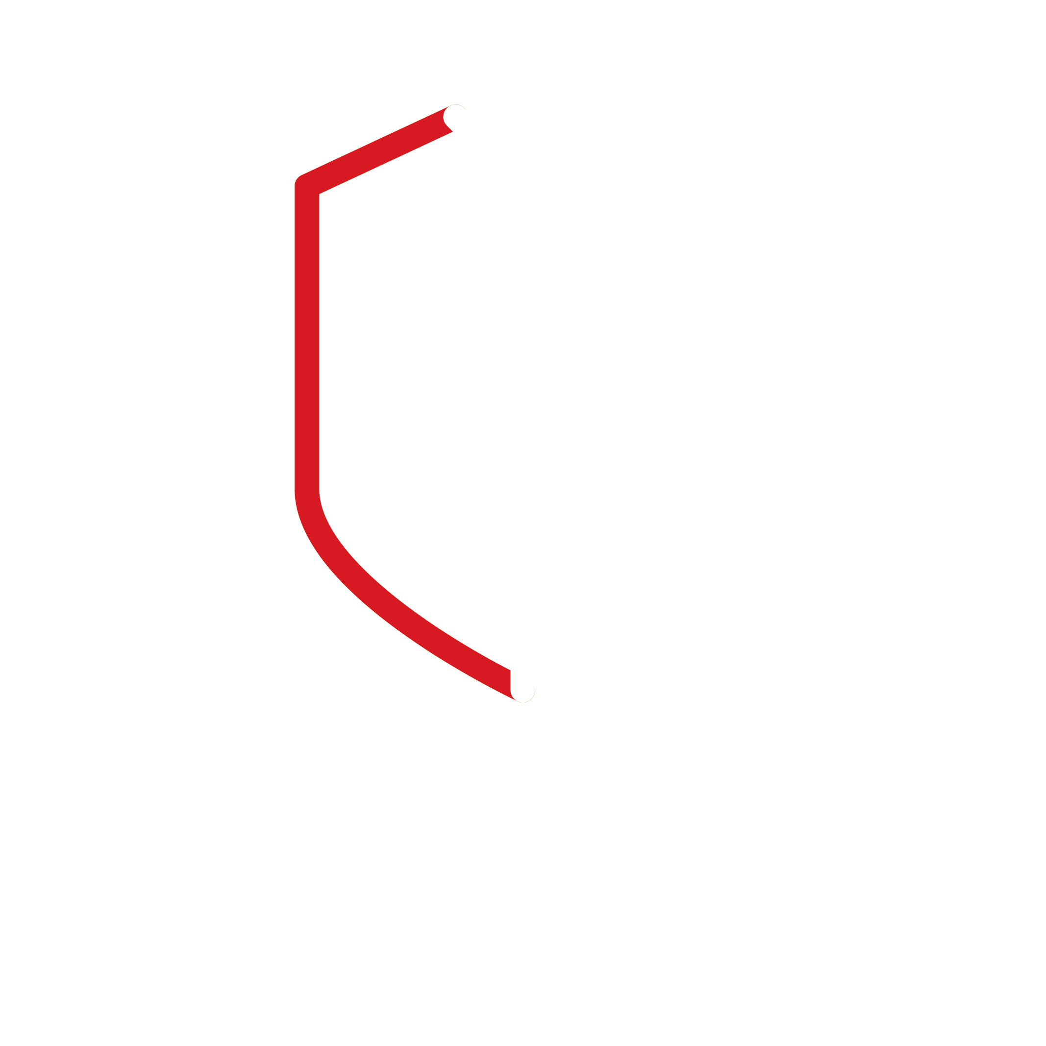



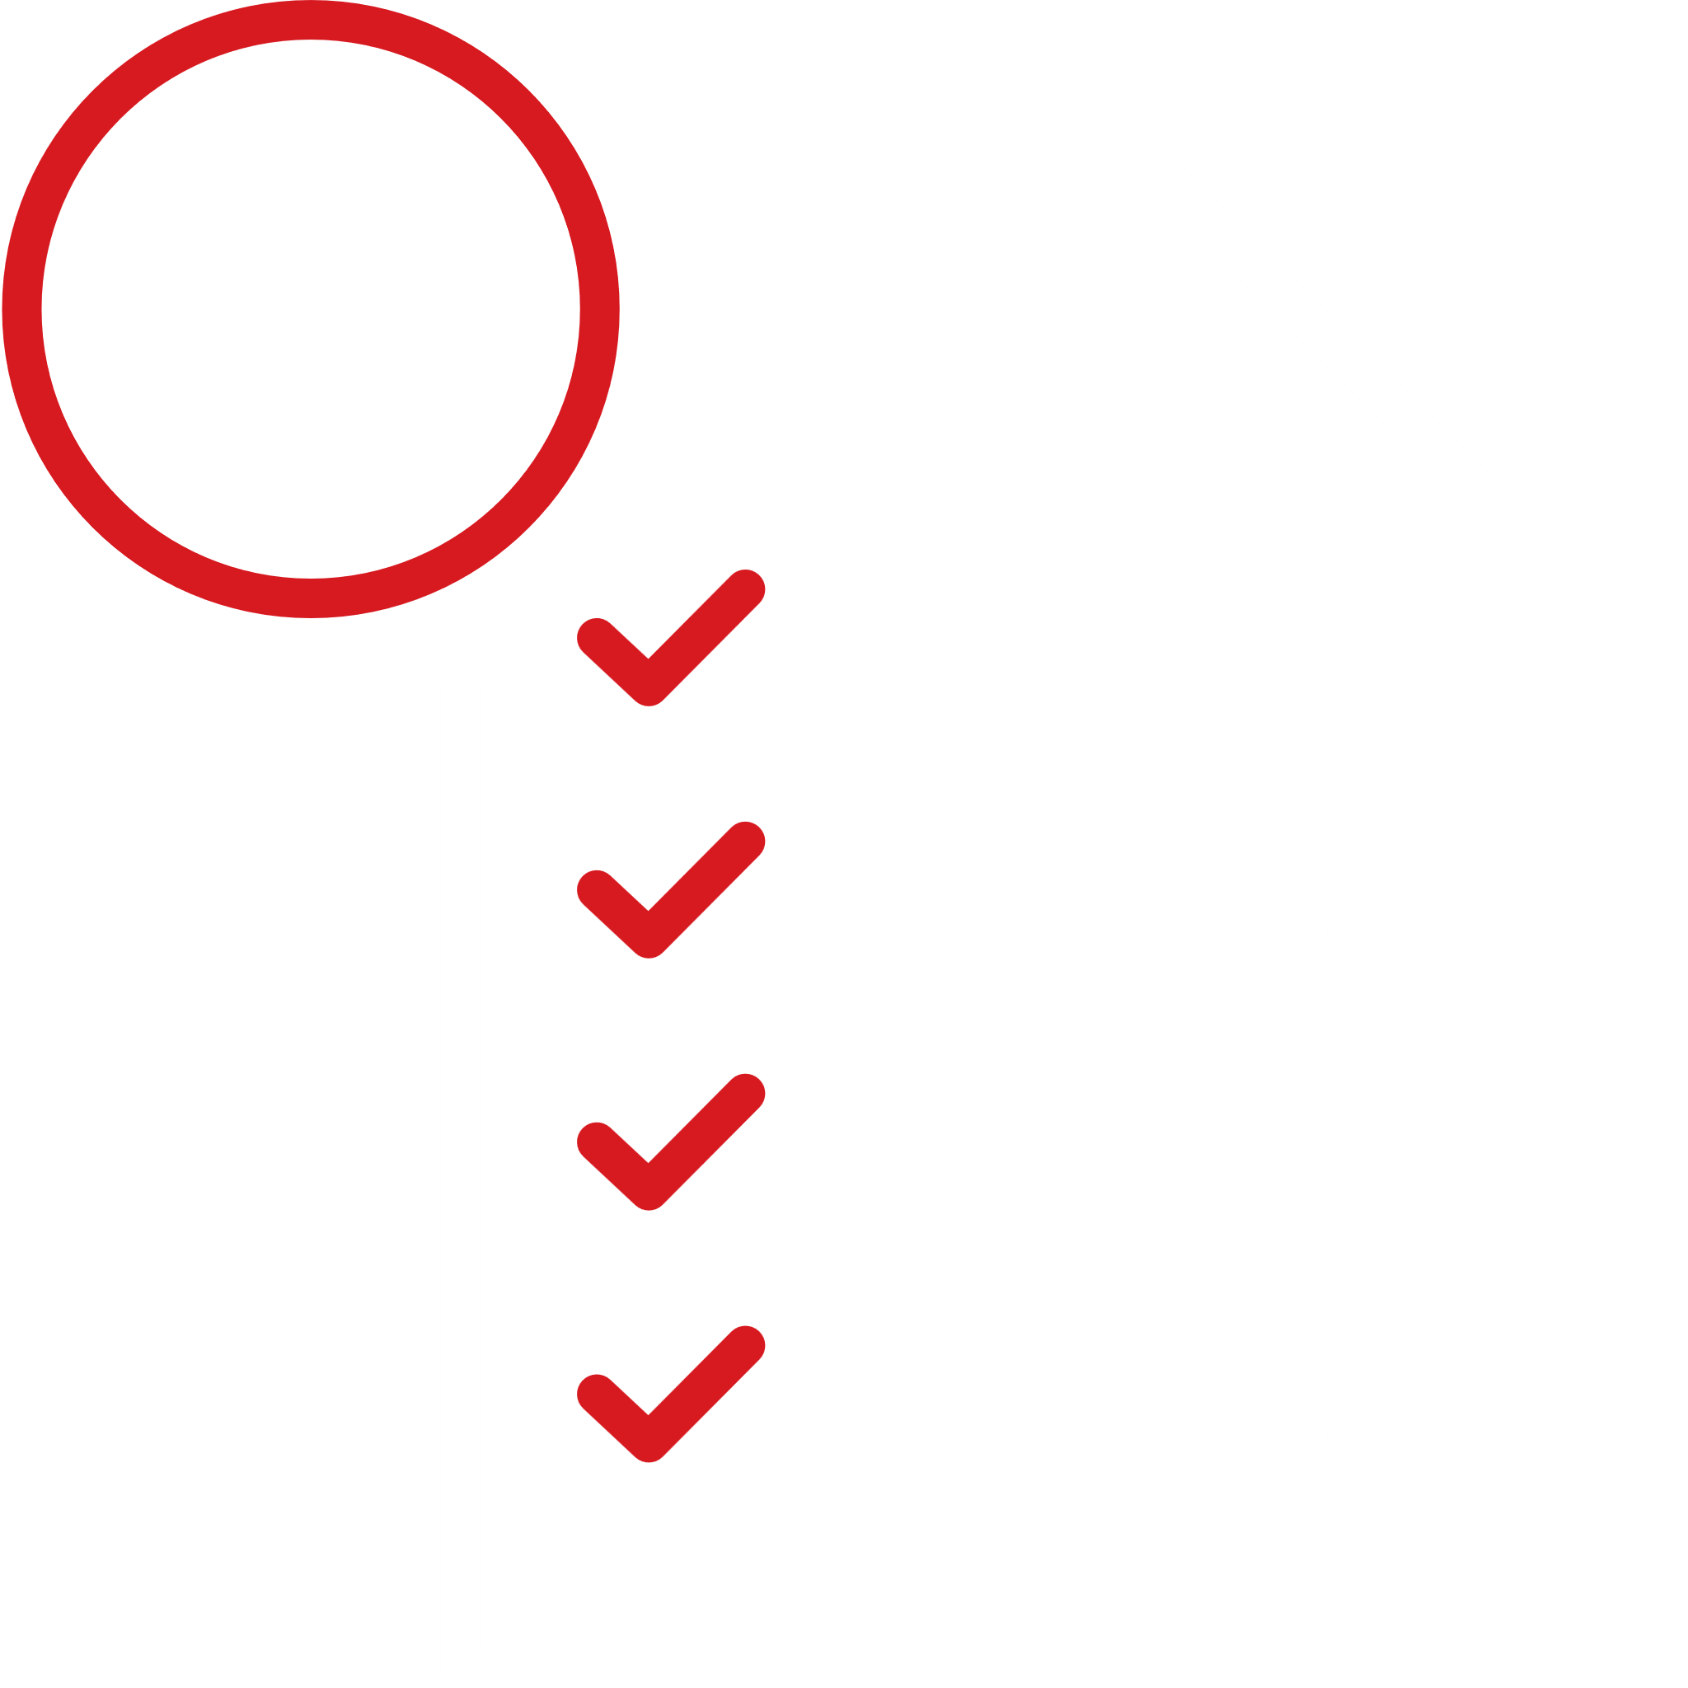

















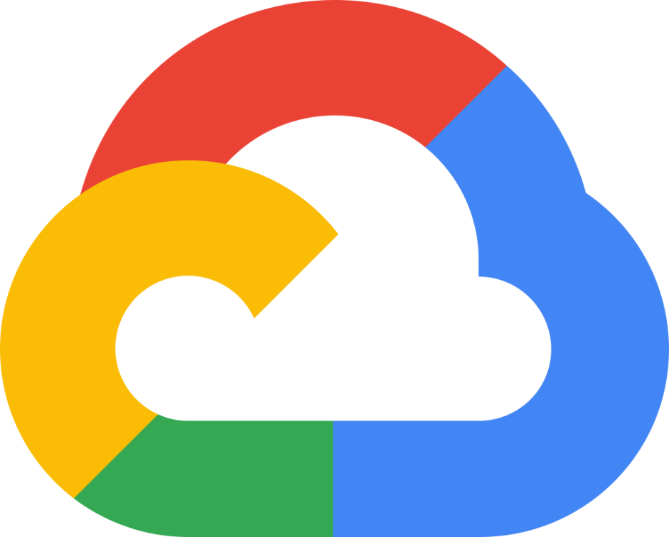

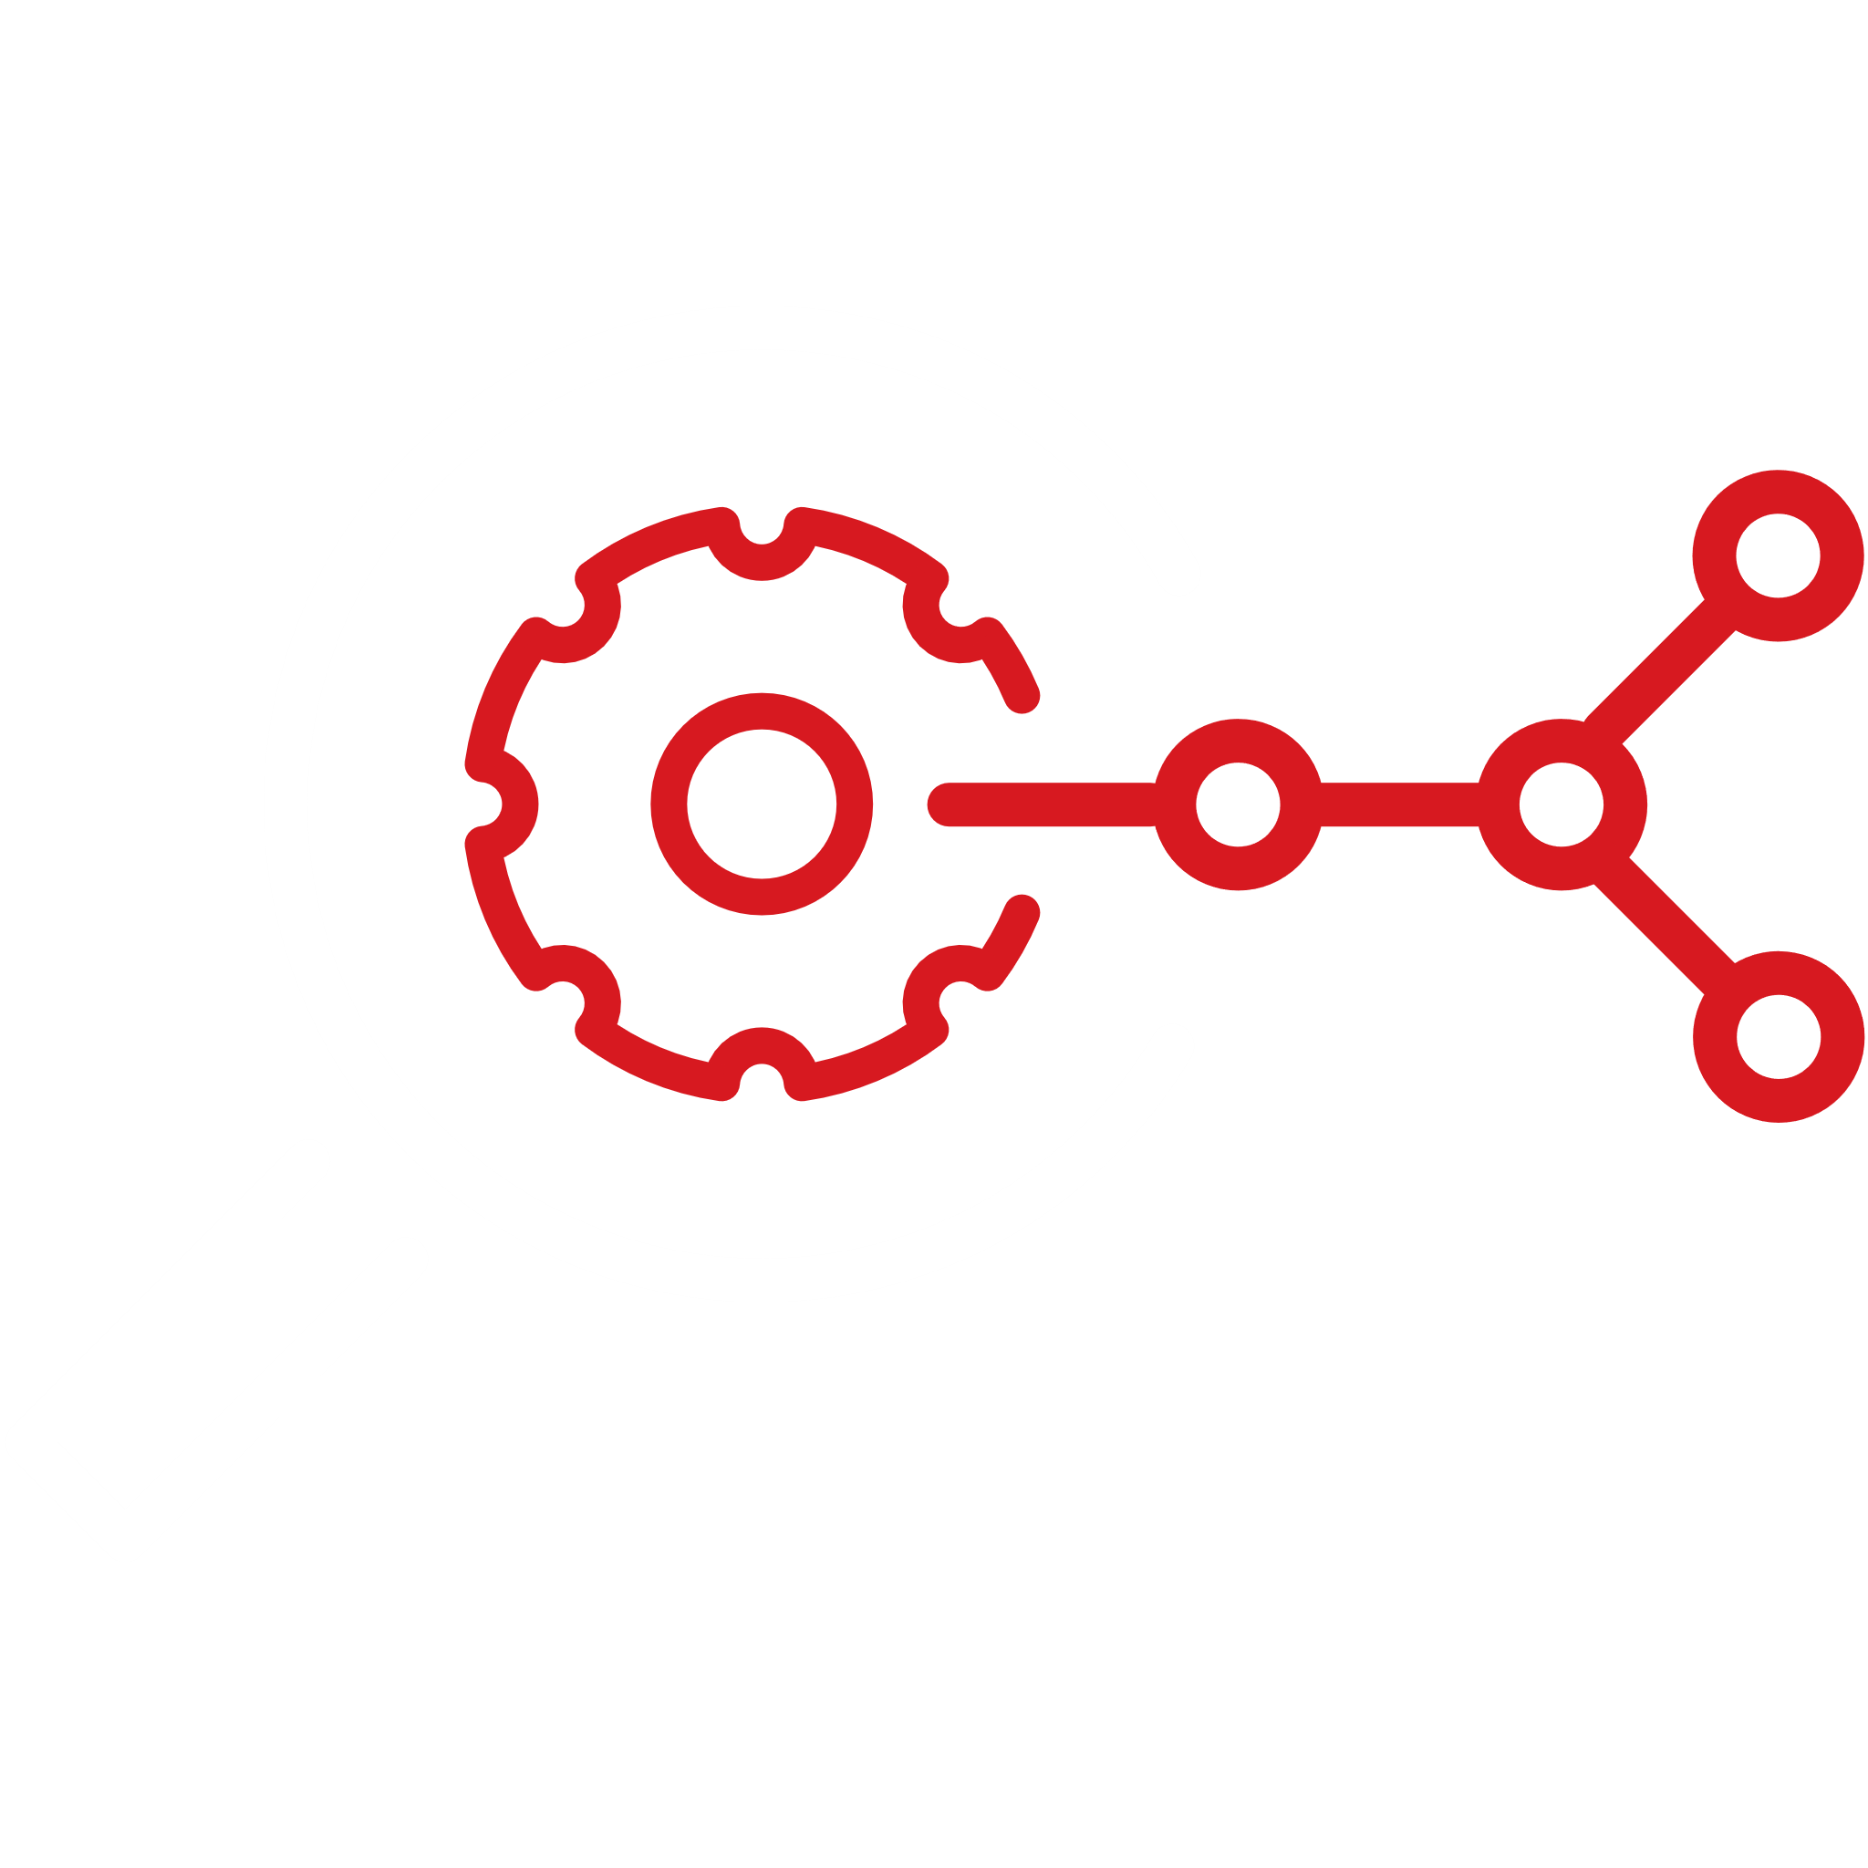




Trend Vision OneTM SecOps Funktion
Enterprise Cybersecurity Platform
Native
3rd Party
Vorteile
Verarbeitung
Cyber Risk
Management
Identity
Data
Vulnerability
Management
Trend
Vision One
Threat
Visualization
Threat
Intelligence
Normalize
Enrichment
Compliance
Reporting
Endpoint
Network
Security
Analysis
Risk Analysis
Firewall
Parse
Ransomware
Outbreak
Prevention
Orchestration
and Automation
Detections
Correlation
AI SOC
Advisor
Server
Email
Endpoint
Ingest
Threat
Hunting
Zero Trust
Workload
Container
Dynamic Data Storage

Slide 9
REAKTIV IST NICHT
GUT GENUG

Slide 10
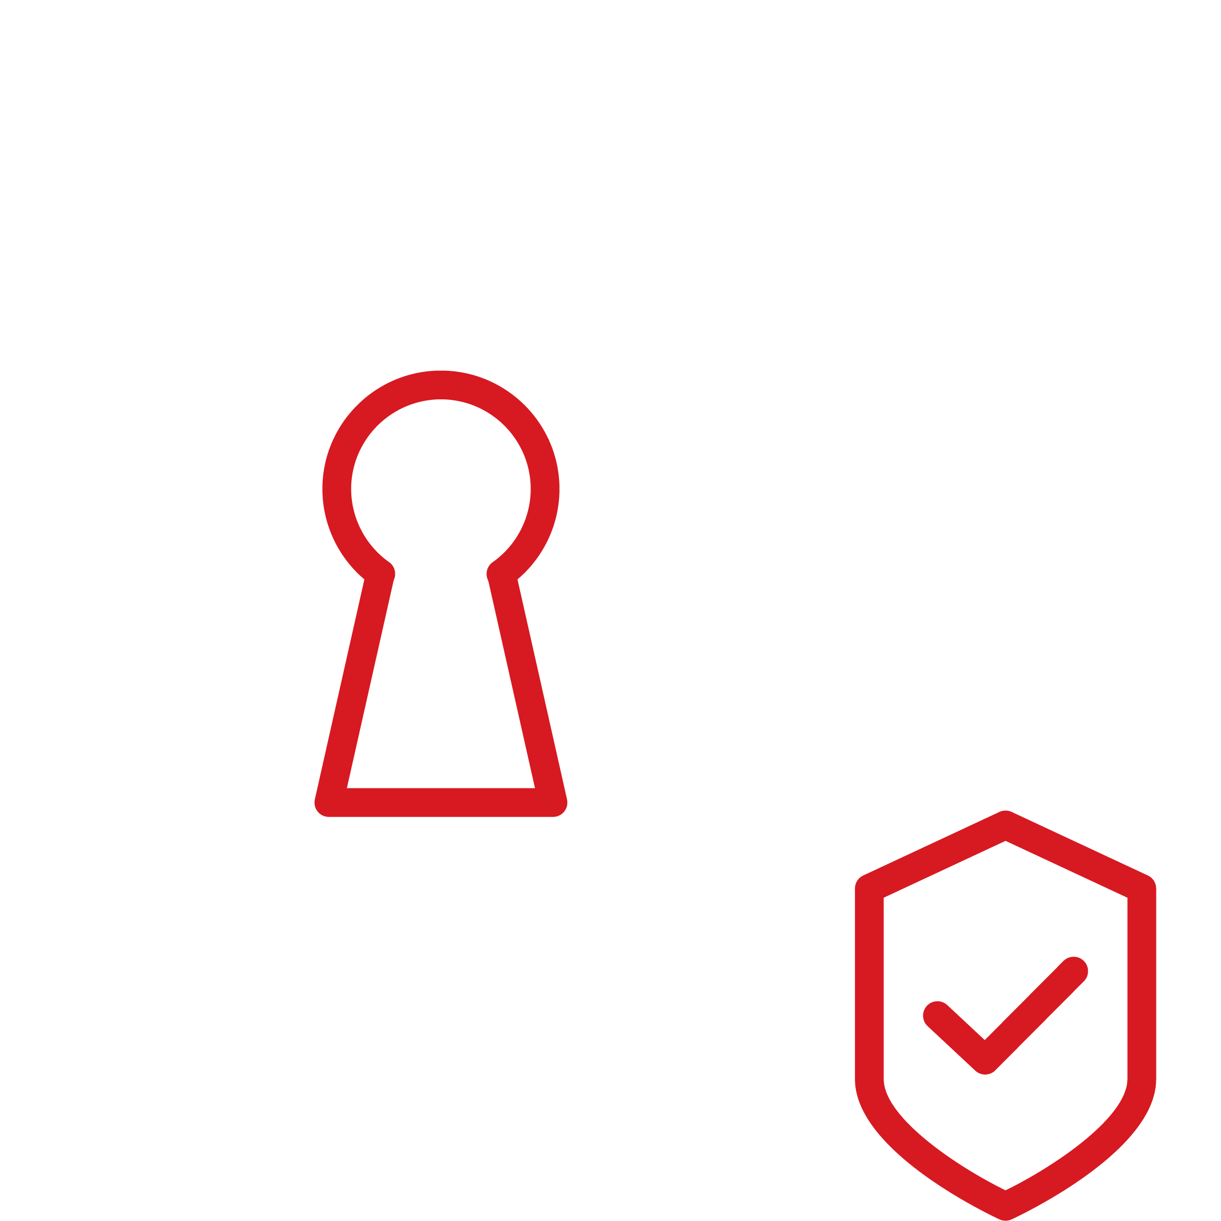

Cybersecurity zur Strategie machen
PREDICT
(Vorhersagen)
PREVENT
(Vorbeugen)
PROTECT
(Schützen)

Slide 11

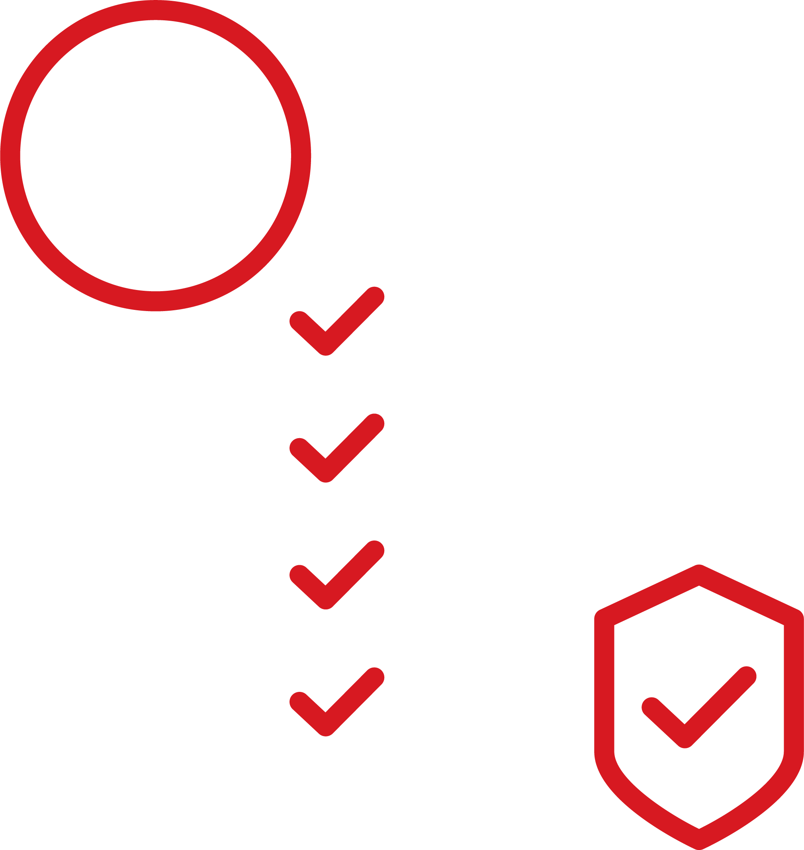
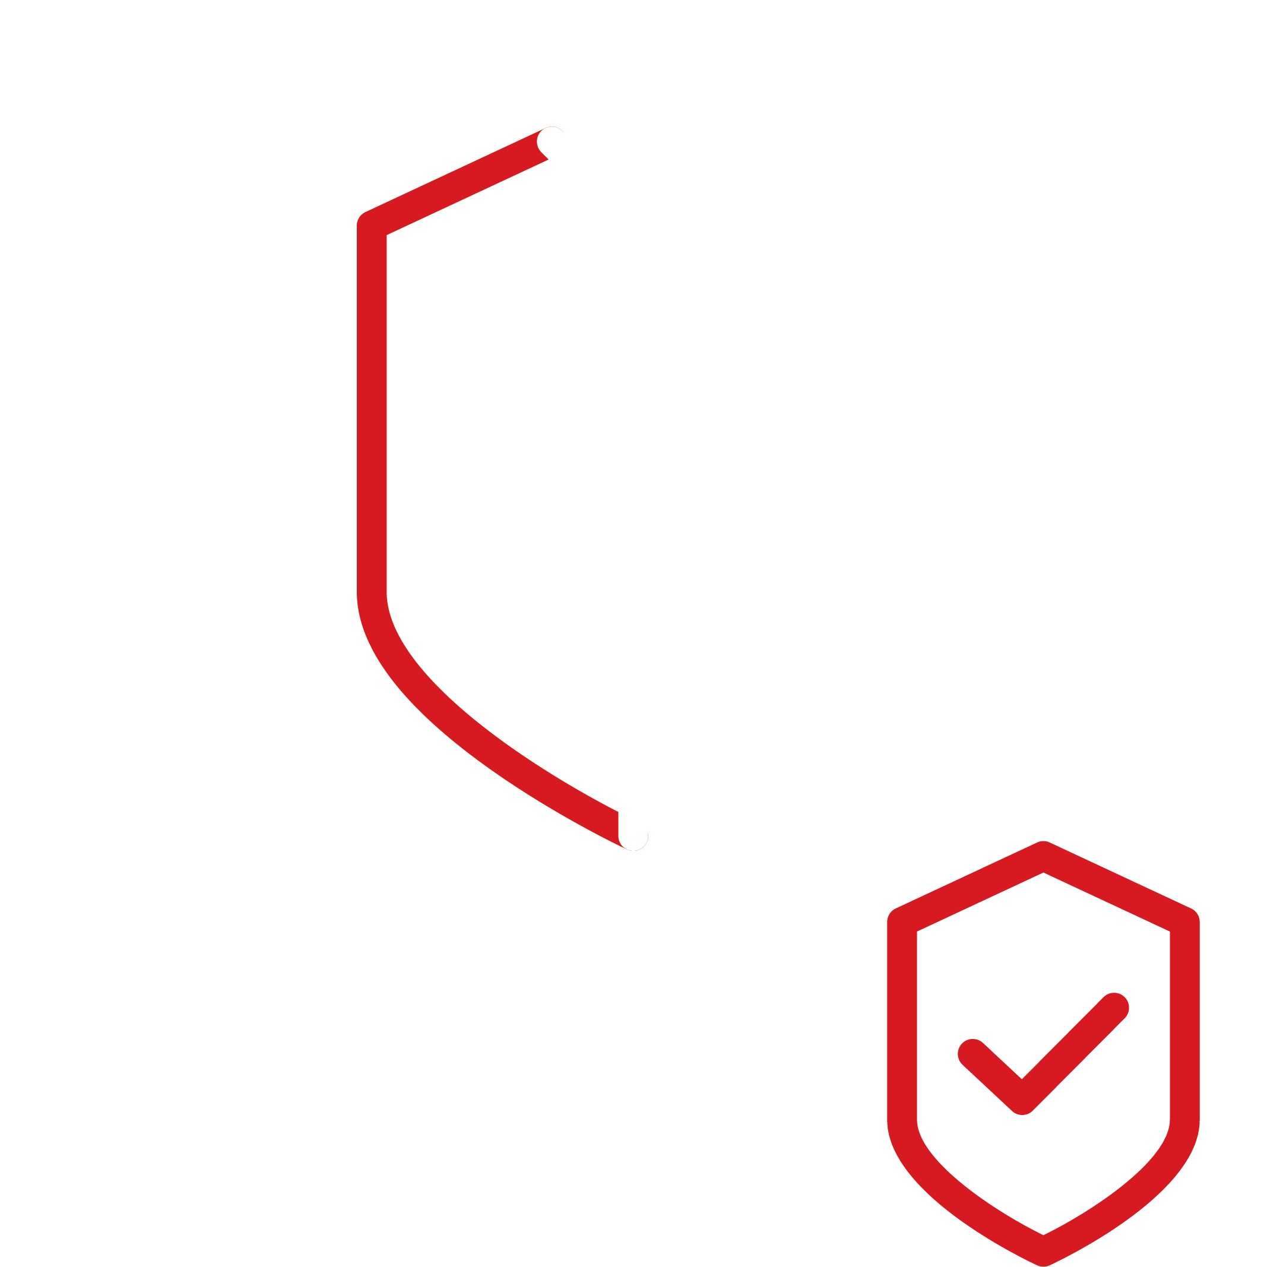

Trend Vision OneTM CREM
Enterprise Cybersecurity Platform

Slide 12
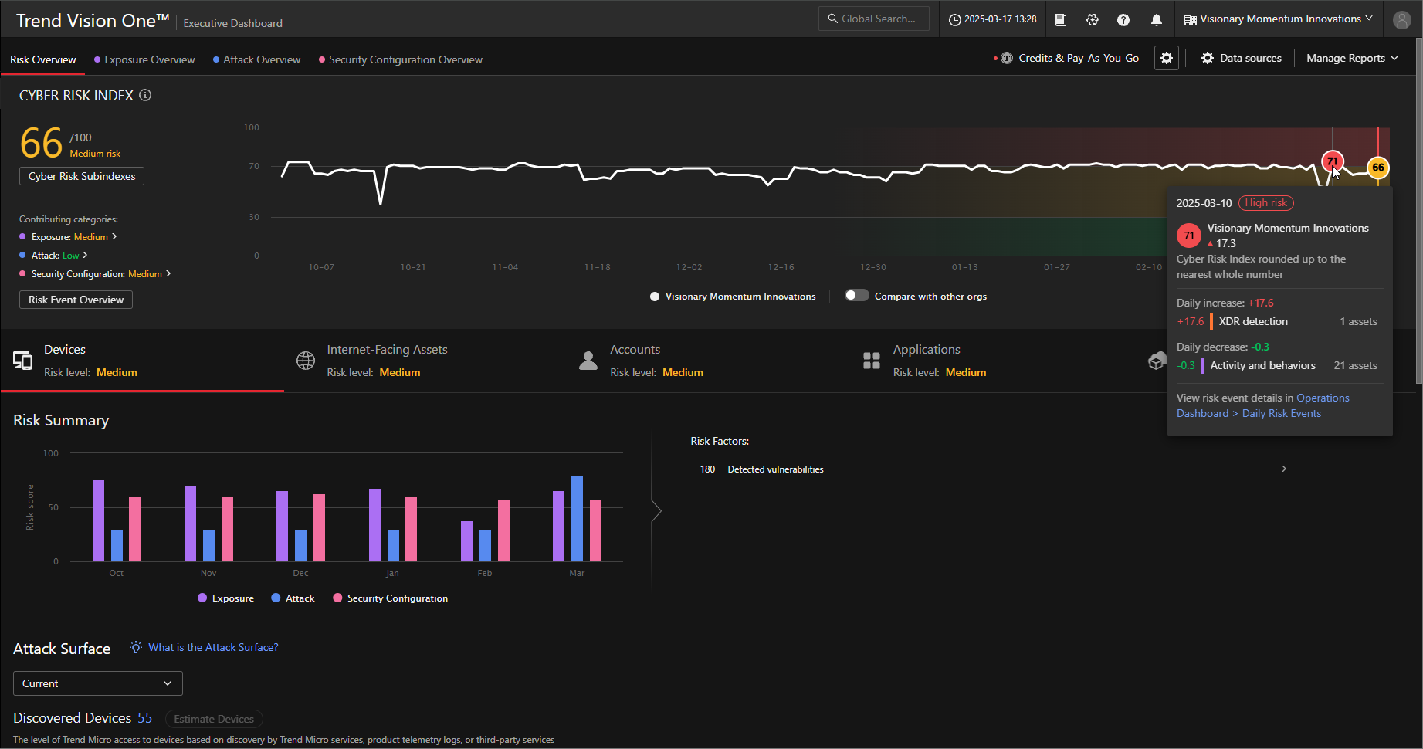
Trend Vision OneTM Risiken erkennen
Enterprise Cybersecurity Platform

Slide 13
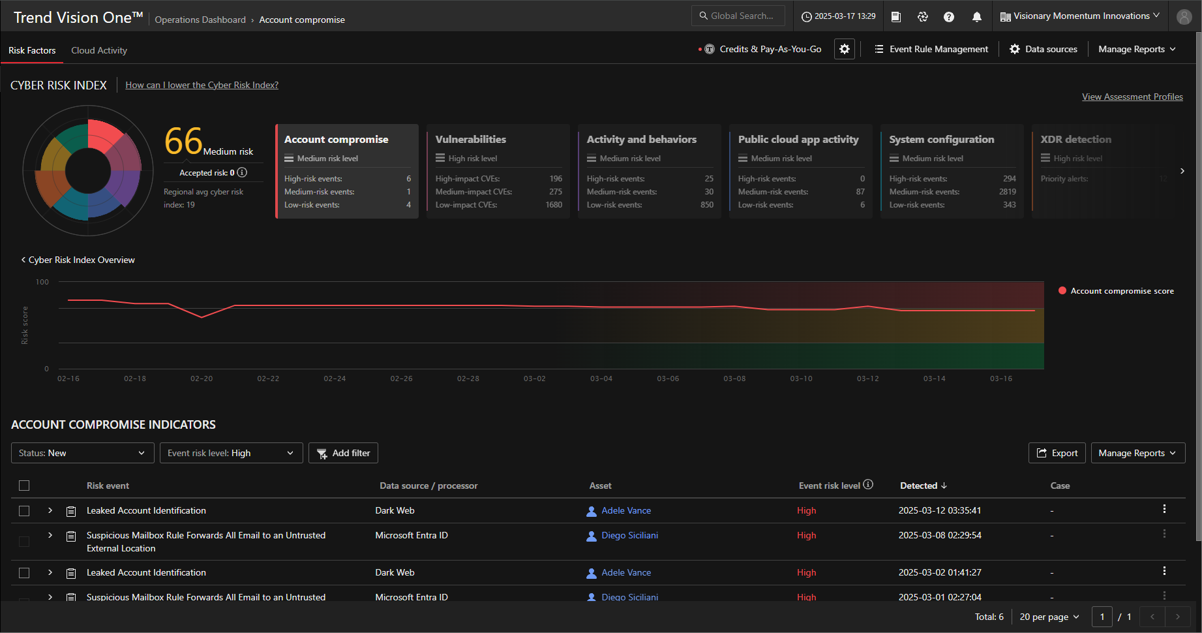
Trend Vision OneTM Risiken verstehen
Enterprise Cybersecurity Platform

Slide 14
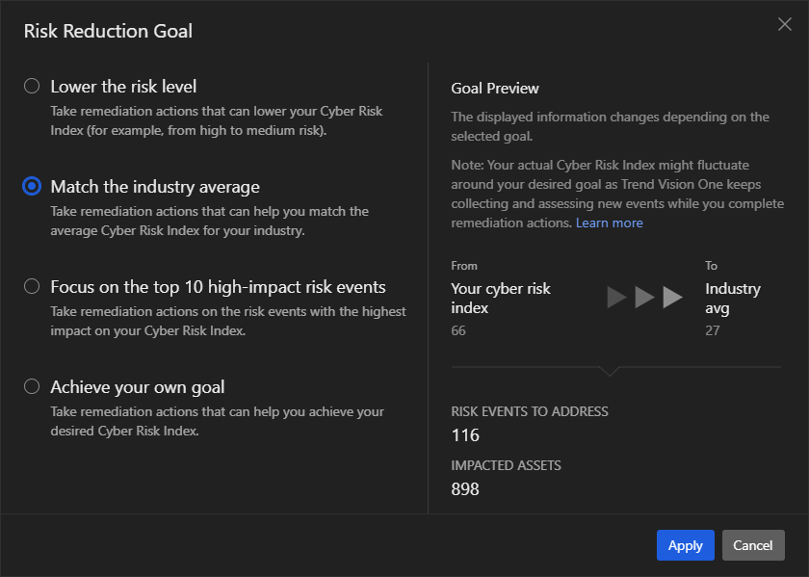
Trend Vision OneTM Risiken verringern
Enterprise Cybersecurity Platform

Slide 15
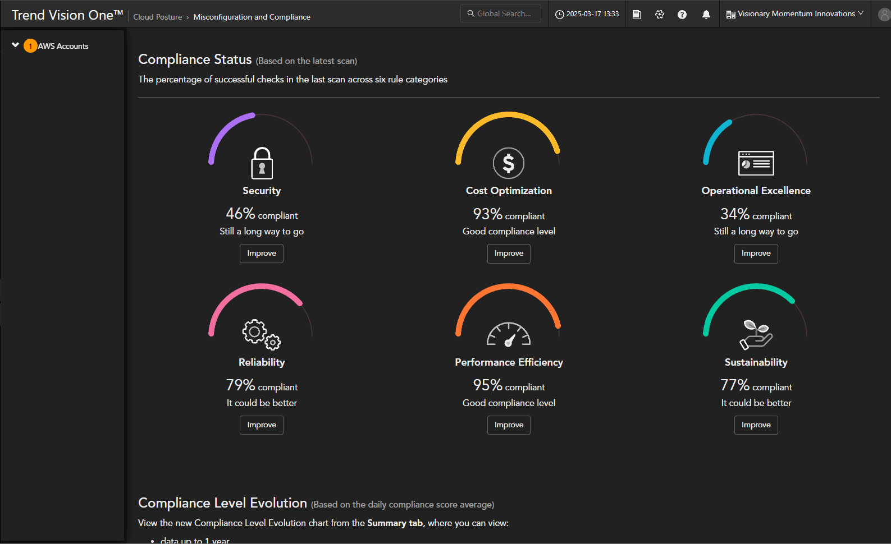
Trend Vision OneTM Compliance erreichen
Enterprise Cybersecurity Platform

Slide 16
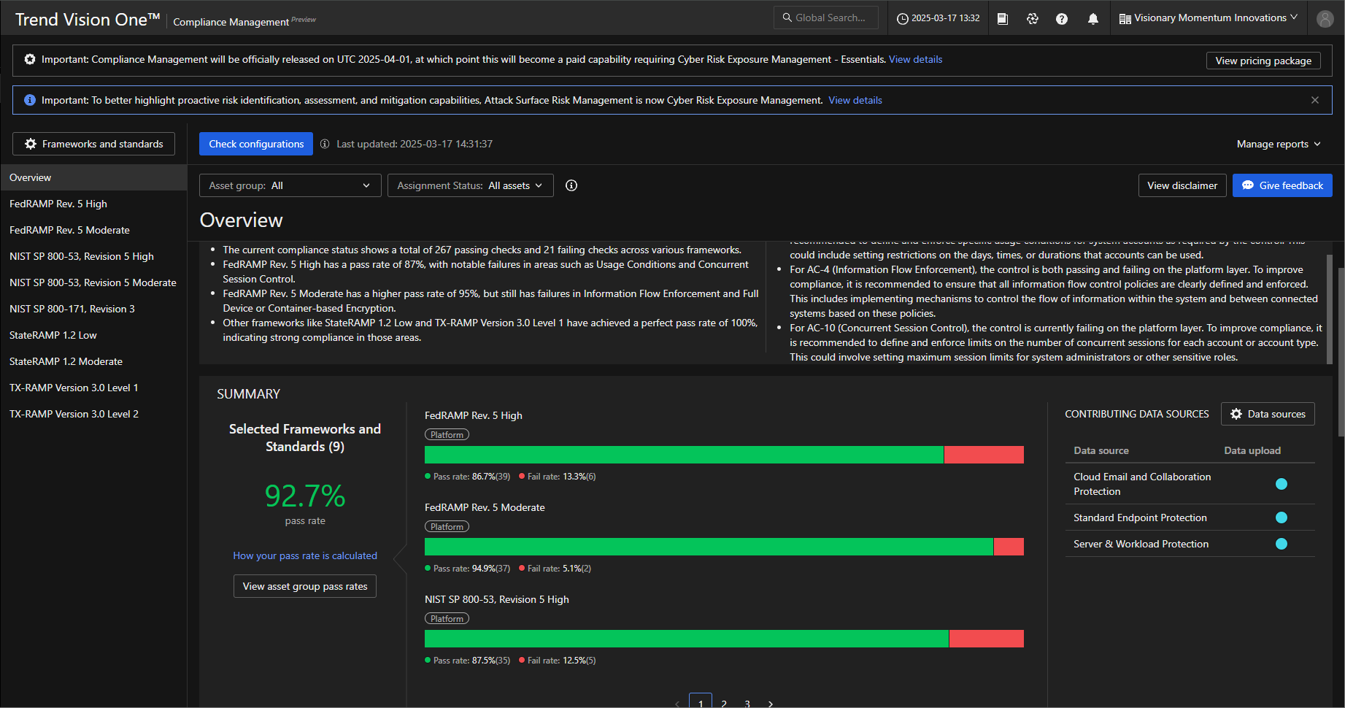
Trend Vision OneTM Compliance erhalten
Enterprise Cybersecurity Platform

Slide 17
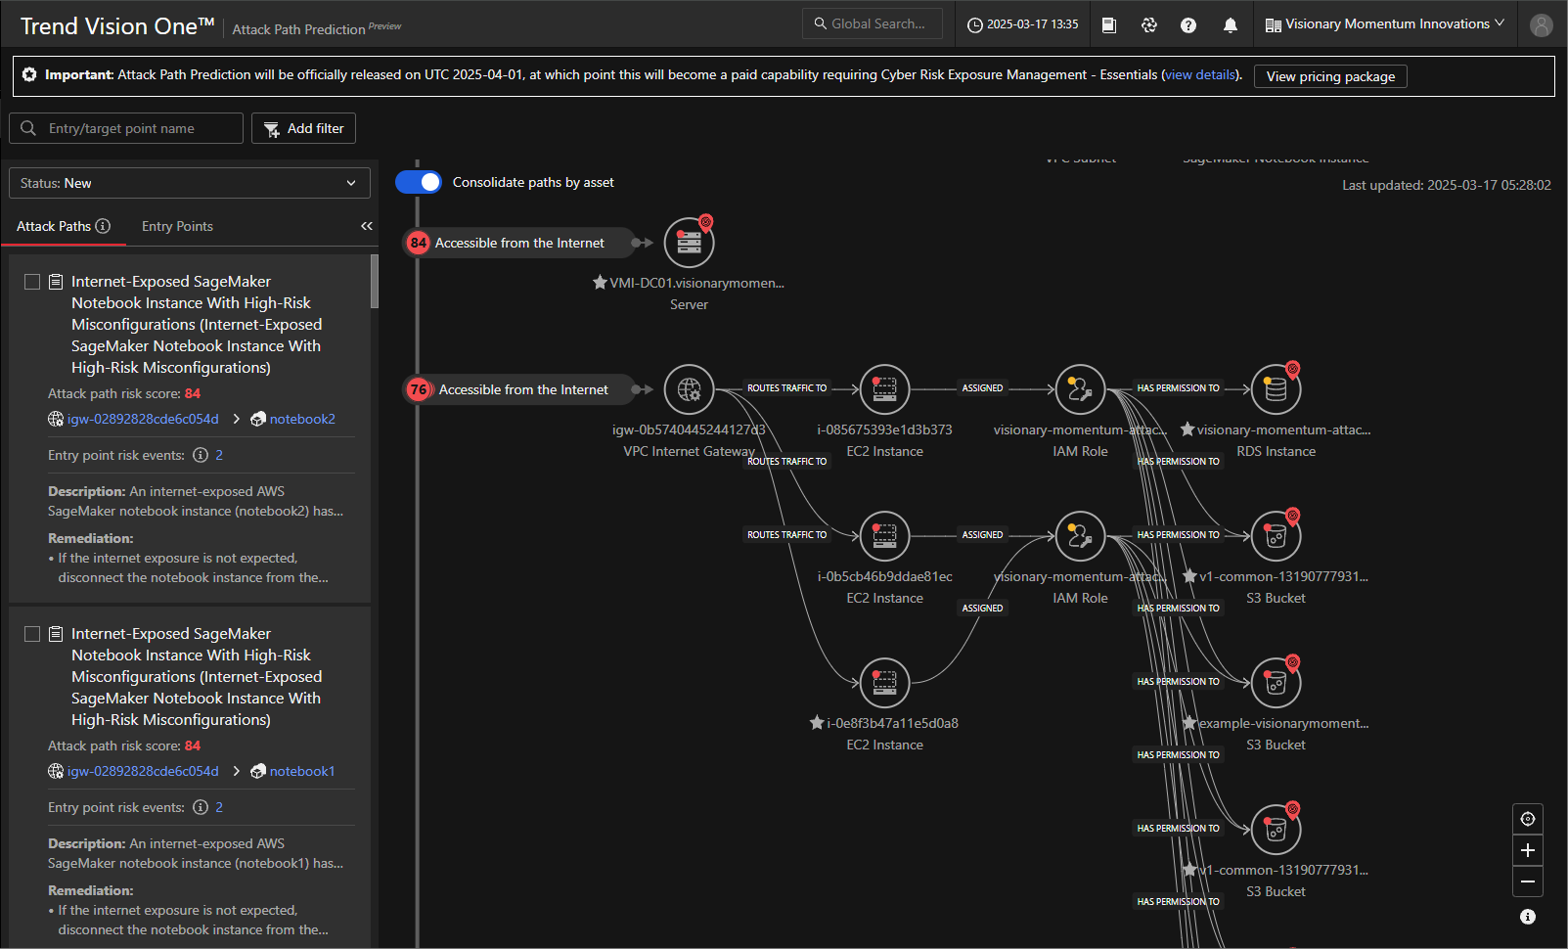
Trend Vision OneTM Angriffspfade aufzeigen
Enterprise Cybersecurity Platform

Slide 18
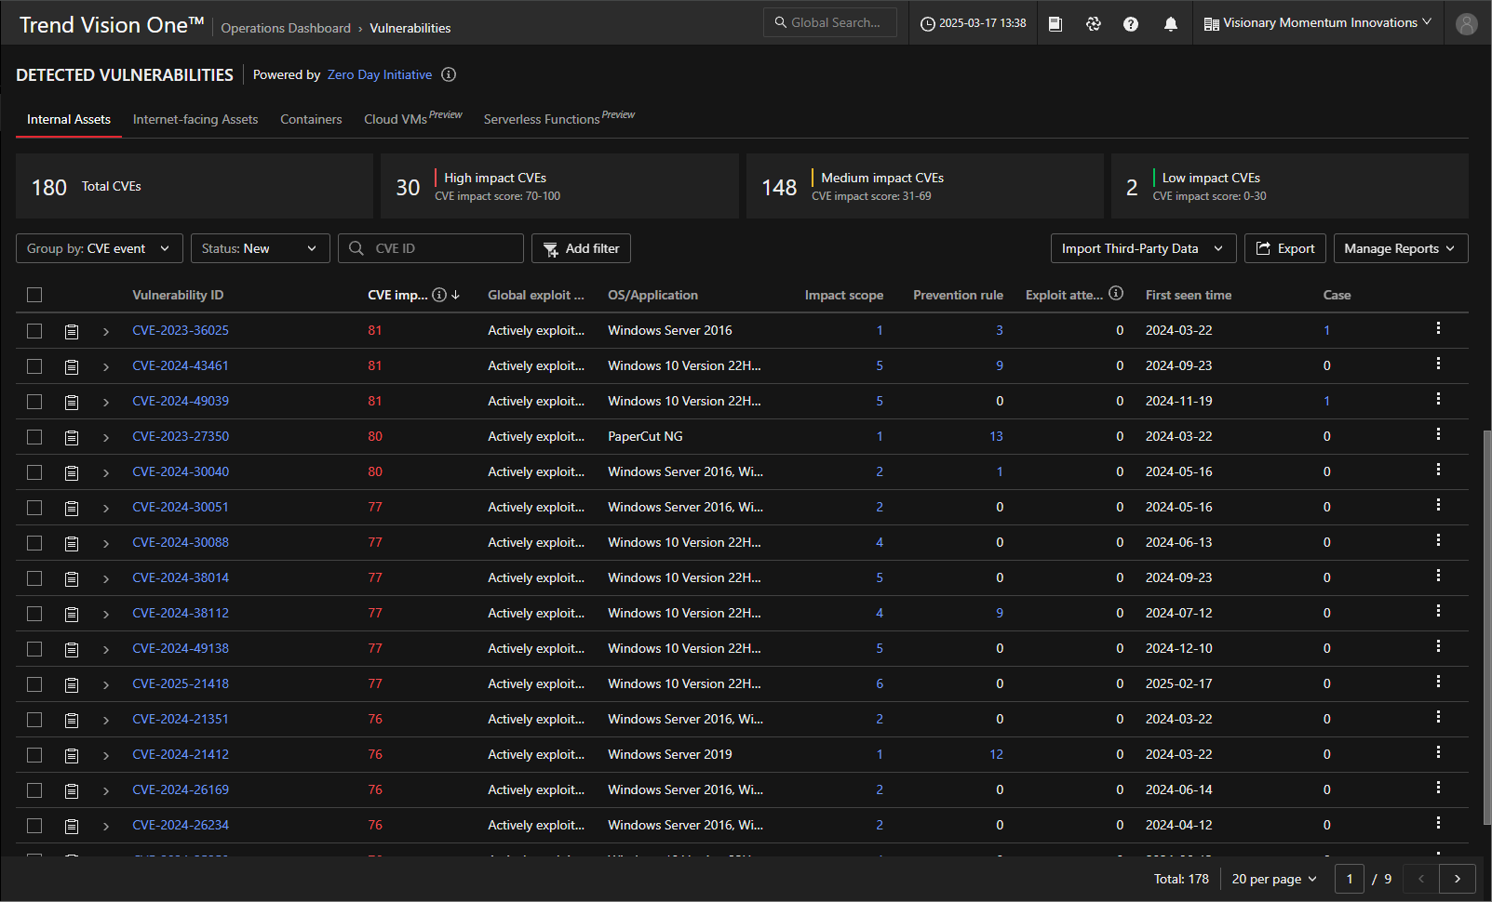
Trend Vision OneTM Impact erkennen
Enterprise Cybersecurity Platform

Slide 19
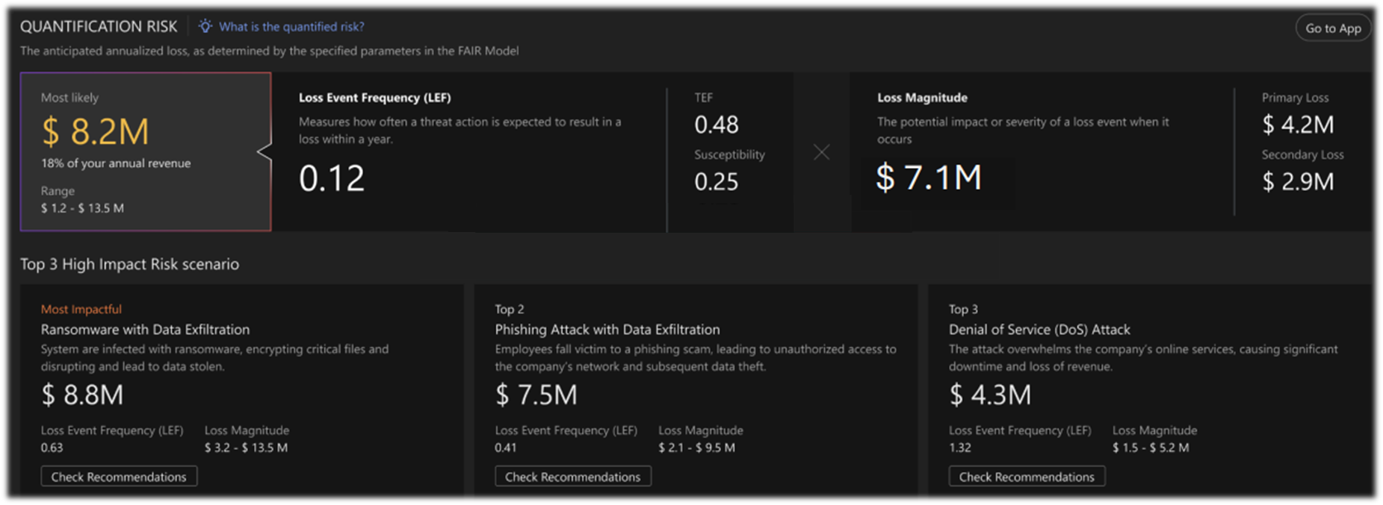
Trend Vision OneTM Risiko kommunizieren
Enterprise Cybersecurity Platform
Roadmap → Änderungen vorbehalten

Slide 20
IST DAS SCHON ALLES?

Slide 21

Trend Vision OneTM innovative KI
Enterprise Cybersecurity Platform
35+ Years of
Cybersecurity Expertise
20+ Years of
AI Expertise
Trend Cybertron
Trend Micro ZDI & Vulnerability
Zero-day vulnerability
In the wild vulnerabilities
OS, app, open source
Specialized Cybersecurity LLM
Generative AI
Trend Companion
Cybersecurity LLM
Attack Path Prediction
Threat Actors & Campaign
APT
Cybercrime
Latest attack techniques
Machine Learning
Anomaly Detection
Predicted ML detection
BEC writing style detection
Steadfast Leadership
#1 in vulnerability disclosure
Leader in ASM
Leading in Endpoint, Network, & Cloud Security
Computer Vision
Deepfake detection
Phishing site detection
Scam detection

Slide 22
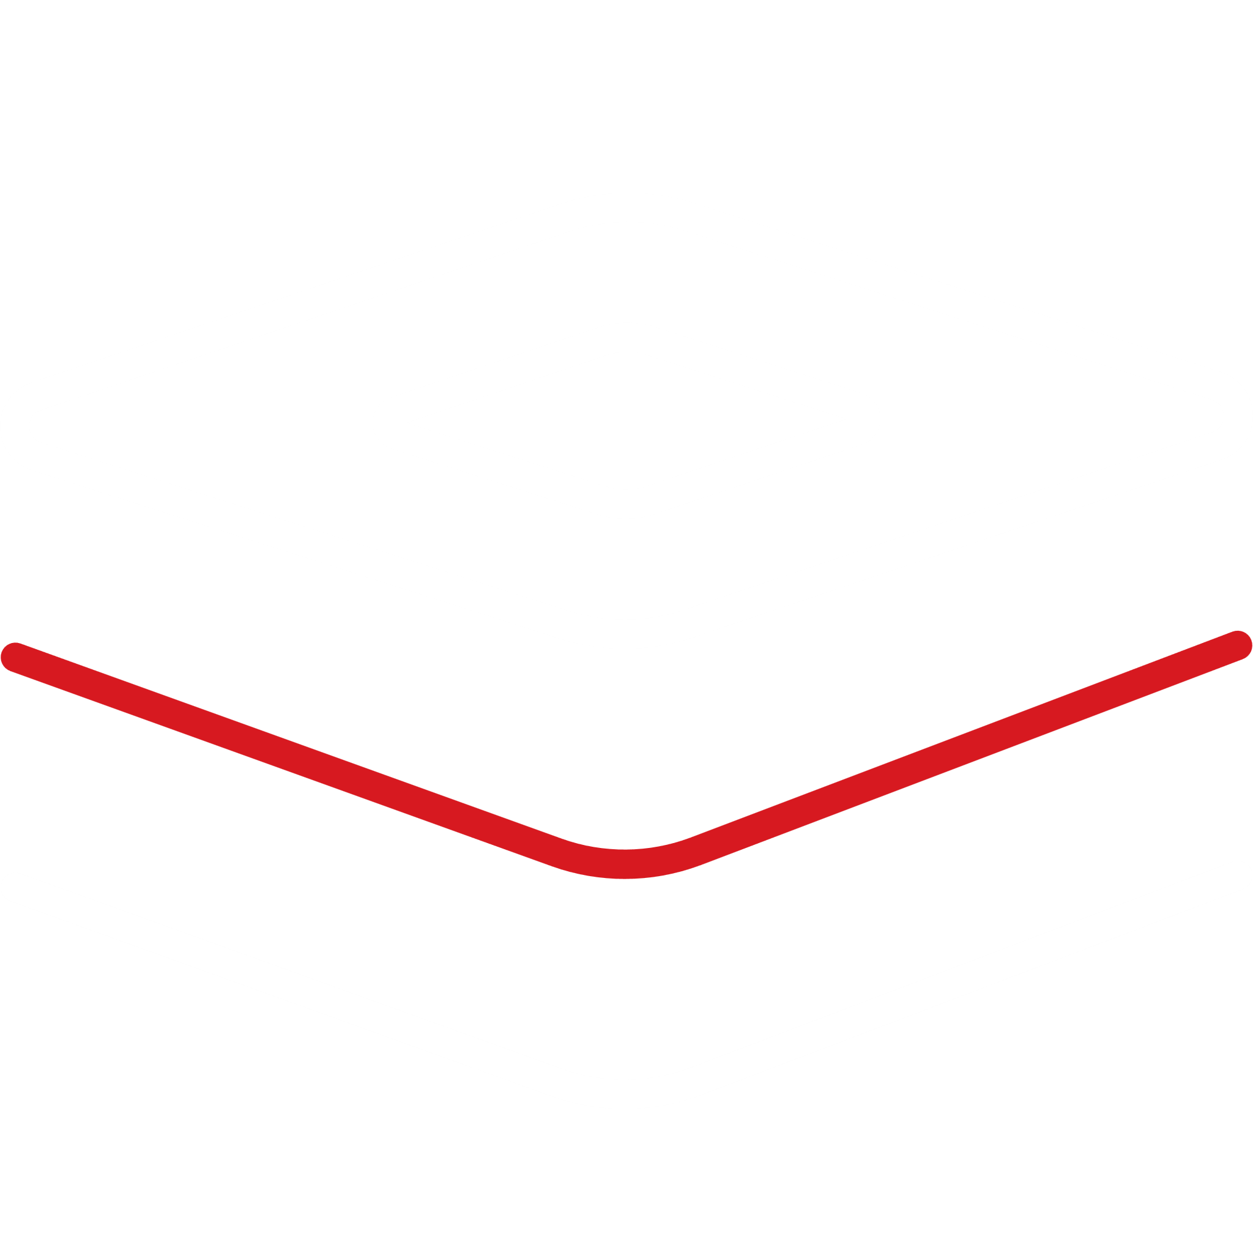
Trend Vision OneTM innovative KI
Enterprise Cybersecurity Platform
Trend
Cybertron
Trend
Vision OneTM
Industry's First Proactive Cybersecurity AI
Trend Cybertron combines the reasoning capabilities of Agentic AI with 35 years of data, threat intelligence, and human expertise to build a vastly capable cybersecurity agent. Integrated with the Trend Vision One™ platform, it uses precise risk assessments and global threat intelligence to predict and prevent threats across your entire attack surface.
Predict & Prevent Threats
Optimize Threat Response
Drive Innovation

Slide 23
Trend Vision OneTM vernetzte KI
Enterprise Cybersecurity Platform

Slide 24
PROACTIVE SECURITY STARTS HERE

Slide 25
Richard Werner
Richard_Werner@trendmicro.com
Notes:
Closing slide

