Slide 1



Hello,
¹
I’m Mia from Aikido Security,
²
your all-in-one
³
software security platform.
⁴
⁵
secure code, containers, clouds & domains
⁶
⁷
⁸
↳ aikido.dev

Slide 2



Slide 3
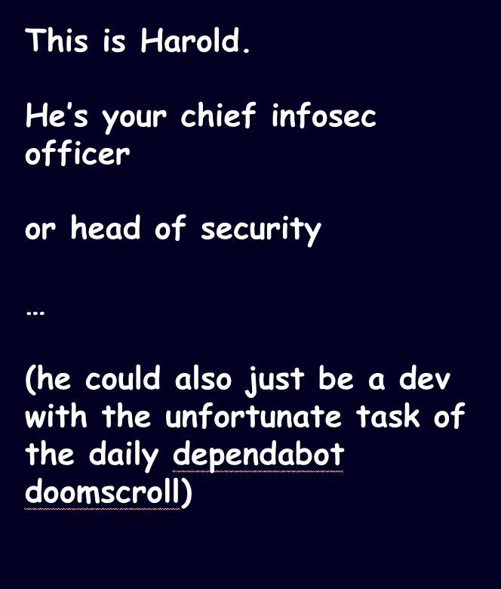


Slide 4
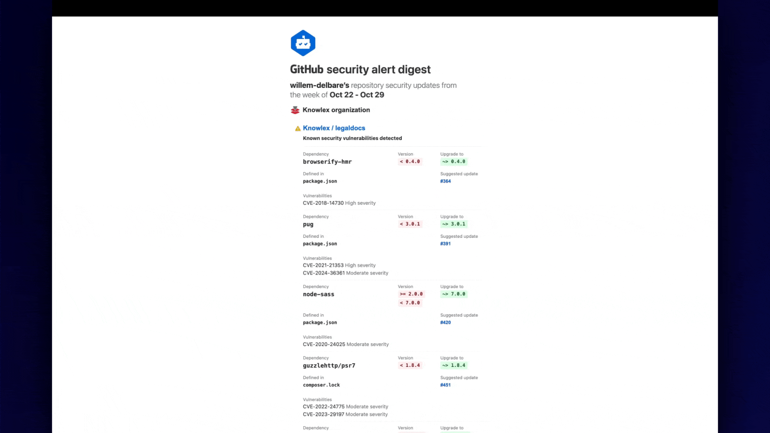

Slide 5
kinda relatable, right?

Slide 6

yeah…
This is Roeland.
Co-founder of Aikido Security.
And less than 4 years ago he faced the same pains as Harold.
so……

Slide 7
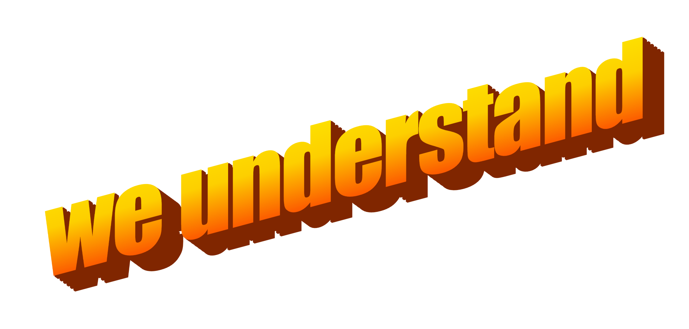

Slide 8












The Problem
Scattered tooling
Confusing
Lots of point solutions.
Some productized, some open-source.
Unwieldy UI & Fighter jet cockpits.
Make you feel dumb.
Noisy
Pricey
Loads of false positives.
Notification overload & alert fatigue.
Costs a ton of money.
Intransparent models.

Slide 9


Security tools today are
covering only few areas,
hard to use,
expensive,
creating tons of false positives,
built on legacy tech,
sales-heavy,
not built for mid-market teams.
Notes:
That’s actually what we were facing when we were tackling this problem at the previous scale-ups we worked at. We spent months finding the right tooling, eventually ended up buying Snyk, Orca and BlackDuck. Spent lots of money on it. Then we were drowning in alerts & false-positives, and had to hire a security engineer to deal with that.

Slide 10

???

Slide 11


Slide 12


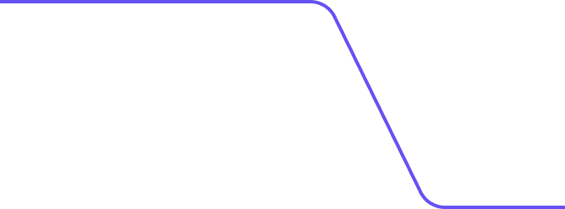




The Solution
¹
10 tools in 1
²
False-positives cancelled
³
UI & UX stellar
⁴
Tech & Vendor agnostic
⁵
Price not ridiculous
⁶

Slide 13
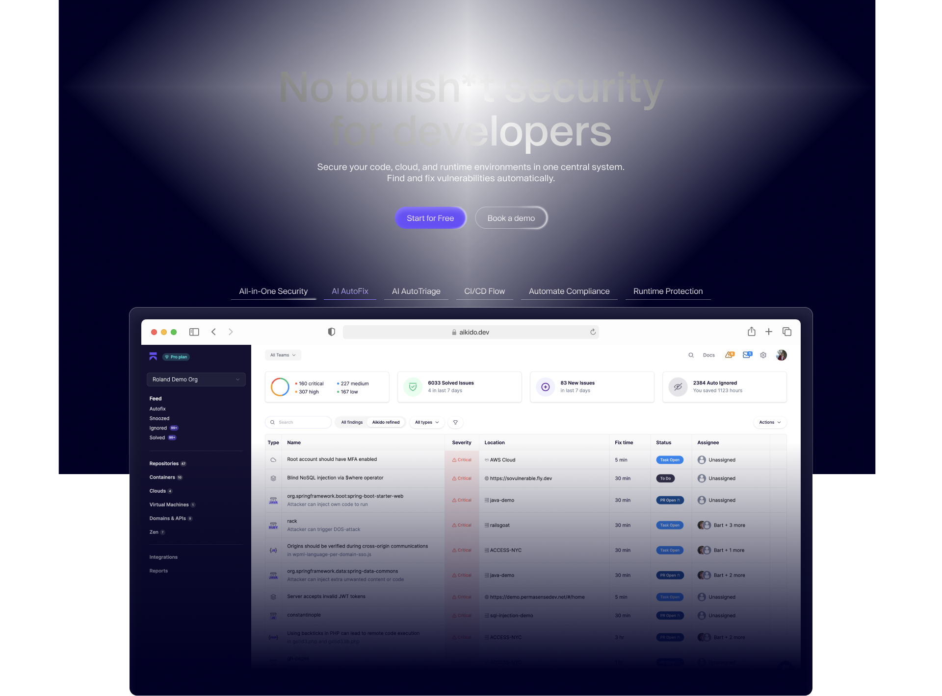


Slide 14
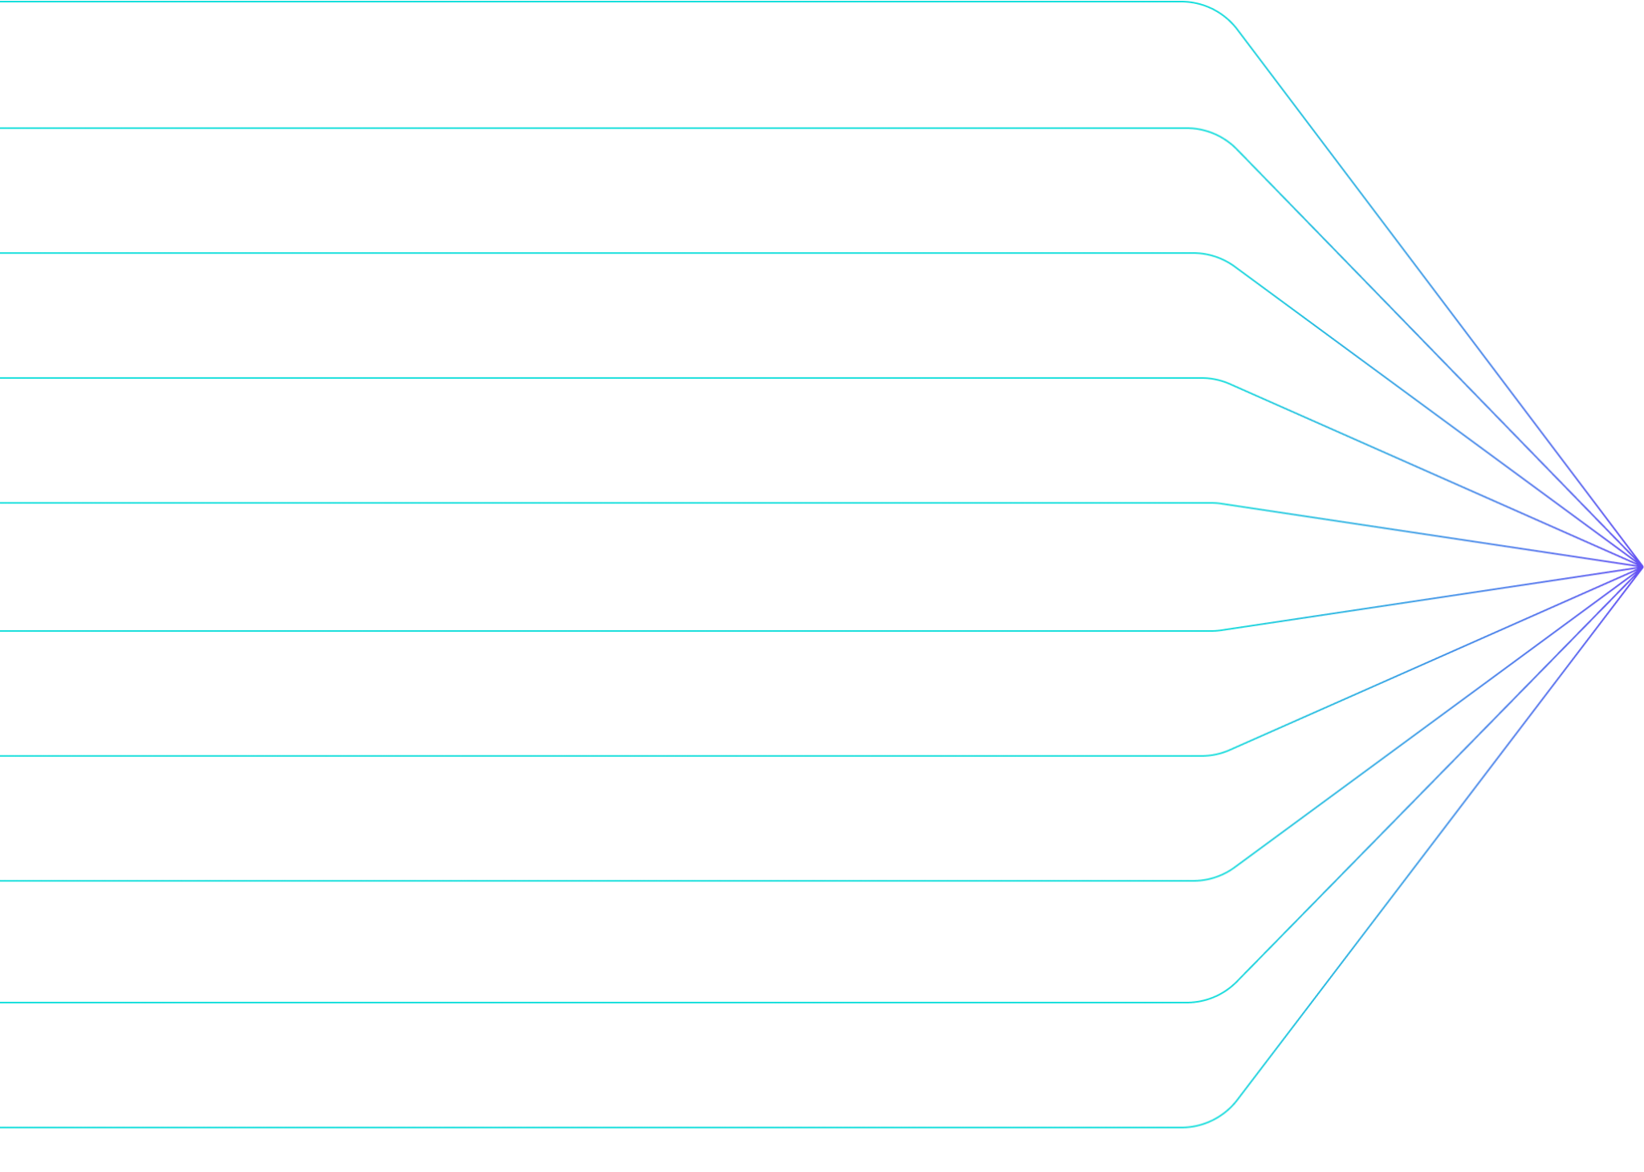
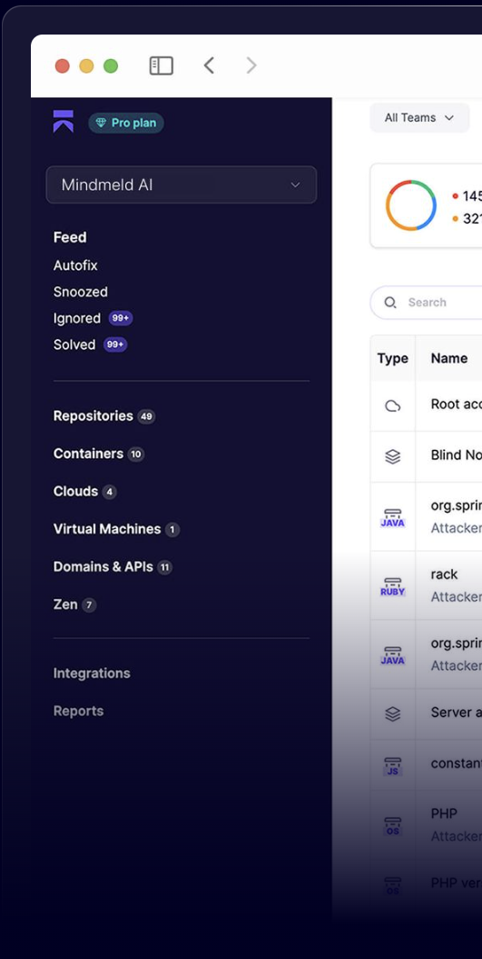
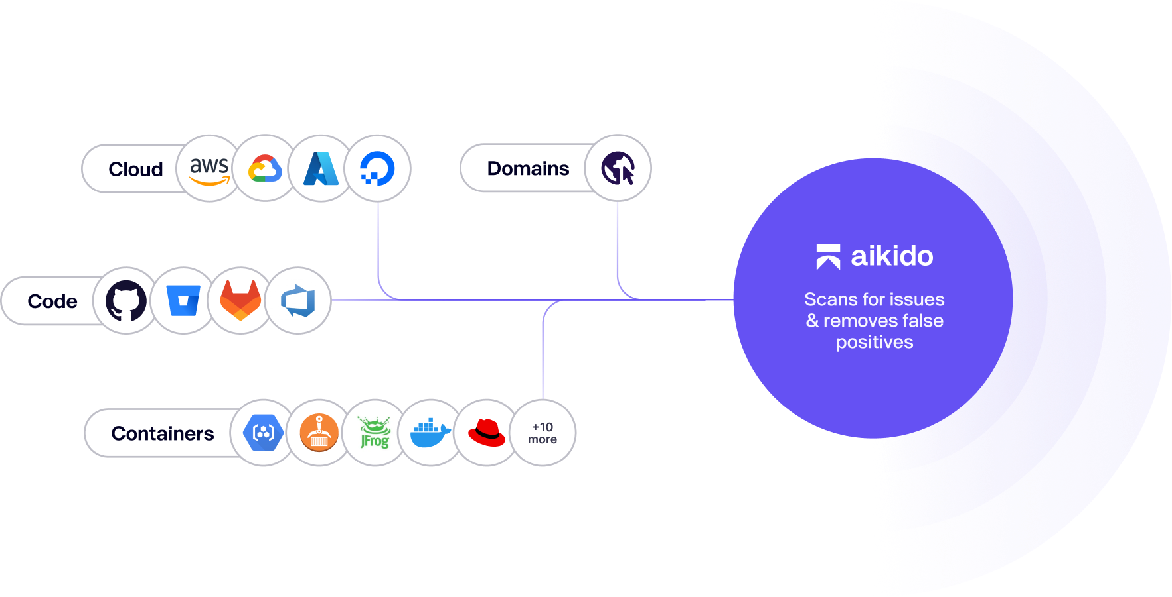


Scan everywhere you build, host & run
Open-source dependency scanning (SCA)
Open-source license checks
Secrets detection
Surface monitoring (DAST)
APIs
Static code analysis (SAST)
Cloud Misconfig checks (CSPM)
Infrastructure as Code scanning
Virtual Machine scanning
Container scanning
Malware scanning
APIs scanning
Notes:
scan
validate, triage
auto remediate
test
long list short list remediated list

Slide 15
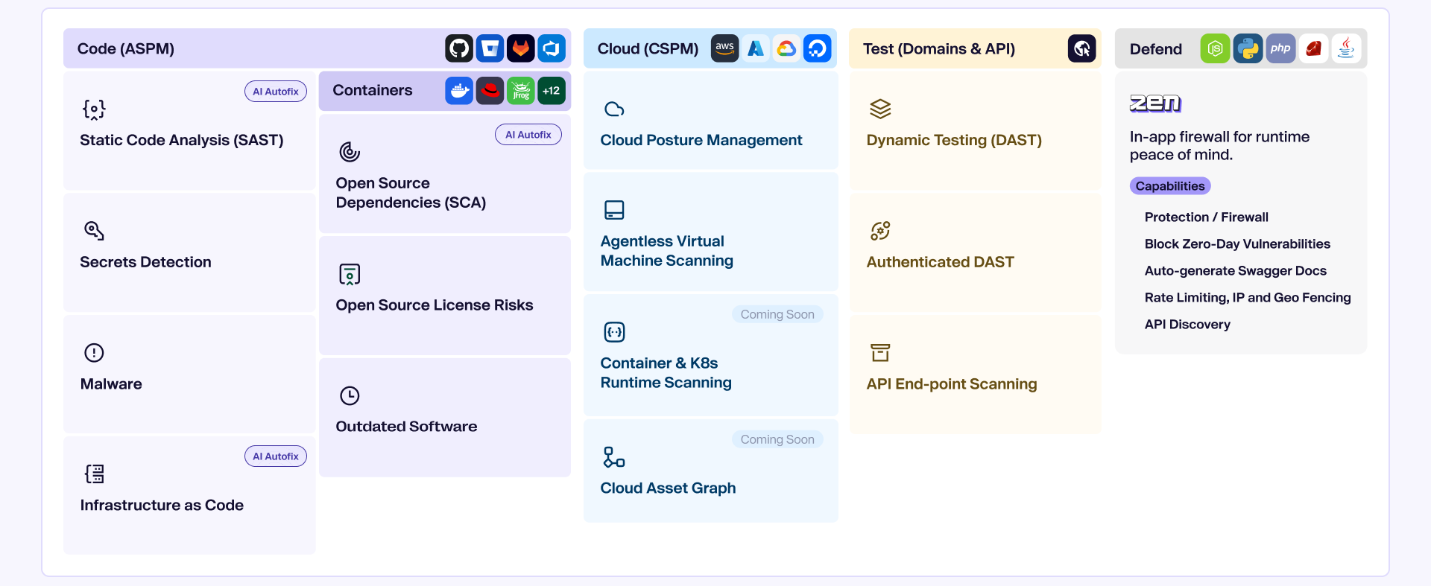
Secure everything end-to-end– one platform for
code cloud & runtime

Slide 16

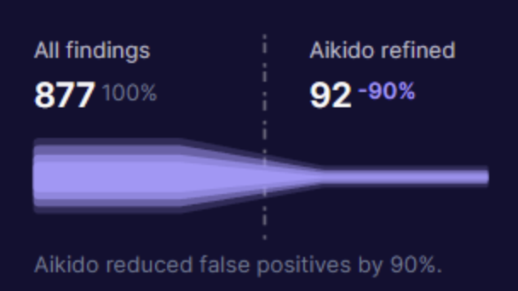
Automatic triaging and fixing false positives
# | Reason for ignoring | # issues | Description
1 | Affected function not in use | 84 | Reachability analysis has determined that this vulnerability can not affect your environment.
2 | Dependency not used in production | 67 | This package is a part of the toolchain you are using to build & test your application. Since it’s not being shipped into the production, solving the issue is not urgent.
3 | Exploits effects only end-user browser speed | 44 | This exploit can only cause the application to become slower in the end-user’s browser. Since there is no security risk and can only affect uptime for 1 user at a time, Aikido has downgraded its severity.
4 | Frontend path traversal attacks | 34 | This exploit can cause path traversal attacks, but Aikido assumed there is no direct filesystem access from the browser, so those attacks are of no importance.
5 | Library not typically used in packaged frontend ... | 21 | This library is usually not used in any packaged front-end application because it mimics browser behavior in nodejs. Thus, Aikido assumes it is unused, and thus not important to fix.
6 | CVE not valid | 18 | This CVE number has either been reserved for a future publication or has been retracted.

Slide 17
in other words…

Slide 18


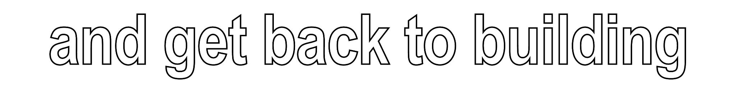

Slide 19

this could be your life.
www.aikido.dev

Slide 20
thanks for listening
🇩🇪💜🥨

Slide 21

🔥
🔥
🔥
🔥
🔥
🔥
🔥
🔥
🔥
🔥
🔥
🔥
🔥
🔥
🔥

