Slide 1

Cyber Resilienz im digitalen Zeitalter
Ronny Wettermann
Zerto Sr. Sales Executive

Slide 2

Agenda
1
Zerto Introduction
What is Zerto
What can Zerto do
DR and Backup
Ransomware Resilience with Zerto
2
Zerto Cyber Resilience Vault
What is a Cyber Resilience Vault
Challenges with Cyber Recovery
HPE CRV Architecture
HPE CRV Recovery
3
Q&A

Slide 3

Zerto Introduction

Slide 4
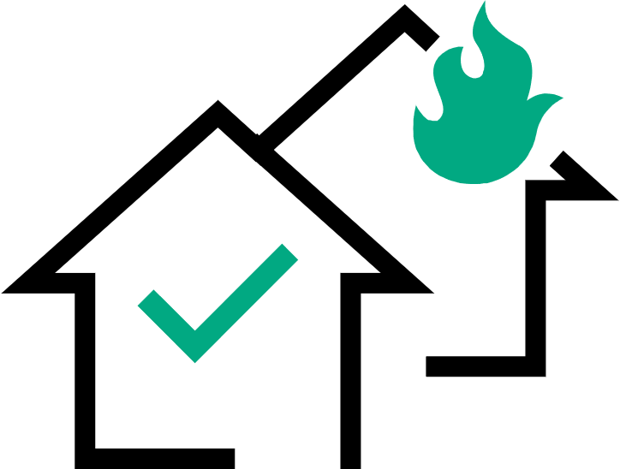









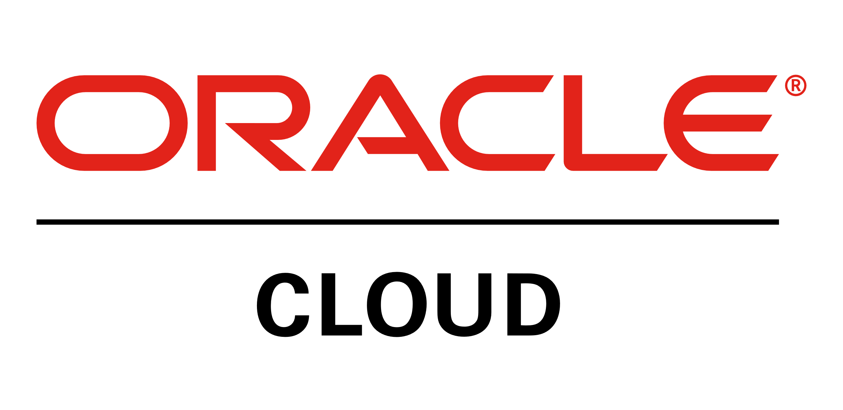


Continuous availability from edge to cloud
Orchestration | Automation | Analytics
Disaster
Recovery
Ransomware
Resilience
Multi-Cloud
Mobility
Radically reduce data loss and downtime with lowest RTOs and RPOs
Real-time detection,
protection, and cyber recovery
Freedom to move and
protect across clouds
Continuous Data Protection
MSP
Notes:
In particular, we’re meeting the challenges you face, across all the platforms you use, with a laser focus on three key use cases: disaster recovery, ransomware resilience, and multi-cloud mobility. We’re focused on these to ensure that all our customers can achieve continuous protection for any app, any cloud, and any threat. All of this based on a foundation of continuous data protection, or CDP, the space that Zerto has pioneered and been a market leader in for over a decade.

Slide 5

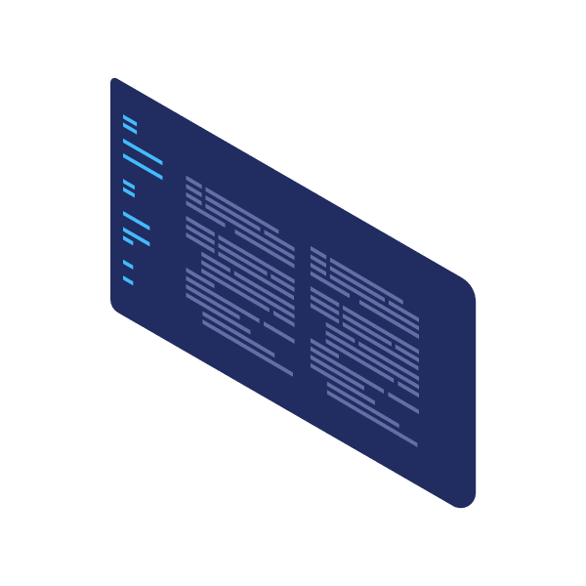
Continuous data protection
Best-in-class CDP using near-synchronous replication
Protect on-premises, to the cloud, or both simultaneously
No scheduling, snapshots, or agents
No production impact or VM stun
Hardware & storage
of your choice
Inline, real-time encryption detection & alerting
Real-time replication of every data change
Confidential - For Training Purposes Only
Notes:
The continuous data protection we’ve been talking about is made possible with Zerto’s block-level replication. And this is near-synchronous replication, so it’s the best of both synchronous and asynchronous approaches. Because we sit at the hypervisor level, we can be a fully software-only solution that is totally independent of the underlying hardware and infrastructure, including storage. That’s part of why Zerto works so well across hypervisors, clouds, and platforms—you have the choice to do what’s best for your business while Zerto effortlessly works in the background without impacting production. And remember, that continuous work in the background is completely hands-off for you: no fiddling with backup windows or tweaking schedules, no managing snapshot chains or wrangling a mess of agents. You simply set it up, replicate, and it stays always-on to keep you always protected.

Slide 6
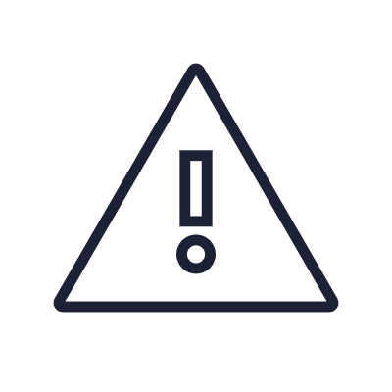
Unique journaling
Granular, point-in-time recovery with the dynamic Zerto journal
10:00:00
DISASTER HITS
10:00:00 BACKUP
Up to 24 hrs data loss
6:00:00 SNAPSHOT
Up to 4 hrs data loss
9:59:55 REWIND
BACK SECONDS WITH ZERTO
Detect
anomalous encryption in real-time to alert to possible ransomware
Respond
quickly to minimize data loss & downtime with low RPOs and
fast RTOs
Recover
in minutes to a clean state seconds before an attack or disruption
Notes:
Part of what makes CDP with Zerto so powerful is the unique journaling capabilities we have. Just being able to capture a write or an IO does not mean you have true CDP. It has to be paired with a dynamic, battle-tested, hyper-efficient journal. The Zerto journal tracks every single change made in your application or on your server, and it logs these as checkpoints every 5 or 10 seconds—even when you have hundreds or thousands of servers. This innovative journal can store the changed data for 1 hour up to 30 days and it offers you unmatched granularity when it comes to recovery. Whenever needed, you can simply rewind to an old checkpoint and easily recover from that exact point in time. For example, if ransomware hits at 10am, it’s very easy to rollback to 9:59 and 55 seconds and completely mitigate the infection. That’s really the power of the Zerto journal.

Slide 7
Complementary IT practices
Implementing both backup and DR together ensures depth and breadth
Cyber Recovery
Disaster
Recovery
Backup
Archive
RECOVERY:
Minutes Hours Days Weeks Months Years
RETENTION:
Minutes Hours Days Weeks Months Years

Slide 8
WHY IS BACKUP NOT ENOUGH?
Systems Unavailable
Systems Online
Systems Operational
Last Backup
RPO
RTO
WRT
Data Loss
Recovery Time
Sync / Test Apps
Hours
Hours
Days / Weeks
Time
Normal
Operations
Disruptive
Event
Recovery
Resume
Production
RPO = Recovery Point Objective
RTO = Recovery Time Objective
WRT = Work Recovery Time
Notes:
Part of what makes CDP with Zerto so powerful is the unique journaling capabilities we have. Just being able to capture a write or an IO does not mean you have true CDP. It has to be paired with a dynamic, battle-tested, hyper-efficient journal. The Zerto journal tracks every single change made in your application or on your server, and it logs these as checkpoints every 5 or 10 seconds—even when you have hundreds or thousands of servers. This innovative journal can store the changed data for 1 hour up to 30 days and it offers you unmatched granularity when it comes to recovery. Whenever needed, you can simply rewind to an old checkpoint and easily recover from that exact point in time. For example, if ransomware hits at 10am, it’s very easy to rollback to 9:59 and 55 seconds and completely mitigate the infection. That’s really the power of the Zerto journal.

Slide 9

Application Consistency Grouping

Slide 10

Backup is not disaster recovery
Legacy approaches leave protection gaps by not focusing on apps
BACKUP
STARTED
BACKUP
ENDED
App
Server
2 HOURS
Web
Server
50 MINS
DB
Server
2 HOURS
File
Server
11 PM
12 AM
1 AM
2 AM
3 AM
4 AM
5 AM
Inconsistent Recovery
Only VM or LUN-level granularity
Staggered backup windows aren’t designed for DR
Misaligned recovery points = extended RTO
Notes:
Lastly, when we talk about true CDP we have to keep a focus on the applications themselves and not think of individual servers in isolation. Modern apps are likely comprised of multiple VMs or containerized pods, all interdependent—think of a frontend connected to a database, with a load balancer and file server in the mix as well. Legacy data protection makes life harder for IT teams like yours by offering restore points from very inconsistent points in time, extending RTO and complicating recovery.

Slide 11

Application-centric protection
Replicate & recover multi-VM app stacks as one consistent whole
App
Server
App
Server
App
Server
App
Server
App
Server
Web
Server
Web
Server
Web
Server
Web
Server
Web
Server
DB
Server
DB
Server
DB
Server
DB
Server
DB
Server
File
Server
File
Server
File
Server
File
Server
File
Server
2:48:00 AM
2:48:05 AM
2:48:10 AM
2:48:15 AM
2:48:20 AM
Write-order fidelity & validation across all VMs or containers in an app
Consistent restore points even for VMs on different
datastores or hosts
No staggered backup windows and no
scheduled replication jobs
Notes:
Zerto, on the other hand, solves for the challenge of recovering complex enterprise apps by protecting your workloads as a cohesive, logical entity. That way, you avoid the inconsistent recovery of multi-VM applications where each VM is being restored to a different point in time.
And this is more than just bundling VMs together as a group to help with management—although that’s part of it. With Zerto, when creating recovery points, all the VMs will share the same validated checkpoint with write order fidelity across all of them regardless of which underlying hosts or datastores are being used—no small feat. When the application is recovered, every VM that makes up the application spins up from that same cross-VM recovery point. All these can come up as a whole, in the boot order of your choice, without any extra work on your part.
This allows you to protect and recover complex multi-VM applications together as one unit to the exact same point in time. It saves a ton of resources when you’re trying to reduce the amount of time dedicated to recovery.

Slide 12
Architecture Overview

Slide 13
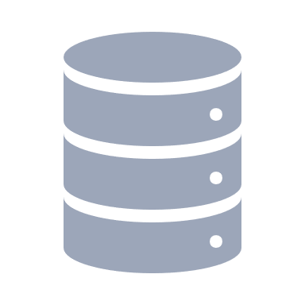
Software-Only, Scale-Out Architecture
1
Zerto Virtual Manager (ZVM)
Management component
Runs on Windows server or Linux OVF appliance
1:1 relation with vCenter/SCVMM
Installs in minutes
Security-hardened, including MFA and RBAC
Virtual Replication Appliance (VRA)
Scale-out architecture
1:1 relation with hosts
Small footprint, low overhead
Built-in compression and encryption
Continuous block-level replication
Auto-deployment and auto-load balancing
DATACENTER
v C E N T E R
S C V M M
Z V M
1
H O S T
V M
V M
V R A
2
2
D A T A S T O R E
P H Y S I C A L
S T O R A G E

Slide 14


Isolate and lock
PRODUCTION
CLOUD DR
v C E N T E R
S C V M M
Z V M
Z C A
Real-Time Detection & Replication
Continuous sync with no performance impact
H O S T
H O S T
Scale-Out Architecture
Small footprint, low overhead components with no compute at DR until recovery
V M
V M
V R A
V R A
Isolation & immutability utilizing cloud
D A T A S T O R E
D A T A S T O R E
Replica
Compressed journal
<= 30-day retention
P H Y S I C A L
S T O R A G E
P H Y S I C A L
S T O R A G E
Immutable Copy on
Azure Blobs, Amazon S3, or S3-compatible
(e.g. Scality)

Slide 15

Non-Disruptive Testing
Easily stress test your recovery plans or create on-demand sandboxes
ISOLATED NETWORK
FAILOVER TEST
V M
V M
V M
PRODUCTION
DR
Orchestrated & automated failover tests

Slide 16
Encryption Detection with Zerto

Slide 17
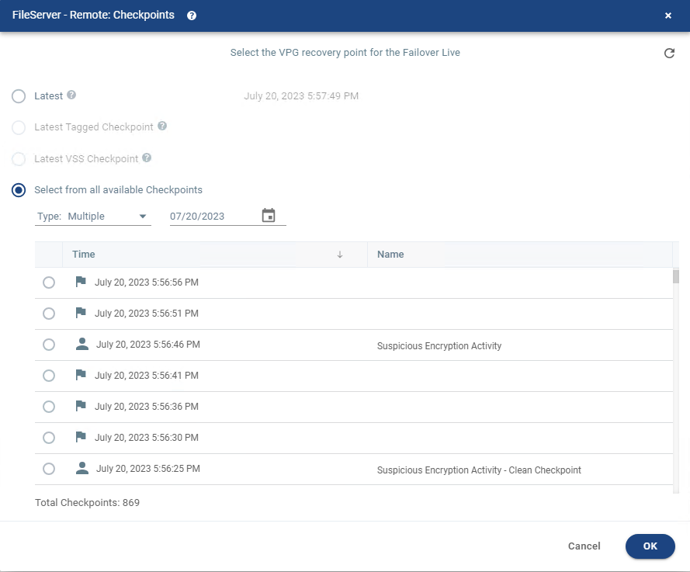


Replicate and detect
Zerto Journal
– □ X
Replicate every change and log as recovery checkpoints every 5-15 seconds
05/18/23 9:54:55
05/18/23 9:54:51
Real-time replication combined with real-time encryption detection
05/18/23 9:53:45
Suspicious anomaly
05/18/23 9:53:38
Detect suspicious writes as they stream in and flag for admins to investigate
05/18/23 9:53:31
05/18/23 9:53:26
“[Zerto’s] real-time ransomware detection puts us in a much stronger position to both identify and mitigate ransomware attacks. This gives us confidence that we can proactively meet the risks presented by ransomware.”
– NETWORK ADMIN AT MANUFACTURING CUSTOMER

Slide 18

Replicate and detect
Detect at the point of encryption, not after backing up
Seconds
Minutes
Hours
Days
Real-time detection and alerting at the first moment of impact
BACKUP
Easily identify blast radius and tag compromised applications
No additional infrastructure required—and no extra cost
API-first design: easily integrate with existing security stack

Slide 19
Zerto Cyber Resilience Vault
Achieving Ransomware Resilience

Slide 20



What is a Cyber Resilience Vault?
Isolated
Isolated, offline, and air gapped with immutable data copies using zero
trust architecture
Purpose-built for cyber recovery—option of
last resort in worst-case scenarios
Air gapped
Your data
Immutable
Zero trust

Slide 21
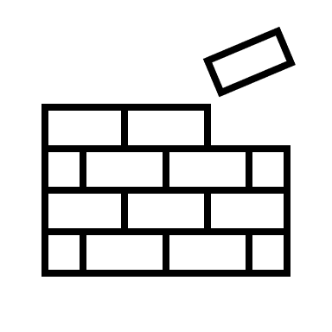


Legacy vault architecture
1. Always-on management layer can be compromised, especially if attackers are behind the firewall
1
2. Backup appliance likely to be slower disks and slower ingress time
PRODUCTION
BACKUP
v C E N T E R
Mgmt Server
Mgmt Server
3. Backup agents are a potential vulnerability to targeted ransomware attacks
Physical Proxy
Physical Proxy
4. Slow post-processing data security scans — likely max 1.5 TB/hour
HOST
HOST
5
Backup Proxy
VM
Backup
Agent
3
4
Scanning Server
Backup Proxy
5. Lengthy backup windows (i.e., daily) = high RPO with prod impact
2
6 Could be PBBA or cloud storage – slower than production-grade infrastructure
7
BACKUP APPLIANCES
7. Cloud vaults will likely rely on internet connection & speeds and will always be connected
6
Confidential - For Training Purposes Only

Slide 22



Three pillars of cyber resilience
#1 Replicate and detect
Streaming near synchronous data replication protects every production write in real time and immediately detects and alerts on any suspicious anomalies.
Three pillars of resilience
#3 Test and recover
Easily identify clean restore points and then quickly recover entire
multi-VM apps onto high-performance storage—all while maintaining cross-VM consistency.
#2 Isolate and lock
Separated vault is fully
air gapped and stores
immutable data copies on secure, high-performance,
FIPS-validated hardware.

Slide 23



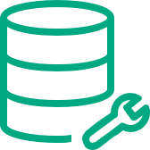
Zerto Cyber Resilience Vault architecture
High-level overview
CYBER RESILIENCE VAULT
LANDING ZONE
VAULT ZONE
v C E N T E R
Z E R T O
HPE ARUBA
NETWORKING
HPE PROLIANT
HPE PROLIANT
HPE ALLETRA MP
HPE ALLETRA MP
Notes:
At a very high-level, this the “technology stack” or architecture diagram of the Zerto Cyber Resilience Vault
Note all the HPE technologies present

Slide 24



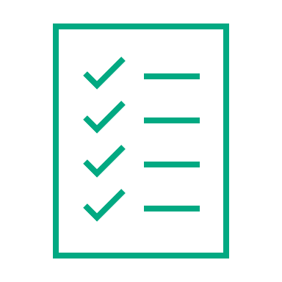



Zerto Cyber Resilience Vault architecture
With XDR/security solution in online landing zone
CYBER RESILIENCE VAULT
PRODUCTION
LANDING ZONE
VAULT ZONE
v C E N T E R
Z V M
v C E N T E R
Z V M
HPE ARUBA
NETWORKING
HOST
HOST
HOST
Encrypted continuous replication
V M
V M
V R A
V R A
HPE PROLIANT
V R A
HPE PROLIANT
Real-time encryption detection & alerting
D A T A S T O R E
D A T A S T O R E
D A T A S T O R E
Security
Scan
Periodic storage replication (RCIP)
HPE ALLETRA
HPE ALLETRA
Storage
Backup Server
Full air gap with port-to-port direct connect
Replica
Virtual Lock: immutable snapshots of all replicas, journals, and all Zerto components needed for recovery
Compressed journal
<= 30-day retention
Notes:
Backup servers can also be integrated with their security tools

Slide 25

Zerto Cyber Resilience Vault ROI
Rapid recovery = less ransomware impact
 | Leading Backup-Based Cyber Vault * | Zerto | Zerto Benefits
Average Data Loss | 2+ days | 4 hours or less | >87% Reduction
Availability of Data | 22+ days | 2 hours | >99% Reduction
Total Ransomware Impact | 3 – 5+ Weeks | 6 hours or less | >99% Reduction
Journal-Based Recovery | NO | YES | Only journal-based solution for cyber recovery
* Real-life example based on customer protecting 300 VMs and 300 TBs

Slide 26
Thank you
Daniel Mueller
Sr. Systems Engineer
+49 152 59228928
daniel.mueller@hpe.com
Ronny Wettermann
Zerto Sr. Sales Executive
+49 160 98151754
ronny.wettermann@hpe.com
a00137922enw

