Slide 1

Hunting The Adversary: Cross-Domain Visibility
Haseeb Ahmad | Sales Engineer, CrowdStrike
Kai Engel | PreSales, Serviceware
Notes:
Falcon Adversary OverWatch Next-Gen SIEM is a major leap forward in proactive threat hunting.
It’s designed to stay ahead of adversaries who are constantly adapting, evolving, and finding new ways to bypass traditional defenses.
Before we dive into the new solution, let’s take a closer look at today’s threat landscape — and why a proactive defense strategy has become absolutely critical to staying secure.

Slide 2

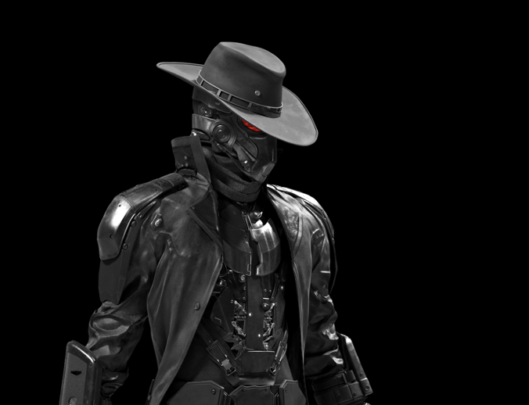




Threat Actor Motivation
Nation-State
eCrime
Hacktivist
® CrowdStrike, Inc. All rights reserved.
Notes:
Adversaries operate with different motivations and tactics. Nation-state actors engage in espionage, sabotage, and disruptive or destructive attacks. In the case of North Korea, they also conduct financially motivated cyber operations to generate revenue for the regime.
Then we have eCrime actors—financially motivated, non-state threat actors. Early on, they focused on credential theft and wire fraud, but their tactics have evolved into ransomware and data extortion. Over the past year, we've seen them expand into new areas, including cloud environments, SaaS platforms, and even leveraging generative AI.
Finally, there's hacktivism—a broad category that encompasses activism, nationalism, and, in some cases, terrorism. Hacktivists typically carry out disruptive attacks such as denial-of-service (DDoS) campaigns, website defacements, and, increasingly, hack-and-leak operations designed to discredit or delegitimize their targets.

Slide 3

2025 GLOBAL THREAT REPORT
Die Bedrohungslandschaft in Zahlen
INITIAL
ACCESS
LATERAL
MOVEMENT
STEALTH
442%
Zunahme beim Voice Phishing
(Vishing) in 2024
50%
Zunahme bei Access
Broker Advertisements
52%
Beobachtete Schwachstellen im Zusammenhang mit dem Erstzugriff
51s
Schnellste Breakout Time
79%
Der Detections erfolgte durch Hands-on-Keyboard
® CrowdStrike, Inc. All rights reserved.
Notes:
We’ve just released our 2025 Global Threat Report, highlighting how today’s threats are accelerating and evolving.
Here are five key stats you need to know:
Starting with initial access, we’ve seen
Voice-based phishing is up 442%, with attackers impersonating users to trick IT help desks and gain access.
Access broker activity jumped 50%, as these actors sell entry points to ransomware groups and others.
52% of vulnerabilities exploited last year were tied to initial access.
Breakout time, the time it takes attackers to move laterally, dropped to 48 minutes, with the fastest at just 51 seconds.
And 79% of attacks in 2024 were hands-on-keyboard, reflecting a shift toward more interactive, targeted intrusions.
These numbers show how rapidly threats are evolving—and why defenders must stay one step ahead.

Slide 4
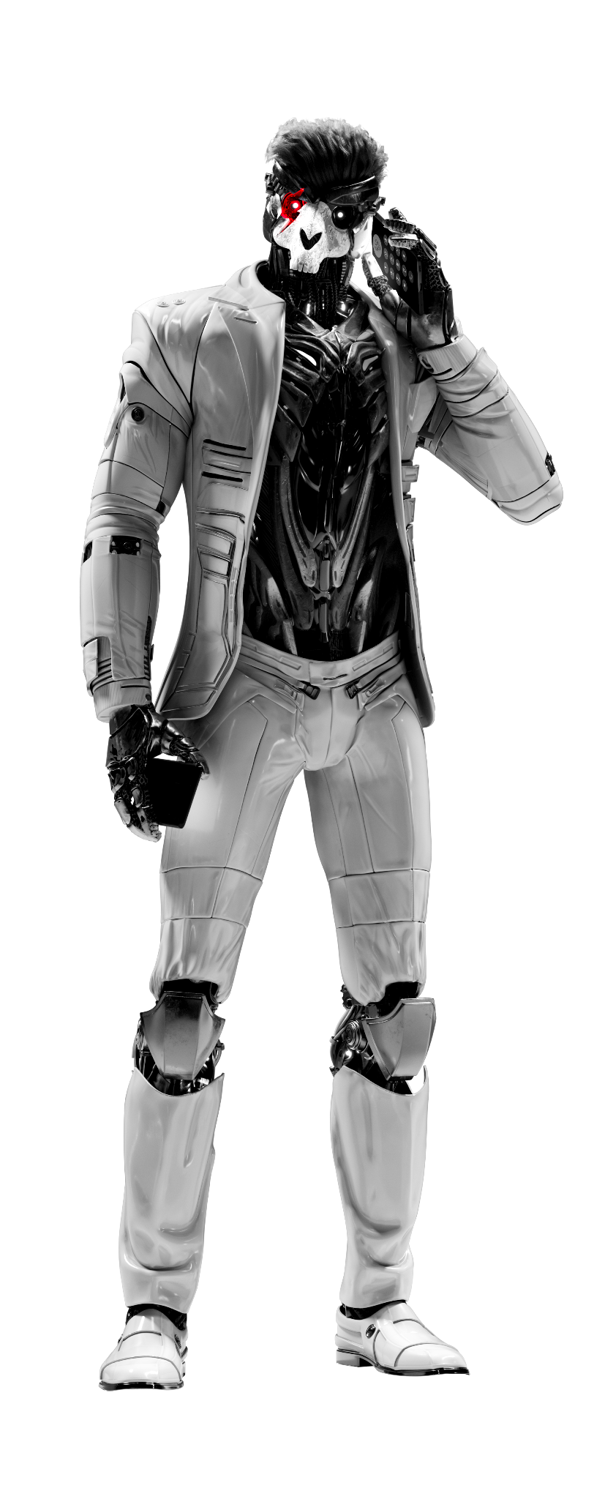

Echtes End-to-End Hunting: Erkennen von Insider Bedrohungen in Echtzeit
Auftragnehmer hat sich mit einem nicht verwalteten Gerät in das Netzwerk eines Kunden eingeloggt
Innerhalb weniger Stunden
Kunde hat die Netzzugänge gesperrt.
INSIDER-
BEDROHUNG engagiert
OverWatch identifizierte sofort die mit FAMOUS CHOLLIMA verknüpfte IP-Adresse anhand von Zugriffsprotokollen von Drittanbietern.
Innerhalb von Minuten
OverWatch führte eine Kreuzvalidierung mit IDP-Daten durch und alarmierte den Kunden
INSIDER-BEDROHUNG beendet
Notes:
Let’s see a real intrusion that Overwatch stopped using third-party data.
FAMOUS CHOLLIMA infiltrated a customer by posing as a contractor. When they logged in from an unmanaged device, OverWatch flagged the activity using third-party access logs and matched the IP to known adversary behavior. Within minutes, our team validated the threat and alerted the customer. Hours later, access was revoked—before any sensitive data was touched.
This is true end-to-end threat disruption, driven by expert hunters and powered by data from everywhere.

Slide 5
Für moderne Angreifer,
ist keine Domain sicher.
Kein Eintrittspunkt ist tabu.
Notes:
Modern adversaries don’t respect domain boundaries. Beyond endpoints, identities, and cloud workloads, they target common entry points like firewalls, routers, and VPNs — places often outside of CrowdStrike’s protection.
That’s why modern defense demands full visibility across the entire attack surface, leaving adversaries nowhere to hide and execute their attacks.

Slide 6




Identity
Angreifer nutzen gültige Anmeldeinformationen, um unbefugten Zugriff zu erlangen
Cross-Domain Hunting
Erkennen Sie das Unsichtbare und ermöglichen Sie umfassende Reaktionen
Endpoint
Bewegen sich lateral, um auf wertvolle Daten zuzugreifen oder Ransomware zur Erpressung einzusetzen
Cloud
Kompromittierte Cloud-basierte User Verzeichnisse um auf Endpoints zuzugreifen.
FIRST-PARTY DATA
Notes:
Today, adversaries aren’t sticking to a single domain. They move fluidly across endpoints, identities, and cloud environments, exploiting every opportunity to gain entry and move fast. Valid credentials are still their weapon of choice — allowing them to blend in, escalate privileges, and laterally move with stealth across domains.
That’s why CrowdStrike leads in cross-domain hunting — using first-party telemetry from endpoint, identity, and cloud, unified on the Falcon® platform, to detect and stop adversaries in real time before attacks can escalate."

Slide 7



Identity
Angreifer nutzen gültige Anmeldeinformationen, um unbefugten Zugriff zu erlangen
All-Domain Hunting
Email
Phishing ist die Haupttaktik, um Zugriff zu erhalten
SaaS
“Exploited” SaaS Applikationen ermöglichen laterale Bewegungen und Datenzugriffe
Erweitern Sie ihre Detections durch die Integrationen von 3rd Party Daten
Endpoint
Bewegt sich lateral, um auf wertvolle Daten zuzugreifen oder Ransomware zur Erpressung einzusetzen.
Cloud
Kompromittierte Cloud-basierte User Verzeichnisse um auf Endpoints zuzugreifen.
FIRST & THIRD-PARTY DATA
Netzwerk
Angreifer greifen Netzwerkgeräte an, um Zugriff zu erhalten.
Notes:
To truly stop today’s adversaries, security teams need expanded detection — not just across domains, but across the entire attack surface.
Attackers are exploiting gaps not only in endpoint, identity, and cloud, but also in SaaS applications, network devices, email gateways, and beyond.
While unified telemetry across first-party endpoint, identity, and cloud is critical, it’s no longer enough on its own.
That’s why we’re taking threat hunting to the next level — integrating both first-party and third-party data sources to expand visibility and uncover threats wherever they attempt to hide.

Slide 8





Next-Gen SIEM
Daten Quellen
Email
Gateway
SaaS
Applications
Identity & Access Mgmt.
Operating Systems
Other Data Ingested
Network
Edge Devices
Identity
Endpoint
Cloud
KI-Native
Plattform
Notes:
OverWatch correlates and hunts on all data ingested by Falcon Next-Gen SIEM, which supports 325+ data sources, and even more through custom or AI-generated parsers.
This expanded coverage includes logs from network edge devices (firewalls, routers, VPNs), identity and access management (Okta, Entra ID), SaaS applications (Microsoft 365, Google Workspace), email security (Mimecast, Proofpoint), operating systems (Windows, Linux), and more.
With this true end-to-end broad visibility, OverWatch leaves adversaries with nowhere to hide, exposing threats earlier and accelerating your ability to respond.

Slide 9

Falcon Adversary OverWatch
24/7 Managed Threat Hunting
über alle Angriffsoberflächen
ENDPOINT
IDENTITY
CLOUD
NG-SIEM
Verfolgt heimliche “hands-on-keyboard” Angriffe auf Endpoints
Erkennt und unterbindet identitätsbasierte Angriffe
Erkennt hybride und Multi-Cloud Runtime und “Control plane” Angriffe
Suche in allen von Next-Gen SIEM erfassten Daten
Notes:
With the new Falcon Adversary OverWatch Next-Gen SIEM solution, that’s exactly what we will deliver.
Falcon Adversary OverWatch Next-Gen SIEM is the industry’s first and only solution to extend proactive threat hunting beyond endpoint, identity, and cloud—now integrating available third-party data from Falcon Next-Gen SIEM to achieve true end-to-end visibility and expose stealthy adversaries everywhere on all attack surfaces.
By analyzing vast amounts of first- and third-party data, OverWatch detects threats earlier in the attack, empowering security teams to stop adversaries before they breach the network.

Slide 10
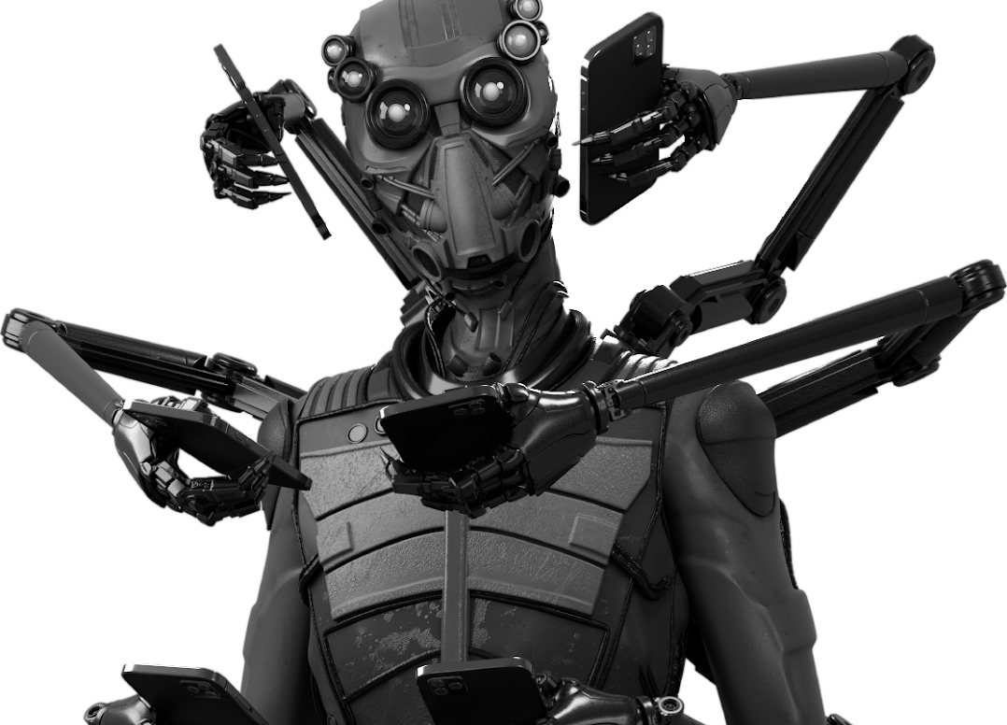
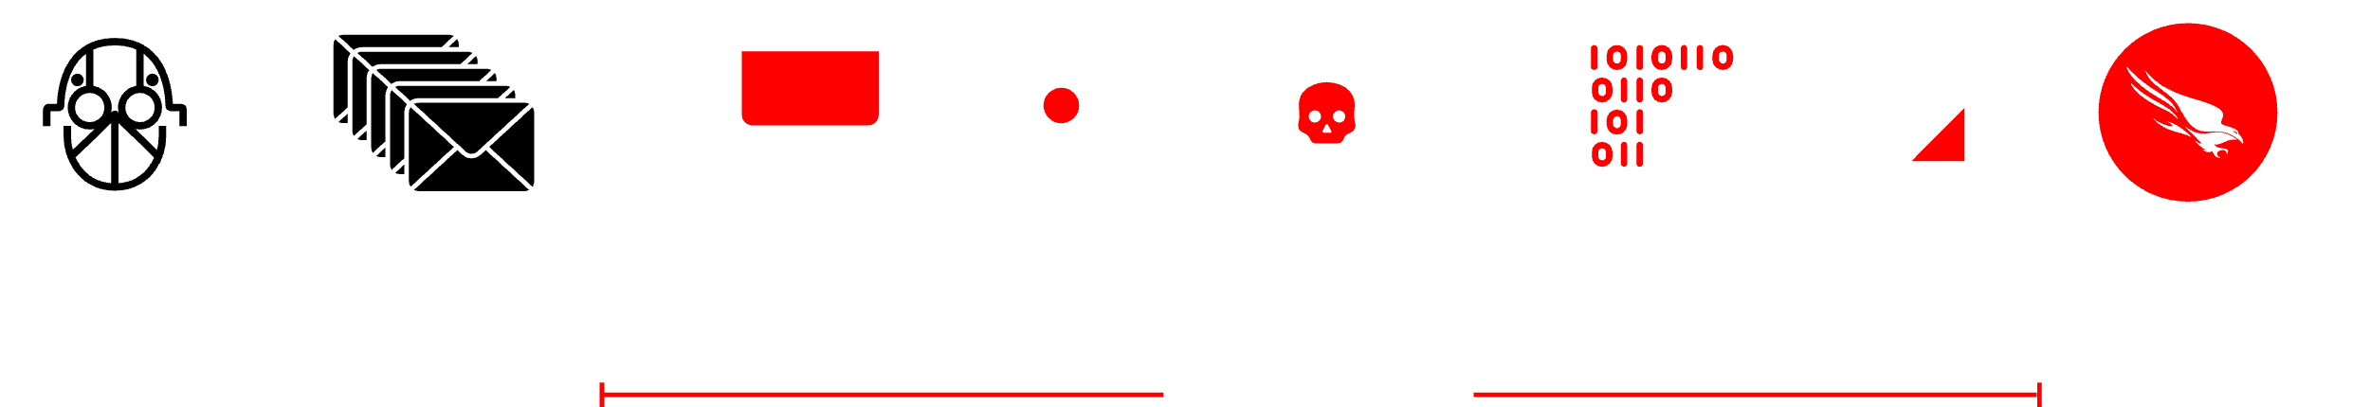
Curly Spider
Spam Bombing
Access
Validate
Curl
Run
Deploy
REMOTE ACCESS ZU QUICK ASSIST
VERBINDUNG ZU ANGREIFER – KONTROLLIERTEN INFRASTRUkTUR
VERWENDEN VON CURL, UM SCHÄDLICHE SKRIPTE HERUNTERZULADEN
SKRIPTS ZUM SETZEN VON REGISTRY RUN KEYS UND ZUM ENTFERNEN VON ARTIFAKTEN
BACKDOOR USER
Adversary
+3:43
+0:06
+0:06
STOP
Vishing Call
CROWDSTRIKE OVERWATCH IDENTIFIZIERT UND BLOCKIERT BACKDOOR-KONTO
OVERWATCH IN AKTION:
STOPPEN EINER SOCIAL ENGINEERING ATTACKE IN UNTER 4 MINUTEN
® CrowdStrike, Inc. All rights reserved.
Notes:
CURLY SPIDER is a prime example of how social engineering tactics have evolved over the past year. This group employs spam bombing as an initial attack vector. They identify a target within an organization and flood their inbox with spam—sometimes for minutes, hours, or even days. Once the target is overwhelmed, the attackers pose as the IT help desk, reaching out to offer assistance.
When the victim confirms they’re experiencing a flood of spam, the attacker provides a malicious link, claiming it will resolve the issue. Once clicked, the adversary gains access to the system and quickly executes additional malicious actions. They use tools like cURL to download further scripts, modify registry keys, remove forensic artifacts, and establish persistence—either by deploying a backdoor or creating a hidden user account.
In this case, the entire initial attack took less than four minutes. The first stage lasted 3 minutes and 43 seconds, followed by two additional actions, each completed in six seconds. Without proactive threat hunting, this could have escalated into a persistent intrusion. Fortunately, Falcon OverWatch detected and alerted defenders within four minutes, preventing further compromise—underscoring the speed at which security teams must operate today.

Slide 11



Erkennen Sie die raffiniertesten Angreifer mit Falcon Adversary OverWatch
All-Domain Threat Hunting
Threat Hunting durch Experten rund um die Uhr auf allen Angriffsflächen, von Endpunkten über Identitäten und Clouds bis hin zu mehr
Unterbrechen externer Bedrohungen
Adversary OverWatch ermöglicht die Überwachung des kriminellen Untergrunds und benachrichtigt, wenn Access Broker gestohlene Zugangsdaten verkaufen oder damit handeln.
AI-Powered Expertise
Weltklasse Security-Spezialisten identifizieren proaktiv neue Threats in Echtzeit und verteilen sofort neue Erkennungsmöglichkeiten.
Mehr Sicherheit und
weniger Arbeit
Weiterentwicklung von Expertise durch Managed Threat Hunting
Schnellere Reaktionen durch informationsgestütztes Threat Hunting
Reduzierung der operativen Last bei SOC Teams
Automatisierte Threat Intelligence
Erhalten von Bedrohungsinformationen innerhalb der Falcon®-Plattform, die schnellere, sichere und bessere Entscheidungen ermöglicht.
Notes:
Falcon Adversary OverWatch Next-Gen SIEM does more than just all-domain threat hunting — it delivers comprehensive, proactive defense to disrupt even the most sophisticated adversaries.
On top of the all-domain threat hunting we’ve been talking about, the OverWatch team also goes on the offensive with external threat disruption — actively monitoring the criminal underground to prevent the exploitation of compromised credentials. It’s not just defense; it’s a counterstrike against adversaries, keeping our customers one step ahead.
Our AI-powered expertise empowers world-class hunters who, armed with cutting-edge technology, proactively identify novel threats in real time and instantly deploy new detections to fortify your defenses.
And with automated threat intelligence integrated directly into the Falcon platform, you get faster, more confident decision-making to continuously strengthen your security posture.
In short, Falcon Adversary OverWatch Next-Gen SIEM delivers more peace of mind with less work — accelerating response times, reducing costs, and ensuring your organization stays ahead of even the most sophisticated adversaries.

Slide 12
Vielen Dank!
Haseeb Ahmad, CrowdStrike
Kai Engel, Serviceware

