Slide 1




Reactive. Complexity. Expensive. not flexible.
Reactive. Complexity. Expensive. not flexible.
SIEM
Splunk or QRadar
DDoS
Cloudflare or Akamai
CDN + Security-features
Fastly
WAF
Imperva or AWS
Cybersecurity rethought
Honeypot
Thinkst Canary or KFSensor
The first hybrid Cyber-Security solution that integrates more than 8+ Tools
with robust protection in a single product!
Carsten Klein
Developed by KraLos GmbH
Patent No: EP4430501
IDS
Snort
Google Analytics
BOT-Management
DataDome

Slide 2


Reactive. Complexity. Expensive. not flexible.
Proactive. Security . Simple. Efficient.
digital Twin
SIEM
Splunk or QRadar
Google Analytics
Patent No: EP4430501
WAF
Imperva or AWS
IDS
Snort
Honeypot
Thinkst Canary or KFSensor
BOT-Management
DataDome
CDN + Security-features
Fastly
DDoS
Cloudflare or Akamai

Slide 3

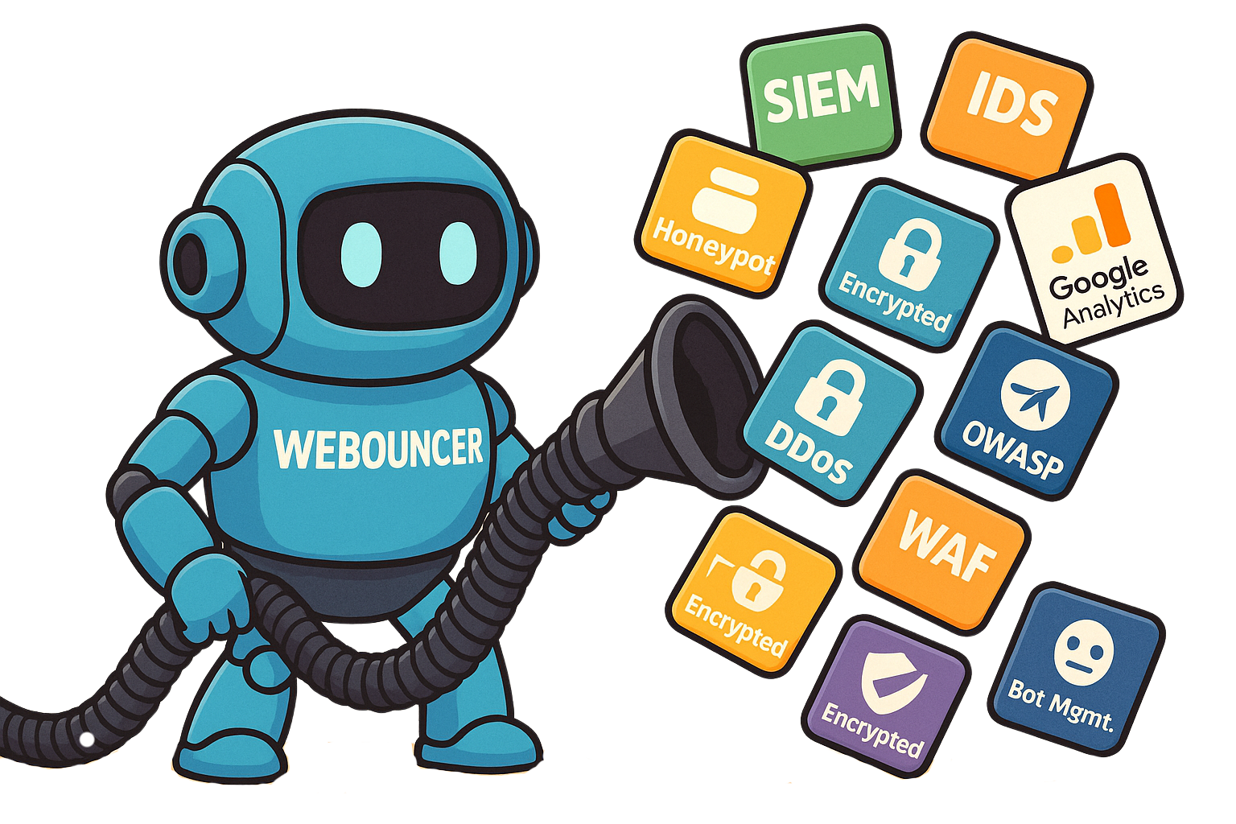
Reactive. Complexity. Expensive. not flexible.
Proven excellence
Unified Platform
Proactive Protection
Proactive. Security. Simple. Efficient.
Replaces 8+ separate security tools
Real-time threat prevention
ALL in One
Award-Winning
Cybersecurity Software of the Year 2025
Reactive. Complexity. Expensive. not flexible.
CDN + Security-features
Fastly
SIEM
Splunk or QRadar
Google Analytics
DDoS
Cloudflare or Akamai
BOT-Management
DataDome
WAF
Imperva or AWS
Honeypot
Thinkst Canary or KFSensor
IDS
Snort

Slide 4



Proactive. Security. Simple. Efficient.
SIEM
Splunk or QRadar
CDN + Security-features
Fastly
BOT-Management
DataDome
Proven excellence
Unified Platform
Experience meets innovation
Proactive Protection
Simplified Security
WAF
Imperva or AWS
One platform replaces multiple point solutions
DDoS
Cloudflare or Akamai
Real-Time Protection
Replaces 8+ separate security tools
Proactive approach stops threats instantly
Cost Efficiency
Reduces security expenditure 30% or more
Real-time threat prevention
Scalability
IDS
Snort
Grows with your business needs
Award-Winning
Christian Greiwe
https://kralos.eu
Cybersecurity Software of the Year 2025
Honeypot
Thinkst Canary or KFSensor
Reactive. Complexity. Expensive. not flexible.
KraLos GmbH
Burgdorf, Lower Saxony, Germany
Carsten Klein
Google Analytics
ALL in One

Slide 5
Proactive. Security. Simple. Efficient.
SIEM
Splunk or QRadar
CDN + Security-features
Fastly
BOT-Management
DataDome
Simplified Security
One platform replaces multiple point solutions
Proven excellence
Unified Platform
Proactive Protection
Cost Efficiency
WAF
Imperva or AWS
DDoS
Cloudflare or Akamai
Reduces security expenditure by up to 30% or more
Replaces 8+ separate security tools
Real-time threat prevention
IDS
Snort
Award-Winning
Christian Greiwe
Carsten Klein
Cybersecurity Software of the Year 2025
Experience meets innovation
Honeypot
Thinkst Canary or KFSensor
Booth S3
KraLos GmbH
Burgdorf, Lower Saxony, Germany
https://kralos.eu
Reactive. Complexity. Expensive. not flexible.
Google Analytics
Real-Time Protection
Scalability
ALL in One
Proactive approach stops threats instantly
Grows with your business needs

