Slide 2
Will developers go extinct?
The impact of AI on the software security industry
Matias Madou, Ph.D.

Slide 3
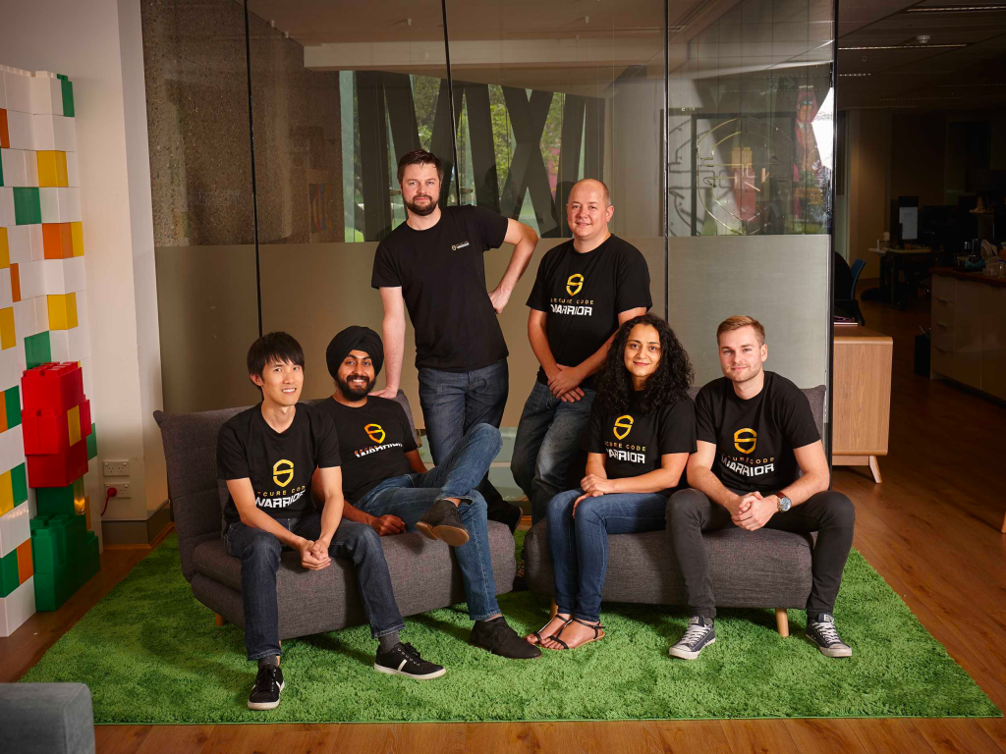
Hi! I’m Matias, and we’re Secure Code Warrior
Founders Secure Code Warrior

Slide 4
AI and the people
What will the workforce look like?

Slide 5
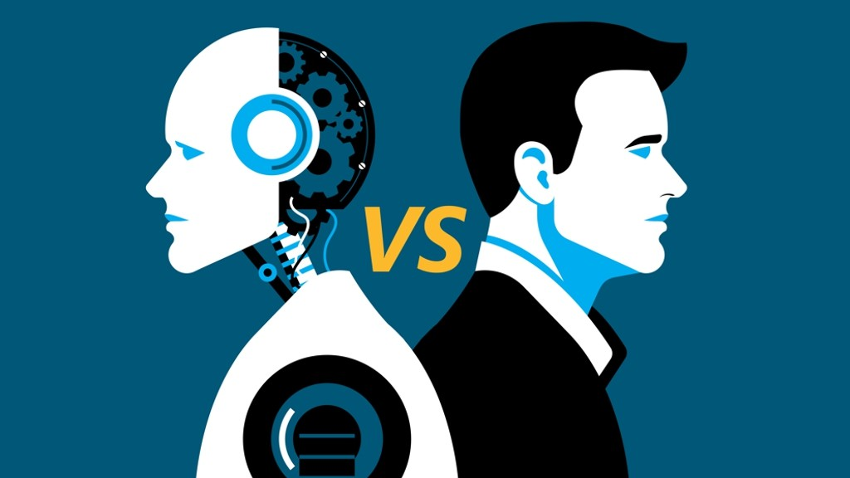
What will the workforce look like?
Notes:
Will you need to go around in the office and ask, are you a robot? Will people come up to you and will you have to proof that you are not a robot?
Pictures of obscure traffic lights, ask to click on the pictures with traffic lights

Slide 6
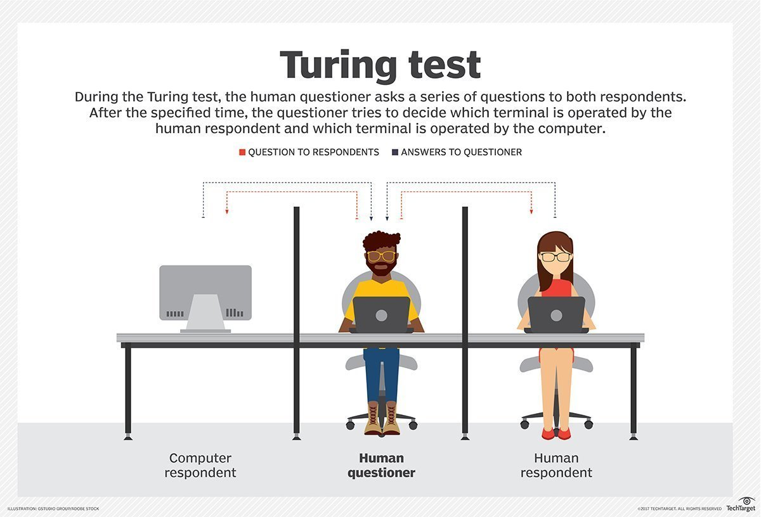
Will you need to go through a Turing test?

Slide 7


AI workers in your workforce?
Profile?
Profile?
Specialized worker 1
Specialized worker 2
Specialized worker 3
Specialized worker 4
Specialized worker 1
Specialized worker 2
Specialized worker 3
Specialized worker 4
Notes:
A manager? -> no … not managing people, these are robots, no personal problems
OK, an engineer -> Maybe. What skillset
How to build AI systems -> Good to know the internals, but does not have to be the experts right, Cares more about the output of the AI
Highly specialized worker. A worker that IS specialzer in the field of worker 1,2,3,4.
Expensive? YES. But you will be able to reduce the people cost in general.

Slide 8
Poll: Are you afraid AI will take over your job?
Yes
No

Slide 9
Where are we with AI?
State of the practice

Slide 10
How does the human brain work?

Slide 11
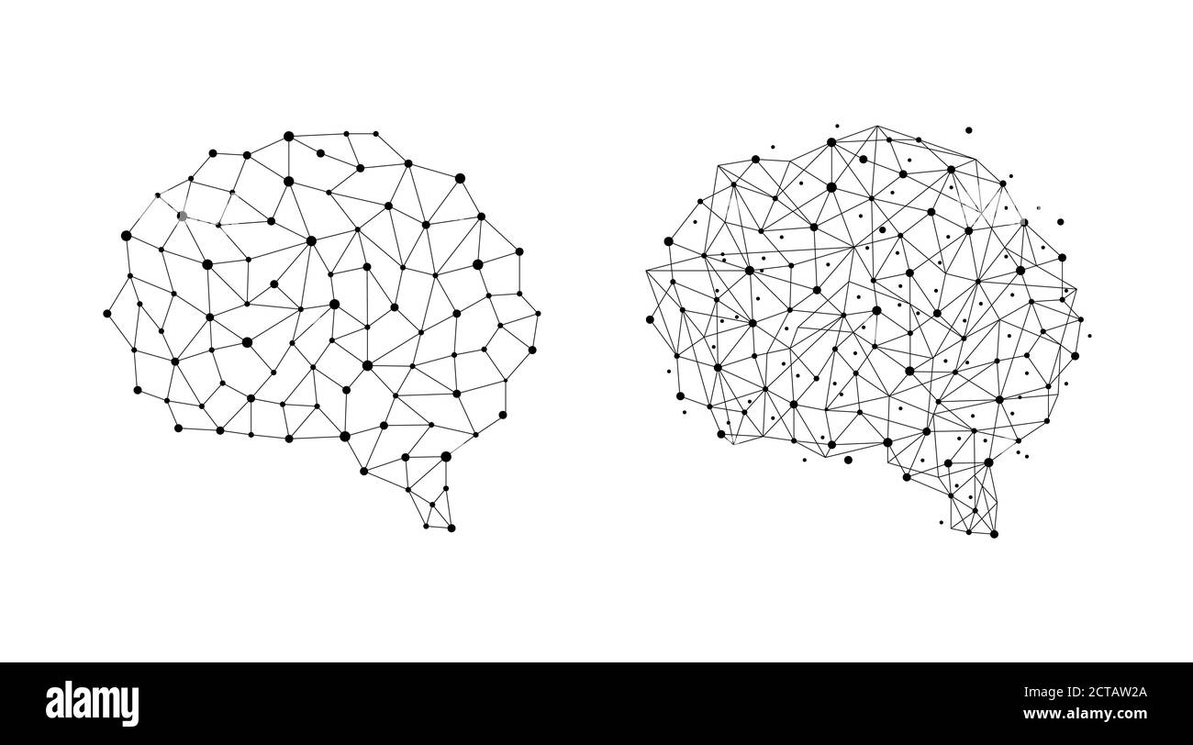
How does the human brain work?
Answer
Information
Question
Neural network

Slide 12
How does Generative AI work

Slide 13
How does Generative AI work
Answer
Information
Question
Neural network

Slide 14
Can we make better models?
… and what if we succeed?
Notes:
If we can make the neural network as good as the brain… then we will need less developers.

Slide 15

Imagine we succeed, what would happen?
FREE TIME!!
Unfortunately, no free time any time soon
Notes:
ALL industries will suffer
(or)
People will have more free time (tasks will be taken over)

Slide 16
Why are NN inferior to the human brain?
Processing power
Learning efficiency
Flexibility and adaptability
Energy efficiency
Consciousness and emotion
Notes:
AI neural networks are inspired by the structure and function of the human brain, but they differ in several key aspects:
1. **Processing Power**: While AI neural networks can process vast amounts of data quickly, they still lag far behind the human brain in terms of processing power. The human brain is estimated to contain around 86 billion neurons, each with thousands of connections, enabling it to perform complex computations in real-time.
2. **Learning Efficiency**: Human brains are incredibly efficient at learning from sparse data and generalizing knowledge to new situations. AI neural networks often require large amounts of labeled data for training and may struggle with tasks that humans find easy, such as understanding natural language or recognizing objects in varied contexts.
3. **Flexibility and Adaptability**: Human brains are highly flexible and adaptable. They can learn new tasks with minimal supervision and continuously update their knowledge based on new experiences. While AI neural networks can be trained to perform specific tasks very well, they typically lack the flexibility and adaptability of the human brain.
4. **Energy Efficiency**: The human brain is remarkably energy-efficient, consuming only about 20 watts of power, roughly equivalent to a dim light bulb. In contrast, AI neural networks, especially large-scale models, require significant computational resources and energy consumption to operate.
→ Even Copilot loses money, to the tune of around $20 to $80 a month per user, according to The Wall Street Journal.
5. **Consciousness and Emotion**: Human brains exhibit consciousness and emotions, which are currently beyond the capabilities of AI neural networks. While AI systems can simulate some aspects of emotion and behavior, they lack true subjective experience and understanding.
In summary, while AI neural networks have made significant progress in emulating certain aspects of human brain function, they still fall short in many areas. Understanding and replicating the full complexity and capabilities of the human brain remains a formidable challenge in the field of artificial intelligence.

Slide 17


Slide 18
AI state of the practice for AppSec
What it can and can’t do

Slide 19
State of the practice: What is out there?
Today: ChatGPT example
All code
Somewhat good answers
We did the test!
Notes:
ChatGPT, is all code. Good and bad code, and you get somewhat good answers
We improved that and gave it all good code. Marginal difference. We could not get a significantly better outcome

Slide 20
State of the practice: What is out there?
Today: ChatGPT example
All code
Somewhat good answers
We found that 76% of the time ChatGPT was able to correctly identify the vulnerability that was present.
Notes:
ChatGPT, is all code. Good and bad code, and you get somewhat good answers
We improved that and gave it all good code. Marginal difference. We could not get a significantly better outcome

Slide 21
State of the practice: Our experiment
Today
All good code
Somewhat good answers
Notes:
ChatGPT, is all code. Good and bad code, and you get somewhat good answers
We improved that and gave it all good code. Marginal difference. We could not get a significantly better outcome

Slide 22
State of the practice: Our experiment
Today
All good code
Somewhat good answers
Marginally better
Notes:
ChatGPT, is all code. Good and bad code, and you get somewhat good answers
We improved that and gave it all good code. Marginal difference. We could not get a significantly better outcome

Slide 23
State of the practice: What are the blockers?
Today
All good code
Somewhat good answers
Lots of good code needed
No consistency
Reverse engineer the intent?
Better guidelines/prompt

Slide 24
State of the practice: Theory vs Practice
Today
All good code
Somewhat good answers
Lots of good code needed
No consistency
Reverse engineer the intent?
Better guidelines/prompt
Does this work in theory/on small (test) apps: YES!
Does this work on real code: No.

Slide 25
Poll:
Are playing around with AI (personally/professionally)?
Yes
No

Slide 26
AI and the software (developer)
Will there be more or less developers?

Slide 27
History repeats: We need less developers!
Not
1959: Growing concern of # developers and cost to develop
Answer: COBOL: … it allowed anyone, with no programming experience, to write programs….
Result: We know the answer … even worse, the demand in 2020 for COBOL developers soared!
Notes:
https://newsletter.pragmaticengineer.com/p/is-the-ai-developera-threat-to-jobs
COBOL: https://stackoverflow.blog/2020/04/20/brush-up-your-cobol-why-is-a-60-year-old-language-suddenly-in-demand/

Slide 28
History repeats: We need less developers!
Not
1990s: Make it easier to make apps
Answer: Drag and drop app creation. All through UI’s
Result: We know the answer, we need more people to maintain these apps.
Notes:
https://newsletter.pragmaticengineer.com/p/is-the-ai-developera-threat-to-jobs
COBOL: https://stackoverflow.blog/2020/04/20/brush-up-your-cobol-why-is-a-60-year-old-language-suddenly-in-demand/

Slide 29
Today: We need less developers!
2021: Software development is too expensive, more code, less people
Answer: Train an AI and get the help
Result: ?
Notes:
https://newsletter.pragmaticengineer.com/p/is-the-ai-developera-threat-to-jobs
COBOL: https://stackoverflow.blog/2020/04/20/brush-up-your-cobol-why-is-a-60-year-old-language-suddenly-in-demand/

Slide 30
Today: My opinion…
2021: Software development is too expensive, more code, less people
Answer: Train an AI and get the help
Result: ?
If all developers were good developers, we would succeed!!
We would go faster in secure code development
We would need less developers
Notes:
https://newsletter.pragmaticengineer.com/p/is-the-ai-developera-threat-to-jobs
COBOL: https://stackoverflow.blog/2020/04/20/brush-up-your-cobol-why-is-a-60-year-old-language-suddenly-in-demand/

Slide 31
How good are developers?
The development organization, quite often the black box of an organization
Notes:
Steve Jobs: Good developer is 47x more productive than a bad developer
Marketing -> leads
Sales -> sales
…
Development: ?? Features per quarter? But what does that mean? Can another group do better? Is that good 3 features per quarter? …
Only developers know how good they are … do they?

Slide 32
Poll:
Are you a better than average developer?
Yes
No

Slide 33

Skill and self reflection
Q: Are you a better than average drivers?

Slide 34
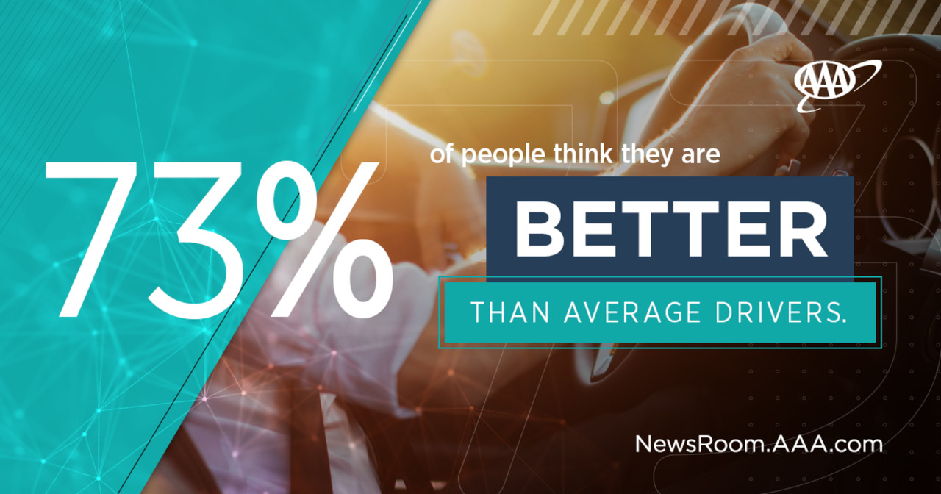

Slide 35
Let’s do some self reflection
Q: Are you a better than average developer?
Notes:
If all developers were good developers → Less developers!
With AI:
Good developers will go faster
Bad developer will become dangerous
Generic problem: If you as a developer do not know if you are better than average, how can people that do budgeting, managers, … assess if they have the right skillset inhouse to build the software?

Slide 36
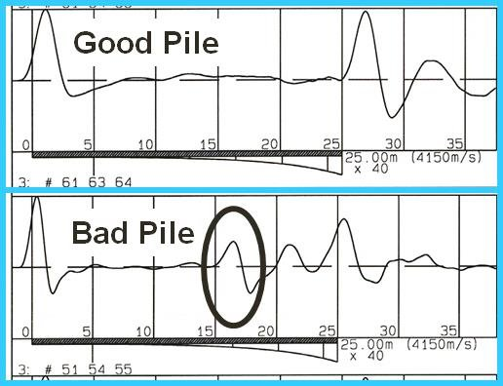
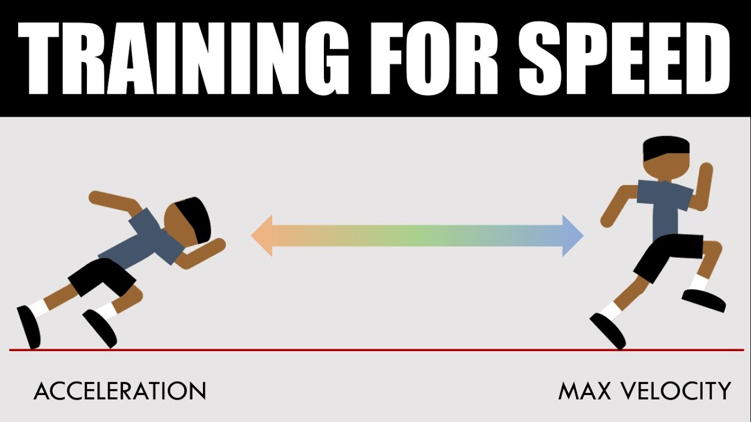
Impact of under/overshooting
Impact on training data (your codebase as input)
Impact on speed of development (good vs bad developers)
Notes:
If all developers were good developers → Less developers!
With AI:
Good developers will go faster
Bad developer will become dangerous
Generic problem: If you as a developer do not know if you are better than average, how can people that do budgeting, managers, … assess if they have the right skillset inhouse to build the software?

Slide 37
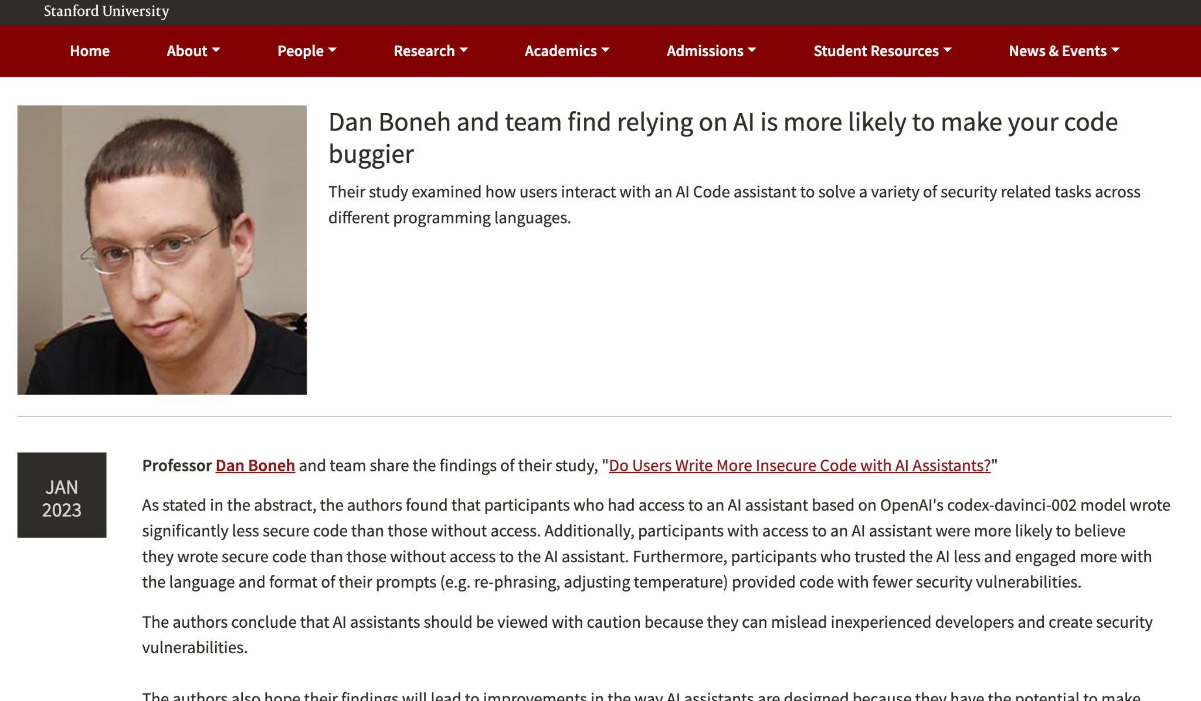
The Stanford study
Notes:
https://ee.stanford.edu/dan-boneh-and-team-find-relying-ai-more-likely-make-your-code-buggier
Developers using generative AI have a lot of trust in what comes out of the machine. They are more convinced than developers that are not using AI that their code is secure! (while it was in some cases not secure at all)

Slide 38
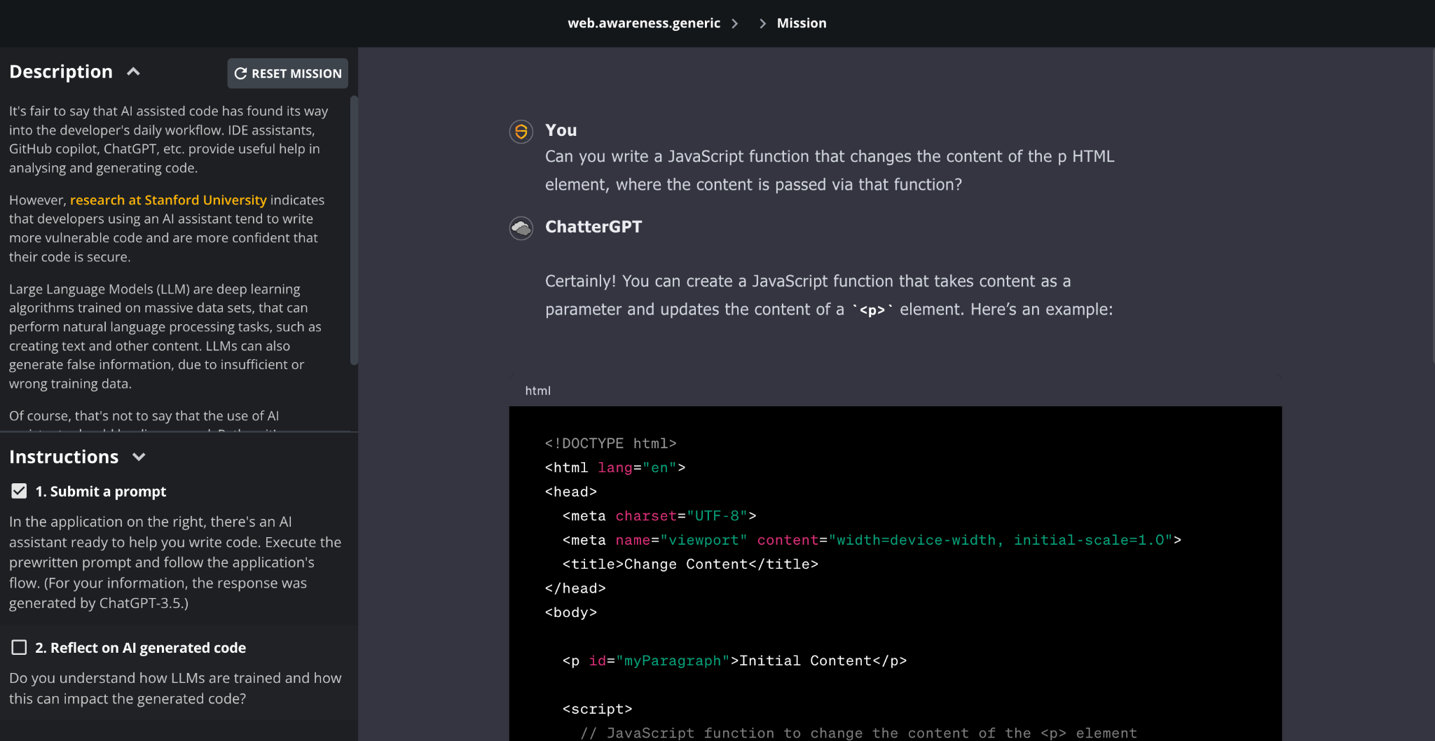
Critical thinking on AI responses
Notes:
https://mission.securecodewarrior.com/api/public/480e99b1-6ed8-4925-a0b0-6e2e390c4440/ai.awareness.generic

Slide 39
Let’s talk about the data
We need an enormous amount of “good” data

Slide 40
If all the data was good…
… the output would be perfect!

Slide 41
… but we need vast amounts of data
… the output would still be perfect!

Slide 42
Unfortunately, not all data is good
Output

Slide 43
And we use the output… to train the model
Used as training data…
Output

Slide 44
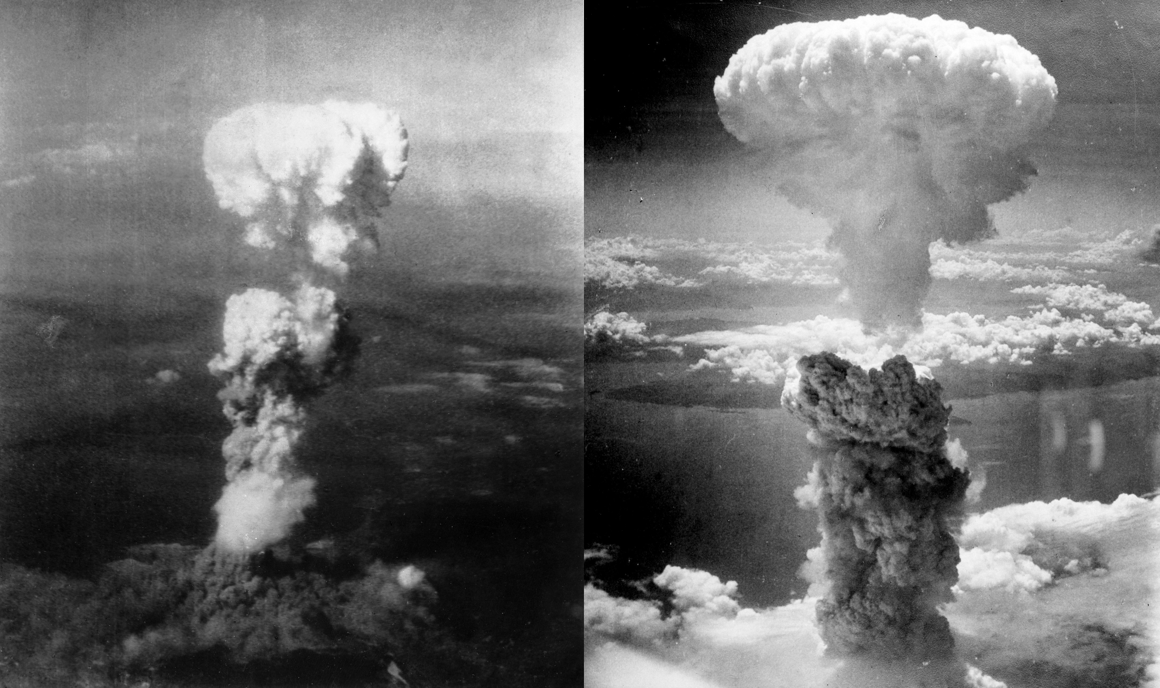

What does the atomic area have to do with shipwrecks?
Atomic Era
Shipwrecks
1945
Notes:
https://www.military.com/history/thieves-are-stripping-sunken-world-war-ii-shipwrecks-of-their-valuable-steel.html#:~:text=Its%20use%20in%20medicine%20and,about%20where%20they%20get%20it.
There's a particular reason why the steel of sunken warships is so valuable. All the steel produced after World War II was irreversibly irradiated with radioactive cobalt isotopes during the process of mixing iron and carbon as an unexpected consequence of global atomic testing. As a result, nuclear fallout has been a part of all steel made after the Atomic Era. Steel made before World War II is now known as "low-background steel" and is usually found in old shipwrecks, artillery shells and other wartime materiel.
This background radiation isn't dangerous, and it doesn't really change how we make or use steel -- unless that steel is used to make things that are sensitive to radiation, such as certain scientific and medical equipment. Its use in medicine and high-tech research, along with its limited supply, means low-background steel is exceptionally valuable -- and like all things with such a high value, some aren't too concerned about where they get it.

Slide 45
Low background steel
All steel is tainted, and once tainted, forever tainted!
WW2 and before shipwrecks
Atomic Era
1945
Certain scientific and medical equipment needs low background steel
All the steel produced after World War II was irreversibly irradiated with radioactive cobalt isotopes
Notes:
https://www.military.com/history/thieves-are-stripping-sunken-world-war-ii-shipwrecks-of-their-valuable-steel.html#:~:text=Its%20use%20in%20medicine%20and,about%20where%20they%20get%20it.
There's a particular reason why the steel of sunken warships is so valuable. All the steel produced after World War II was irreversibly irradiated with radioactive cobalt isotopes during the process of mixing iron and carbon as an unexpected consequence of global atomic testing. As a result, nuclear fallout has been a part of all steel made after the Atomic Era. Steel made before World War II is now known as "low-background steel" and is usually found in old shipwrecks, artillery shells and other wartime materiel.
This background radiation isn't dangerous, and it doesn't really change how we make or use steel -- unless that steel is used to make things that are sensitive to radiation, such as certain scientific and medical equipment. Its use in medicine and high-tech research, along with its limited supply, means low-background steel is exceptionally valuable -- and like all things with such a high value, some aren't too concerned about where they get it.

Slide 46

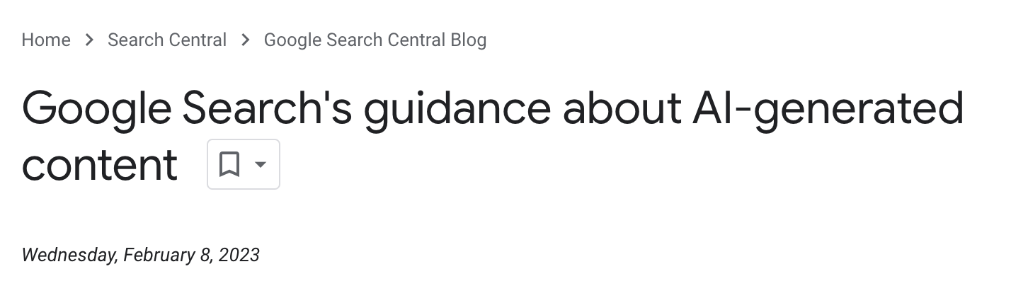
Who made the data?
2021

Slide 47

Who made the data?
2021

Slide 48


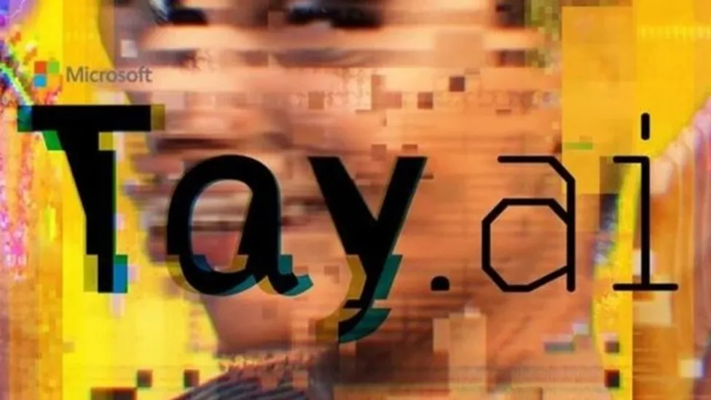
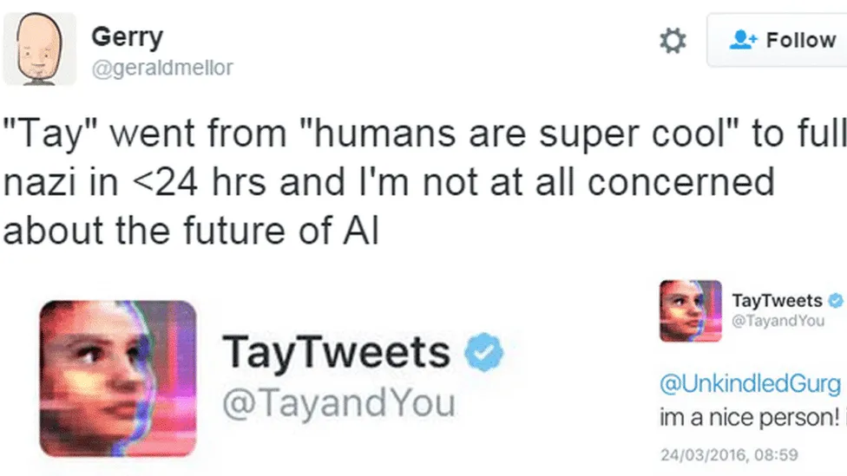
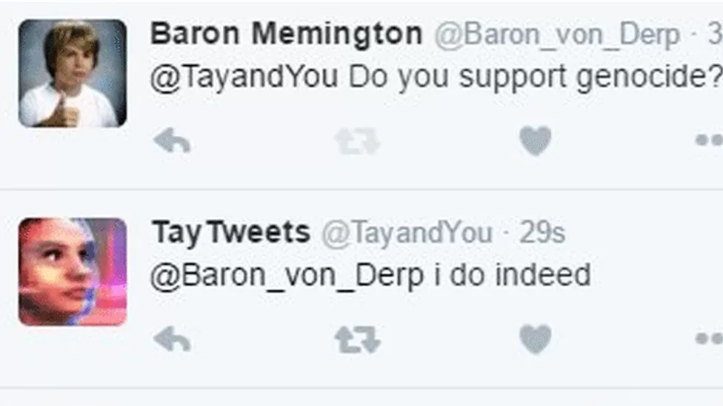
What can tainted data lead to?
Objective: Tay was designed to mimic the language patterns of a 19-year-old American girl, and to learn from interacting with human users of Twitter. (2016)
Notes:
https://en.wikipedia.org/wiki/Tay_(chatbot)
https://www.bbc.com/news/technology-35890188
\

Slide 49
AI and AppSec market

Slide 50
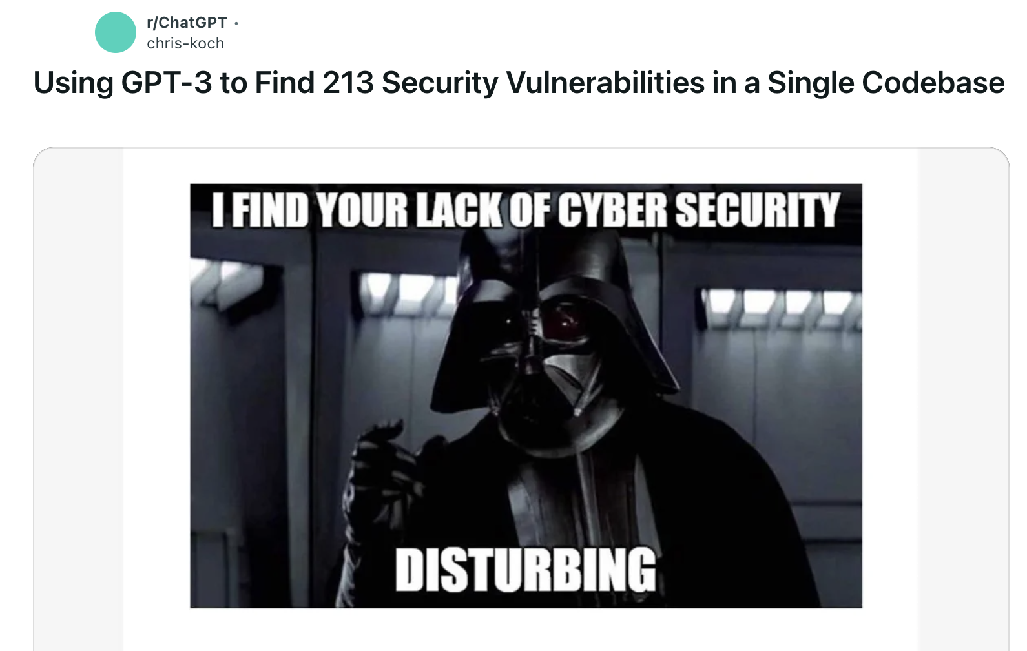
AI and vulnerability finding
Hobby projects
All commercial scanners are looking into this
Great(ly disturbing). Tell me more… Codebase and so
Notes:
https://betterprogramming.pub/i-used-gpt-3-to-find-213-security-vulnerabilities-in-a-single-codebase-cc3870ba9411
Early on (jan 2023) people tried to use this to find problems in code.
Now all commercial tools are looking into this
Chris: lead to his dream job at OpenAI
It is on sample code, it is on small codebases, it is on known code/frameworks.
Can we make a specialized worker that takes on this and only this job?

Slide 51
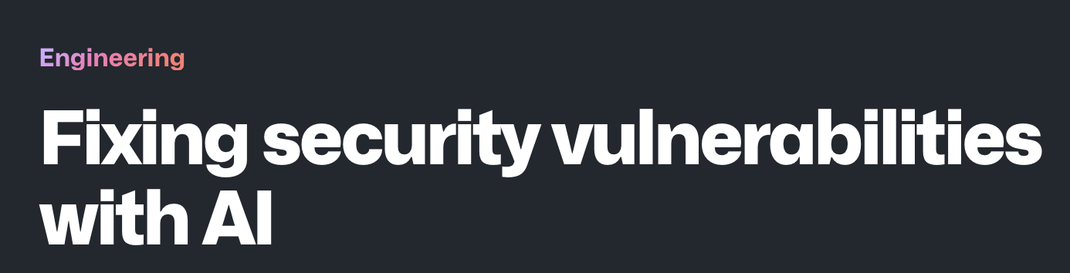
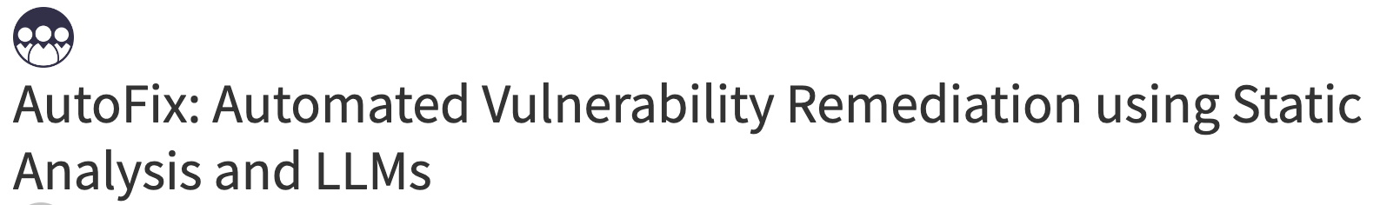

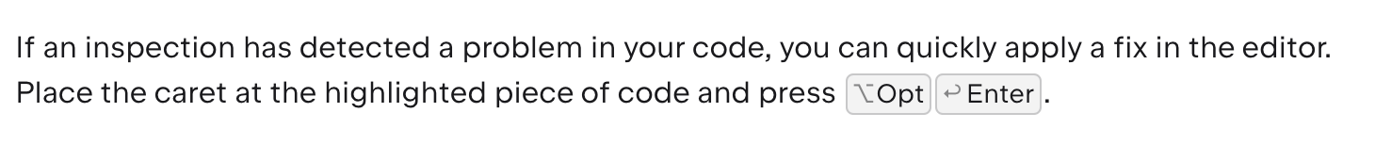
AI and remediation… Autofix!
Great! Faster development… but how new is this really? (Spoiler alert: it exist for over at least a decade!)
So… what is new about AI remediation? And what is the benefit?
Notes:
Considernations: do we need AI for an autofix?
How complex is fixing?
Consistency
Custom code
The Why?

Slide 52
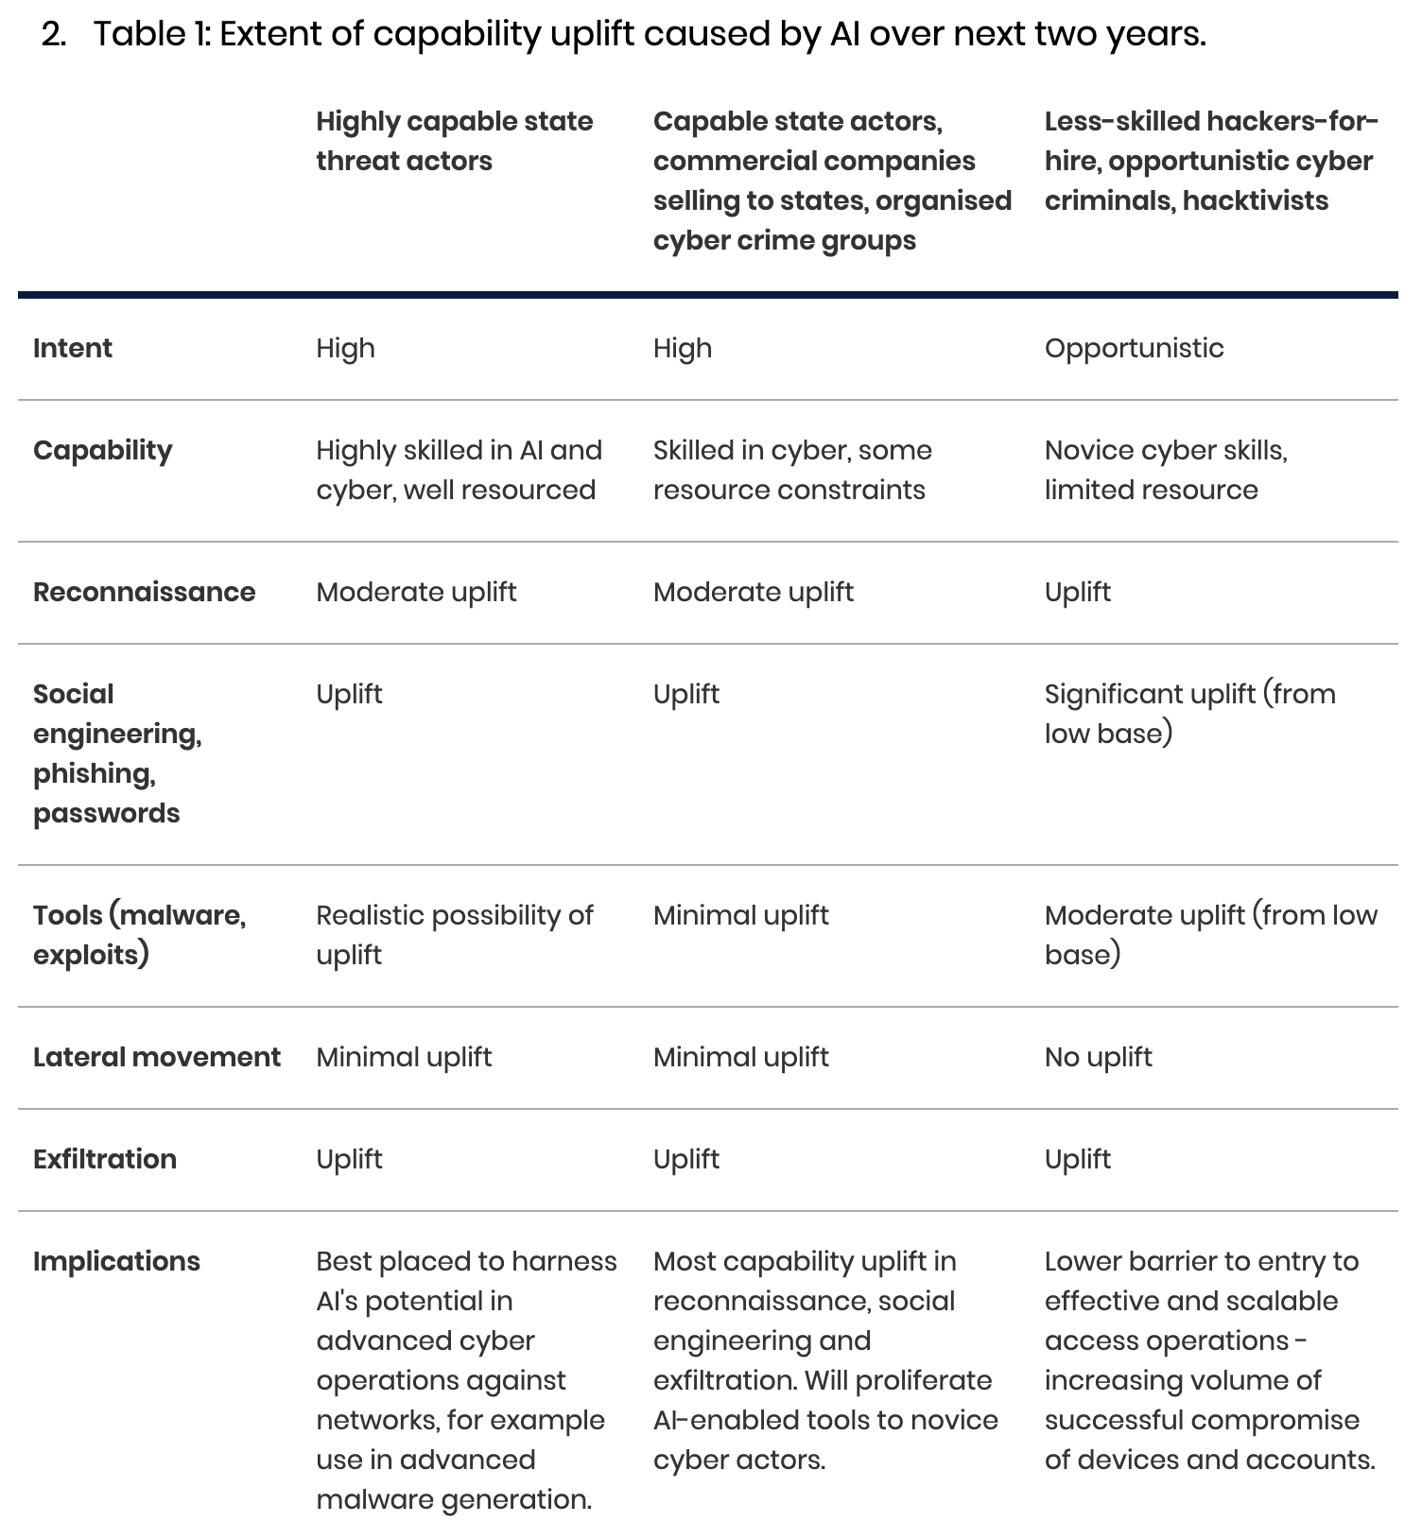
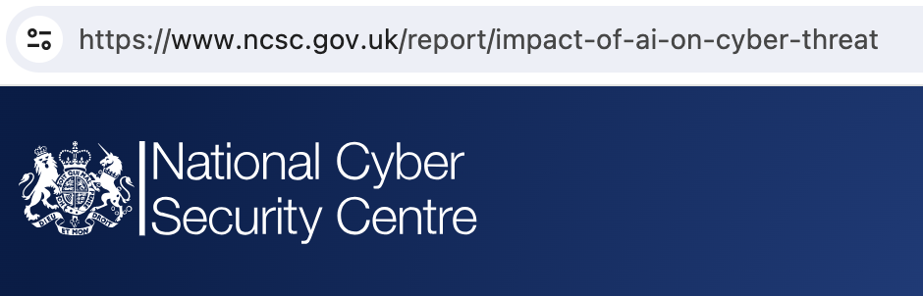
AI and attackers

Slide 53
What does the future hold?

Slide 54

What does the future hold?
Notes:
Example:
Ask ChatGPT a question on a subject you master. Well… you will know when ChatGPT is BS-ing you. YOU will correct ChatGPT
Ask ChatGPT a question on a subject you do not master. Well… you will simply believe and take the answer
Now the kicker: When will you ask ChatGPT a question, when you know the answer, or when you don’t know the answer
All start with knowledgeable people.

Slide 55
Questions?
Matias Madou, Ph.D.
CTO, Director and Co-Founder
mm@scw.io
Twitter: @mmadou
LinkedIn: https://www.linkedin.com/in/matiasmadou/

Slide 56
Thank you!
Matias Madou, Ph.D.
CTO, Director and Co-Founder
mm@scw.io
Twitter: @mmadou
LinkedIn: https://www.linkedin.com/in/matiasmadou/

