Slide 1

From Vulnerable to ahead. Together.
Made in Europe: Cybersecurity Services & SOC Services

Slide 2
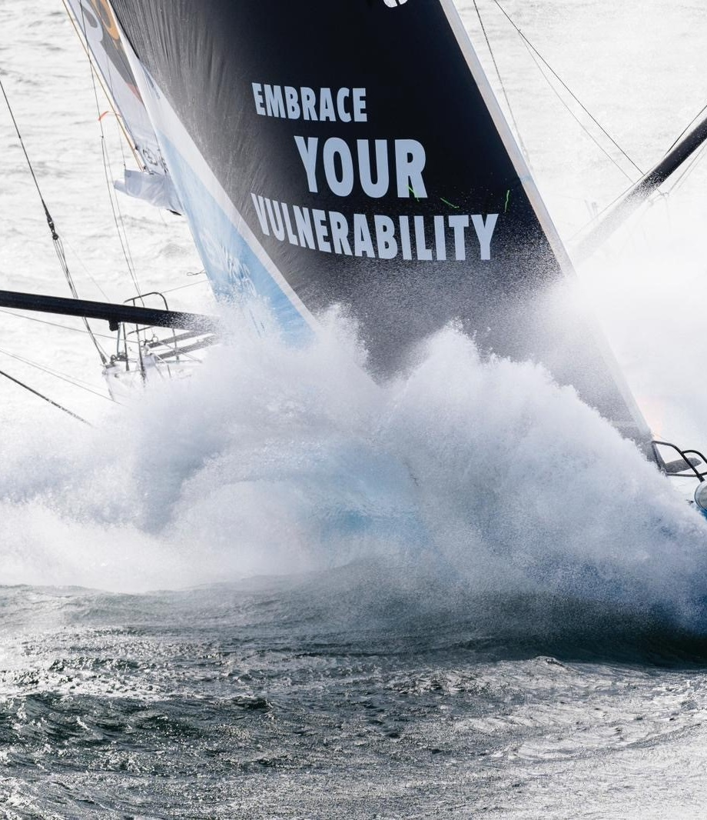
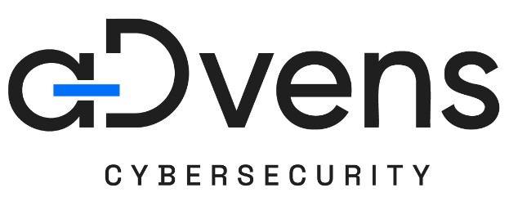

Our purpose.
Social Impact is in our DNA since the beginning 25 years ago. But in April 2024, ADVENS became the first European company founded in France to place vulnerability at the heart of its mission and written into our bylaws.
Making vulnerability a strength for Cyber, People and the planet.
Vulnerability defines both our business and our mission:
we protect against its risks, combat those who exploit it, and harness it as a source of value creation for individuals and communities.

Slide 3
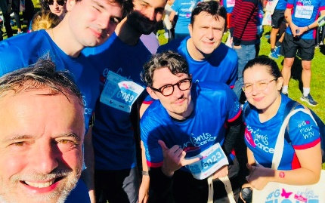
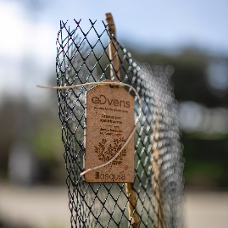
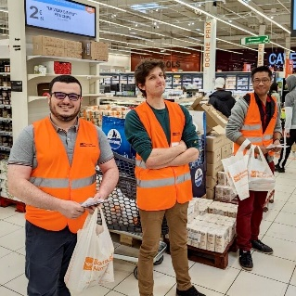
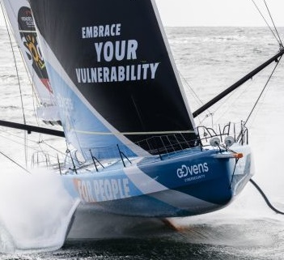
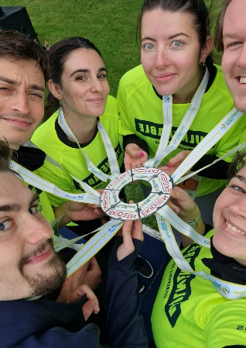
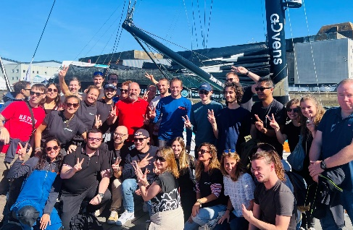
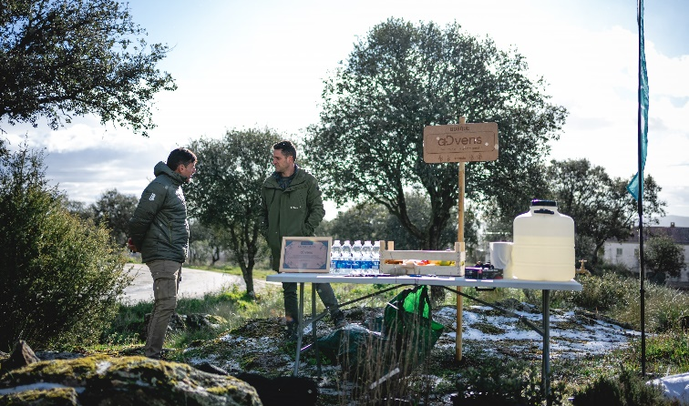
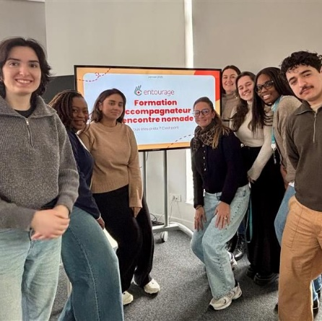
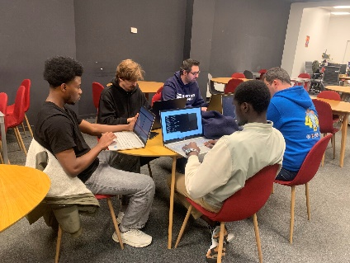
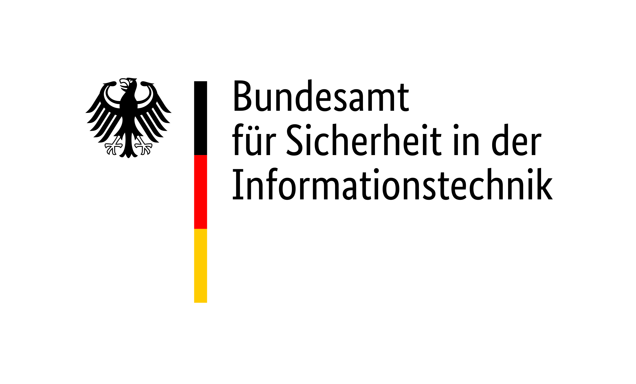















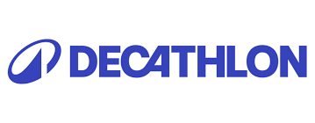
Honnêteté
Honnêteté
Collectif
Audace
Utilité
Honnêteté
Collectif
Audace
Utilité
Our portfolio
Cybersecurity Consulting
  Strategy & Organization
  Architecture & Integration
  Audit & Offensive Security
Cybersecurity Technologies
Managed Detection & Response Services
  Holistic SOC Services for IT & OT
  CERT
    Incident Response
    Cyber Threat Intelligence
Our DNA
As a European cybersecurity pure-player, ADVENS has played a decisive role in strengthening Europe in terms of digitization and sovereignty – and has been doing so for 25 years now.
Independent and sovereign through our own
mySOC platform
Our values:
Boldness + Impact + Collective + Integrity
Impact
Collectif
Audace
Our experience
Proven Cybersecurity expertise since 2000
SOC service track record since 2016
500+ customers trust our services
600+ Cybersecurity experts, alone 280+ in mySOC
Client base spans private business from various verticals, critical infrastructure operators, 150+ hospitals & public organizations
Global reach, local touch
While providing global ability to execute, regional teams ensure client proximity and market fit.
Notes:
3 valeurs
Audace: esprit entrepreneur, lancer de nouveaux projets, nouveaux clients, nouvelles offres, nouveaux pays, nouvelles solutions à des problèmes cyber
Impact: faire en sorte que nos missions de cyber aient un vrai impact chez le client, augmenter son niveau de sécurité, mieux le protéger
Impact sur la Société: les actions des collaborateurs via leur engagement ont un impact sur la Société
Collectif: esprit d'équipe. Les défenseurs doivent travailler main dans la main avec les clients, les partenaires, etc.contre des attaquants toujours plus virulents.

Slide 4
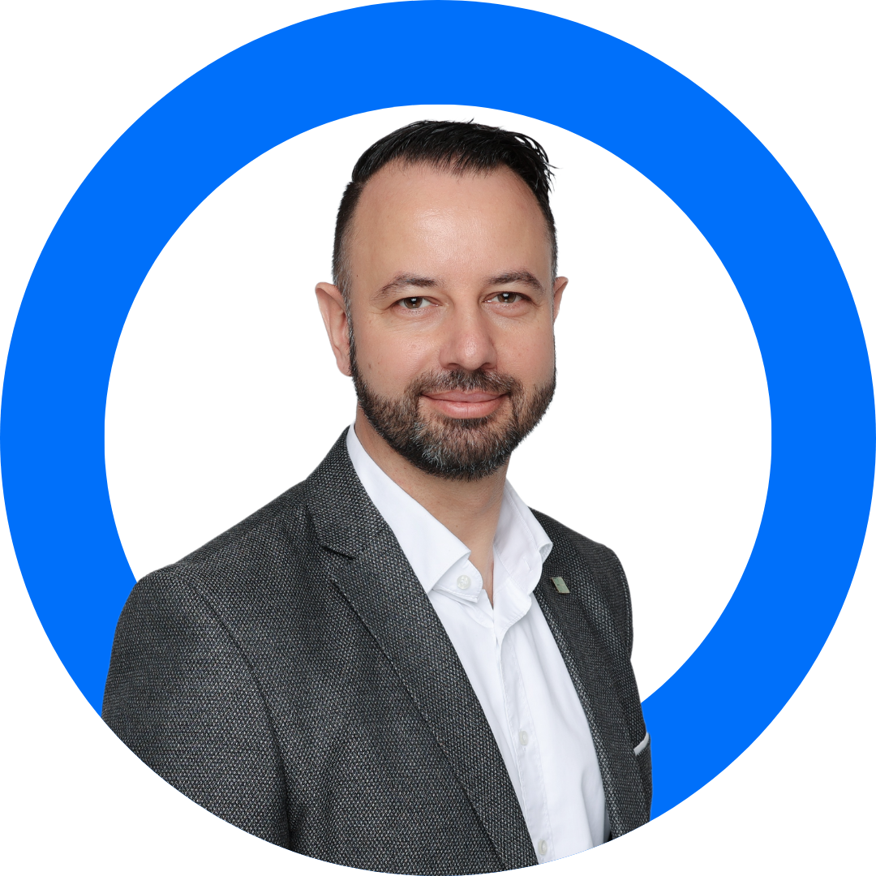
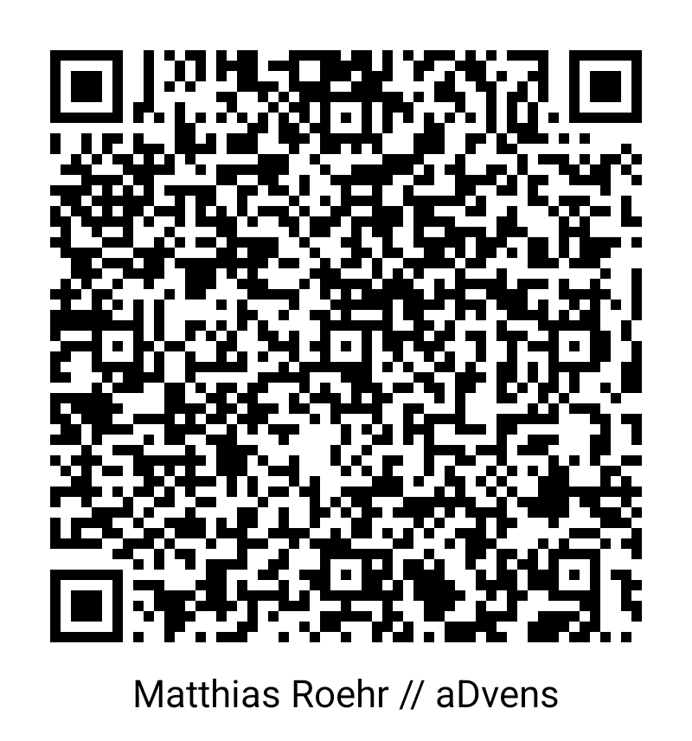
Matthias ROEHR
VP Sales & Business Development
+49 176 189 888 01
MATTHIAS.ROEHR@ADVENS.COM
aDvens GmbH
Weihenstephaner Str. 12
81673 Munich
GERMANY

Slide 5




www.advens.com

