Slide 1
The Architecture of Resilience: Eliminating Complexity

Slide 2
Your Cloud Footprint Is a Growing Attack Surface
110%
77%
94%
year-over-year surge in cloud specific attacks by threat actors
of attacks in 2024 used compromised credentials as the initial access method
of ransomware victims had their backups targeted by attackers
Source: — CrowdStrike Global Threat Report 2024
Source: —Sophos Active Adversary Report of 2024
Source: — Sophos The Impact Of Compromised
Backups On Ransomware Outcomes 2024
Notes:
Talk Track: “These statistics tell the story. In the past year, ransomware attacks have increased sharply, and backups are now a prime target — 94% of victims had their backups compromised. Cloud-specific attacks are up 110%, and 77% of all incidents start with stolen credentials. The cloud has become both a business enabler and a battleground.”
AE Note: Pause here to let the customer react — this slide builds urgency. Reinforce that these are not theoretical numbers but real, observed trends across industries.
Transition: “Even with all of Azure’s built-in security, Microsoft makes it clear that data protection is ultimately your responsibility.”

Slide 3



Your Microsoft 365 Data & Backups are Under Attack
$
600M
275%
20%
daily attacks targeting Microsoft’s customers
YoY increase in ransomware attacks on Microsoft customers
of M365 users report data recovery difficulties
Source: Microsoft News
Source: Microsoft Digital Defense Report 2024
Source: The Hacker News - 2025 State of SaaS Backup and Recovery Report
Notes:
Ransomware threats are increasingly targeting your last line of defense—your backups.
In 70% of attacks, backups were the most common target, showing attackers are actively seeking to destroy recovery options.
Alarmingly trusted platforms like Microsoft 365 aren’t immune—21% of organizations reported data loss despite having M365 backup policies in place.
Furthermore, 20% of M365 users report data recovery difficulties - Source: [The Hacker News - 2025 State of SaaS Backup and Recovery Report](https://thehackernews.com/2025/01/2025-state-of-saas-backup-and-recovery-report.html)
These stats make one thing clear: backups alone aren’t enough. You need an integrated, immutable, and resilient data protection strategy to withstand today’s evolving cyber threats.

Slide 4
Why Backups Matter
1
2
Ensure Business Continuity with Fast, Reliable Recovery
Protect Critical Data Against Cyber Risks and Mistakes
3
4
Legal & eDiscovery Readiness
Stay Audit-Ready and Aligned with Compliance Regulations
Notes:
Data protection is your responsibility - secures data from tampering, misuse & loss.

Slide 5
Microsoft Expects You to Secure Your Data
Microsoft protects infrastructure — not your data:
❌ Accidental or malicious deletion
❌ Ransomware or insider attacks
❌ Inactive/deleted user data loss
❌ Compliance & legal hold failures
“You're responsible for protecting the security of your data and identities”
-
- Microsoft
Notes:
According to Microsoft’s shared responsibility model - Microsoft secures the platform, but you’re responsible for protecting and securing your data and identities.
Despite Microsoft's robust security, it can’t guarantee cyber resilience on its own.

Slide 6
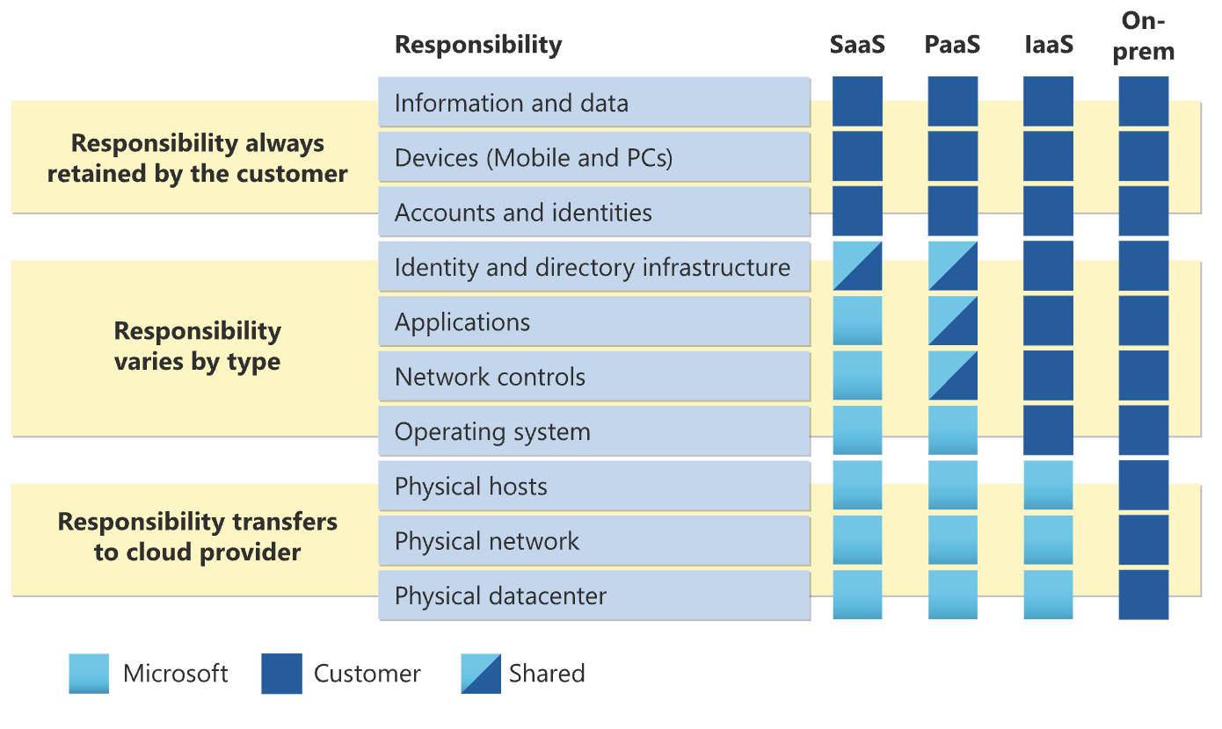

Azure Won’t Secure Your Data — That’s On You
While Azure secure the underlying infrastructure, their Shared Responsibility Model make it clear:
protecting your information and data—including backup, recovery, and identities—is your responsibility.
Notes:
“Microsoft’s Shared Responsibility Model is crystal clear: they secure the infrastructure, but your organization is responsible for your data, your backups, and your recoverability. That includes protection from accidental deletion, credential misuse, or ransomware.”
Transition: “So even with Azure’s robust infrastructure, the data layer is still a shared risk that must be owned by you.” https://learn.microsoft.com/en-us/azure/security/fundamentals/shared-responsibility

Slide 7
Why Legacy Backups Fall Short
Slow, Incomplete Recovery
Retention Doesn’t Guarantee Recovery
Security Gaps
High Cost & Complexity
Insufficient Data Protection
Legacy tools lack fast, granular recovery — impacting productivity & continuity
M365 offers availability, not isolated, immutable backups or point-in-time recovery to prevent data loss
Legacy backups and retention policies offer limited assurance, lacking the speed, reliability, and security for efficient long-term recovery
No built-in ransomware rollback, immutable storage, or insider threat protection
Legacy tools require multiple backup setups for each workload, creating management silos, increasing IT effort, & driving up cost without unified protection
Notes:
No True Data Protection Native M365 offers availability, not isolated, immutable backups or point-in-time recovery.
Retention ≠ Recovery Limited default policies and mailbox holds aren't designed for long-term, reliable restore.
Slow, Incomplete Recovery Legacy tools lack fast, granular recovery — hurting productivity and continuity.
Security & Ransomware Gaps No built-in ransomware rollback, immutable storage, or insider threat protection.
High Cost & Complexity Legacy tools require heavy setup, ongoing maintenance, and don’t scale efficiently.

Slide 8


Key Components of an Ideal Solution Cyber Resilience
Secured Air-gapped Backups
Significantly Lower Mean Time to Recovery
Guaranteed Clean Recovery
Accelerated Detection, Investigation, and Response
Streamlined Governance and Compliance
Scale Operations to Support Growth

Slide 9
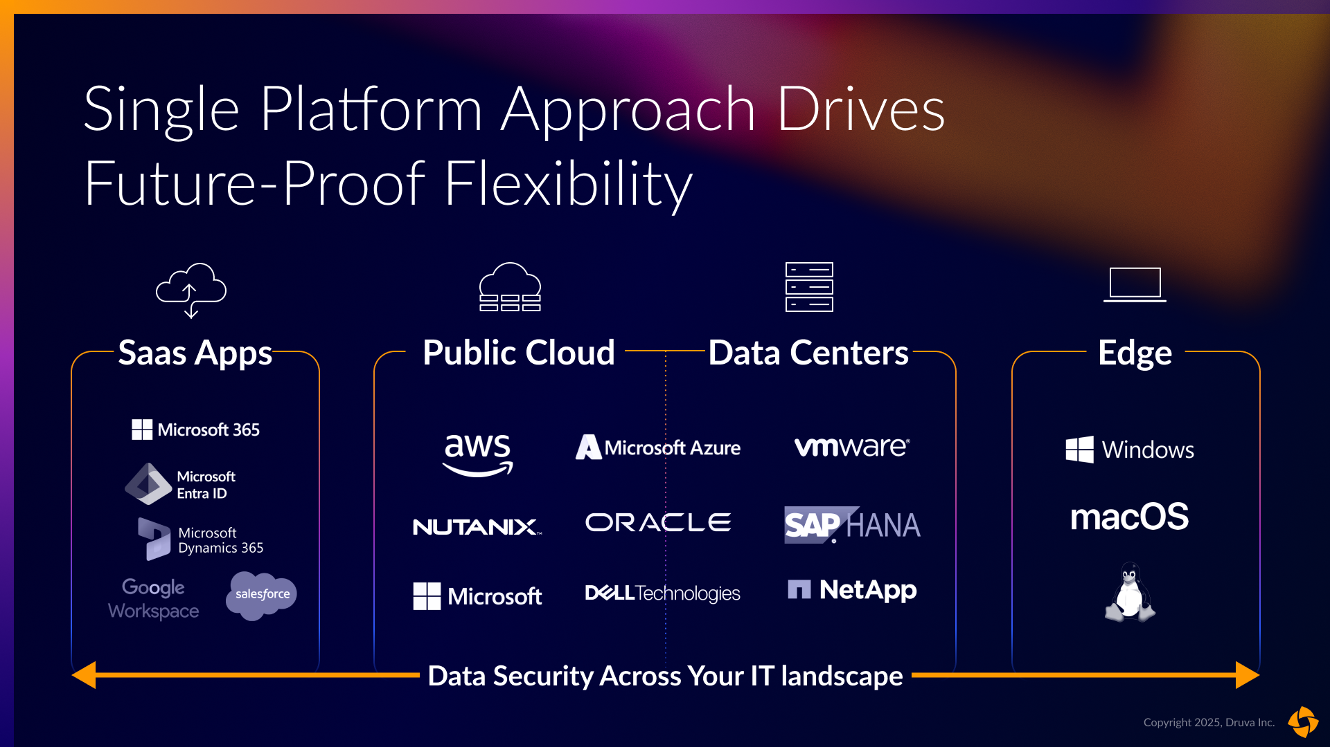
One Platform. Every Workload. Zero Complexity.
Total Data Protection from SaaS and Cloud to Data Center and the Edge

Slide 10
The Druva Advantage
Always-On, Air-Gapped Protection
Fast, Granular, Clean Recovery
Built-in Ransomware & Threat Defense
Long-Term Retention & Compliance
Protected with air-gapped, cloud-native storage that’s immutable and built for cyber resilience
Restore emails, files, chats, or entire accounts in minutes—precisely, cleanly, and without the risk of reinfection
Includes anomaly detection, rollback, quarantine, and 24x7 AI-driven Managed Detection & Response
Flexible retention with immutable backups and audit-ready recovery to meet regulatory needs.
Notes:
✅ 1. Long-Term Retention & Compliance
Druva offers flexible, policy-based data retention with immutable backups to safeguard critical Microsoft 365 data over extended periods. This ensures organizations can meet evolving compliance mandates and audit requirements with confidence. With centralized management and tamper-proof protection, Druva empowers IT teams to uphold legal hold and regulatory obligations—without operational complexity.
✅ 2. Fast, Granular Recovery
Whether it's a single email, Teams chat, or an entire OneDrive account, Druva enables point-in-time recovery within minutes. Its intuitive interface supports granular, search-driven restores across Exchange, SharePoint, Teams, and OneDrive—ensuring rapid resumption of operations after accidental deletions, insider threats, or disruptive incidents.
✅ 3. Built-in Ransomware & Threat Defense
Druva enhances M365 resilience with integrated anomaly detection, automated rollback, data quarantine, and 24x7 AI-powered Managed Detection and Response (MDR). These capabilities allow early identification of malicious activity and immediate response to threats—reducing dwell time, minimizing data loss, and accelerating recovery with full situational awareness.
✅ 4. Always-On, Out-of-Band Protection
Unlike solutions dependent on the Microsoft environment, Druva stores backups in isolated, air-gapped, cloud-native infrastructure. This ensures uninterrupted access to M365 backups—even during Microsoft service outages, security breaches, or tenant compromise. Organizations gain always-available recovery assurance, operational continuity, and complete data sovereignty.

Slide 11









4000+ Customers Trust Druva for M365 Data Protection
Cross-Cloud, Multi-Cloud Cyber Resilience for Microsoft Workloads
Backup & Restore | Microsoft 365 Backup Storage Integration
Exchange Online
OneDrive
SharePoint
Security Posture & Observability | Advanced Ransomware Recovery
Microsoft 365
Groups
Planner
100% SaaS Platform to Protect All Workloads
Microsoft Entra ID
(Protect Entra ID — Now FREE with Druva M365 Backup)
Search & Audit | Legal Hold
Notes:
Introducing Druva Data Security Cloud – a 100% SaaS platform delivering unified data protection and cyber resilience across all your Microsoft 365 workloads including Entra ID for free with M365 protection.
Druva addresses critical risks across the entire data lifecycle with three key pillers:
1. (Data Protection) - Ensure high-performance, scalable backup and rapid restore with Druva’s native Microsoft 365 solution and Microsoft Backup Express (MBE).
2. (Cyber Response & Recovery) - Defend against ransomware and insider threats with secure, immutable backups and guaranteed clean recovery—even after a cyberattack.
3. (eDiscovery & Compliance) - Proactively monitor, govern, and retain sensitive data to stay compliant with industry regulations and streamline legal readiness.

Slide 12
500+ TB Recovered in 4 Days from Ransomware Attack
Customer Spotlight
Global Analyst Firm
(100+ Countries)
Wed 8pm
Thurs 1am
Thurs 9am
Sunday 1pm
Detection
Ransomware using compromised credentials. Malware spreads across endpoints, triggering M365 encryption.
Engaged Druva Customer reached out to Druva Support. Emergency rollback assistance was initiated.
Recovery Druva began recovery of 502.65 TB of encrypted data across M365 accounts & endpoints.
Restored
By Sunday, data recovery was complete. The firm resumed normal operations by Monday morning.
Results
100%
Data
Restored
<4 Days
To Resume Full
Operation
500+TB
Recovered
Notes:
Druva Case Study: Global Analyst Firm Recovers 500+ TB in 4 Days
Client Profile A global analyst firm operating in over 100 countries suffered a major ransomware attack. Compromised credentials led to widespread malware encryption across M365 accounts and endpoints.
Incident Timeline & Response
Detection (Wed 8 PM): Ransomware identified; encryption triggered across Microsoft 365.
Druva Engaged (Thurs 1 AM): Emergency support activated within hours.
Recovery (Thurs 9 AM): Druva began restoring 502.65 TB of encrypted data.
Full Restoration (Sun 1 PM): All systems recovered; business operations resumed by Monday morning.
Key Results
500+ TB of Data Recovered
100% Data Restored
<4 Days to Full Recovery
Takeaway Druva enabled fast, complete recovery from a devastating ransomware event—highlighting its critical role in minimizing downtime and ensuring business continuity at global scale.

Slide 13
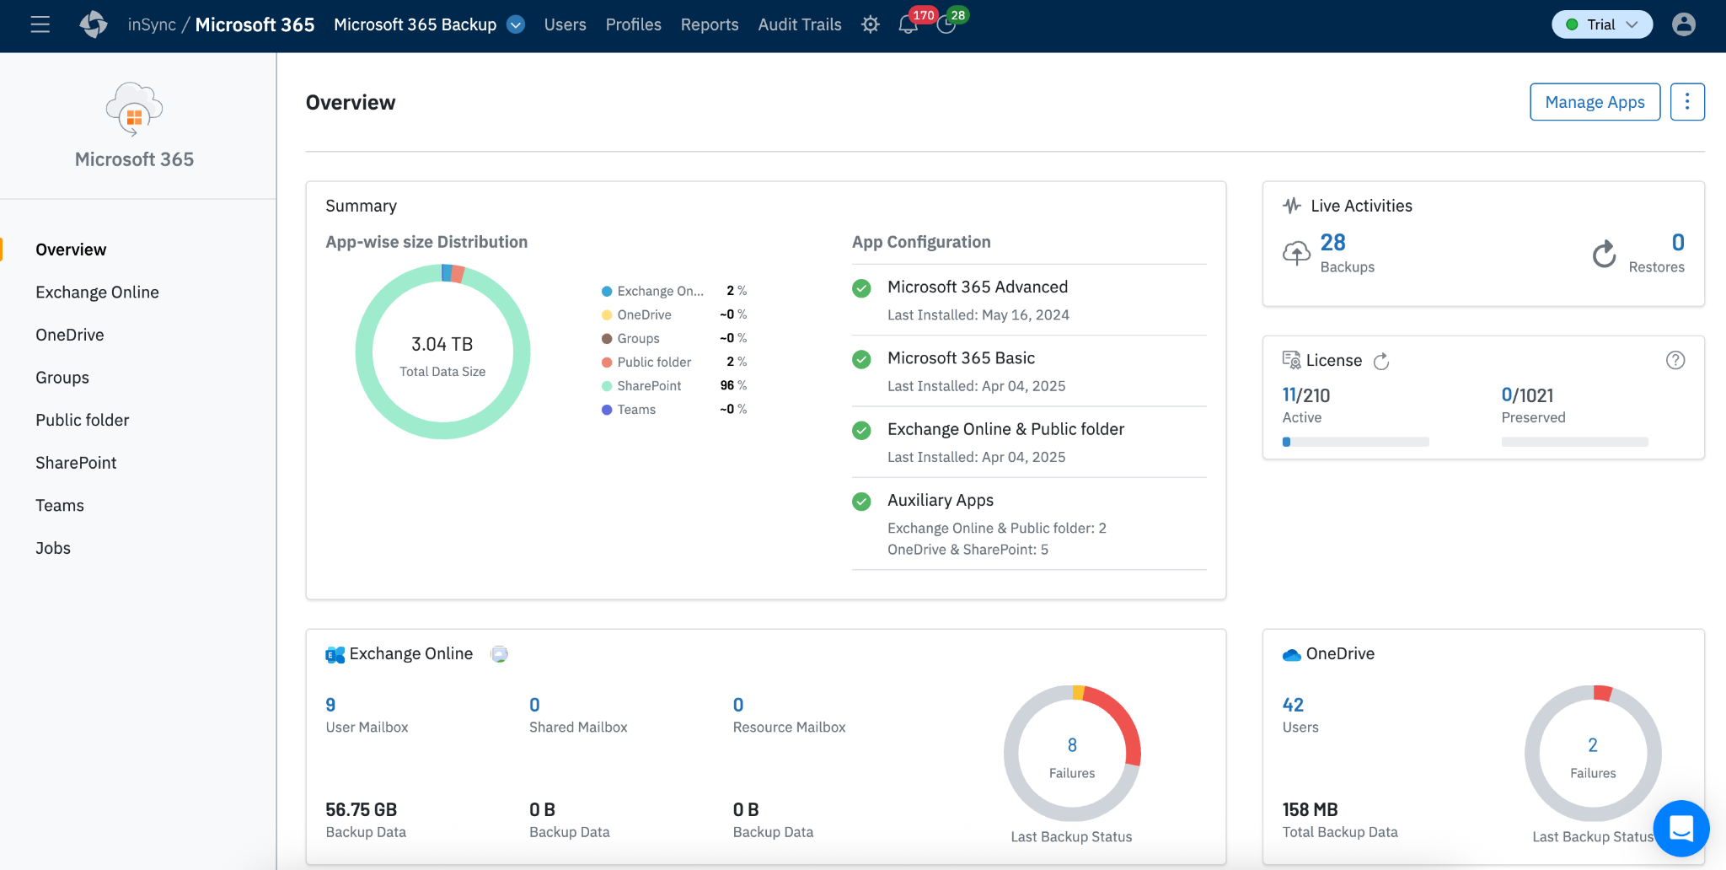
Modern Data Protection: Fast, Immutable, Resilient
Smarter Storage Efficiency
Global deduplication, incremental, high-speed backup and unlimited retention
Resilient, Ransomware-Proof Protection
Secure, air-gapped backups that attackers can’t touch
Immutable by Design
Data Lock ensures backups are tamper-proof, undeletable, and compliance-ready
Notes:
Druva Cloud Data Backup & Recovery
Full-featured protection for Microsoft 365:
One console for Exchange, SharePoint, OneDrive, Teams, and more.
Unlimited retention and granular restores for compliance and legal hold.
Deduplication + forever-incremental backups to save space and speed performance.
100% SaaS with air-gapped, immutable storage to block ransomware and insider threats.
Druva M365 Backup Express
Fast, streamlined backup for lighter needs:
Easy deployment via Azure Marketplace with MACC support.
Quick backup and bulk recovery for Exchange, SharePoint, OneDrive, and Entra ID.
1-year retention, hosted in Microsoft’s secure infrastructure.

Slide 14
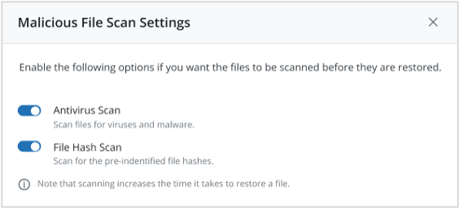
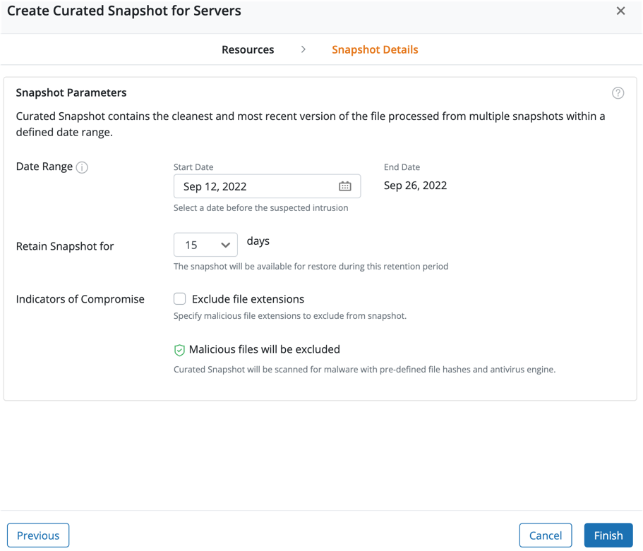
Fast & Clean Recovery with Curated Snapshot
Curated Recovery
Automatically recover the most recent, clean version of every file
Bulk Recovery
Recover fast without API throttling
Recover with Confidence
Scan snapshots for malware and IoCs during recovery
Automate Incident Response
Quarantine infected data to ensure clean, secure recovery
Notes:
Druva Cloud Data Backup & Recovery
Full-featured protection for Microsoft 365:
One console for Exchange, SharePoint, OneDrive, Teams, and more.
Unlimited retention and granular restores for compliance and legal hold.
Deduplication + forever-incremental backups to save space and speed performance.
100% SaaS with air-gapped, immutable storage to block ransomware and insider threats.
Druva M365 Backup Express
Fast, streamlined backup for lighter needs:
Easy deployment via Azure Marketplace with MACC support.
Quick backup and bulk recovery for Exchange, SharePoint, OneDrive, and Entra ID.
1-year retention, hosted in Microsoft’s secure infrastructure.

Slide 15

Save Time and Reduce Data Loss with Automation
Curated Recovery:
Saves time and data
Daily
Snapshot
121
122
123
124
125
126
127
128
File-1
v5
File-1
v1
v2
v2
v3
v3
v4
v5
File-2
v2
File-2
v1
v1
v1
v2
File-3
v3
File-3
v1
v2
v3
File-4
v3
File-4
v1
v2
v2
v3
File-5
v1
File-5
v1
Automatically finds the most recent clean version of each file and adds it to a single “curated snapshot”
Notes:
Snapshot 124 is free of encrypted files
Data loss in File 1, 3 & 4

Slide 16
Druva Capabilities for Your Cyber Resilience Journey
Level 5: Enhance Detection
Proactive Threat Defense
Gen AI Cyber Investigation
Level 4: Cyber Investigations
AI and ML-based threat detection
SIEM and AI Integration
Level 3: Cyber Remediation
Fast, Curated and Clean Recovery
Level 2: Backup Security
Zero Trust Platform 24x7x365 Monitoring
Level 1: Data Immutability
Immutability, Air gap
Notes:
“You’ve nailed the fundamentals with Druva — immutable backups and a Zero Trust-secured environment. Now it’s time to close the loop with real-time cyber intelligence and faster, cleaner recovery. Levels 3 to 5 unlock a proactive security posture, bringing forensic depth, AI-driven detection, and response-ready cyber resilience to your data protection strategy.”
🟩 Why this matters: These two levels provide strong data protection — but they are reactive. True cyber resilience requires detection, response, and remediation capabilities.
🔵 Level 3: Cyber Remediation
Key Function: Fast, Clean Cyber Recovery
Customer Value:
Rapid isolation and recovery of clean data after an attack.
Automated workflows that reduce Mean Time to Recovery (MTTR).
Minimized business downtime and revenue loss.
Druva Differentiator: Clean snapshot identification and automated restoration eliminate the guesswork of ransomware recovery.
🔵 Level 4: Cyber Investigations
Key Functions:
AI and ML-based threat detection
XDR/SIEM and Security AI Integration
Customer Value:
Identifies unusual behaviors in backup activity (e.g., mass deletions, encryption spikes).
Integrates with broader security ecosystems (e.g., SIEMs) for forensic traceability.
Provides visibility into what was compromised and when — critical for legal, compliance, and incident reporting.
Druva Differentiator: Context-rich anomaly detection in backup data, enriched with AI models, often catches issues missed by traditional EDR/XDR tools.
🔵 Level 5: Enhance Detection
Key Functions:
Proactive Threat Defense
Gen AI Cyber Investigation
Customer Value:
Uses GenAI to interpret threats and accelerate root-cause analysis.
Shifts response posture from reactive to proactive.
Surface-level indicators become deep insights (e.g., “why this system was targeted”).
Druva Differentiator: GenAI reduces dependency on overworked analysts by automating the first level of cyber triage using backup and behavior metadata.

Slide 17
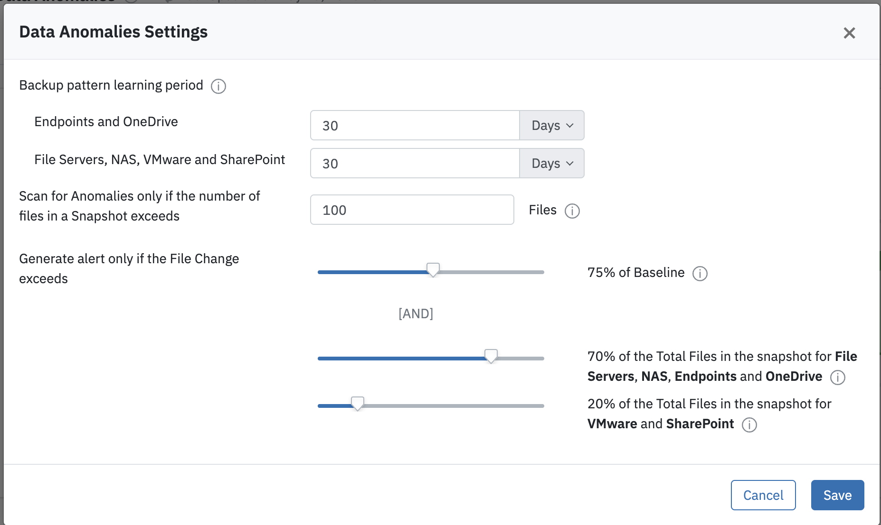
AI & ML-Driven Threat Detection with Data Anomalies
Accelerate Incident Response
Act faster with automated threat response
Improve Data Resiliency
Ensure uptime with self-healing protection
Streamline Investigation
Simplify forensics with unified visibility
Notes:
AI and ML-driven Threat Detection (Druva Data Anomaly Detection) 🚀 Key Benefits
⚡ Accelerate Incident Response
Automates anomaly detection and alerting based on behavioral deviations in backup patterns.
Detects threats early and reduces mean time to respond (MTTR) with intelligent thresholds.
Enables faster containment through policy-driven actions.
🔁 Improve Data Resiliency
Ensures data availability and integrity with self-healing protections.
Automatically detects and corrects abnormal file change patterns across endpoints, NAS, VMware, and cloud apps.
Configurable thresholds for anomaly detection safeguard continuity.
🔍 Streamline Investigation
Centralized anomaly dashboard unifies forensic visibility across workloads.
Simplifies root cause analysis with customizable anomaly detection rules.
Empowers SecOps with tunable thresholds (e.g., % file change, # files impacted).
📊 Visual Configuration Example: Data Anomaly Settings Panel
Backup pattern learning period configurable per workload type (e.g., Endpoints vs. VMware).
Anomalies flagged based on file count thresholds and baseline deviation percentages.
Adaptive alert settings for different workloads (e.g., stricter detection for endpoints vs. SharePoint).

Slide 18




Integration with Microsoft Sentinel & Security Co-Pilot
Defeat Cyber Threats
Augment SIEM with Backup Telemetry from Druva
Better Ransomware Response and Remediation
Improved Incident Response
Enhance detection & security effectiveness with Security Co-Pilot
Data Security Cloud
Confidentiality
Immutability
Reliability
Durability
Availability
Notes:
Druva integrates backup telemetry directly into Microsoft Sentinel and Security CoPilot.
This bridges the gap between IT backup and Security operations — faster detection, richer insights, better response.
SIEM Integrations Strengthen Cyber Resilience & Fill Security Gaps
Druva’s SIEM integrations provide real-time insights into data security events, improving threat detection & response.
Helps customers bridge gaps in their cybersecurity posture, aligning with industry frameworks like NIST and Cyber Maturity Models.
Positions Druva as a critical piece in the broader security ecosystem.

Slide 19
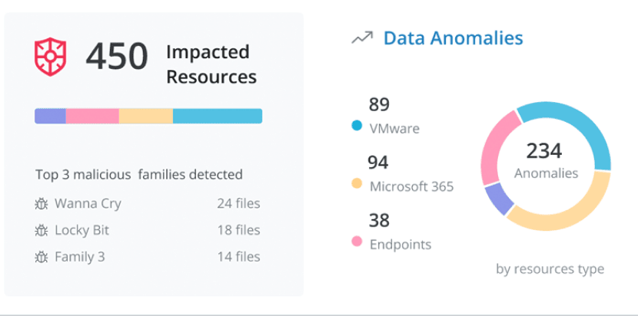
Proactive Threat Defense with Managed DDR (MDDR)
24x7 Expert Threat Monitoring
Continuous surveillance of backups
AI-Driven Anomaly Detection
Identify unusual data patterns
Automated Backup Lockdown
Prevent active threats & accelerate recovery
Notes:
Proactive Threat Defense with Druva MDDR
Druva MDDR offers a multilayered approach to threat mitigation, with expert monitoring, AI-driven detection, and automated response—all focused on ensuring data protection and accelerating recovery.
🛡️ 24x7 Expert Threat Monitoring
Value: Continuous surveillance of backup environments Message:
Druva’s MDDR team provides round-the-clock monitoring of backup data.
This 24x7 visibility helps detect malicious activities as they occur—even if endpoint or network defenses fail.
Example: 450 impacted resources were identified and triaged—showcasing live threat visibility.
🤖 AI-Driven Anomaly Detection
Value: Early warning system for unusual behavior Message:
Druva leverages machine learning to analyze backup behaviors across environments (VMware, M365, Endpoints).
It flags unexpected deletions, file modifications, or ransomware-like activity.
Example:
234 anomalies detected across platforms:
94 Microsoft 365
89 VMware
38 Endpoints
Top threats like Wanna Cry, Locky Bit, and others are immediately flagged for response.
🔐 Automated Backup Lockdown
Value: Fast containment of threats, reduced blast radius Message:
Once anomalies are detected, Druva can automatically lock down backups, preventing further encryption or deletion by malicious actors.
This safeguards clean restore points and accelerates recovery.
Accelerated recovery becomes possible because clean backup copies are isolated from live threats.
📊 Actionable Forensics Dashboard
Value: Enhanced threat response with clear visibility Message:
The dashboard in the screenshot offers real-time insights:
Impacted files
Affected platforms
Malware families
It simplifies forensic investigation and compliance reporting.

Slide 20
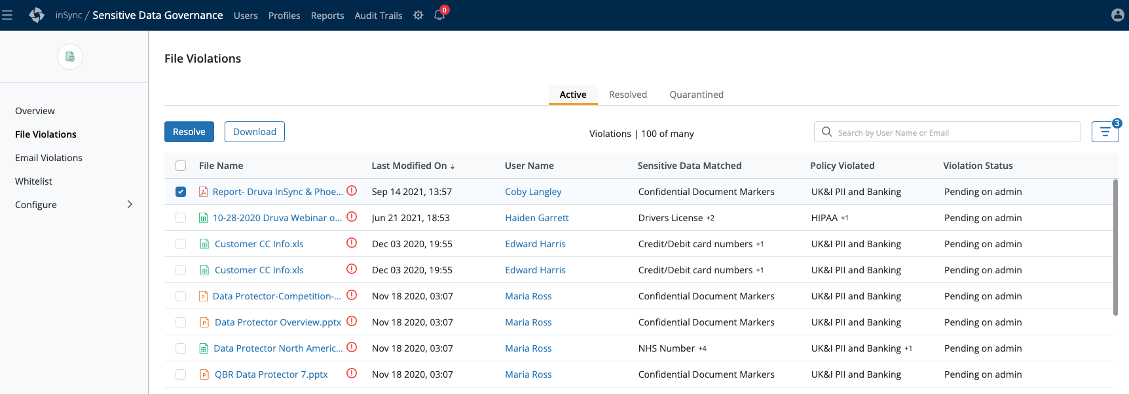
Unified Data Governance and Compliance
Sensitive Data Governance
Automatically detect, govern, and remediate policy violations for regulated data like GDPR, HIPAA, and CCPA
Federated Search
Instantly locate files, emails, or sensitive data across all Microsoft 365 users from a single interface
eDiscovery Legal Hold
Preserve and protect user data immutably for legal and compliance needs across M365 workloads
Notes:
Proactive Threat Defense with Druva MDDR
Druva MDDR offers a multilayered approach to threat mitigation, with expert monitoring, AI-driven detection, and automated response—all focused on ensuring data protection and accelerating recovery.
🛡️ 24x7 Expert Threat Monitoring
Value: Continuous surveillance of backup environments Message:
Druva’s MDDR team provides round-the-clock monitoring of backup data.
This 24x7 visibility helps detect malicious activities as they occur—even if endpoint or network defenses fail.
Example: 450 impacted resources were identified and triaged—showcasing live threat visibility.
🤖 AI-Driven Anomaly Detection
Value: Early warning system for unusual behavior Message:
Druva leverages machine learning to analyze backup behaviors across environments (VMware, M365, Endpoints).
It flags unexpected deletions, file modifications, or ransomware-like activity.
Example:
234 anomalies detected across platforms:
94 Microsoft 365
89 VMware
38 Endpoints
Top threats like Wanna Cry, Locky Bit, and others are immediately flagged for response.
🔐 Automated Backup Lockdown
Value: Fast containment of threats, reduced blast radius Message:
Once anomalies are detected, Druva can automatically lock down backups, preventing further encryption or deletion by malicious actors.
This safeguards clean restore points and accelerates recovery.
Accelerated recovery becomes possible because clean backup copies are isolated from live threats.
📊 Actionable Forensics Dashboard
Value: Enhanced threat response with clear visibility Message:
The dashboard in the screenshot offers real-time insights:
Impacted files
Affected platforms
Malware families
It simplifies forensic investigation and compliance reporting.

Slide 21

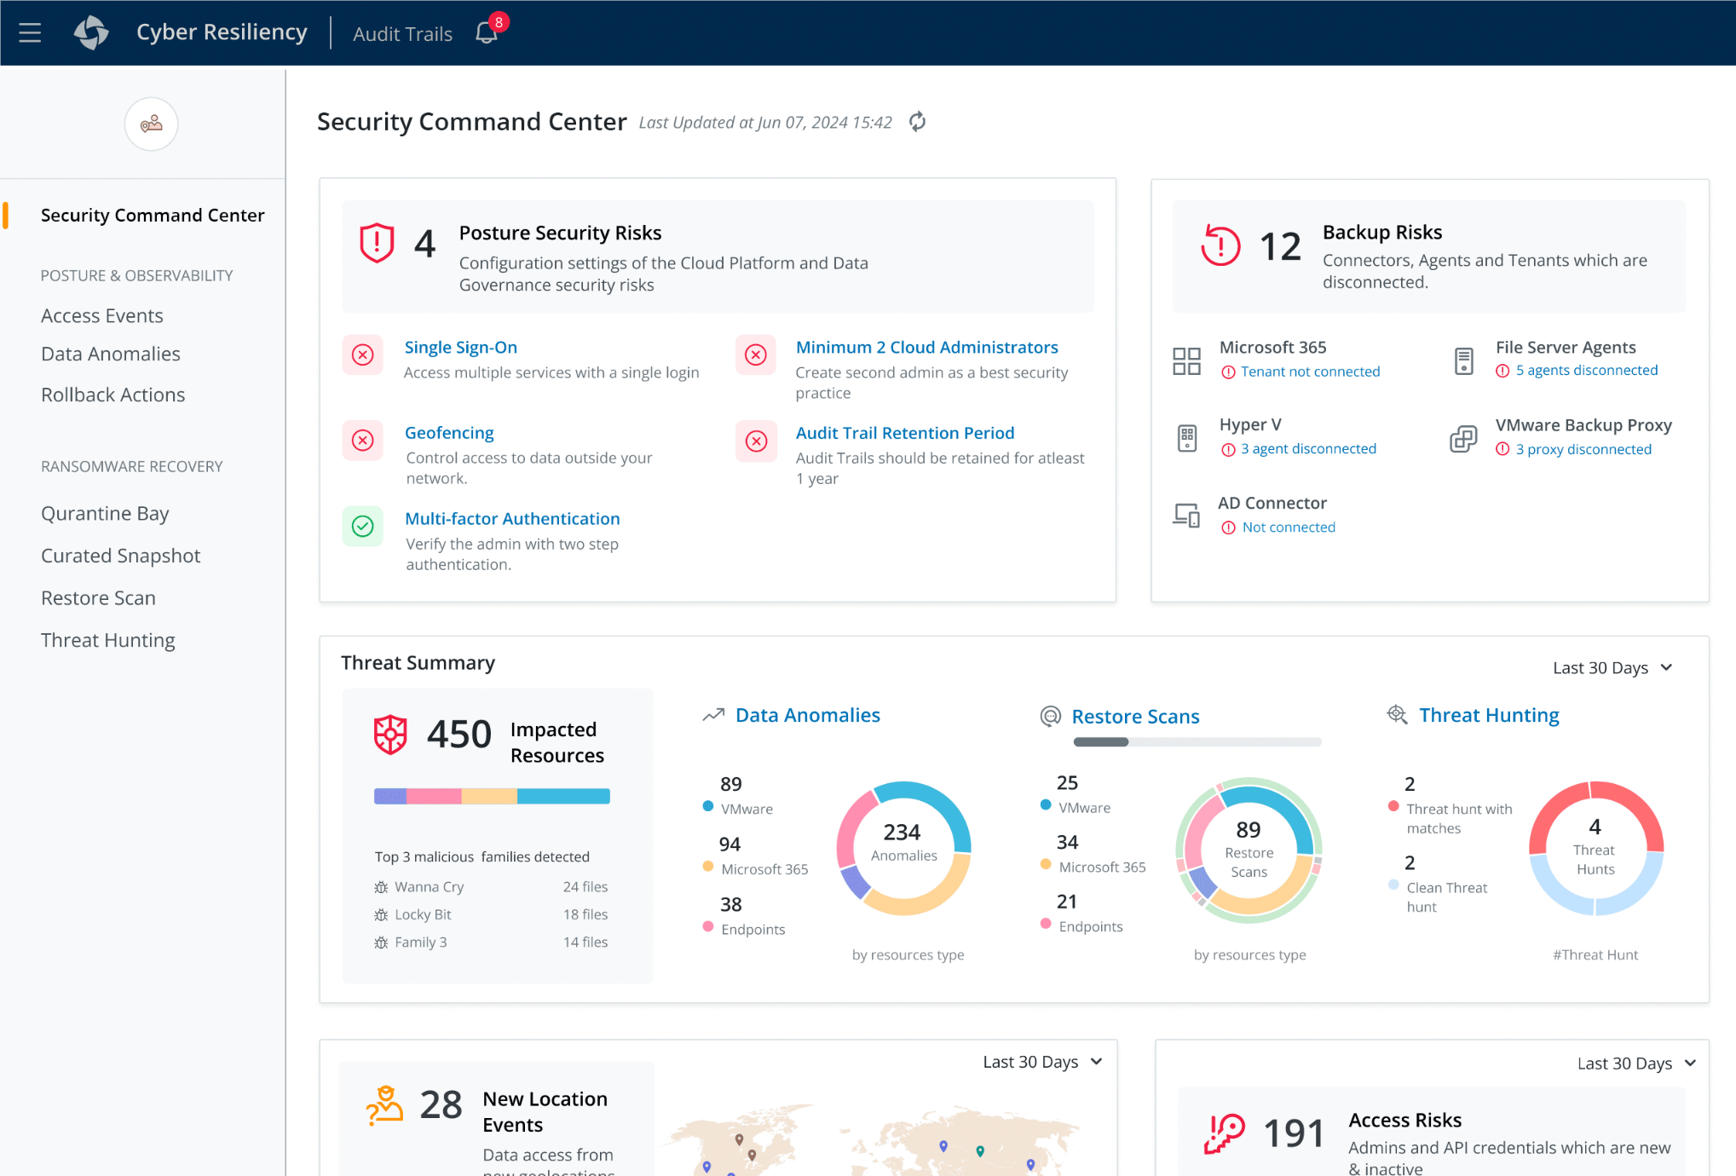
Getting Started With Druva
Start a Free Trial
Take a Product Tour
Schedule a Tabletop Exercise

Slide 22
& meet us at C2

