Slide 1
AI based attacks, the big shift.
January 1st, 2025
Notes:
This is a Title Slide. Click the Headline text to add your presentation title. Click the smaller text to add the name and title of the presenter(s).

Slide 2

About
3 Decades in Cybersecurity
From mischief to profession
Nation State Offensive engineering
Design and build of defense systems
Mission Vision Strategy and Operation
Several Cybersecurity startups

Slide 3
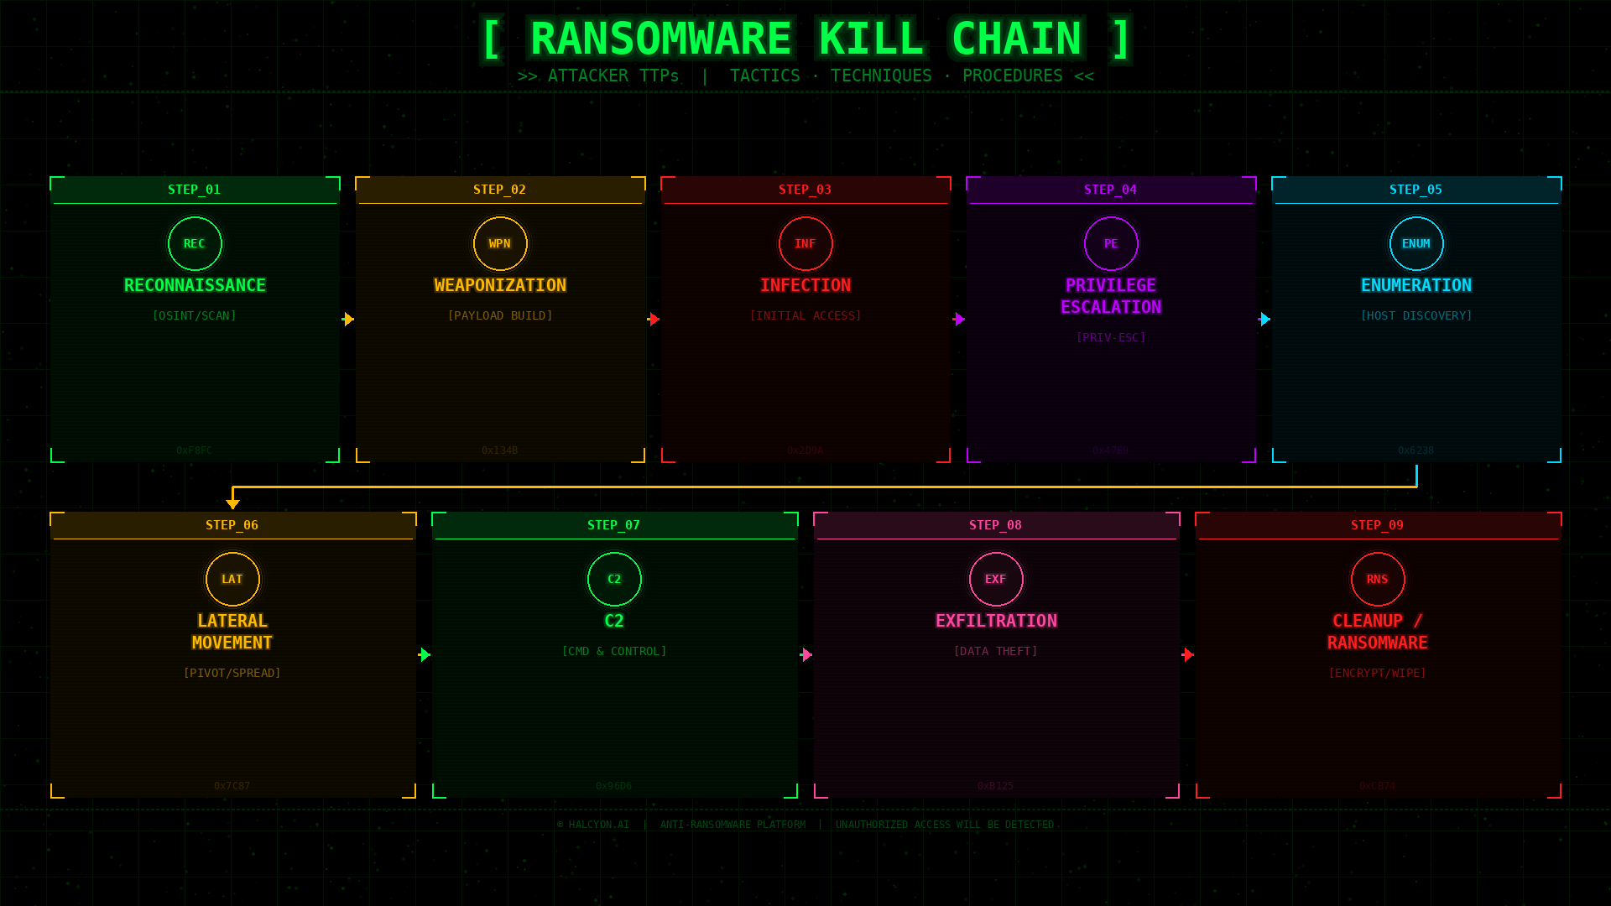

Slide 4

My first serious AI wake-up call in 2018
2018 live IR assignment after infiltration
Reverse hack with exfiltration
Attacker AI investigation

Slide 5

Implications of AI in cyber attacks
Incredibly fast acceleration of the kill chain (AI recon, weaponization and operation)
Autonomous malware
Limited C2
MTTX is failing (architectural designs and limitations contribute)
And sadly much more…..

Slide 6

Fun facts
Common Dwell Time
    26 days
    16 days (64% notified by external source)
    13 days (54% notified by external source)
    2.5 days
    Very peculiar numbers… .Why did this happen? Did the industry get better at detecting threats??
    No……
    Activity is much quicker (they were in longer before)
    Exfil is much quicker

Slide 7
AI in the hands of the attacker
Automated exploit discovery
AI generated malware
Deepfake social engineering
Hyper-personalized phishing at scale
Reconnaissance automation
Infiltration automation and persistence
The battle of AIs
This is just the beginning…………

Slide 8

What needs to change?
Build a faster setup. The epi-center will be AI.
Stop putting your telemetry collection on a diet. Richness of data!
Get a mandate to respond and automate… Respond… ask questions later.
Train on your SOC outcomes. Create confidence levels and take automated actions based on that.
Use build-in operating system mechanisms. (auto lock accounts for example)
Use new upcoming AI Tech (Swarm AI, Agentic AI, GenAI protection etc)
AI driven SOC
Put automated SMART controls back on the ENDPOINT!!!!

Slide 9
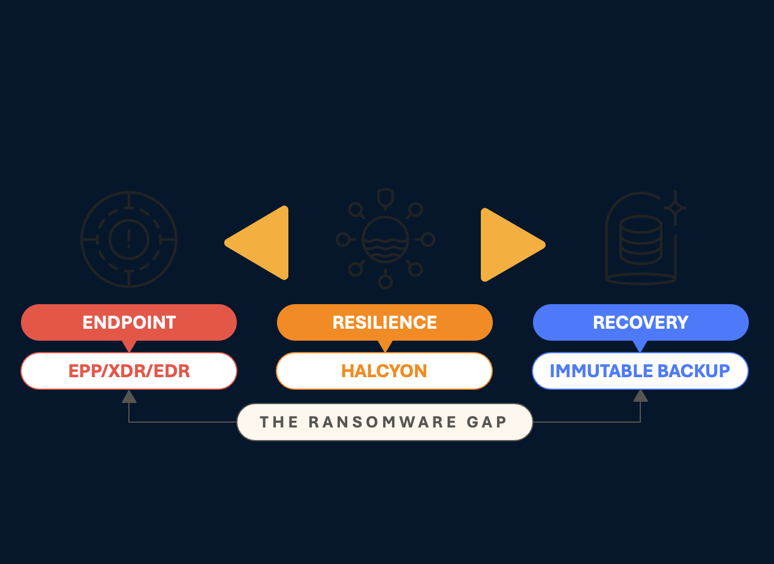
SMART Controls with Halcyon
Halcyon provides an endpoint Ransomware Resilience solution.
It closes the ransomware GAP
Captures encryption keys for decryption. No more ransom payments.
Encryption immunity module. No file shall be maliciously encrypted
Stop exfiltration with DXP (Data Exfiltration Protection)

Slide 10
Notes:
This should be your last slide of your presentation. You can also use the “Halcyon Light Theme” Master or “Dark Theme” to add visual contrast.

