Slide 1
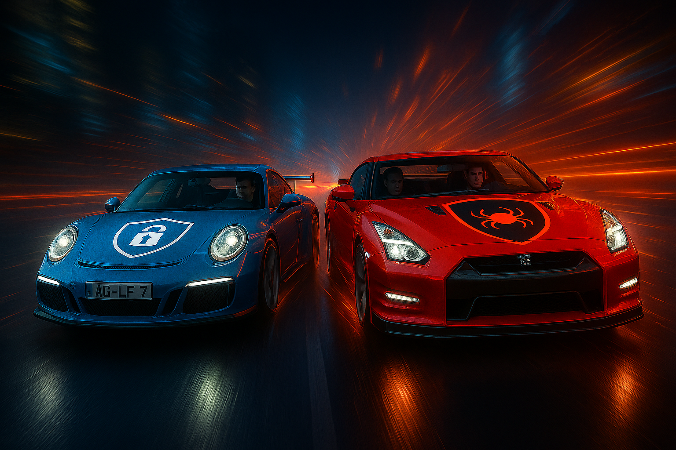
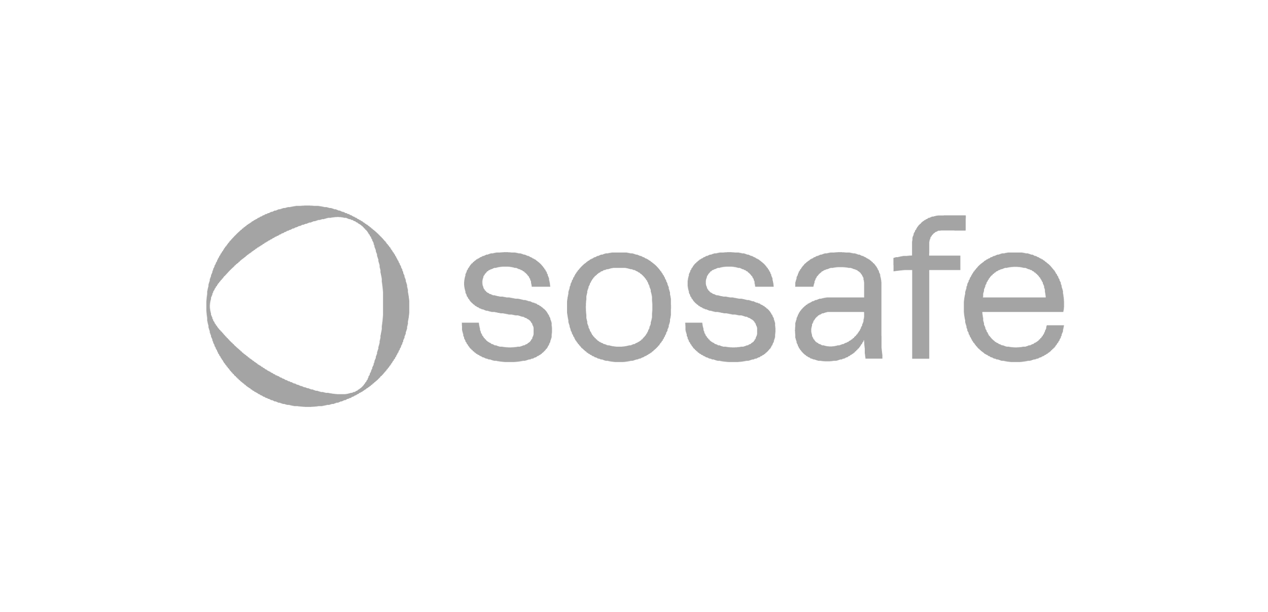
Need for Speed
Mensch. Geschwindigkeit. Kultur.

Slide 2
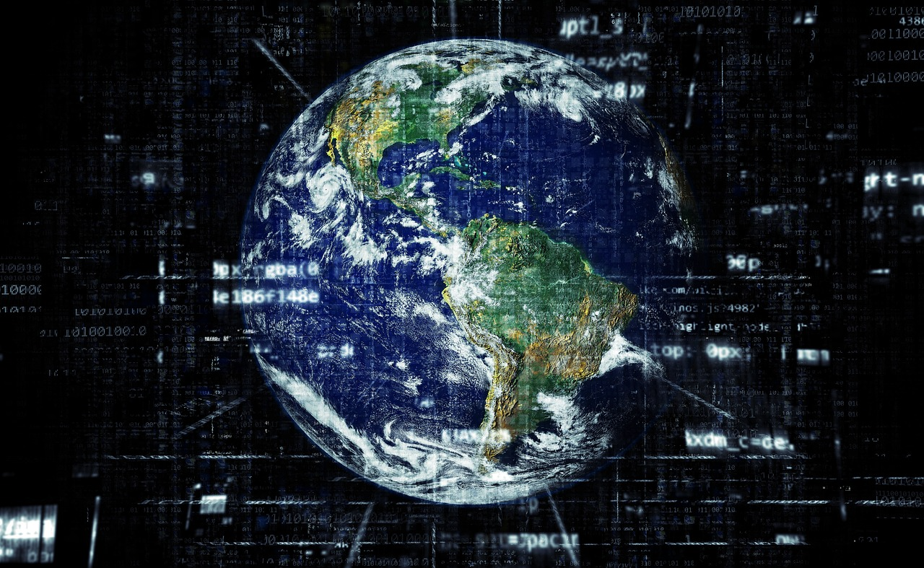

Slide 3
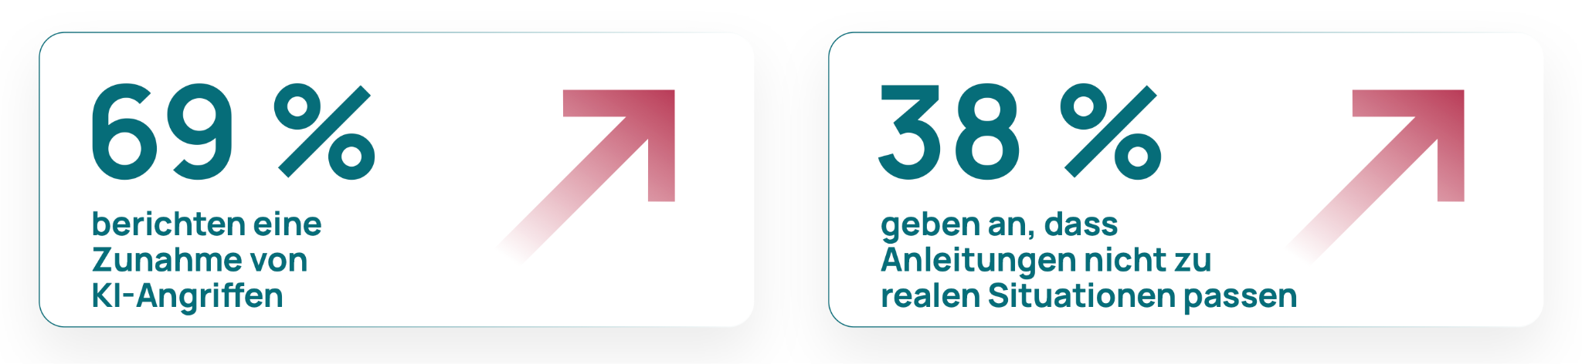
Status Quo

Slide 4
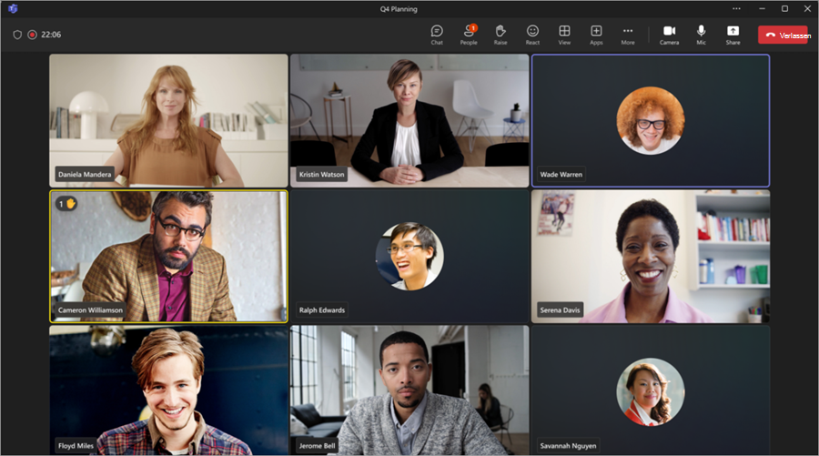
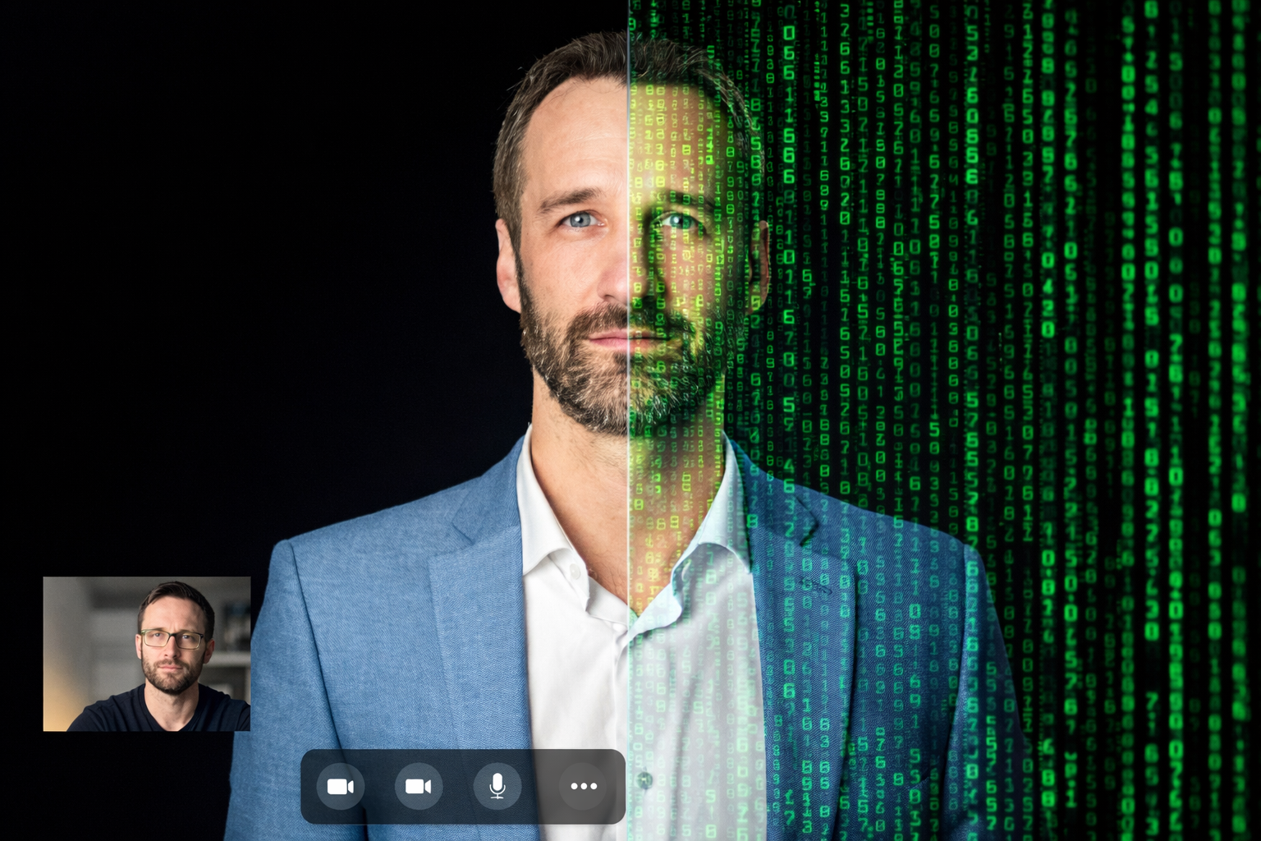
True Crime -
Wenn Deepfakes Realität werden

Slide 5
Klartext
AI Angriffe sind kein Zukunftsszenario und mehr als gut geschriebene Mails
Komplexität und Qualität der Angriffe steigen
Wir sind diesen Angriffen nicht schutzlos ausgeliefert
Angreifer werden immer schneller. Wir auch?

Slide 6




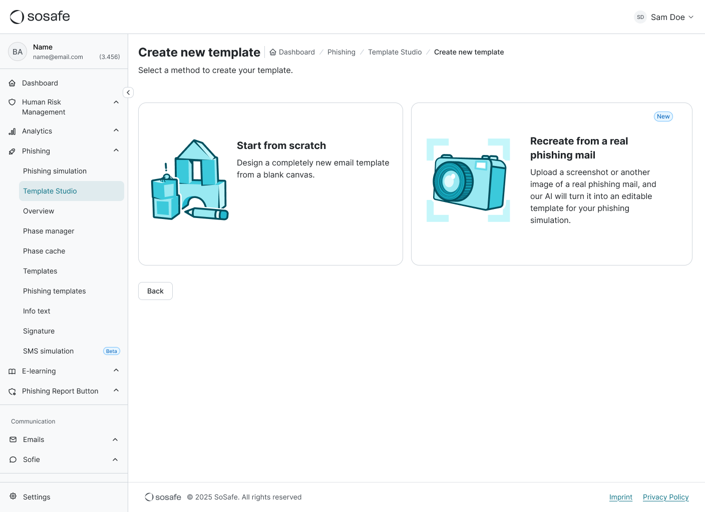
Need 4 Speed
Recreate Attack
Notes:
Excited to introduce Recreate Attack. New feature bridges this gap.
Instead of blank canvas, upload screenshot of actual phish.
AI instantly creates editable, safe simulation template.
Handle translations. Keep learning consistent across globe.
Status: Recreate Attack is moving into Beta this quarter. Preview.

Slide 7
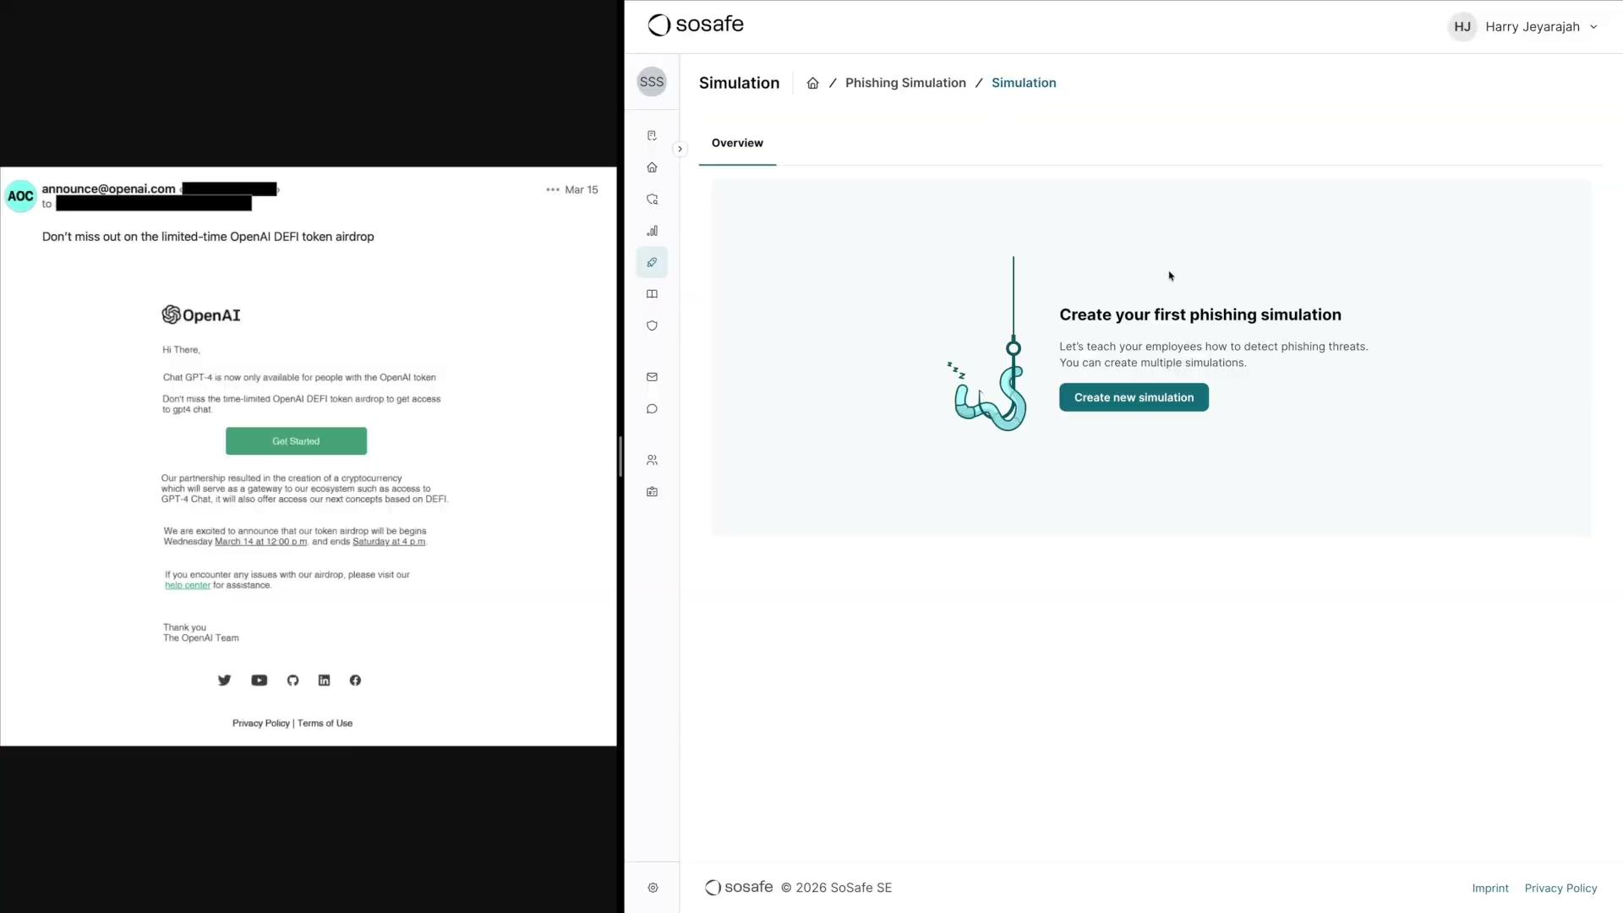
Notes:
Let's see this in action. I’m in the SoSafe Manager. Instead of starting from scratch and building HTML blocks or prompting the AI, I go to the Template Studio and select 'Recreate Attack'. This is where we flip the script on the attackers.
I take a standard screenshot of that exact OpenAI phishing mail we just looked at, and you simply upload it here. you don't need the EML file. Just the image.
Now, the template engine works in the background. It’s extracting the text, identifying the logos or images to recreate, it translates the content to different languages if needed, assesses the difficulty level and mapping the malicious links to our SoSafe learning pages.
You don't have to wait and watch a loading bar; you can keep working... and there's the notification when it’s ready. So obviously for the demo I accelerated this whole process, in reality it would take a few minutes to finish.
And this is a key strength of SoSafe. We don’t lead with fear. We turn each of these threats into learning moments to drive behavioral change.

Slide 8
Take Aways

Slide 9
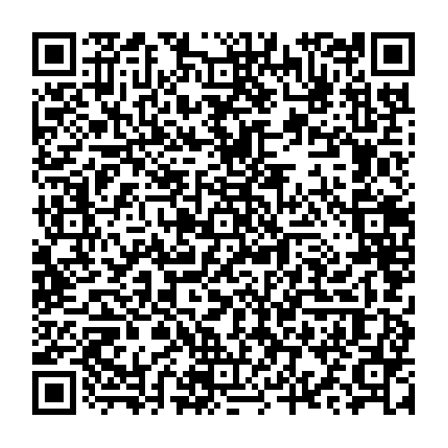

Sprechen wir über Ihre Adaptive Verteidigung
Stand C4

