Slide 1
Macht der Transparenz: Angriffsflächen mit Exposure Management minimieren
Jonas Weyand
Senior Security Solutions Engineer

Slide 2
“Only 17% of organizations can clearly identify and inventory a majority (95% or more) of their assets.”
The Problem
- Gartner’s Cybersecurity Controls Assessment Benchmark 2023

Slide 3

The Security Visibility Gap
Decreasing Visibility
Visibility Gap
Increasing Risk
Increasing Attack Surface
Evolution of Digital Infrastructure
Legacy
Virtual
Hybrid
Containerization
Edge
Siloed Technology Ecosystem

Slide 4














IOT
Fragmented Attack Surface Challenges Productivity, Efficiency, Credibility
CLOUD
SAAS
NETWORK
Security
Focus
BYOD
MORE DATA TO SYNTHESIZE
Challenged to keep up with volume of change to get a cohesive understanding of your total attack surface that you can trust
SERVERS
VMs
CONTAINERS
COMPLEX SYSTEMS INTEGRATIONS
Caught in a web of disparate, conflicting sources to try to get effective context, make decisions, and know where to focus
ENDPOINTS
AI/ML
IDENTITIES & USERS
APIs
INCREASING BUDGET DEMANDS
Escalating investments in technologies and training, as teams become more burnt out and struggle to point to ROI
WEB
DOMAINS
SUPPLY CHAIN
Notes:
What we have seen and what we hear on repeat from security and risk practitioners like you, is that sprawling attack surface demands high volumes of data to assess and monitor your technology footprint. But the dynamic nature of modern business operations and the constantly evolving threat ecosystem makes successful data management across the attack surface impossible. Teams will always be chasing:
More data
More systems
More budget
[Breaking it down]
Exponential data growth has left teams running down disparate data sources to try to understand and visualize their total attack surface - without success. Teams have accumulated numerous point solutions to try to keep pace with business growth - but it's actually intensifying the problem.
With more systems, teams are actually collecting more data than ever, but getting less and less from it. Security practitioners are consumed by systems integration - trying to create connection between a myriad of different solutions.
This lack of connection makes it impossible to get the context and clarity needed to actually make sense of data, know what to prioritize, and where to focus. And this inefficiency comes at a huge operational and technical cost.
Attackers are able to exploit this data sprawl - hiding in mountains of data and banking on your inability to visualize your attack surface and identify the insights that matter.

Slide 5






Organization’s Lack Accurate Visibility
Data Reconciliation
ASSETS
68,234
THREATS
18,345
VULNS
456,789
CONTROLS
78% EPP
60,123
35,532
10,749
64,278
25,749
580,900
92%
TRUE ATTACK SURFACE
52,789
22,874
360,356
64%
16,874
64, 321
40, 749

Slide 6
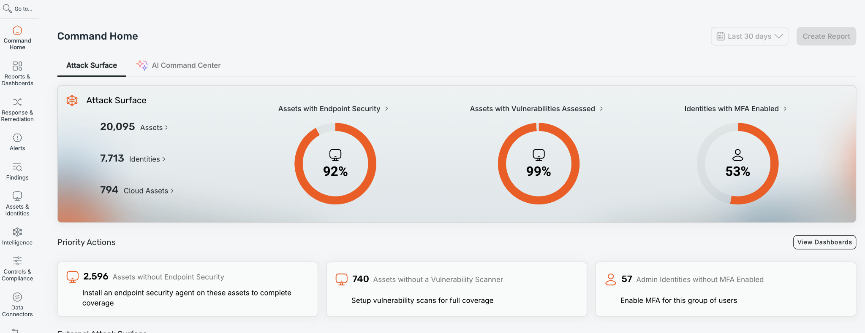
Endpoint to Cloud with Exposure Command

Slide 7
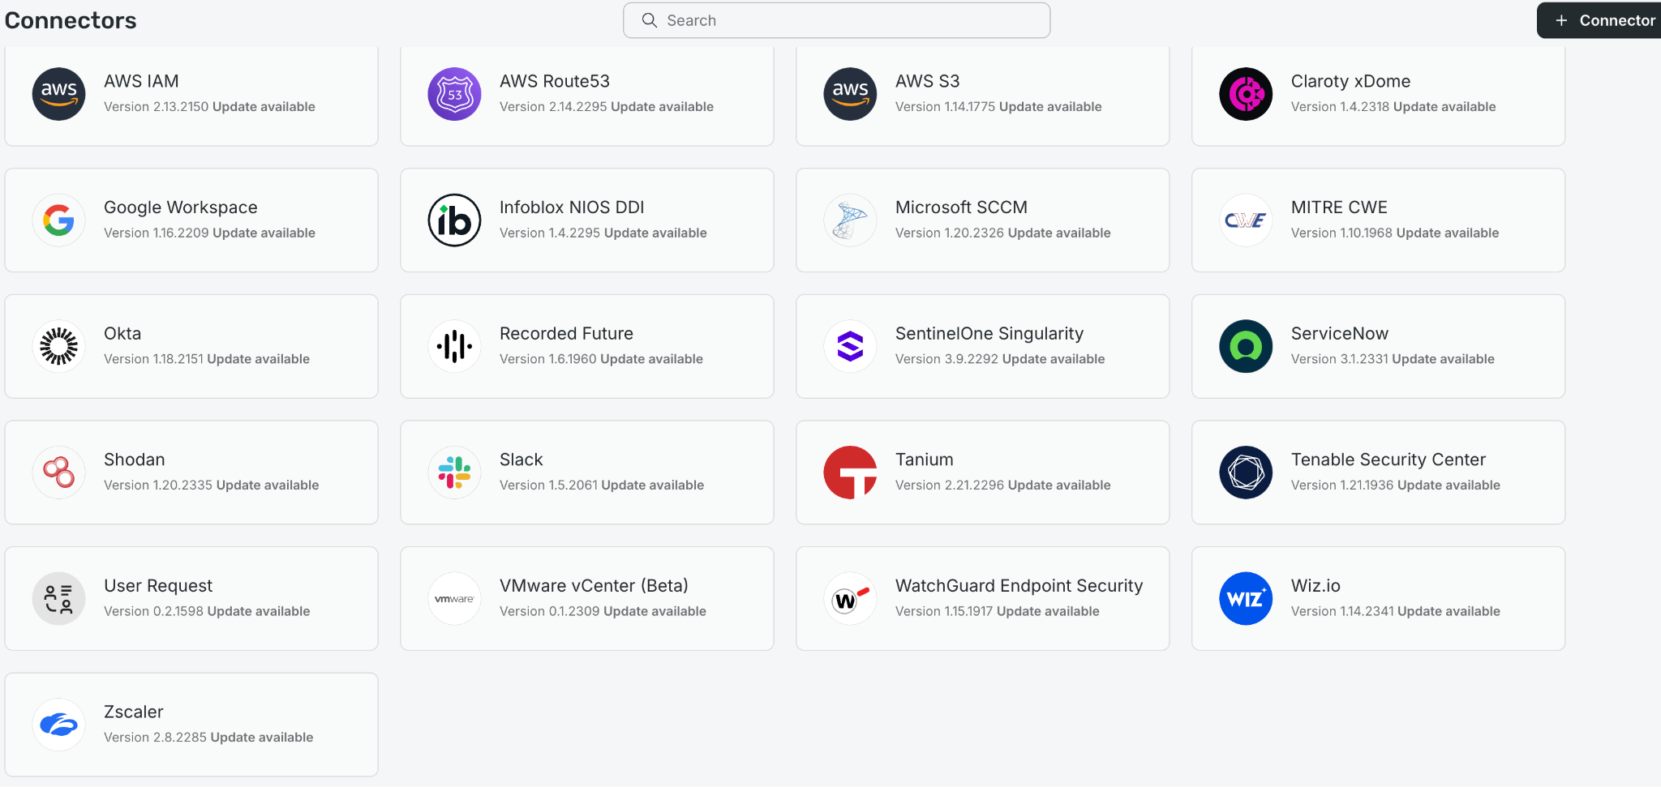
Connectors

Slide 8
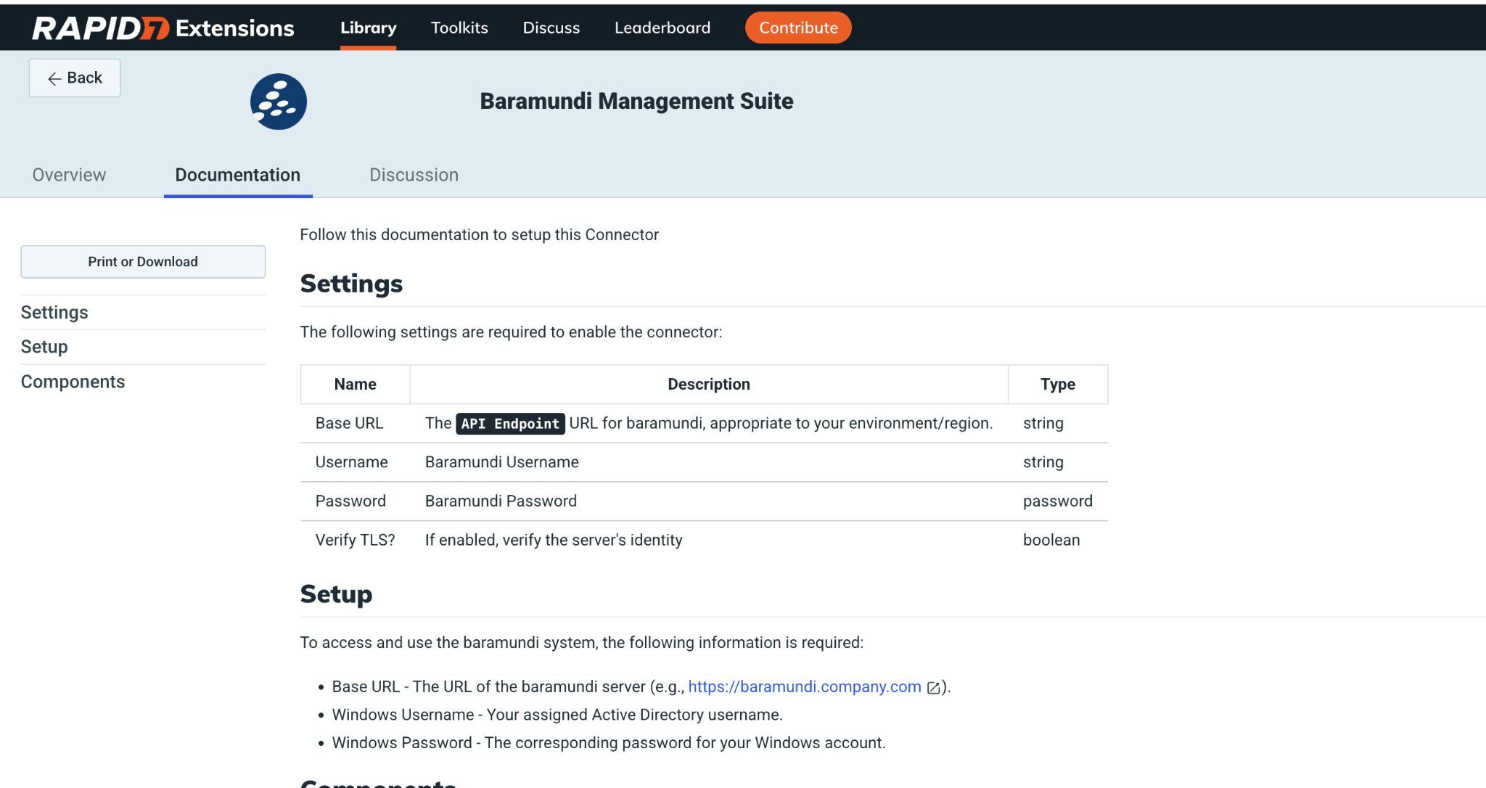
Baramundi

Slide 9
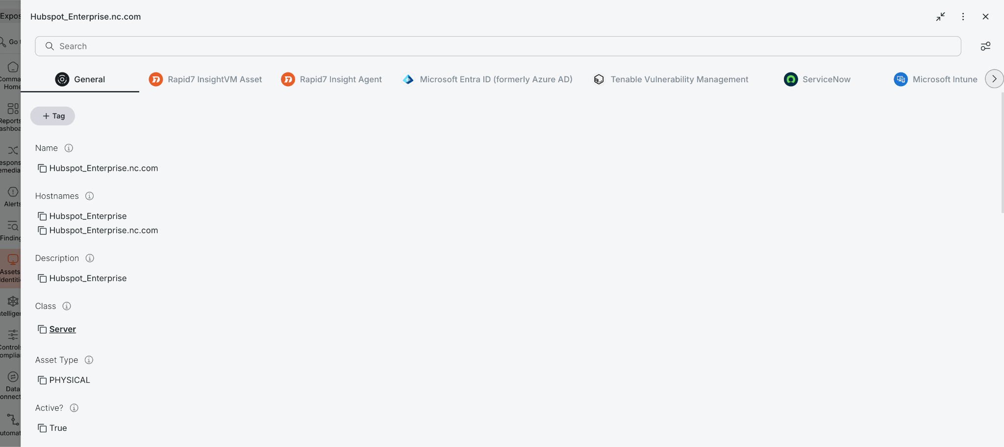
Asset view

Slide 10
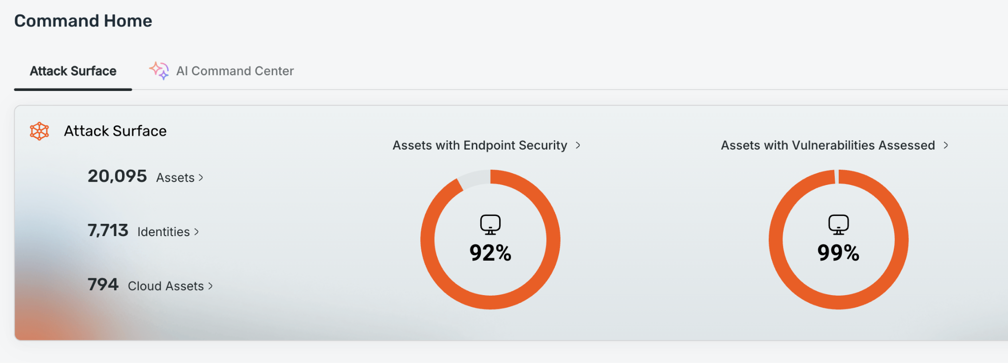
Visualize Your Assets

Slide 11
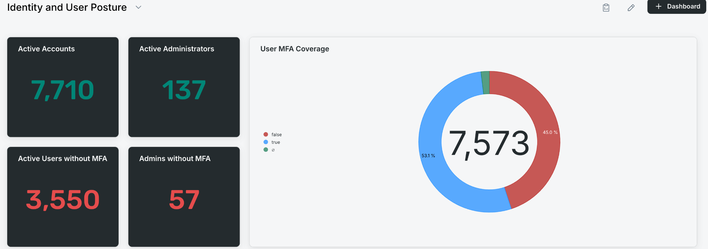
Visualize Your Identities

Slide 12
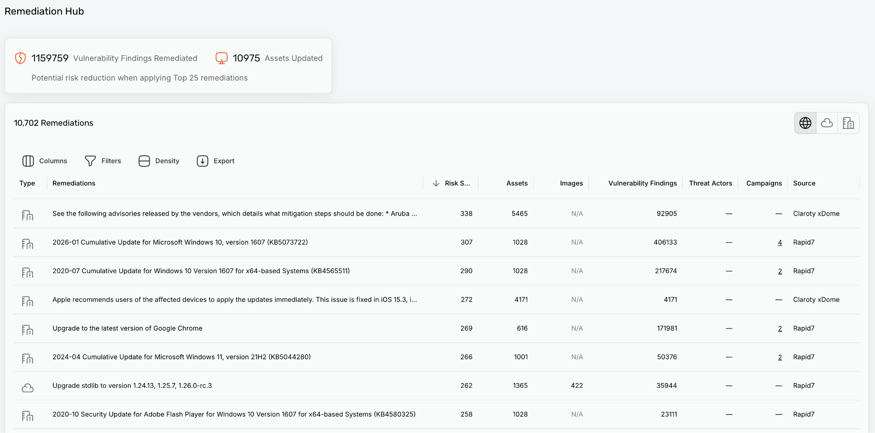
The Greatest Impact With:

Slide 13
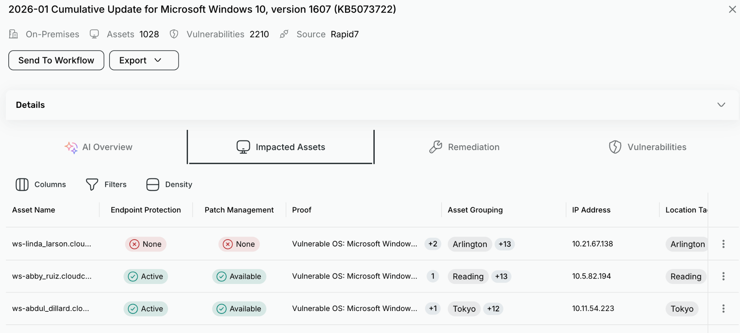
More Context more insights

Slide 14
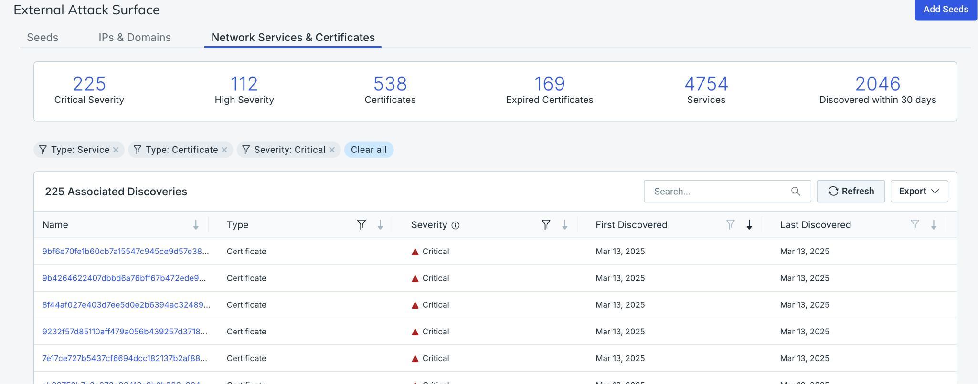
Visualize Your External Attack Surface

Slide 15
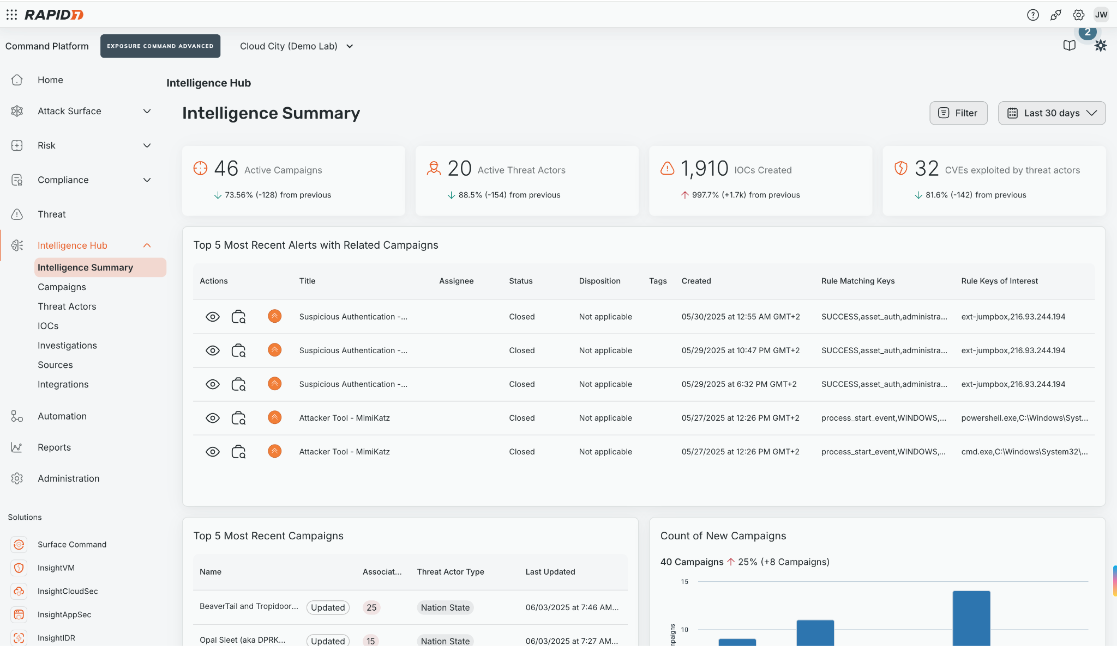
Transparency & Visibility: Powered By The Intelligence Hub

Slide 16
Sprechen Sie uns gerne an
sales-dach@rapid7.com

