Slide 1
RESILIENCE FOR EVERYTHING
How to ensure Business Continuity across Cloud, Identity and AI

Slide 2








Can Your Team Answer These Questions?
Determine scope
of attack
What data was compromised? What was encrypted?
Determine point
of infection
At what point was data compromised? Can we quickly identify clean recovery points?
Assess sensitive data impact
What sensitive patient data was exfiltrated?
Find
malware and quarantine
Can we find all locations of malware? Can we isolate malware to prevent re-infection?
Restore
from backup
Did our backups survive?
Time
Notes:
And, then finally you’ll need to ask:
Did our backups survive? Were credential compromised and backups expired? Backups may be immutable, but that’s no guarantee
Legacy backup and recovery doesn’t give you these insights into the cyberattack, which is required for a surgical, rapid, and successful recovery.
Cyber RTO extends by 100X, without the essential ingredients of cyber resilience.

Slide 3
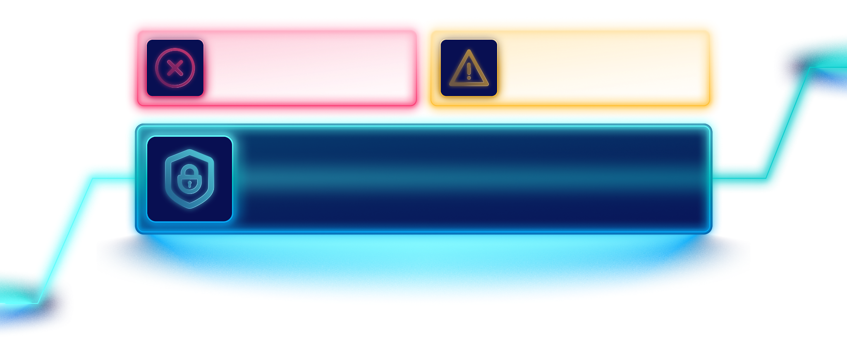
Courses of Action
Hope it won’t happen
Brace for impact
Have a cyber recovery blueprint
Notes:
So, what can we do about the chaos that cyberattacks bring? You can:
hope it won’t happen to us: That’s not a strategy. It’s wishful thinking at best.
brace for impact: less than adequate preparation, like showing up to a rainstorm with an umbrella—just not enough.
become cyber resilient: The only wise and forward-thinking decision.
This means preparing ahead of time, testing everything out, and executing plans flawlessly.

Slide 4



What It Takes
Clean Cyber RPO
Ability to restore to a clean state, free from re-infection risks.
Fast Cyber RTO
Ability to get your business back up and running quickly.
Notes:
To get there, you can measure your maturity using two concepts:
Clean Cyber RPO: Ability to restore to a clean state, free from re-infection risks.
Fast Cyber RTO: Ability to get your business back up and running quickly.

Slide 5
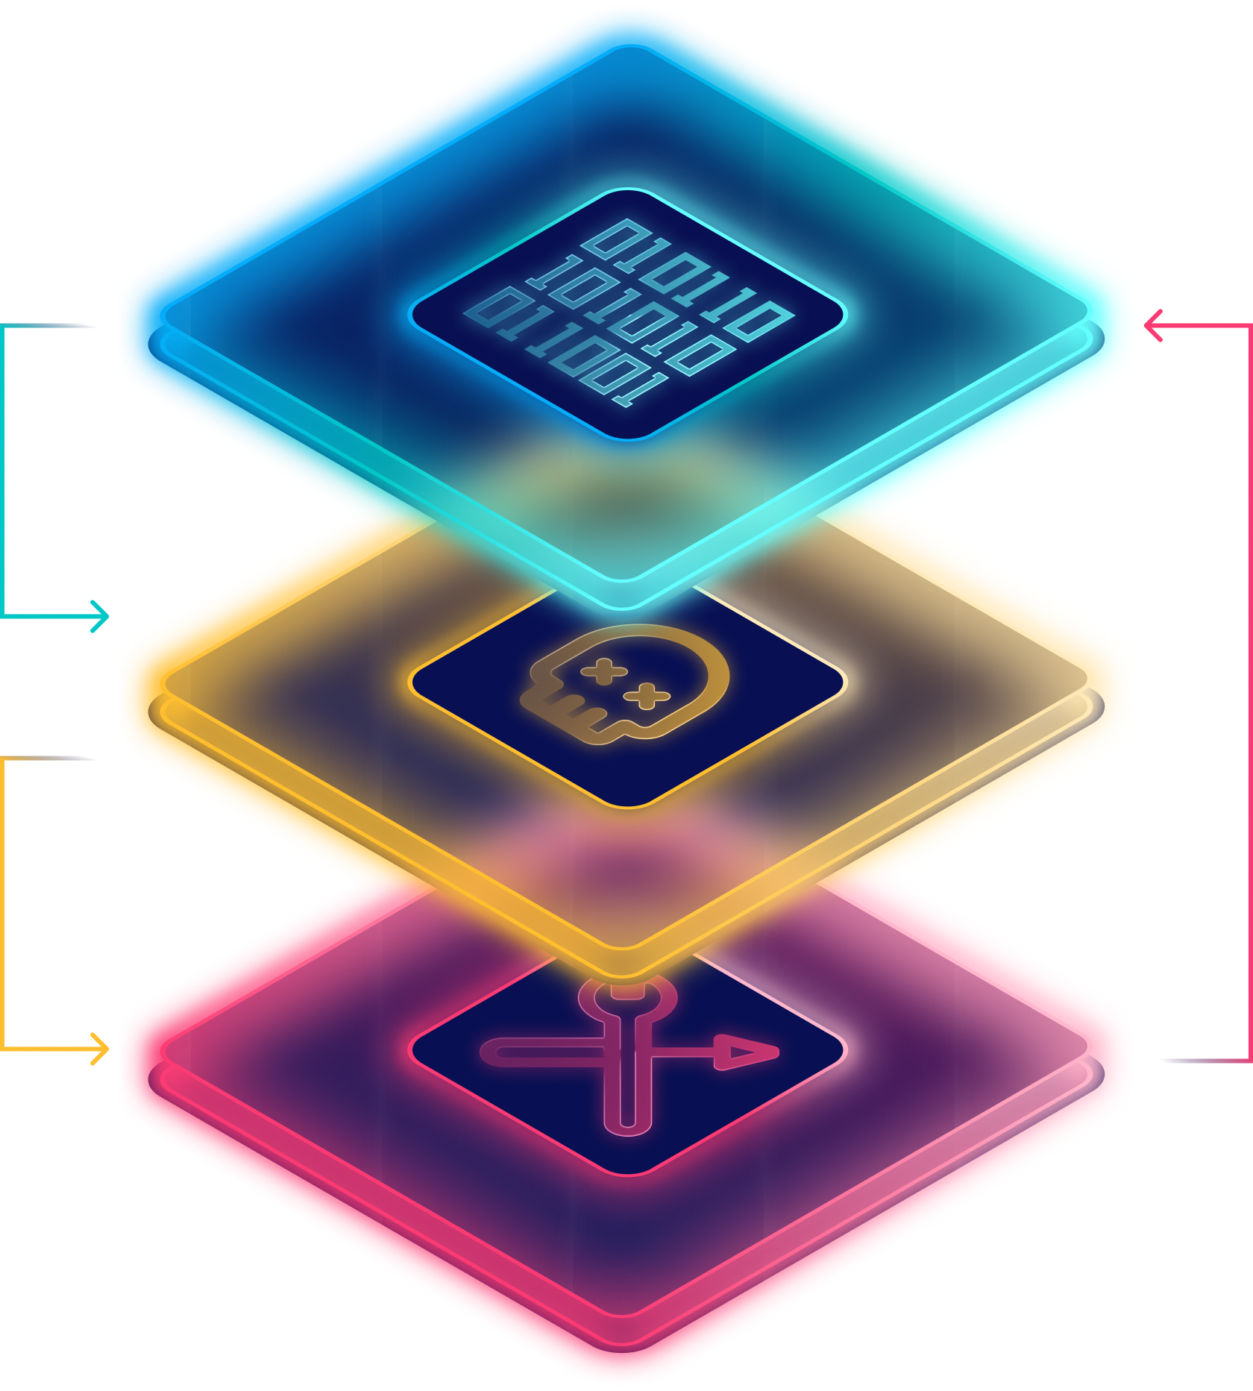



What is a Clean Backup?
01
Data Pre-Encryption
or Deletion
Recovering an attackers tools i.e. remote access, command & control allows them to re-encrypt & re-ransom
02
Free From Attacker Ransomware
03
Free From
Attacker Tools
Notes:
To get there, you can measure your maturity using two concepts:
Clean Cyber RPO: Ability to restore to a clean state, free from re-infection risks.
Fast Cyber RTO: Ability to get your business back up and running quickly.

Slide 6

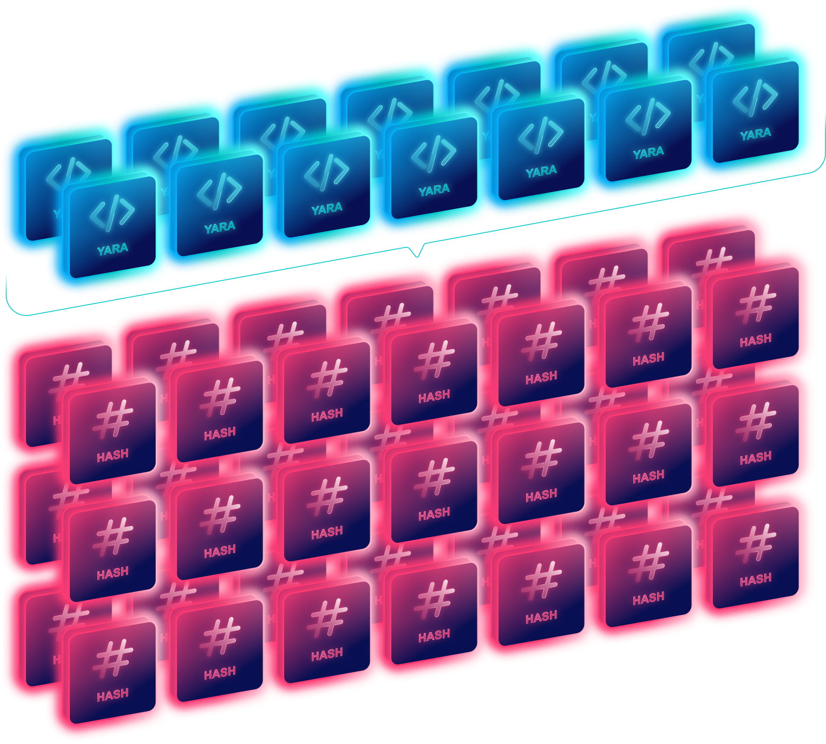




Scanning Backups For Malware
Of the known malware families,
51% contain both YARA and HASH based Indicators of Compromise (IOCs), 49% are HASH only.
Common tools used for persistent remote access and exfiltration, allowing attacker to regain access post-compromise if restored
with backups.
Tool-based IOCs are HASH only!
If you can’t scan the backup for a HASH, you cannot find a clean recovery point.
Notes:
To get there, you can measure your maturity using two concepts:
Clean Cyber RPO: Ability to restore to a clean state, free from re-infection risks.
Fast Cyber RTO: Ability to get your business back up and running quickly.

Slide 7







Let’s Recover from Backups, but
Total Servers x Daily Retention = Total Backups To Scan
i.e. 1,000 Servers/VMs x 30 Daily Backups = 30,000 Backups!
Even at 1 per minute, that would be 20 days!!
Notes:
To get there, you can measure your maturity using two concepts:
Clean Cyber RPO: Ability to restore to a clean state, free from re-infection risks.
Fast Cyber RTO: Ability to get your business back up and running quickly.

Slide 8






If You Can’t Find a Clean Backup …
Business as usual
Operations down, financial losses,
| multi-week cyber recovery
1
Restore from backup
Initial compromise
Persistence & exfiltration
Determine
scope of attack, likely source of compromise, find IOCs & quarantine
4
Verify clean
& repeat…
2
Isolate
system
Reconnaissance & lateral movement
Malware & encryption
3
Install agent
& scan

Slide 9

Identity
Resilience - Key to the kingdom
Restore from backup, isolate, install agent, scan to verify clean, repeat..
Restore from backup, isolate, install agent, scan to verify clean, repeat..
Restore from backup, isolate, install agent, scan to verify clean, repeat..
Restore from backup, isolate, install agent, scan to verify clean, repeat..

Slide 10






Domain Controllers
(20)
SFDC
3rd Party
Mission
Critical
Apps
S-NOW
150 pages
GHUB
Windows
VM
M365
3-7 day RTO
AD
Azure
EntraID
Windows
Shared
Responsibility
Model
28 days RPO
VM
VM
AWS
GCP
AD
Apps
Software
93%
Windows
b/up
IdP
VM
data
hyp
open
Storage
Full Trust

Slide 11
Identity Recovery
AD
Software
93%
Windows
- Hardened Linux
- Logically Air-gapped
- Natively Immutable
- MFA/TOTP/QAuth/MClock
##
#
Entra
VM
RSC-G
open
EE
- Cyber Services
M365
SFDC
…
Storage
FE
Zero Trust
VMs
DBs
Servers
Full Trust
Azure
AWS
1. Orchestrate
data
2. Compare
vs
Value: 100x Cyber RTO
3. Entra
4. Hybrid Recovery
Azure
AWS
E.A.
A.R.
CAR
3rd Party
AD
Entra
M365
SFDC

Slide 12

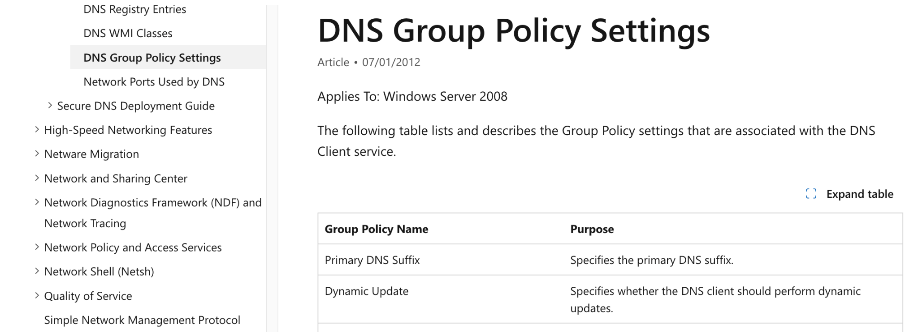
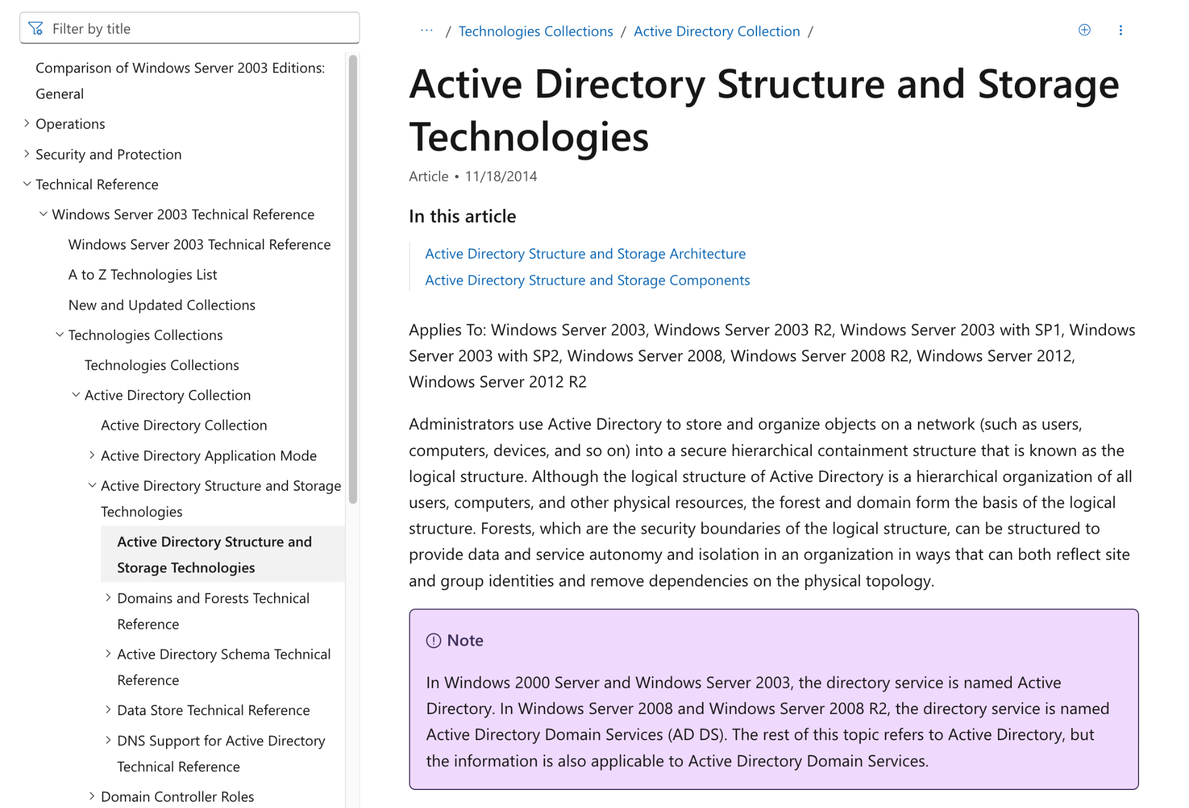
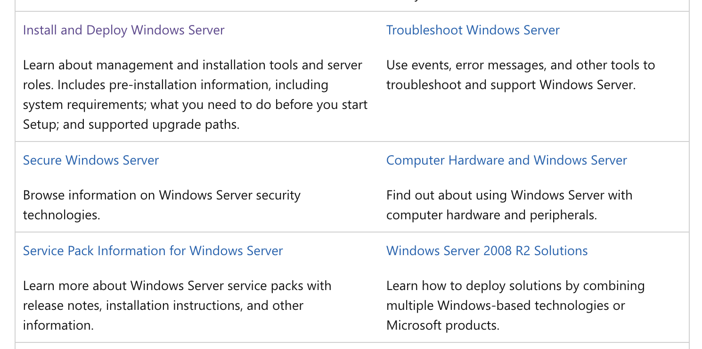
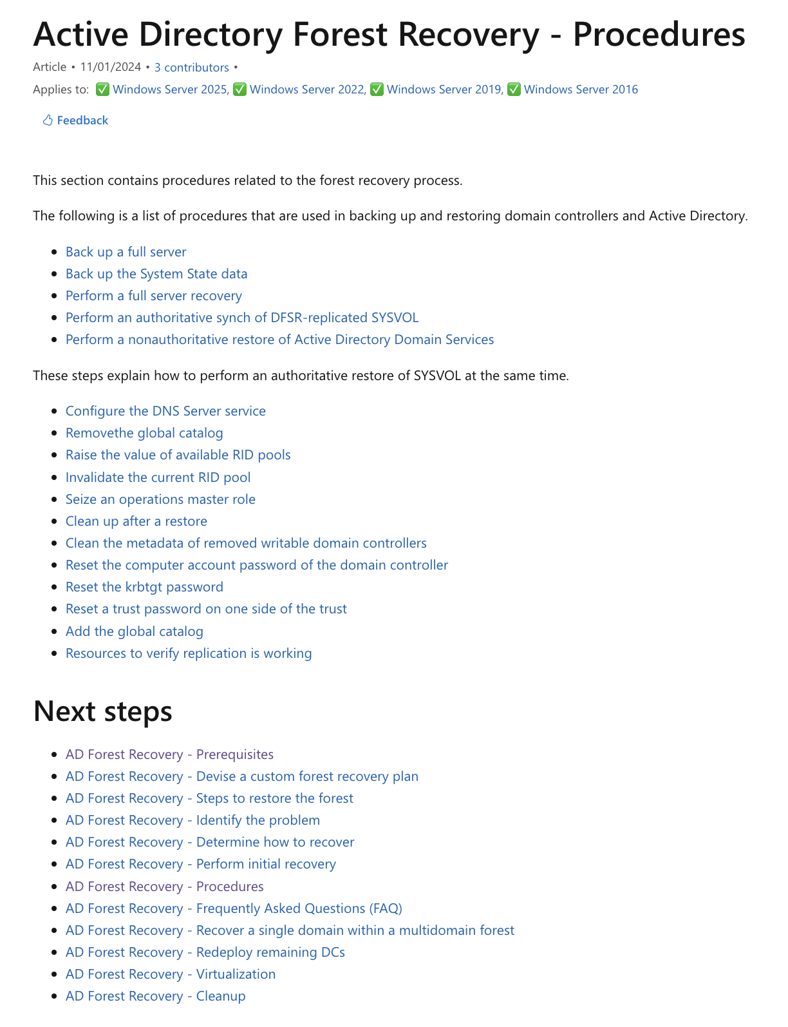
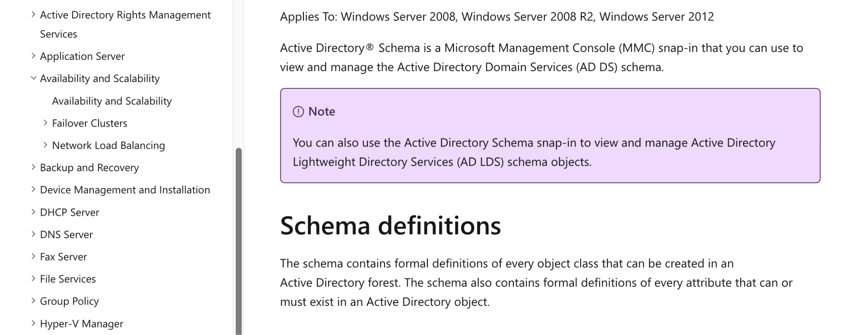
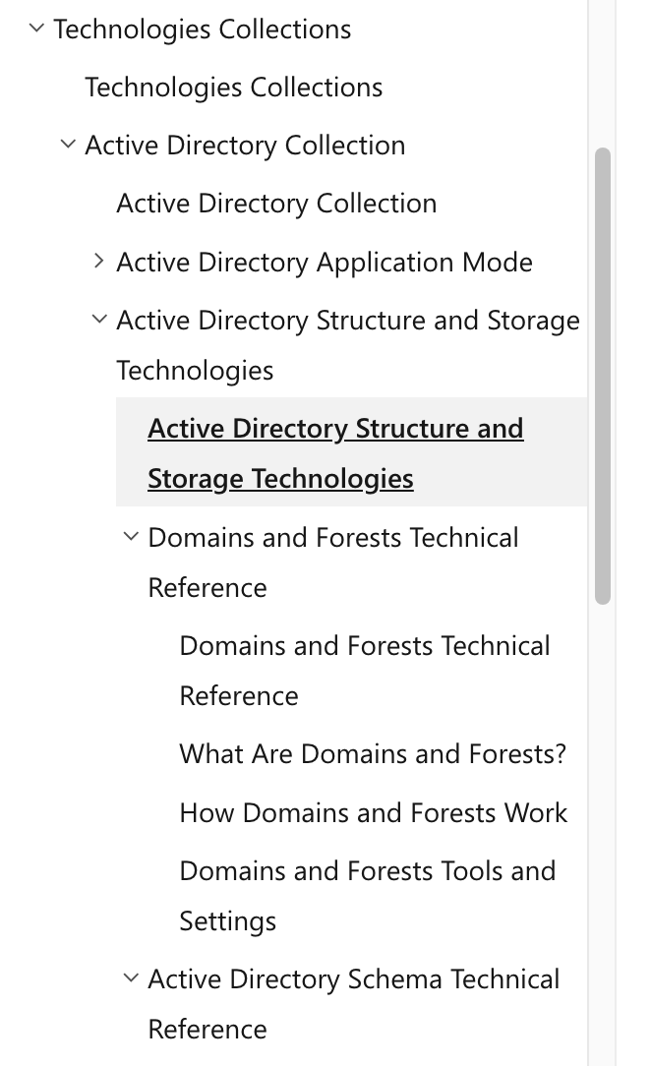
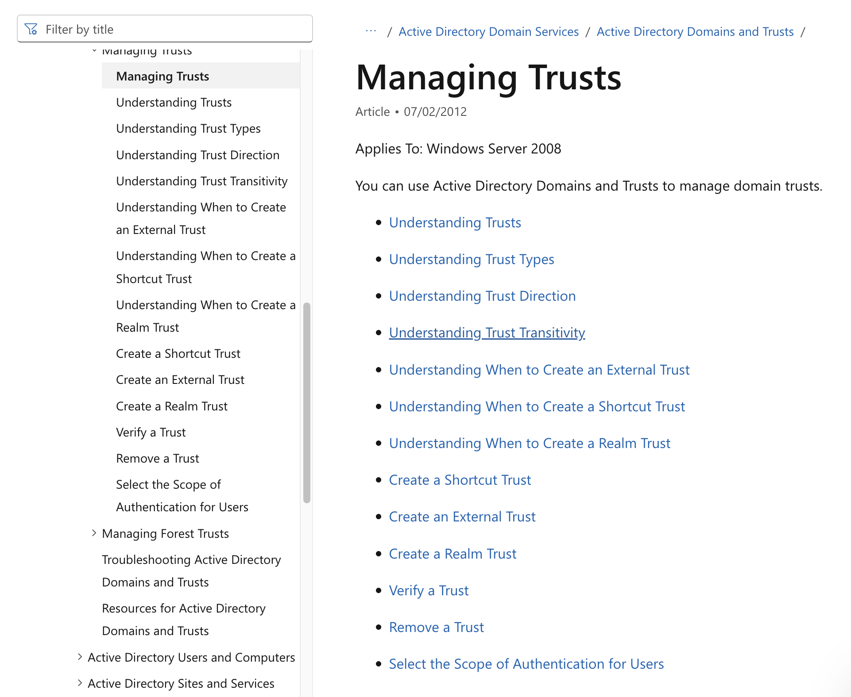
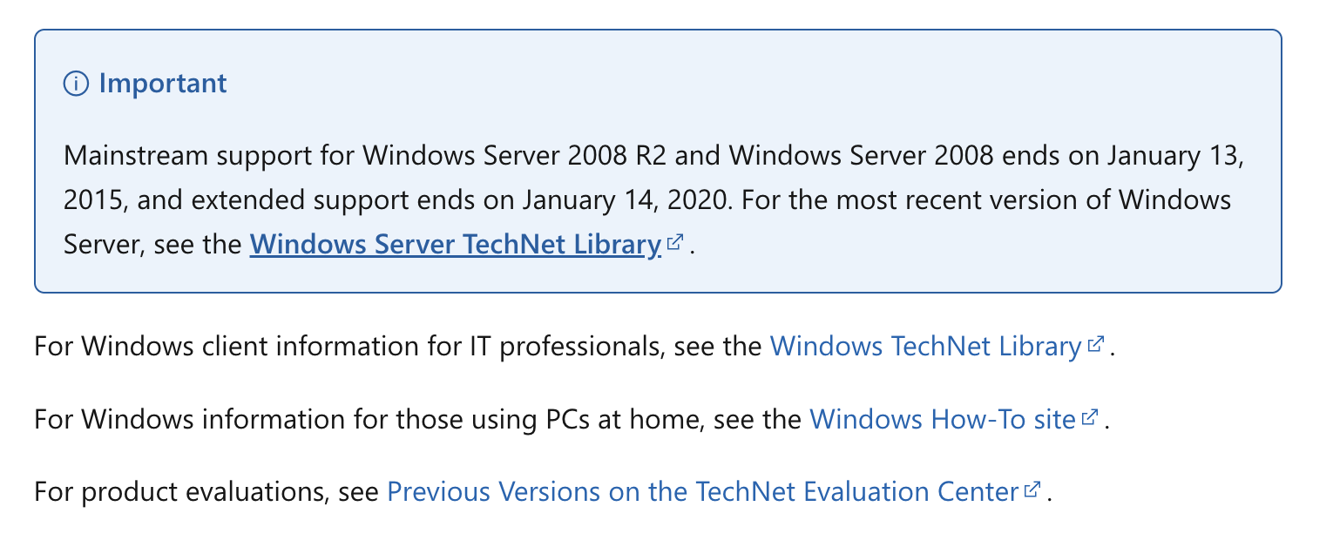
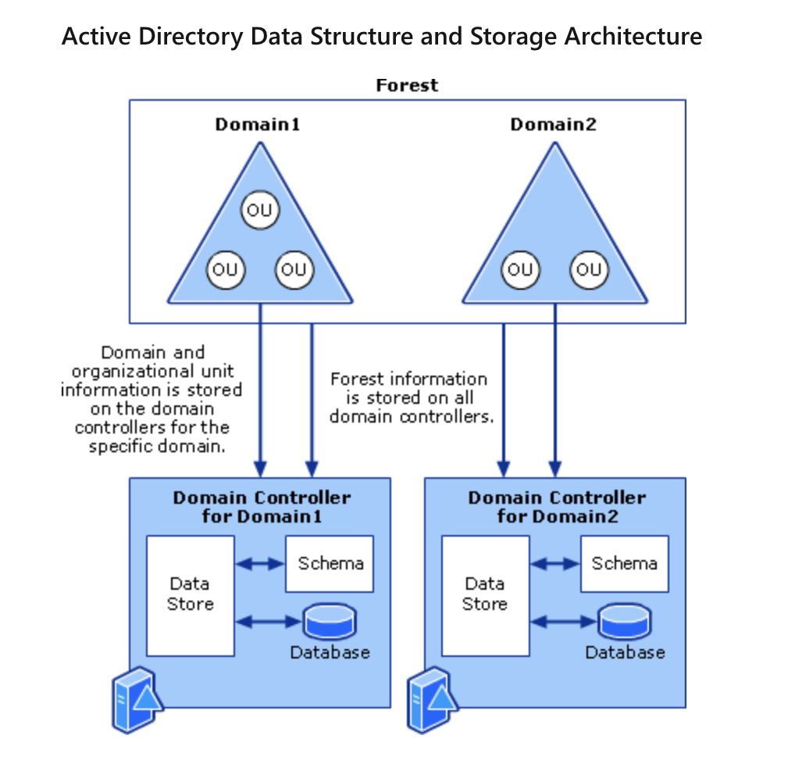
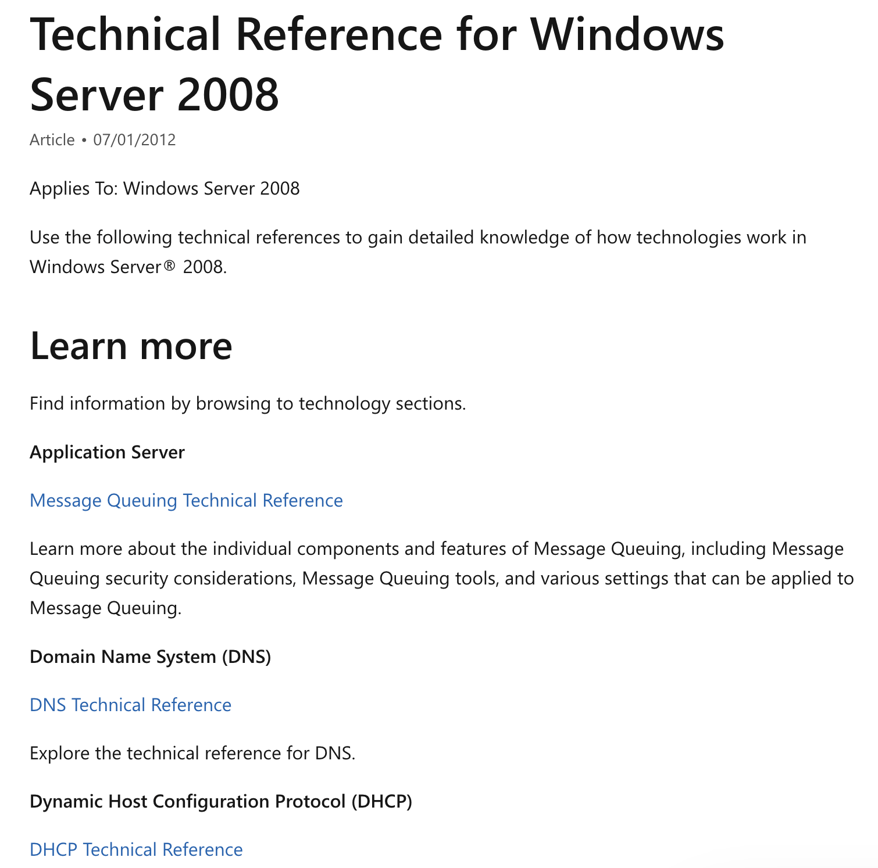
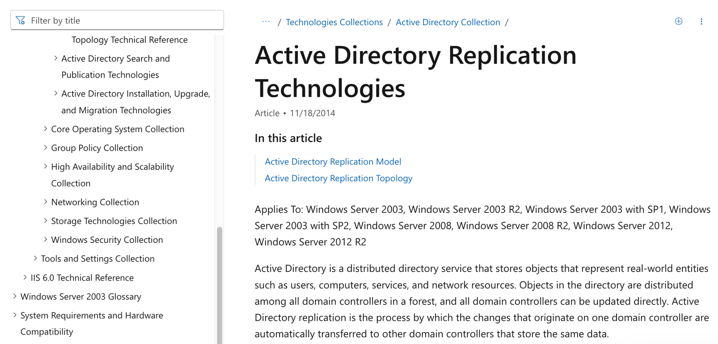
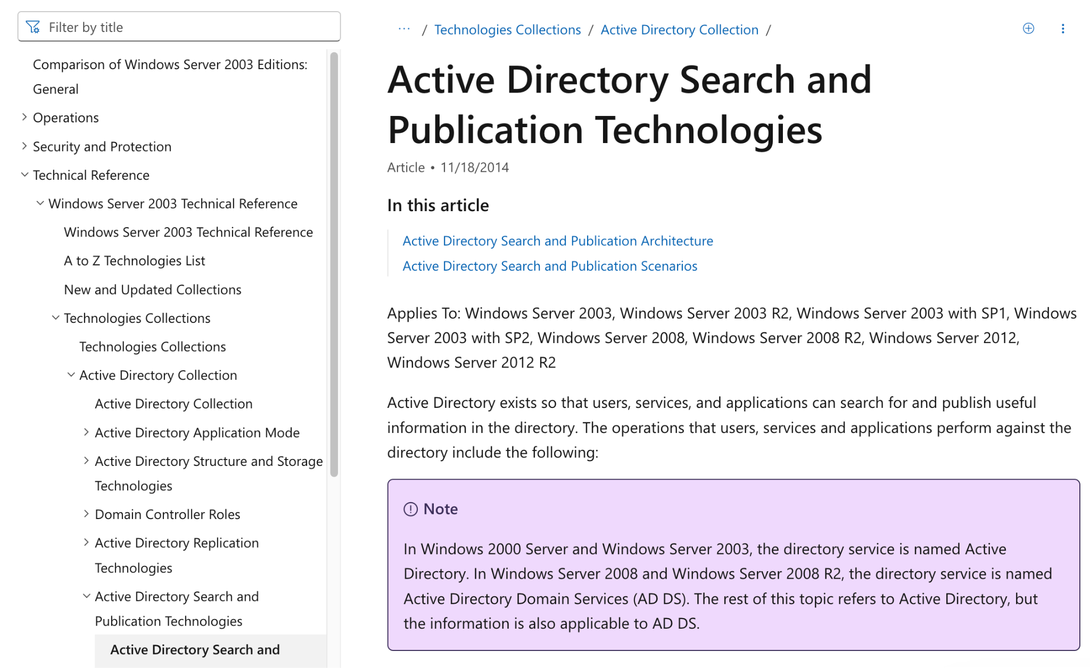
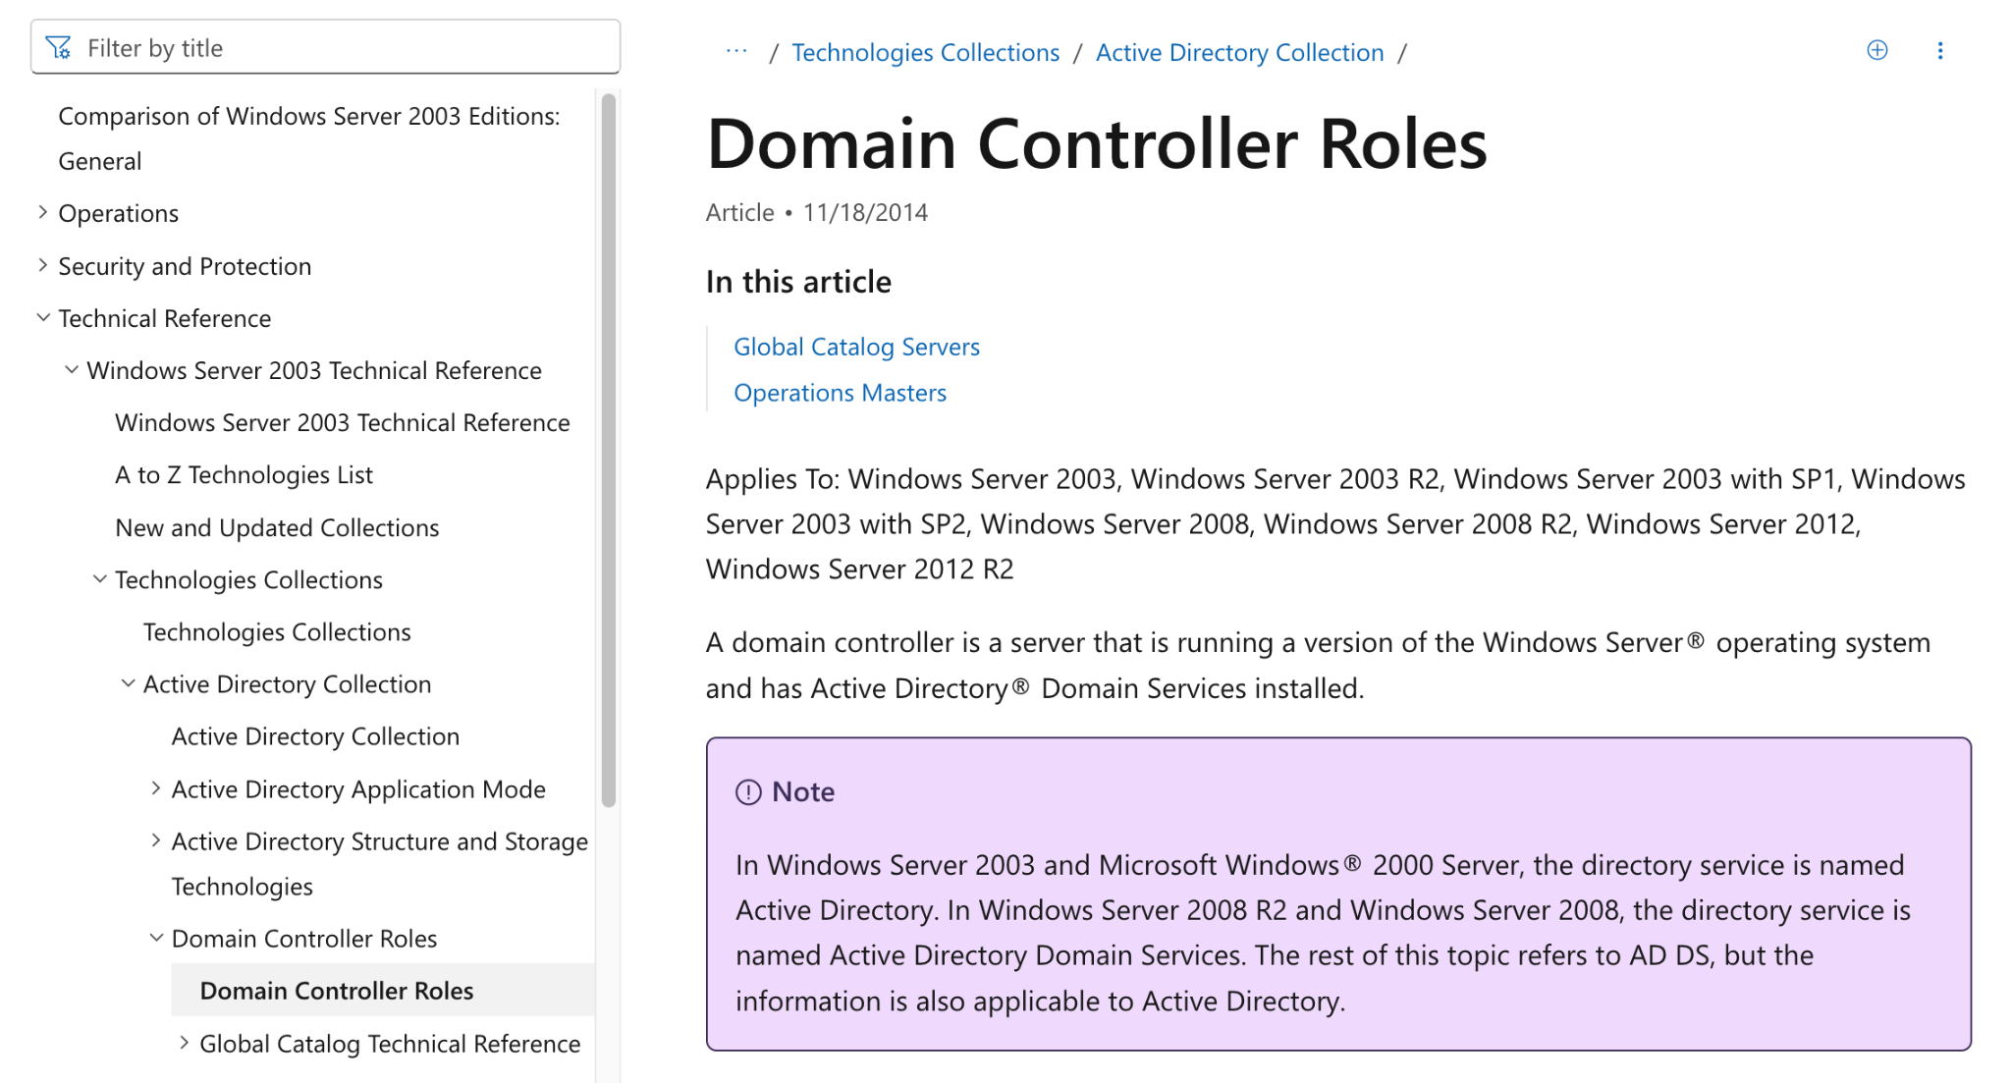
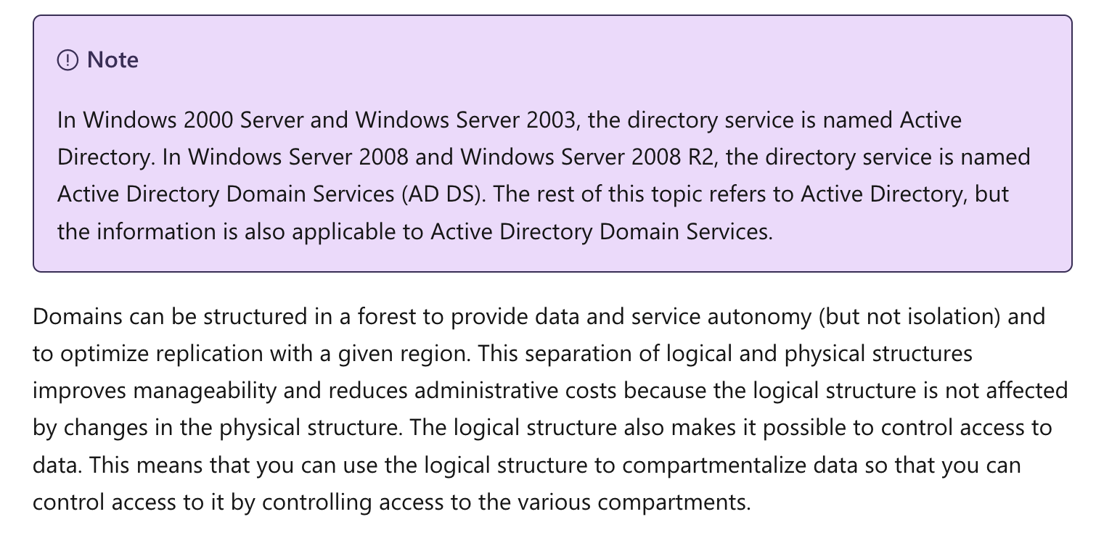
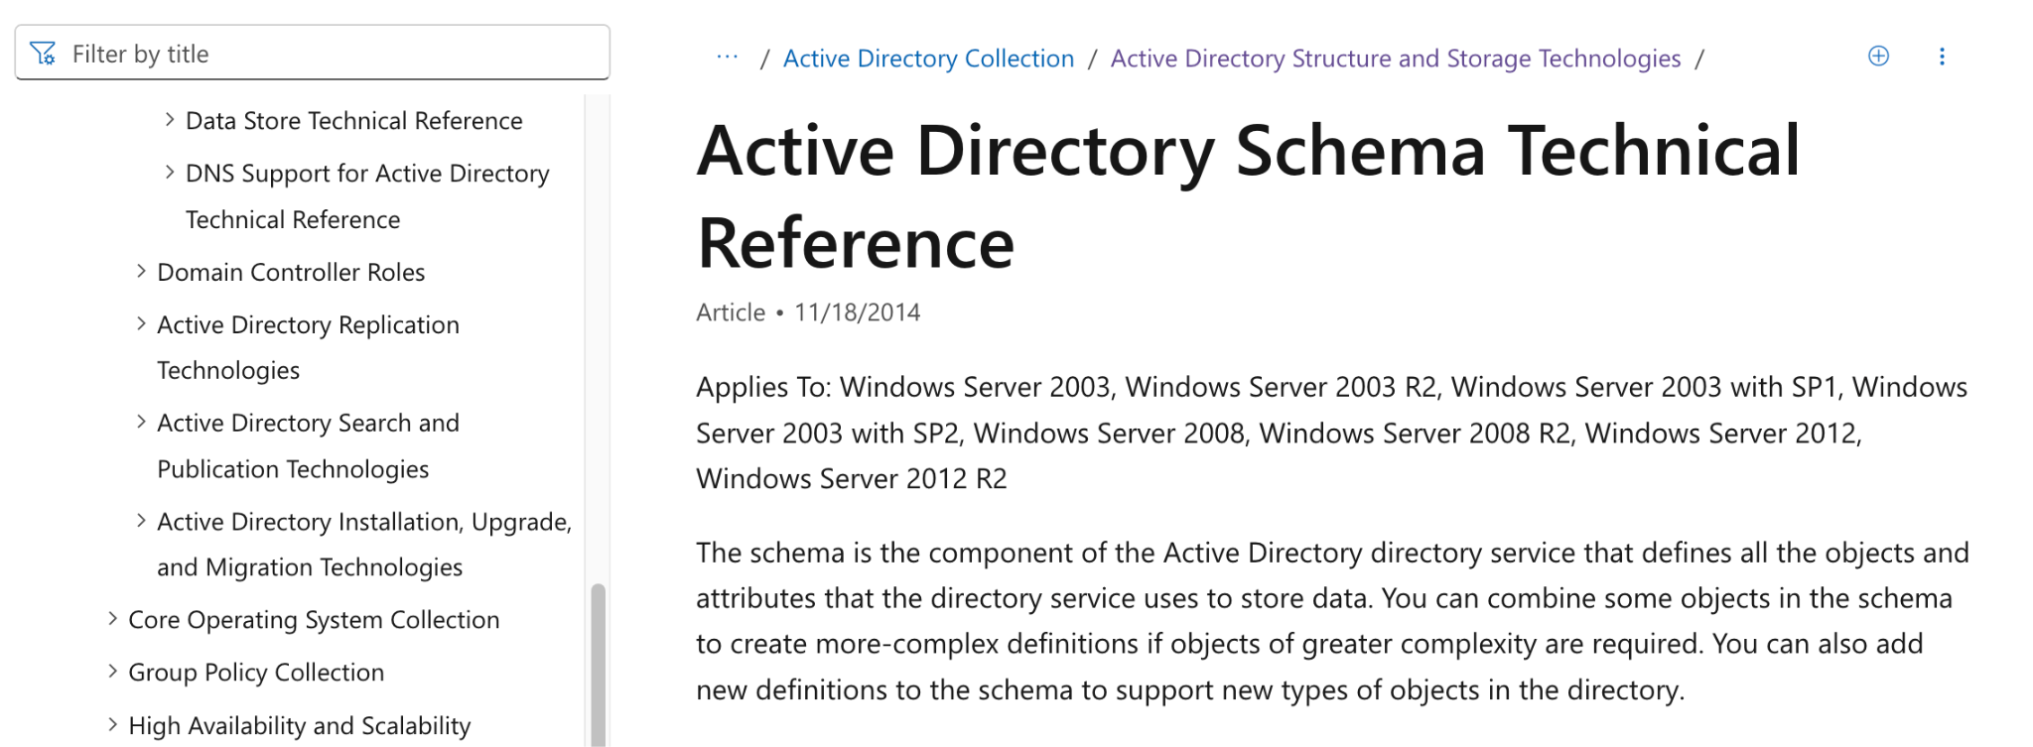
Microsoft AD Forest Recovery
is cumbersome
RECOMMENDED 20+ STEPS FOR EACH DOMAIN
Notes:
20+ steps (80+)
72hrs vs weeks
When AD Forest is down, MSFT recommends 20+ recovery steps for each domain to be followed in a sequence. Following these steps during ransomware recovery or a disaster is complex and error prone.
Source: https://learn.microsoft.com/en-us/windows-server/identity/ad-ds/manage/forest-recovery-guide/ad-forest-recovery-procedures?source=recommendations

Slide 13




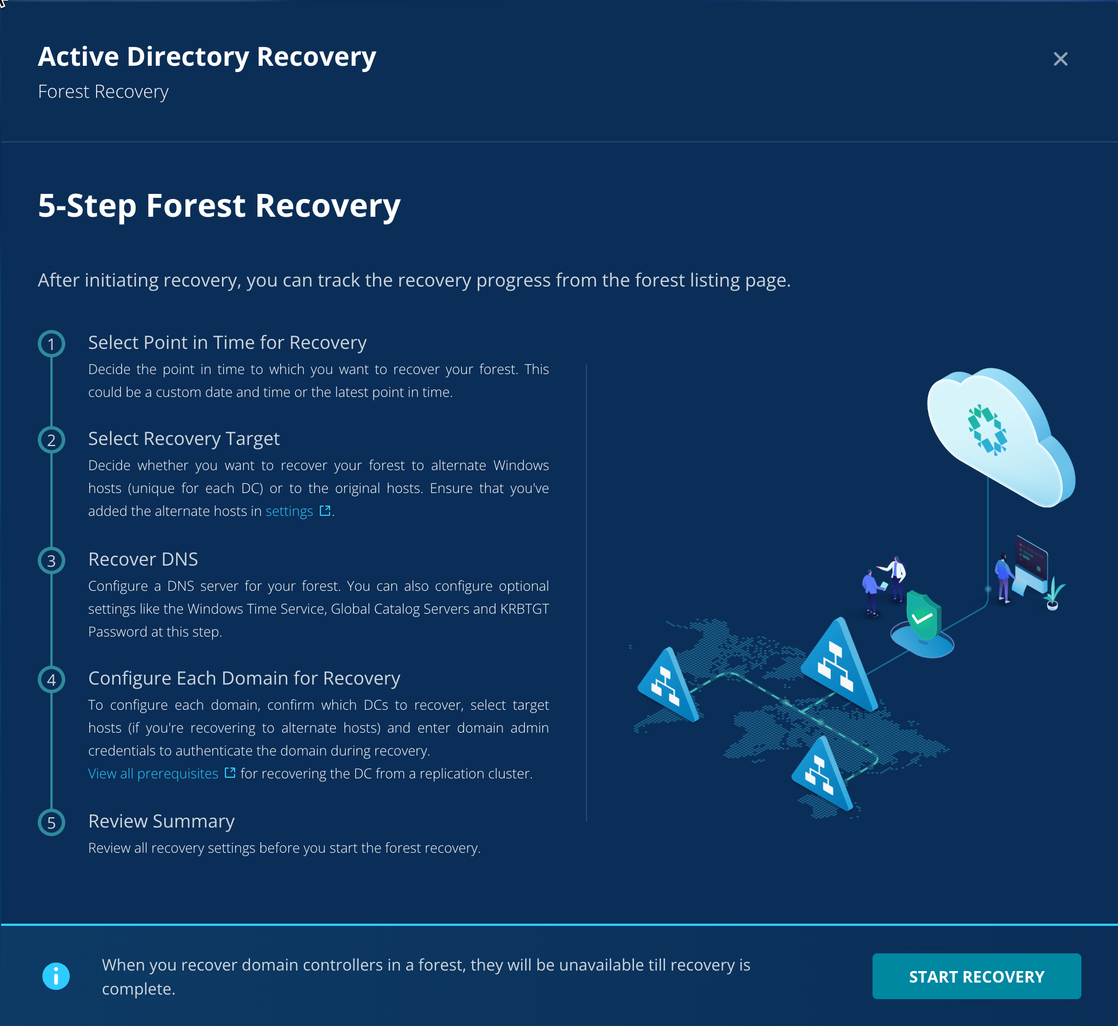
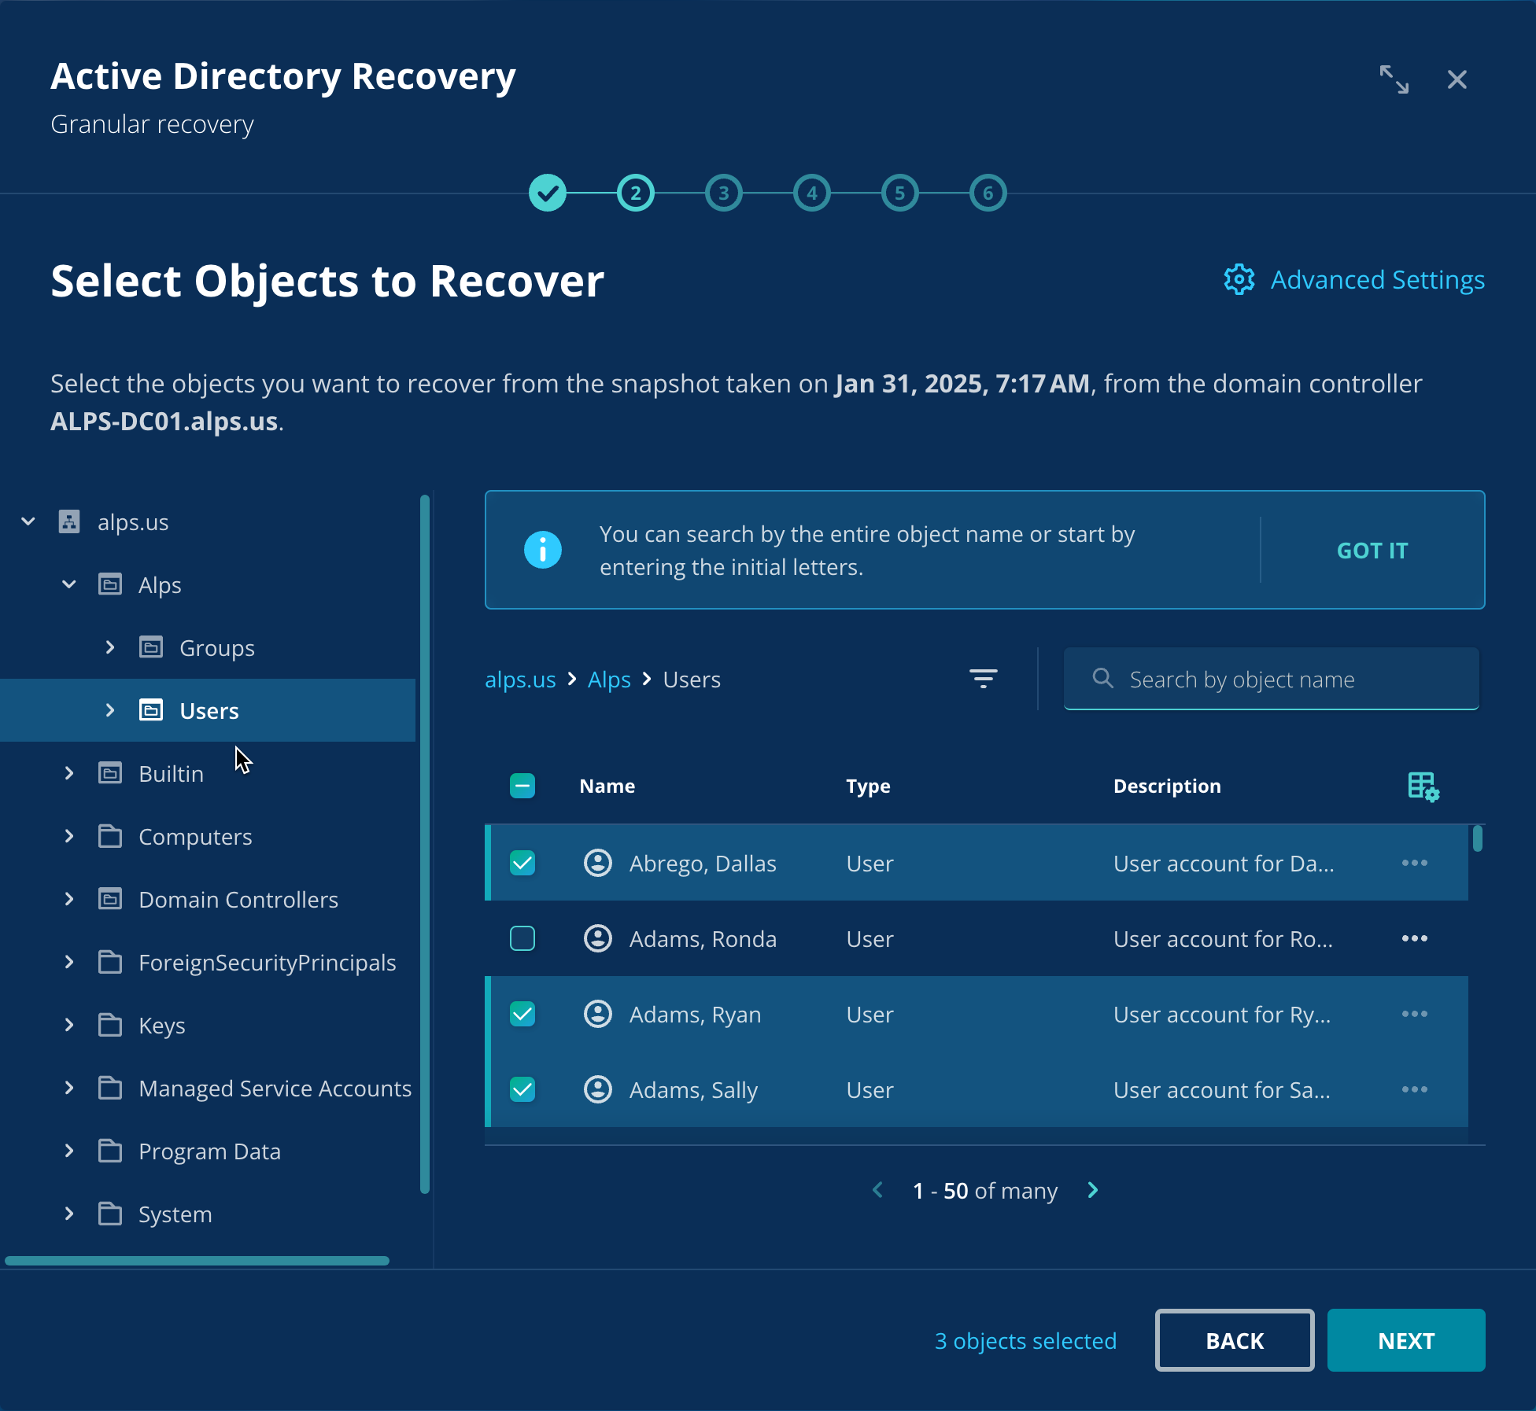
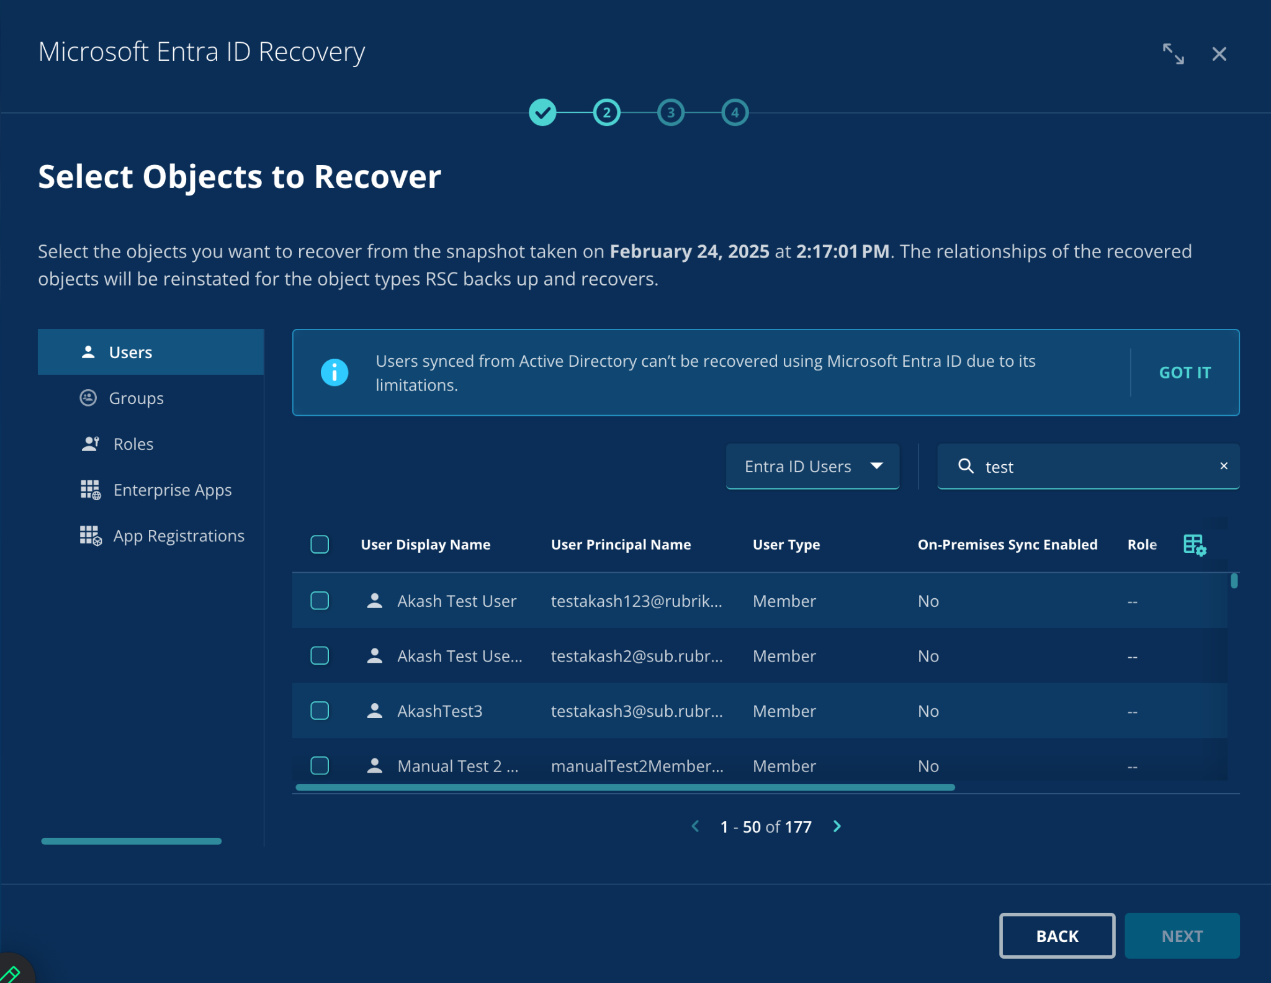
A Better Way - Rubrik Identity Recovery
Quickly and confidently recover a clean copy of Identity
Restore AD Forest with
a simple workflow and shorter RTO
Easily locate and recover accidentally deleted AD objects/ attributes through simple search
Hybrid recovery solution that includes Entra with enterprise apps, app registrations and conditional access policies

Slide 14

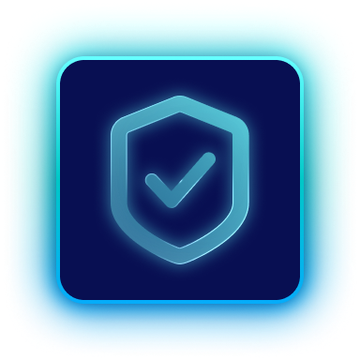

Rubrik Identity Resilience
Capabilities Overview: AD & Entra for Human & Non-Human Identities
Monitoring & Remediation
Visibility
Recovery
across users, non-human identities, & configurations
by identifying and
remediating exposures
fast, orchestrated,
and hybrid
Inventory
Exposure
Misconfigurations
Privilege Escalation
GPO Monitoring
Data Access Control
AD Forest
Entra ID
Hybrid Orchestration
No other vendor brings all three together — across hybrid IDPs — in one platform.
Notes:
Maybe reduce copy on the slide by changing copy to read:
Visibility → Inventory | Exposure | Misconfigurations
Risk Reduction → Remediation | Hygiene Monitoring | Change Tracking
Recovery → AD Forest | Entra ID | Hybrid Orchestration
Talk Track:
Rubrik’s Identity Resilience is built on three pillars:
Visibility – across users, non-human identities, and configurations
Risk Reduction – by identifying and remediating exposures
Recovery – fast, orchestrated, and hybrid
No other vendor brings all three together — across hybrid IDPs — in one platform.
Key Takeaway:
Identity Resilience is not just a product. It’s an outcome delivered in full by Rubrik.
Transition:
Let’s put it all together.

Slide 15



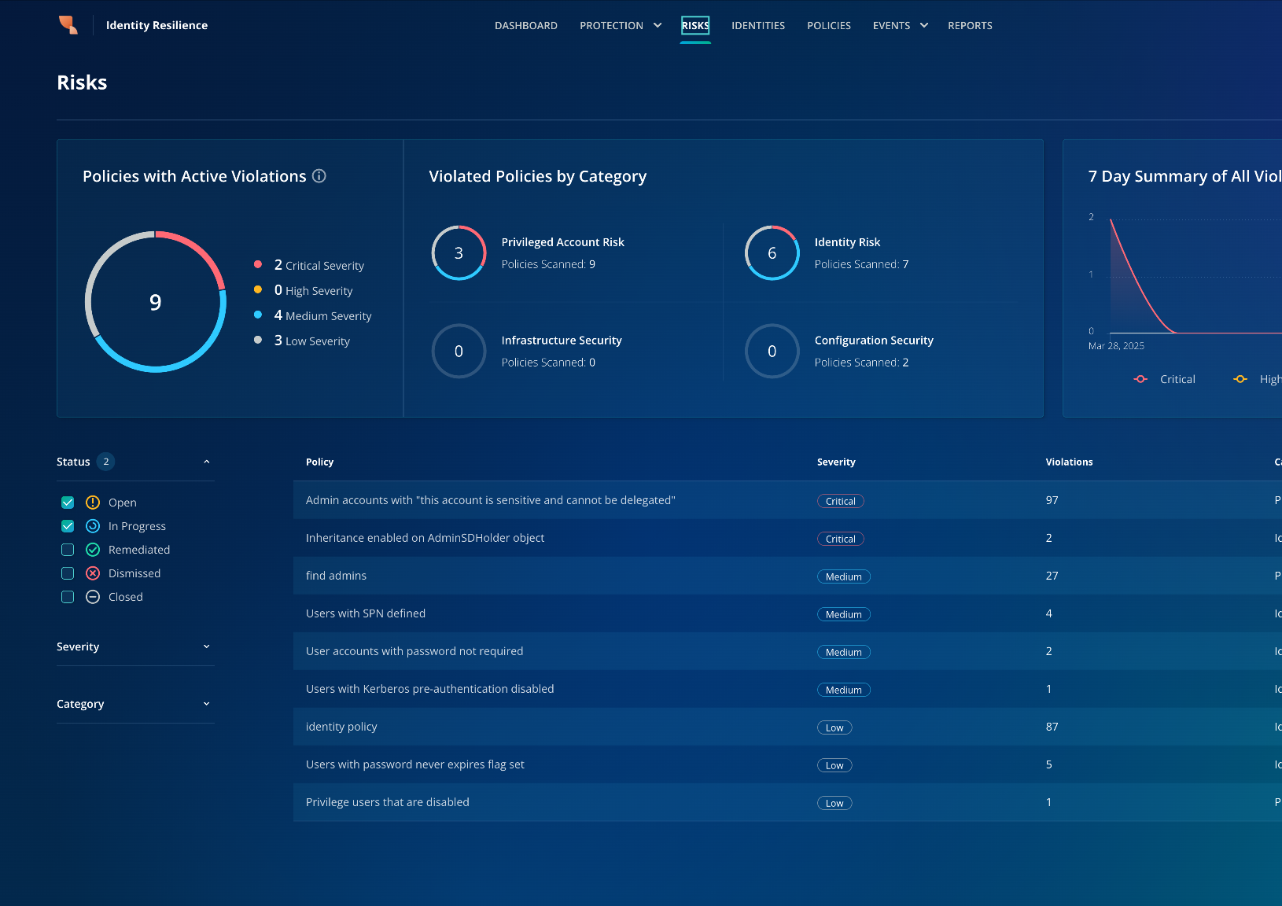

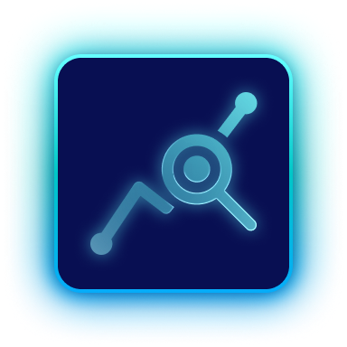



Proactive Risk Management
Alerts, IOEs and Remediation Workflows
Real-time alerts – detect privilege escalations,
group membership changes, and identity anomalies.
Indicators of Exposure (IOEs) – a growing number of AD & Entra ID security risks mapped to the
MITRE ATT&CK framework
Remediation workflows – both manual and automated remediation options to disable, rotate or remove risky identities and stale permissions
Centralized Risk Dashboard – track policy violations,
attack paths and exposure trends over time.
Notes:
Organizations can take the holistic visibility to continuously monitor their IdPs and get real-time alerts, automated and manual remediation workflows to stop identity-based attacks before they escalate. With a policy-driven approach to identity security, Rubrik ensures you stay ahead of threats.

Slide 16
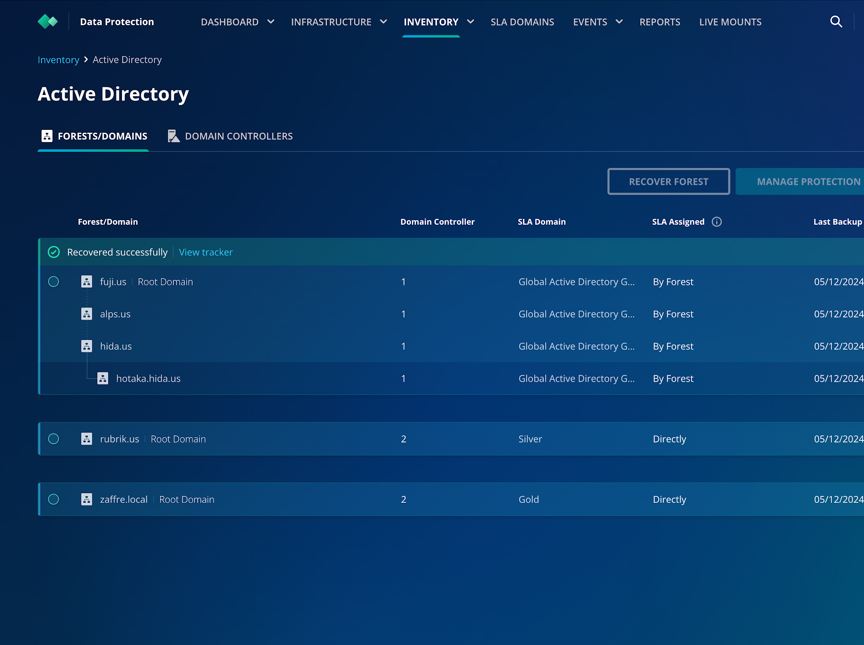

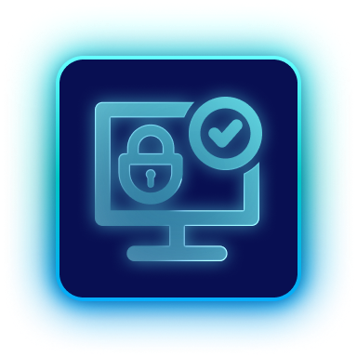

Seamless Identity Recovery
Across AD & Entra ID
Reduce downtime – Simplify complex AD Forest recovery with few clicks using immutable backups
Reduce malware reintroduction – Clean Room recovery of AD to new Windows environment
Secure AD Forest – Automate MSFT recommended security best practices
Notes:
Identity Resilience means more than just backup - it’s about fast, reliable recovery across hybrid environments. Rubrik ensures organizations can restore Active Directory & Entra ID with synchronization between the two, minimizing downtime and disruption.

Slide 17



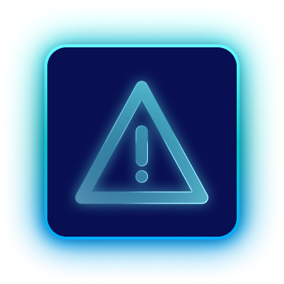


Rubrik: The New Standard for Identity Resilience
One platform for identity. Resilient by design.
Resilience is in our DNA. Rubrik weaves together visibility, risk, and recovery to protect every identity — human and non-human, whether in the cloud or on-prem.
Identity Exposure
Rubrik Identity Resilience
User & Data
Context
Indicators of Exposure
Privilege
Risk
Compromise Detection
Hybrid
Recovery
Notes:
Talk Track:
Rubrik doesn’t just protect data. We protect the identities that access it. And because of our experience on the data side, we’ve innovated to bring the same level of security to your identity infrastructure
From detection to remediation to orchestrated recovery – Rubrik weaves visibility, risk and resilience together in a single platform.
Whether it’s a user, a service account, an API token or an OAuth app– we’ve got your identities covered.
Key Takeaways:
Rubrik unifies data resilience and identity resilience
Protecting both human and non-human identities across hybrid environments
Build for today’s threats and tomorrow’s challenges
Transition:
Head over to our demo pod to see the solution in action that we are unveiling for the first time here at RSAC!
****************************************************************************************
Subtitle options:
One platform for identity. Resilient by design.
One platform. Total identity resilience. Always ready.
One platform. End-to-end identity resilience. Always on.
Built for identity. Unified for resilience. Ready when it matters.
Visual: Identity resilience as a living, interconnected system — not a collection of siloed tools. The DNA double helix metaphor represents how Rubrik weaves together visibility, risk reduction, and recovery across hybrid identity environments (human + non-human, on-prem + cloud).

Slide 18

Agentic Cloud
Restore from backup, isolate, install agent, scan to verify clean, repeat..
Restore from backup, isolate, install agent, scan to verify clean, repeat..
Restore from backup, isolate, install agent, scan to verify clean, repeat..
Restore from backup, isolate, install agent, scan to verify clean, repeat..

Slide 19










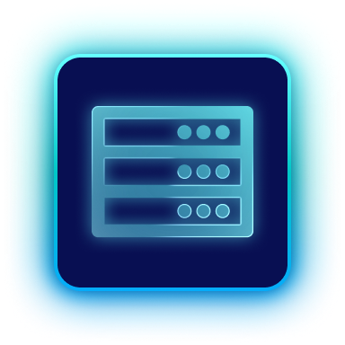

Pioneering Cyber Resilience: Our Journey
A.I.
Agent Operations
Security
Identity as Attack Vector
Cloud
Cyber Resilience
Data Center
Infrastructure Modernization
Notes:
Talk Track:
Rubrik doesn’t just protect data. We protect the identities that access it. And because of our experience on the data side, we’ve innovated to bring the same level of security to your identity infrastructure
From detection to remediation to orchestrated recovery – Rubrik weaves visibility, risk and resilience together in a single platform.
Whether it’s a user, a service account, an API token or an OAuth app– we’ve got your identities covered.
Key Takeaways:
Rubrik unifies data resilience and identity resilience
Protecting both human and non-human identities across hybrid environments
Build for today’s threats and tomorrow’s challenges
Transition:
Head over to our demo pod to see the solution in action that we are unveiling for the first time here at RSAC!
****************************************************************************************
Subtitle options:
One platform for identity. Resilient by design.
One platform. Total identity resilience. Always ready.
One platform. End-to-end identity resilience. Always on.
Built for identity. Unified for resilience. Ready when it matters.
Visual: Identity resilience as a living, interconnected system — not a collection of siloed tools. The DNA double helix metaphor represents how Rubrik weaves together visibility, risk reduction, and recovery across hybrid identity environments (human + non-human, on-prem + cloud).

Slide 20






More Agents = More Risk
What if agents make mistakes?
What if they go rogue?
And what if they’re compromised?
Action
Data
Action
Data
Action
Data
Identity
Action
Notes:
The question is, How do businesses deal with agents going rogue, agents making mistakes by hallucination, or worse agents get taken over by cyber criminals
When you have more agents your risk is exponential

Slide 21
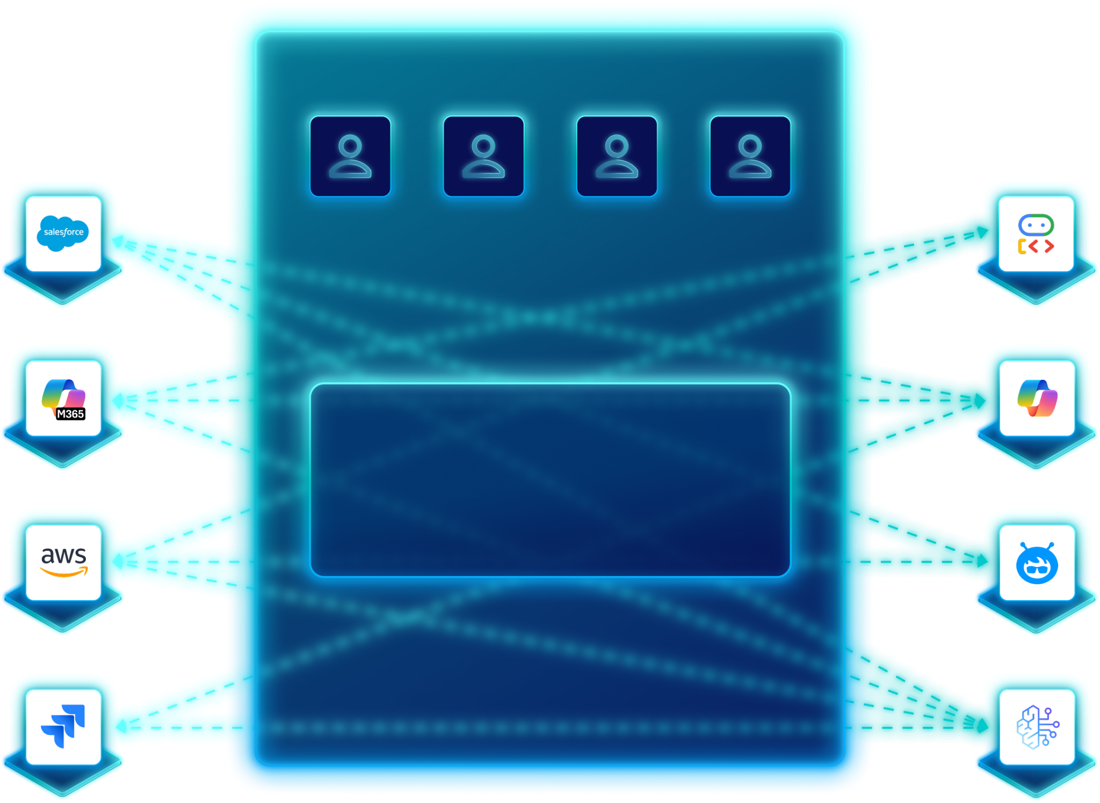
Agents are Rapidly Spreading
across the Enterprise
Applications
AI Agents
Salesforce
IT
Security
Eng
BU
ADK
Microsoft 365
Copilot
100s of New
Connections
AWS
Agentforce
Jira
Bedrock
Notes:
We define agents as LLMs w/ access to tools & to take actions
A few things make agentic AI particularly challenging….
Proliferation of NHIs, Agents have non-human identities- Have identity and access w/o having typical guardrails with things built for humans- never full control what output will be
Based on LLMs that are deterministic
Agents can access production systems autonomously- Have ability to do write access to different tools

Slide 22
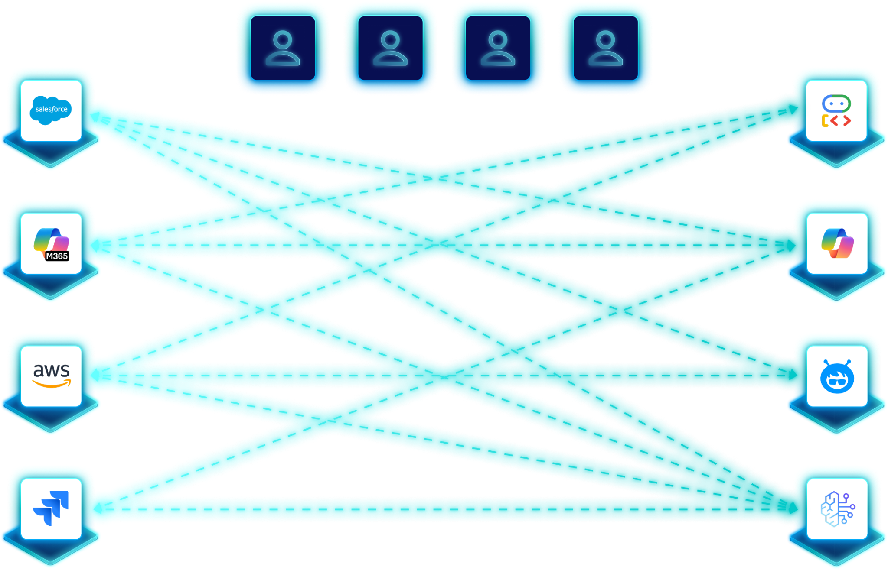

Data Access is Unguarded,
Unmonitored and Uncontrolled
IT
Security
Eng
BU
Applications
AI Agents
Salesforce
ADK
Microsoft 365
Copilot
AWS
Agentforce
Jira
Bedrock
No Single Pane of Glass
What AI agents are actively running?
What tools and data can they access?
Can I stop data leaks and attacks?
Can I measure and improve agent quality?
How do I recover from AI mistakes?
Action
Notes:
Which of these resonates the most with you?
How are you planning to handle observability around agents and their actions?
Understand Agent Blast radius, what that means = Which tools, data access & permissions does the agent have?

Slide 23




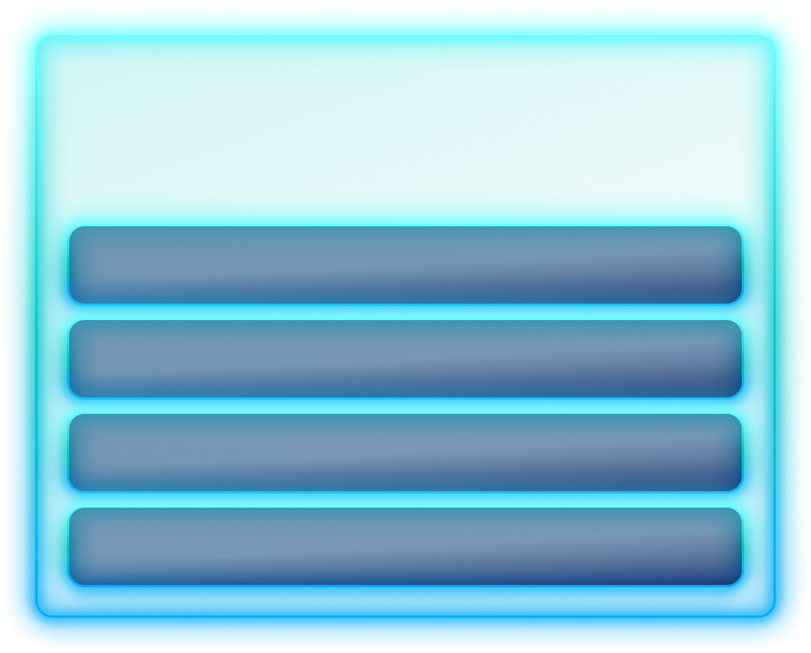





Rubrik Agent Cloud
All Your Applications
Users and Agents
Observe
Full visibility into your agents and their actions with granular app & identity understanding.
AI Resilience
Agent Registry
Govern
Agent Identity & Access Mgmt.
Enforce Policies, quantify risk and detect agent errors in real time
Agent Guardrails
Agent Rewind
Remediate
Undo destructive actions to data, apply guardrails, and optimize agent performance.
AI Models & SLMs
Notes:
- What AI Agents do I have?
- What are they capable of doing?
- What data can they access?
- What did they just do?
- If something goes wrong, an agent deletes data, an agent is taken over by a cyber hacker- can I undo it?

Slide 24
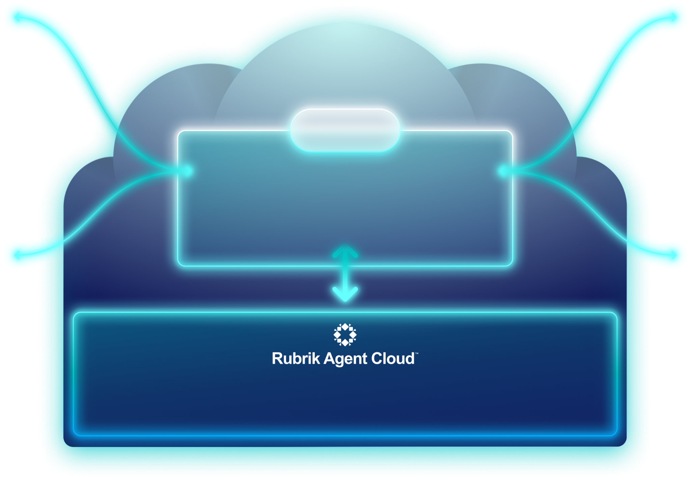
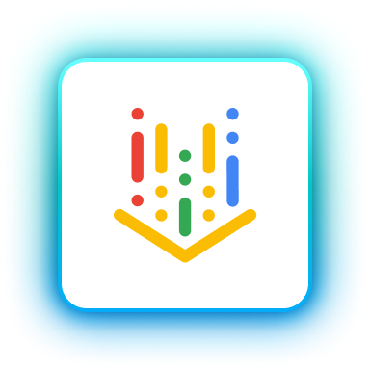
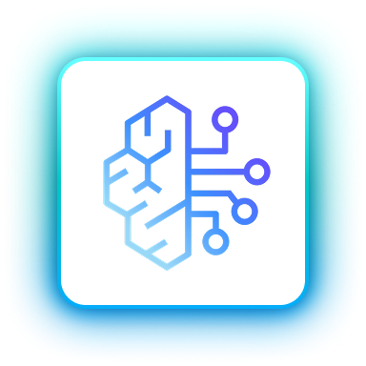

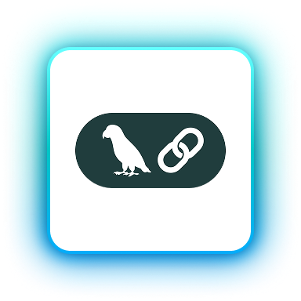
















How it Works
Rubrik Customer Tenant
Custom Agents
Cloud Agents
Vertex
Bedrock
Copilot
VPC
LangChain
N8n
AI
Gateway
Metadata
Activity
Processor
Model Providers
Endpoint Agents
OpenAI
Anthropic
Cursor
Claude
Clouds
Applications
IAM
Meta
Mistral

Slide 25
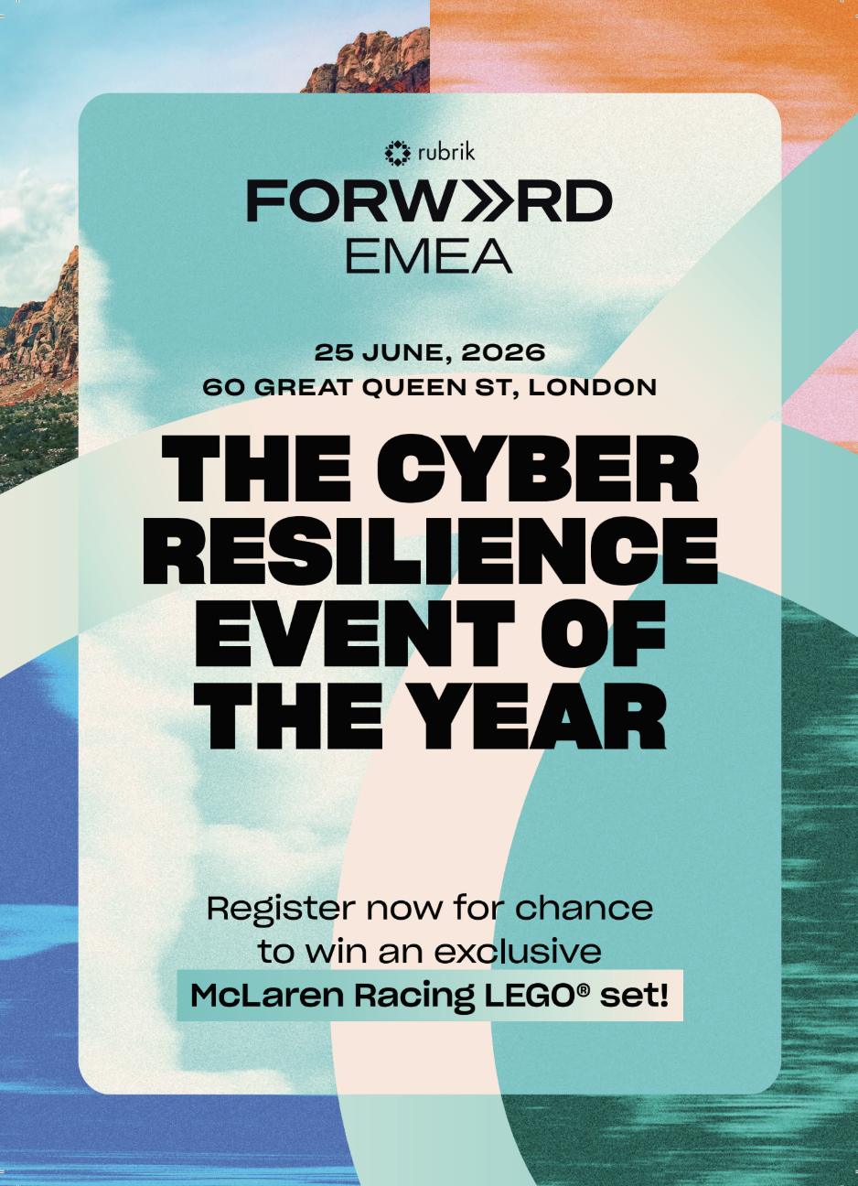

JOIN
FORWARD
25 June, 2026 | London
forward.rubrik.com/2026-emea

Slide 26


Thank You

