Slide 1
Keine Datenlecks:
EASM meistern mit privaten Cloud-LLMs

Slide 2
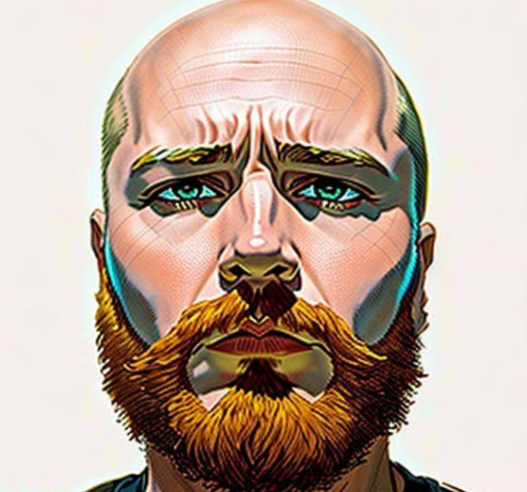
Cyber Security Summit 2026
15+ Jahre in InfoSec
Pentester
Incident Response
Security Engineer, Analyst, Architect
NIS Auditor
PO für Offensity (EASM-SAAS)
Nerd & Hacktivist
AI User & Abuser
Bernd Forstner
Security Architect

Slide 3
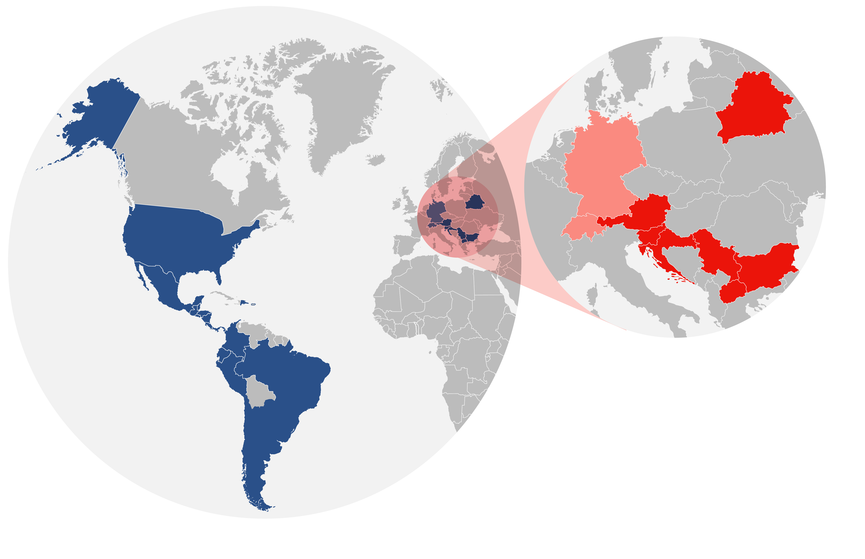
Cyber Security Summit 2026
A1 Digital –
Who we are
300 MIO+
Customers
25
Countries
América Móvil
(including A1 Telekom Austria Group)
A1 Telekom Austria Group

Slide 4
Cyber Security Summit 2026
A1 Group –Map

Slide 5
Cyber Security Summit 2026
IoT
Connect everything and leverage the full potential of your business assets. Build your IoT application from scratch using our full stack or get a pre-built solution.

Slide 6
Cyber Security Summit 2026
Cloud
Scale your business and keep it up-to-date with Exoscale:
A1 Digital’s secure, european-based cloud.

Slide 7
Cyber Security Summit 2026
Network
Connect your entire infrastructure on a single, secure and cloud-based network. Manage and monitor it on one central platform – with SD-WAN.

Slide 8
Cyber Security Summit 2026
Cyber Security
24/7 Cybersecurity for small to mid-sized companies and MSPs in the DACH region - from security consulting to vulnerability management and more.

Slide 9

Cyber Security Summit 2026
Preis der Digitalisierung
Vernetzt
Verteilt
Remote
24/7

Slide 10
Cyber Security Summit 2026
EASM – External Attack Surface Management
Im Prinzip ist EASM nur ein Buzzword von Gartner.
Asset Management
Vulnerability Management
IAM
Dataleaks
...

Slide 11
Cyber Security Summit 2026
EASM bisher
SAAS
Selten One-Stop-Shop
Auch als Service bei Hyperscalern
Input für SOC/SIEM

Slide 12

Cyber Security Summit 2026
AI
AI all the things
Hype?
Snake Oil?
Bubble?

Slide 13

Cyber Security Summit 2026
Mythos etc.
Leider kein Access
Wie schlimm wird es?
Was nun?

Slide 14
Cyber Security Summit 2026
Zurück zu unserer Realität
Was kann Jede:r selber damit machen?
Agentic AI
Selfhosted LLM
OSS Security Tools

Slide 15




POC Setup
OpenClaw
Hexstrike AI
Agent
Let's test the hype
MCP Server
Verbinding zu Tools in Kali-VM
Qwen 3.5
Exoscale
Open Model
HW Anforderungen sind OK
A1 Digital Cloud
Inference Provider

Slide 16
Cyber Security Summit 2026
OpenClaw
Agent-based architecture
Memory system
Sub-agent orchestration
Cron scheduling
Session management
Self-hosted
Integrations (Mail, Chat-Apps, GIT, ...)
Skills-Hub

Slide 17
Cyber Security Summit 2026
Hexstrike AI
150 Tools
  Network Reconnaissance & Scanning
  Web Application Security Testing
  Authentication & Password Security
  Cloud & Container Security
  Bug Bounty & OSINT Arsenal
Intelligent Endpoints
  Target Analyse
  Tools Selection
  Tool Parameter Optimierung

Slide 18
Cyber Security Summit 2026
Local LLM
Full Cost Control
Full Data Privacy
No Throttling
Change / Update Model

Slide 19
Cyber Security Summit 2026
Exoscale
I have access to our own Cloud Provider ;)
GPUs
Inference as a Service

Slide 20
Use Cases
Chat
Integration von Hexstrike MCP
Chatten mit dem Agent
Build App
Mit dem Agent EASM App bauen

Slide 21
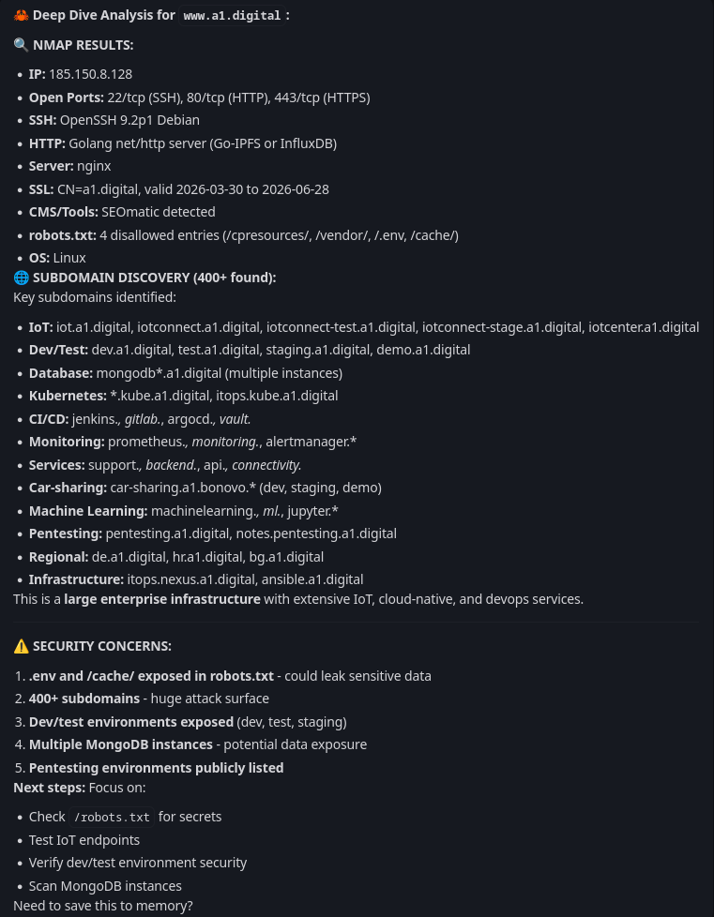
Cyber Security Summit 2026
Chat
Kaum Know-How notwendig
Interaktiver Hacking Helper
Script Kiddie auf Steroiden
Note:
Wurde so schon aktiv eingesetzt!

Slide 22

Cyber Security Summit 2026
Vibe Cooding - EASM App
Prompting für inkrementelles Entwickeln
  Markdowns generieren lassen
  Logging
Markdown Specs für Persistenz
  Backup/Restore/Rebuild

Slide 23
Cyber Security Summit 2026
EASM App - Results
Leider viel schlechter als via OpenClaw mit Hexstrike MCP
Lange Test/Refactor Zyklen
Probleme
  Tool Argumente fehlerhaft
  Parsing Fehler
  Reporting ist mangelhaft

Slide 24
Cyber Security Summit 2026
Fazit
Zum schnellen Erfolg einfach einen Agent verwenden und MCP integrieren
Vibe Coding braucht auch Zeit und ist besser mit Claude

Slide 25
Cyber Security Summit 2026
Outlook
AI is here to stay
Prepare for the worst

Slide 26
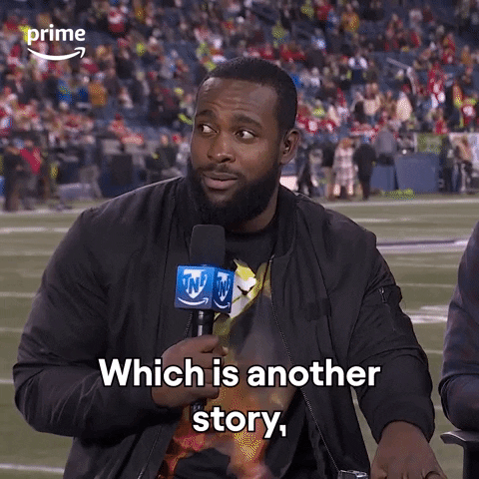
Cyber Security Summit 2026
Hints & Tips
Besucht mich an unserem Stand
Gerne auch offene Diskussion bei der Party

Slide 27
Cyber Security Summit 2026
Bernd Forstner
Bernd.forstner@a1.digital

